Slide 1
Skills flash cards
Mindfulness

Slide 2
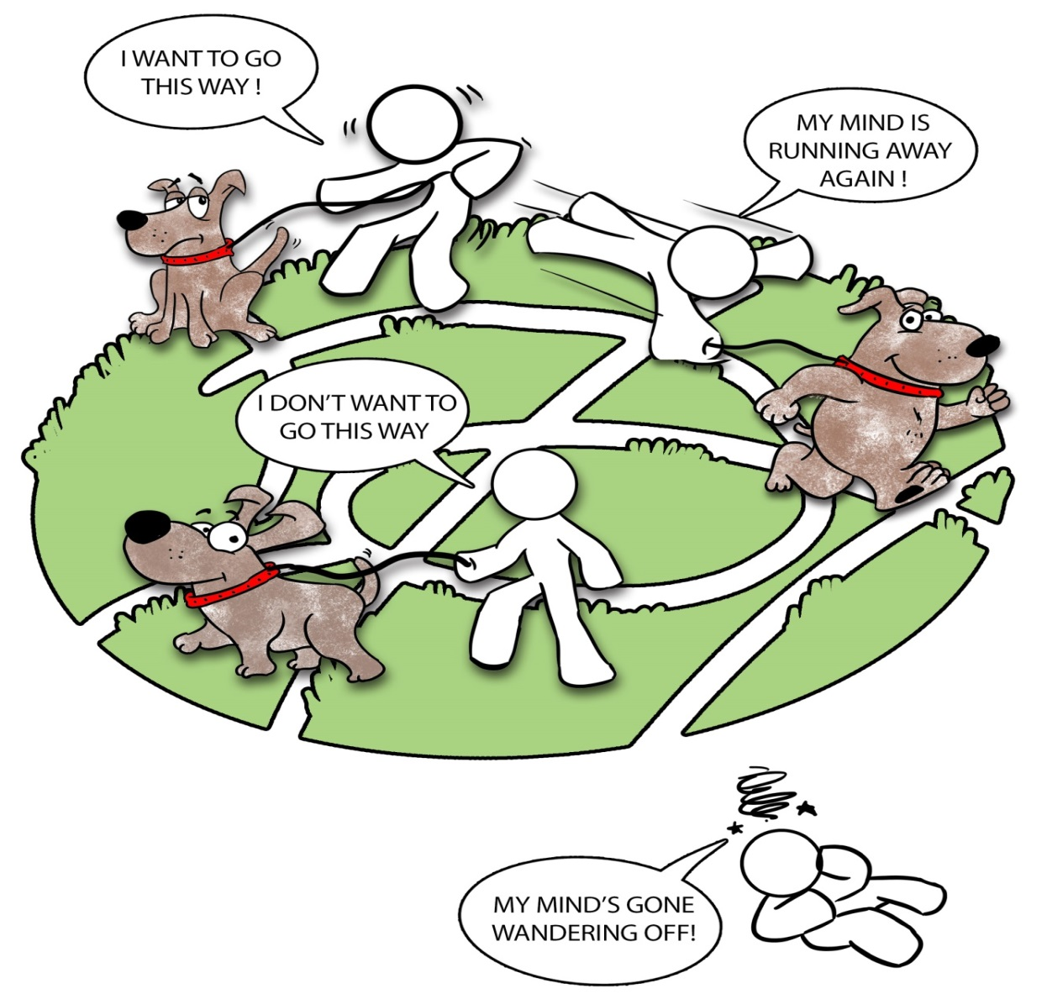
Training ‘Mind’, the dog

Slide 3
Mindful activity examples
Breathing
Eating
Listening
Walking
Listening to music
Playing Xbox
Touch
Doing a word search
Drawing
Washing hands
Colouring in
Brushing teeth
Showering
Washing hair
Painting
Drinking

Slide 4
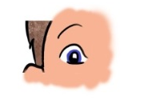
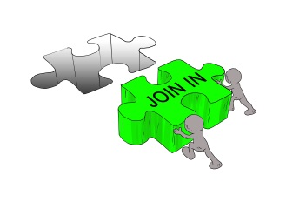

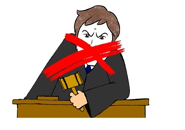
Mindfulness
What we do and how we do it
  Notice
  Join in
  One thing at a time
  Don’t judge

Slide 5
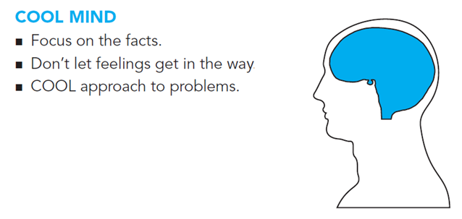
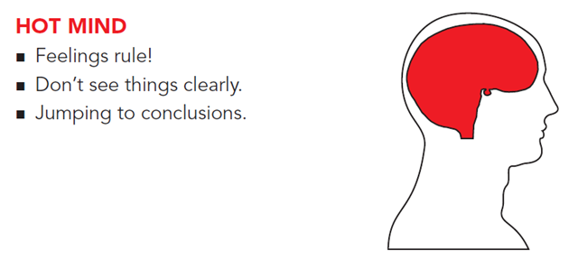
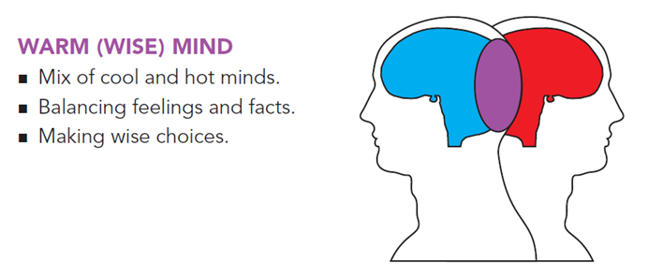
States of mind
COLD MIND

Slide 6
Skills flash cards
Managing feelings

Slide 7
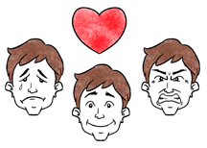
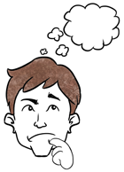
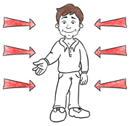
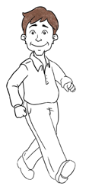
Recognising and labelling feelings
Emotion feeling
Behaviour
Thoughts
Body feeling

Slide 8
Thoughts
A thought is something which happens in our heads or minds.
We can’t see thoughts.
They can be in words or pictures.

Slide 9
Body feelings
Body feelings are physical sensations we have all over and inside our bodies.
Examples include feeling butterflies in our stomach, heart racing, sweaty palms.

Slide 10
Emotion feelings
Emotions are names we give to our feelings.
Examples include happy, sad, angry, guilty, scared or anxious.

Slide 11
Behaviours
Behaviours are our actions, the things we choose to do.
Examples include hitting someone, walking away, watching TV, self harming, speaking to staff.

Slide 12
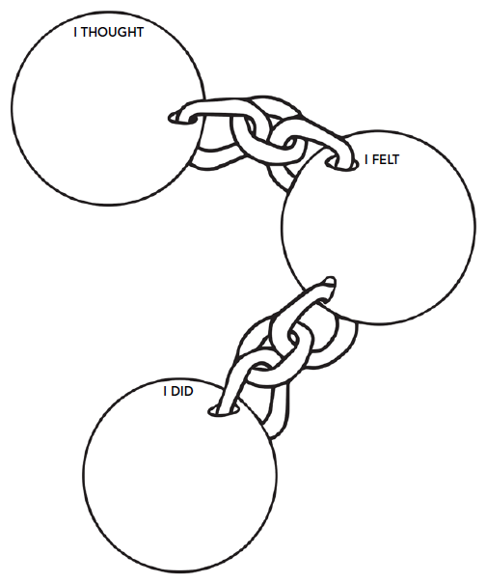
Behaviour chain

Slide 13
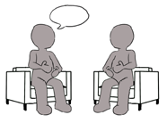


Why do we have feelings?
Communication
Protection
Information

Slide 14
Beliefs about feelings
My myth | My challenge
Being angry will make me feel better! | Is my feeling based on facts?

Slide 15
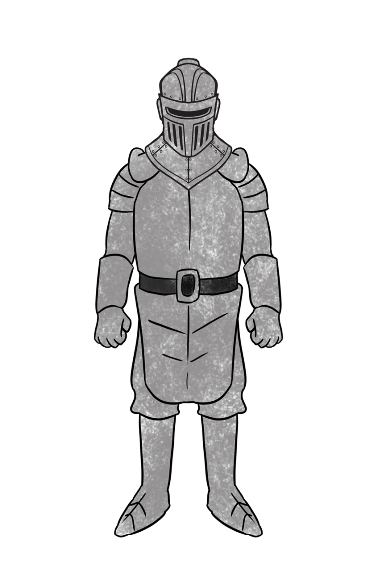
Building up our armour
Mindfulness to feelings
Fun and positive experiences
Reacting differently
Feel good factor
Future goals
Kind actions
Accept feelings
Change problem situations

Slide 16
Fun activity examples
Swimming
Playing card games
Drawing a picture
Planning a holiday
Watching a comedy
Cooking a meal
Playing video games
Bowling
Planning a surprise
Playing sport
Going for a walk
Online shopping
Going to the cinema
Reading a book
Writing a letter
Playing an instrument
Daydreaming

Slide 17

React differently – decision tool
Questions to ask yourself…
Is my feeling based on facts?
Is my feeling helping me to keep safe?
Will reacting differently to my feeling urge cause harm?
If you answered Yes to any of the questions...
Try using another one of your skills
If you answered No to all
of the questions...
Try reacting differently
to your feeling urge

Slide 18
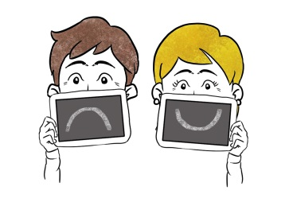
Reacting differently
Situation | Urge | Different reaction
Argument with my friends | Shout at them | Make them a nice card
Missing my family | Be on my own and cry | Watch a comedy film

Slide 19
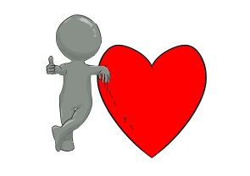
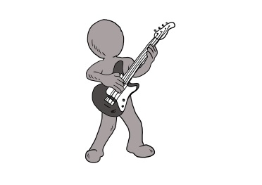
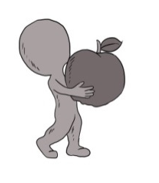
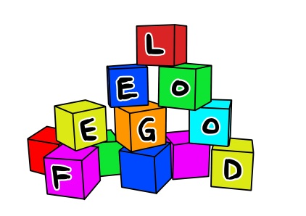

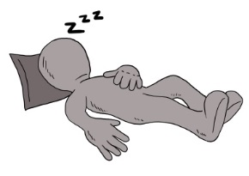
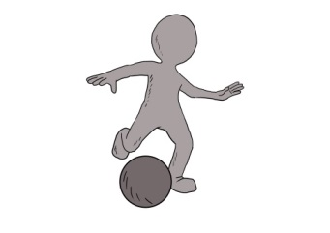
Maintain the feel-good factor
Do tasks that make me feel good about being me
Look after my health
Have a good diet
Keep myself fit and active
Avoid substances that can change my mood
Get a good night’s sleep

Slide 20
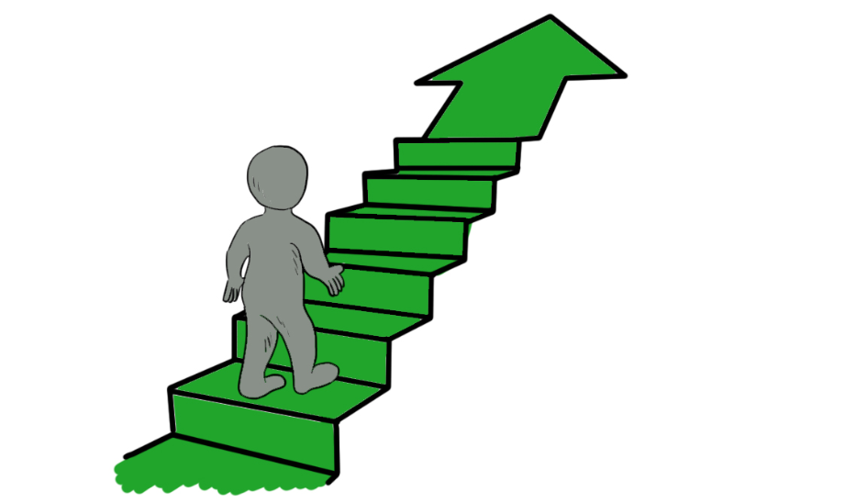
Future goals
What can I work towards in the future?
What can I work towards now?

Slide 21

Kind actions
Hold a door open for somebody.
Say please and thank you to people.
Make someone a drink.
Send someone a card.
Pay somebody a compliment.
Offer to help somebody with a task.

Slide 22

Accept feelings

Slide 23
Change problem situations
What is the problem situation?
What do I want to achieve?
Do I have all the facts?
List ideas that might help.
Choose the best idea.
Put the best idea into action!

Slide 24
Skills flash cards
Coping in crisis

Slide 25
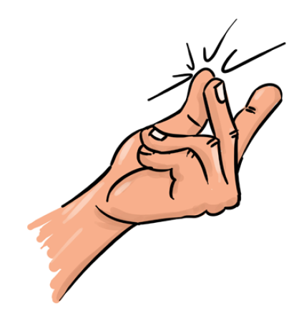
SNAPP skill
Splash cold water
Now!!
Activate your body
Paced breathing
Paired muscle relaxation

Slide 26
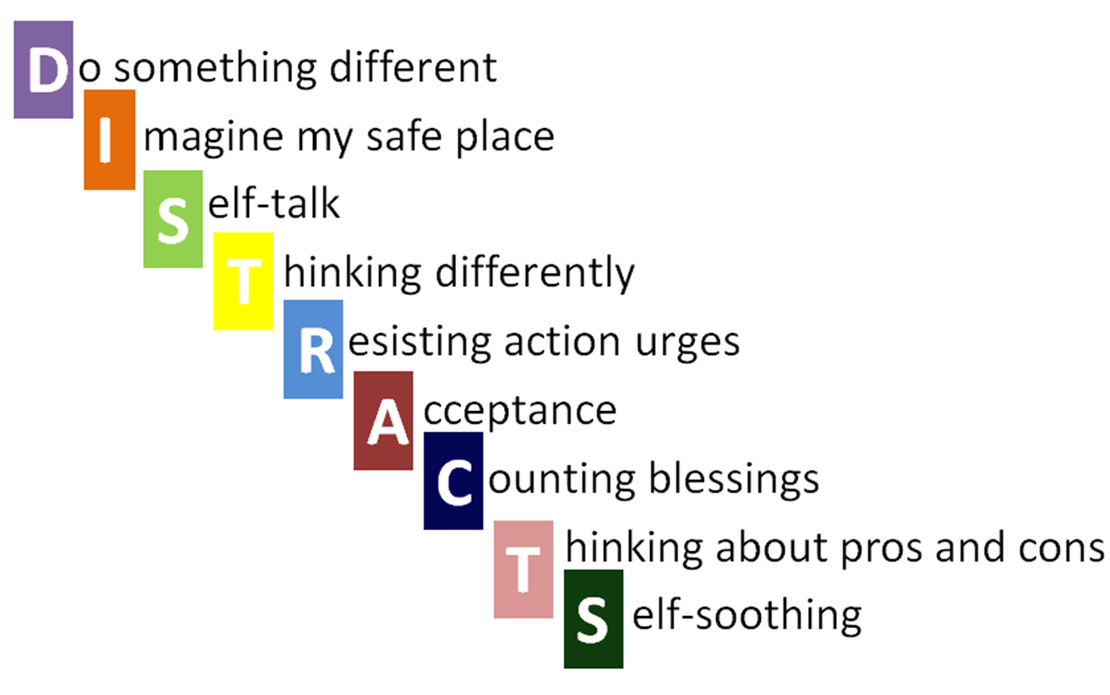
DISTRACTS

Slide 27
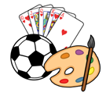
Do something different
Think of all the different things you could do…
  Go for a walk.
  Watch a film.
  Do some exercise (badminton, pool, football, catch, running, go to the gym).
  Talk to someone about something else.
  Listen to music.
  Plan your next meal.
  Play Xbox.

Slide 28

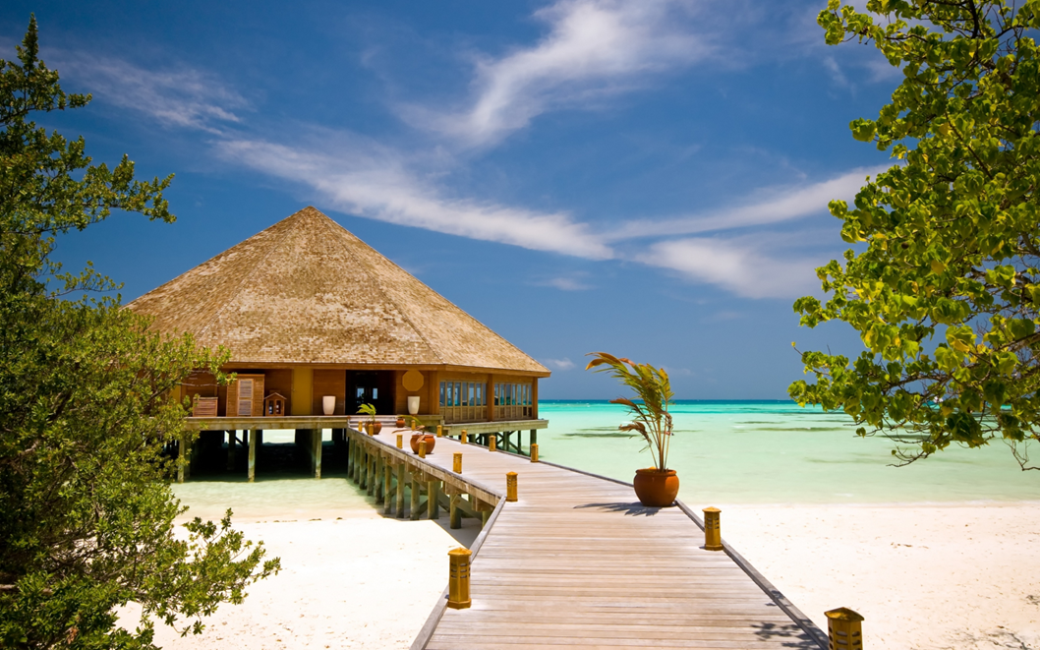
Imagine your

Slide 29
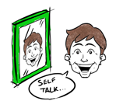
Self-talk
Try to say something to yourself
that makes you feel better like…
‘I can cope.’
‘This feeling will not last forever.’
‘I can get through this.’

Slide 30
Thinking differently
Try to think about times that
make you feel better like…
when you felt good
when you got a compliment
when you had fun

Slide 31

Resisting action urges

Slide 32

Acceptance
Acceptance does not mean giving in.
Acceptance does not mean approval.
The fight is often the problem.

Slide 33







Count your blessings
Think of all the basic things you take for granted like…
  You’re in hospital getting help.
  You have clean running water.
  You have 3 meals a day.
  You have shelter.
  You can walk.

Slide 34
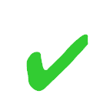
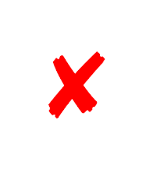
Thinking of pros and cons
✔ Pros ✔ | ✗ Cons ✗

Slide 35

Self-soothing
Think of all the things you could do to self soothe – remember to use all your senses…
  Look at a tree outside.
  Smell some shower gel.
  Listen to your favourite song.
  Eat some chocolate.
  Have a warm bath.

Slide 36
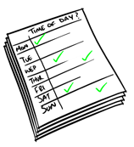
Plan ahead
Describe problem situation.
Pick a skill.
Imagine problem situation.
Practice how well you will cope.
Practice mindfulness.

Slide 37
Skills flash cards
People skills

Slide 38
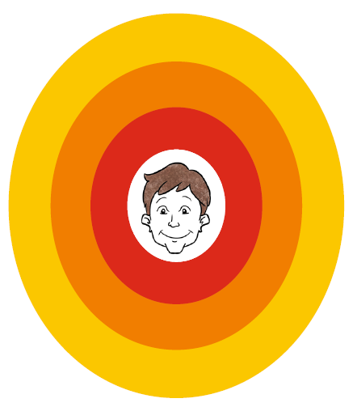
People in my life

Slide 39
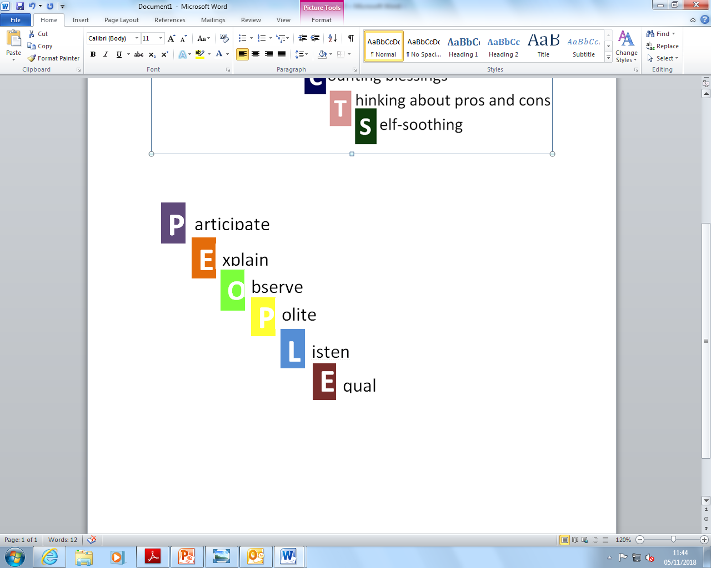
PEOPLE skills

Slide 40

Participate
Ask someone what their favourite film is.
Go to a party.
Go to a café.
Join a club.
Join a sports team.
Go to a music gig.
Smile.
Ask someone how their day has been.
Play a board game.

Slide 41

Explain
Explain the situation
Explain how you feel
Explain what you want
Negotiate (give and take)

Slide 42
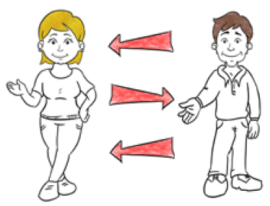

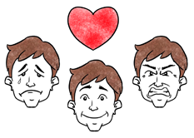
Observe
Body language
Personal space
Eye contact
Facial expression

Slide 43
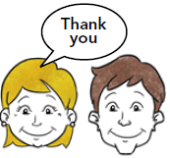
Polite
Appropriate language
Gentle tone
Confident
Truthful
Ignore attacks and threats

Slide 44
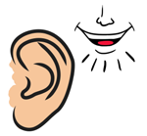
Listen
Face the person.
Reduce distractions.
Take turns.
Check out what they said.
Don’t fidget.
Don’t talk over people.
Write down key points.

Slide 45

Equal
Remember to be assertive in your:
  self-talk
  communication
  actions

