Slide 1
Self-soothing
Slide 1
Learning to cope with everyday and extraordinary stress

Slide 2
What is the self-soothing programme?
Slide 2
This training consists of an introductory module explaining some of the science behind stress and resilience, and six modules each focusing on a different sense or physical experience with exercises to practice:
Sight
Breath
Body
Sound
Touch
Smell

Slide 3
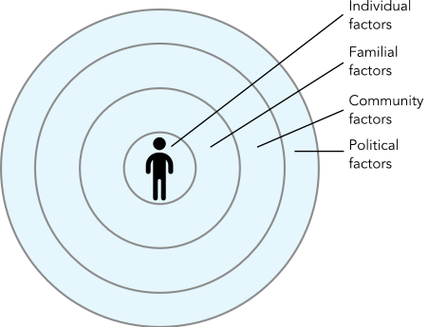
Resiliencies
Slide 3
Layers of resilience
There are many layers of resilience and support as we move away from the sphere of the individual’s internal factors, in the centre, through the factors at play within their close family or social circle that increase their resilience, and then out into the wider community around them. Finally there is the political context within which they live, which can also impact the individual’s level of resilience to mental distress.

Slide 4
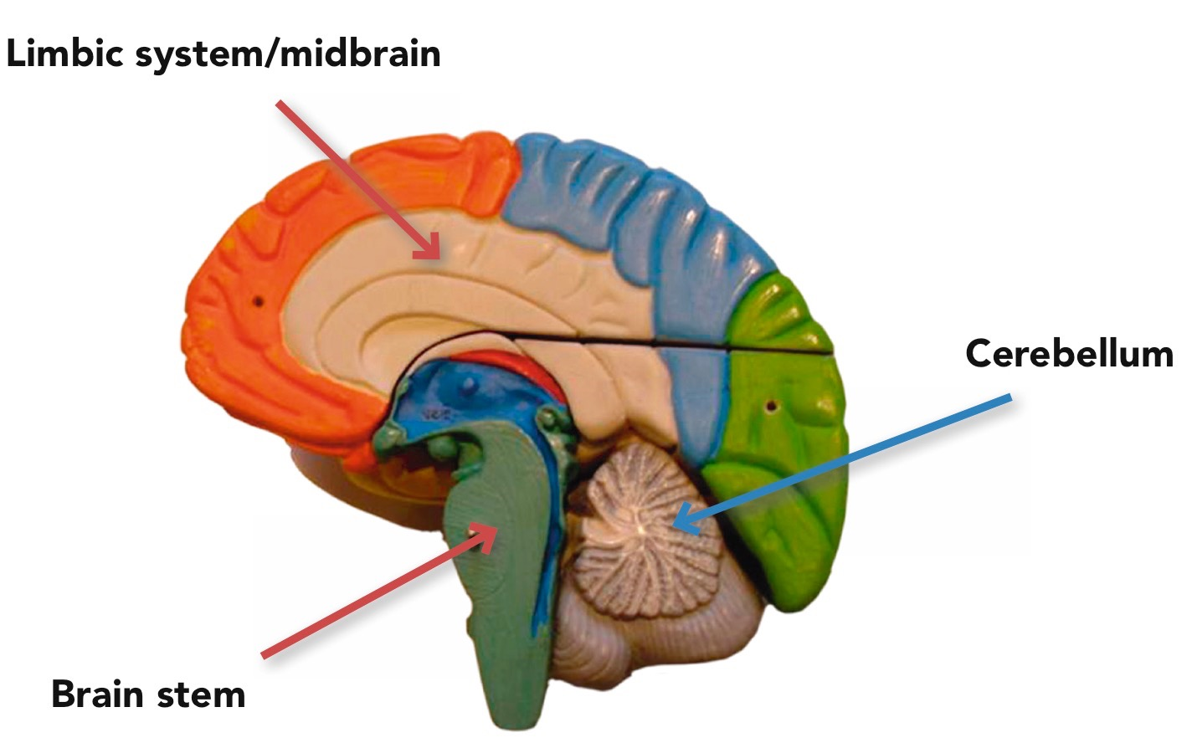
A cross section of the brain
Slide 4

Slide 5
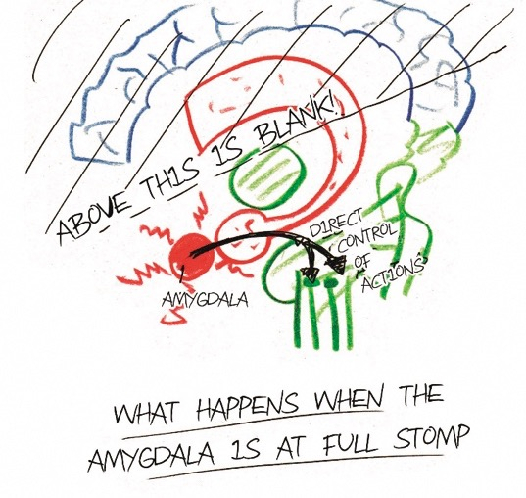
Amygdala highjack
Slide 5
Reproduced with kind permission from Curran A (2008). The Little Book of Big Stuff About the Brain: The true story of your amazing brain. Carmarthen: Crown House Publishing.

Slide 6
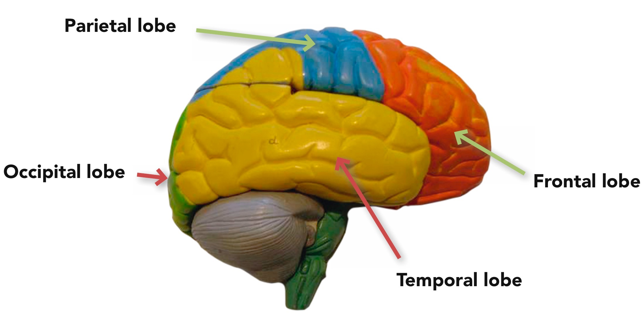
The divisions of the cerebral cortex
Slide 6

Slide 7
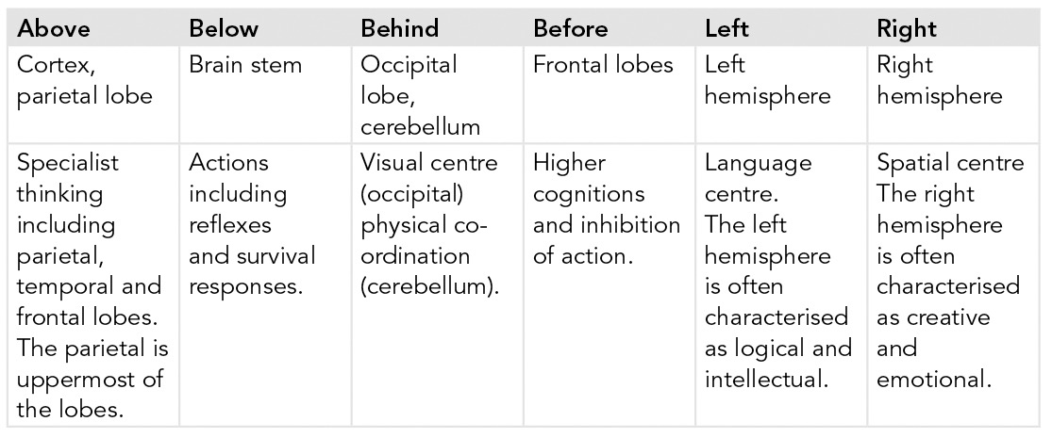
Areas of the brain and their functions
Slide 7

Slide 8
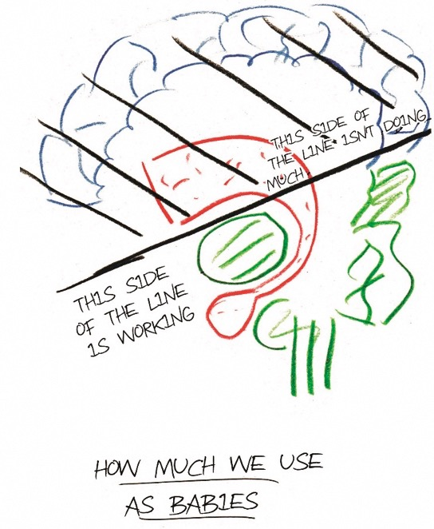
How much of the brain babies use
Slide 8
Reproduced with kind permission from Curran A (2008). The Little Book of Big Stuff About the Brain: The true story of your amazing brain. Carmarthen: Crown House Publishing.

Slide 9
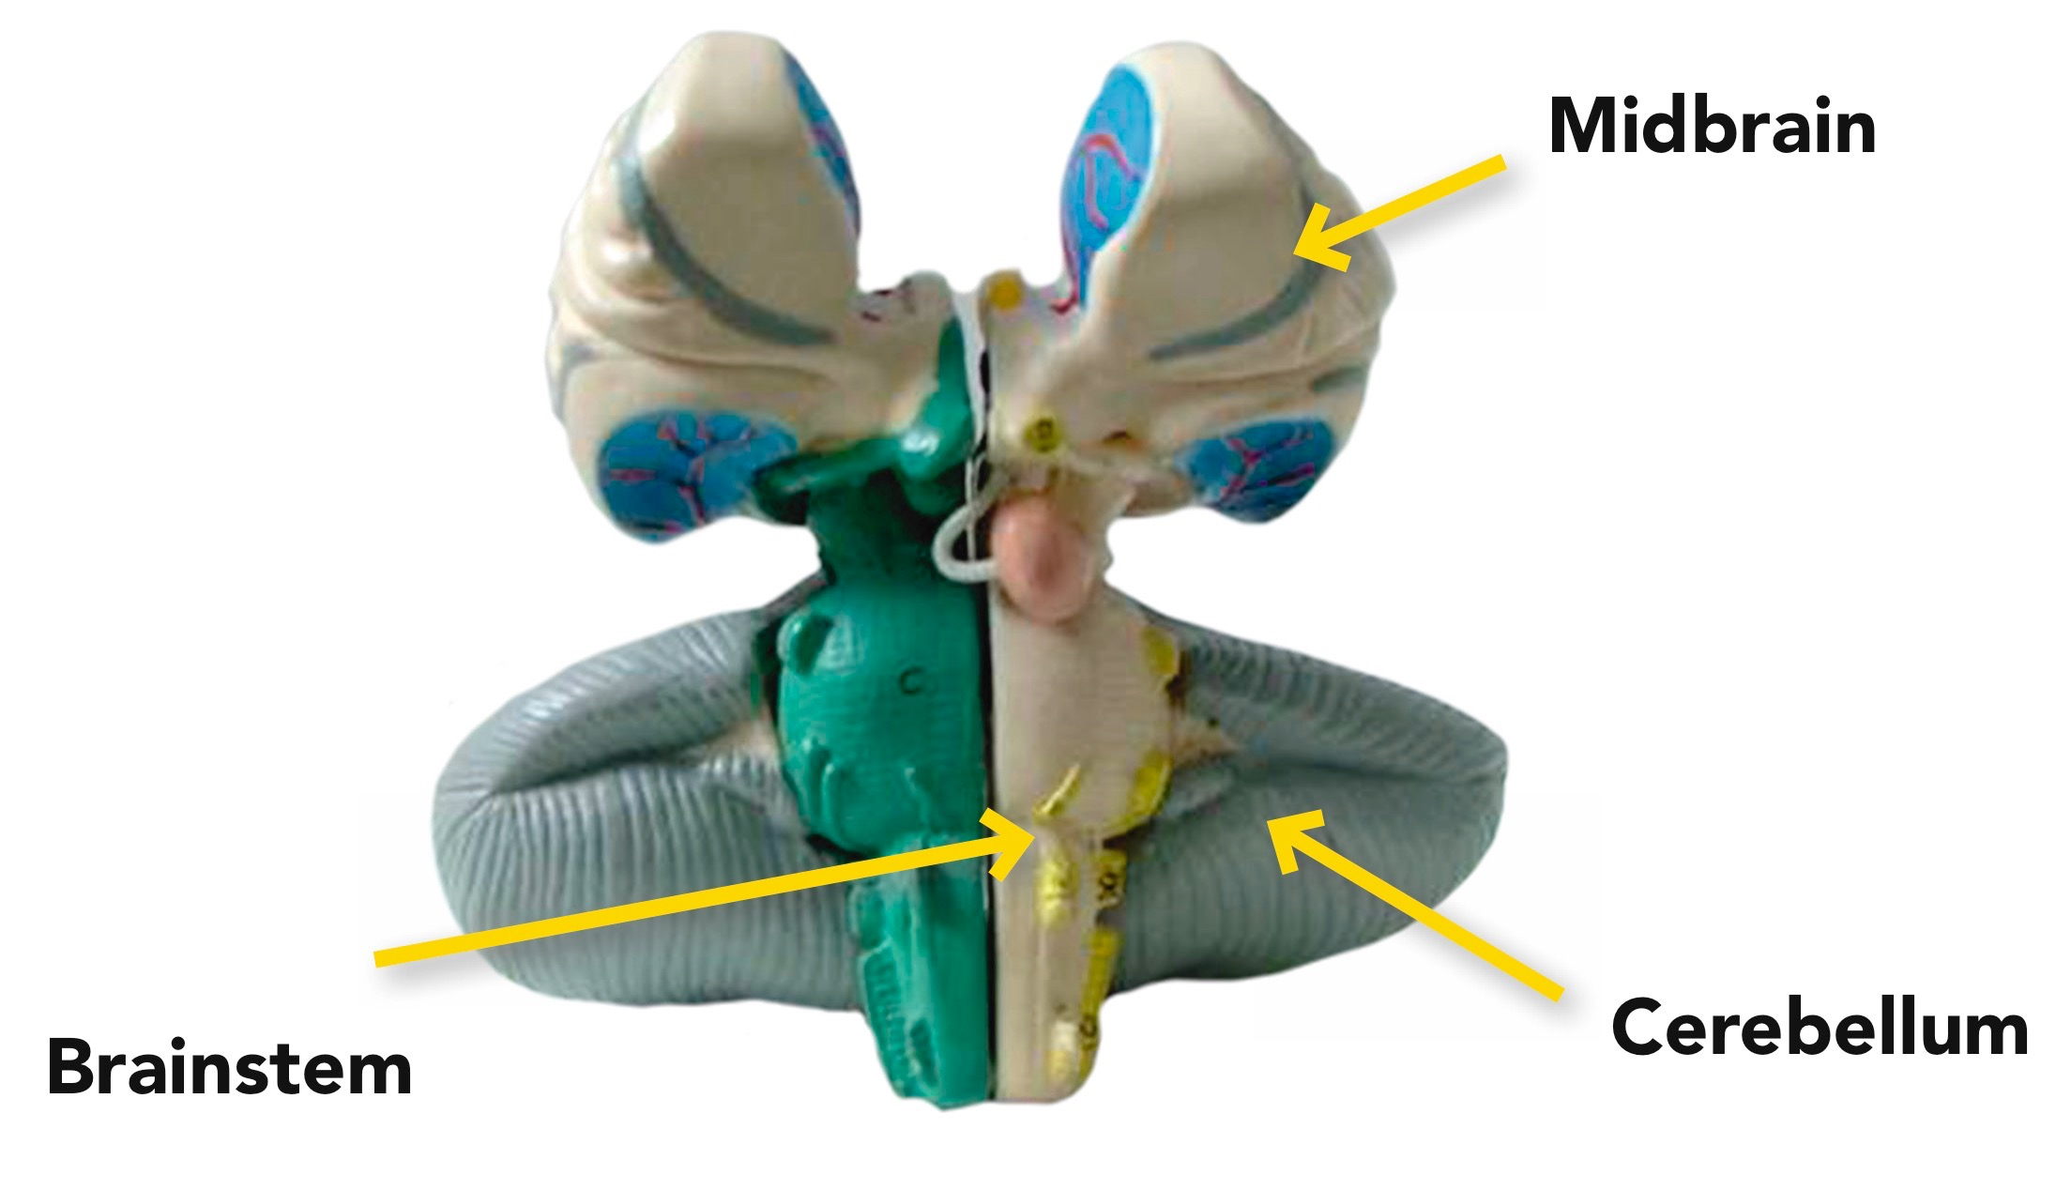
The midbrain, brainstem and cerebellum
Slide 9

Slide 10
Slide 10
In summary
the brain stem is our ‘action centre’
the limbic system our ‘feeling centre’
the cortex our ‘thinking centre’

Slide 11
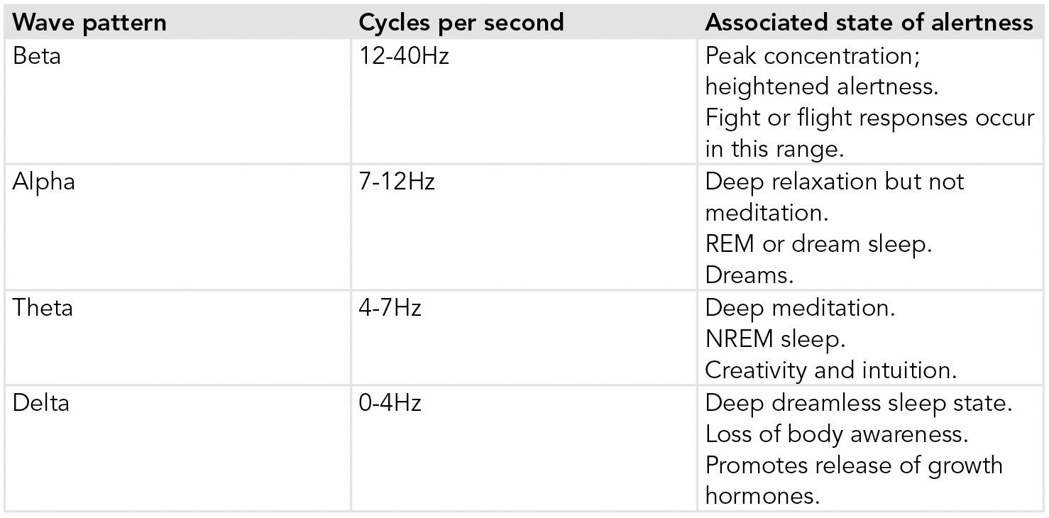
Brain waves
Slide 11

Slide 12
How does this information apply to the self-soothing programme? (1)
Slide 12
The brain can change and develop in response to our experiences. This is called plasticity, and it is what allows us to learn.
It involves the brain growing new neuronal pathways.
To establish new neural pathways simply requires repetition – regular practice.

Slide 13
How does this information apply to the self-soothing programme? (2)
Slide 13
For a new neural pathway to develop (for us to learn), the neurons must ‘fire’ together repeatedly – a bit like a string of Christmas tree lights where certain colours light up or patterns repeat themselves.
Changing old habits requires establishing new ones through practice and repetition.
This creates and reinforces the new neural pathways that allow us to change.

Slide 14
How does this information apply to the self-soothing programme? (3)
Slide 14
Constant and repeated exposure to stress fires up the stress response system, and the plasticity of the mind means that these responses can become ‘hardwired’ in our brains. The body becomes accustomed to being on stress alert. Changing this wiring is what we need to achieve.
The aim of the techniques in this programme is to ‘retrain’ our minds, to learn new habits and thoughts, and to form new neural pathways that allow us to enter a relaxation state at will, or more easily.
To do this, we need to learn how to control our bodies’ stress response and be able to relax mode after stressful periods.

Slide 15
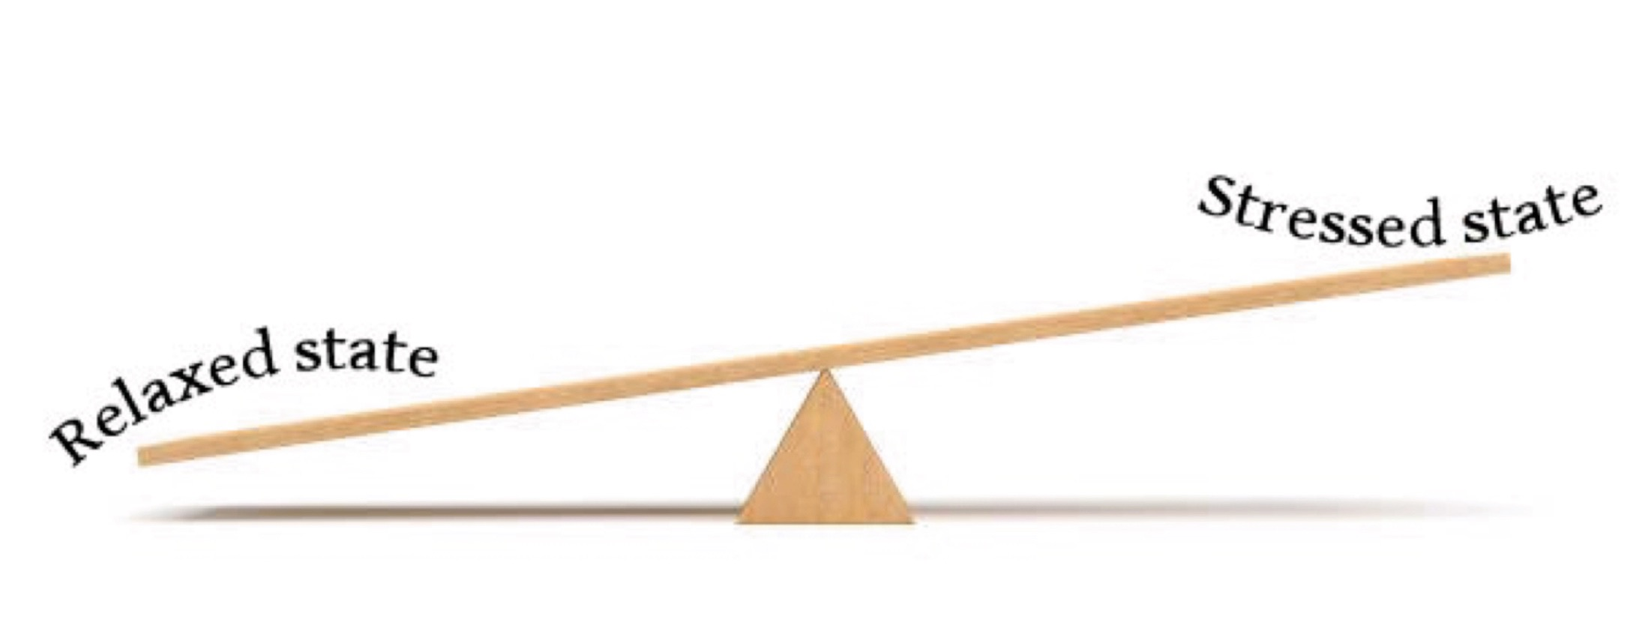
The seesaw of stress
Slide 15

Slide 16
The continuum of stress
Slide 16

Slide 17
Module 1: Harness the breath

Slide 18
Slide 18
Harness the breath
The benefits of long, deep breathing are:
lowering heart rate
lowering blood pressure
increasing oxygen supplies to the body
increasing lung capacity
improving muscle tone
lowering production of stress hormones
inducing the relaxation response (parasympathetic dominance).

Slide 19
Blood pressure for adults
Slide 19

Slide 20
Blood pressure
Slide 20
Blood pressure is usually given as two figures, such as ‘120/80’, which shows the systolic pressure (when the heart pumps) over the diastolic pressure (when the heart relaxes).
It changes throughout the day, generally being lowest in the morning and rising throughout the day, but it can rise quickly at any time, especially if someone is anxious.
It is best to work in partnership with your GP to monitor and control your blood pressure.
However the research evidence on how simple breathing techniques can lower blood pressure is impressive.

Slide 21
Exercise 5.1: Feel your breathing
Slide 21
Sit with one hand on your chest and one hand on your stomach.
Then breathe in through your nose. As you do so, notice which part of your body moves – the chest or the stomach? Or both?
Focus on your stomach hand, and as you breathe out, you should feel your stomach move in towards the spine. Try this for a few more breaths.
You may find it easier to do this exercise lying down. When lying down, you should be able to see your stomach rising and falling with each breath.

Slide 22
Exercise 5.2: Breaths per minute
Slide 22
Sit comfortably in a chair with your back straight (this will be easier if you sit on the edge of the seat).
Count how many breaths you take in one minute. This includes the inhale and the exhale.
It may be easier if you count each time your chest or stomach rises.
If doing this exercise at home, use a timer on a mobile phone or a watch to time one minute.
How did you do?

Slide 23
Breaths per minute for adults
Slide 23

Slide 24
Breathing rates for children
Slide 24

Slide 25
Exercise 5.3: The breath count
Slide 25
Lean over from a standing position and put your hands on your knees.
Next, focus on the following breathing pattern: breathe in through the nose and out through the mouth. Continue to repeat this pattern.
Next, make the out-breath longer than the in-breath. You can do this by counting silently to yourself. For example, ‘In 2-3-4; out 2-3-4-5-6; in 2-3-4; out 2-3-4-5-6’. If you can’t get to four, just go as far as you can.

Slide 26
Exercise 5.4: Holding your breath
Slide 26
Take a deep breath and hold it in.
Use a timer or a watch with a second hand to time how long you can hold your breath for in this way.
Next, breathe out and at the bottom of the exhale, hold your breath again. If using this exercise with children it can help to gently pinch the end of the nose to ensure the breath stays held out – otherwise sneaky sniffs can make for false results!
Time how long you can hold your breath for in this way
Which did you find easier?

Slide 27
The controlled pause
Slide 27

Slide 28
Exercises 5.5: Check your breathing
Slide 28
Using a timer, as we did for exercise 5.4, count how many breaths you are taking in the space of one minute.
As a homework exercise, set an alarm at various different times in a typical day. When it goes off, see how many breaths per minute you are taking. If you are breathing more than 12 breaths per minute, take a ten minute breathing break.

Slide 29
Exercise 5.6: Breathing through a single nostril
Slide 29
Close off your right nostril and breathe in and out through your left nostril only.
Do this slowly and easily for at least three minutes.
As you breathe in, feel your lungs fill up right to the bottom, and as you breathe out feel your lungs empty, squeezing out all the stale air.
This exercise is child friendly.

Slide 30
Exercise 5.7: Ocean breath
Slide 30
This breathing technique is often used in yoga and is formally known as Ujjayi pranayam or ‘victorious breathing’. It is sometimes also called the ‘Ocean Breath’. I once heard it called ‘Darth Vader breathing’ and I have adopted this term for when working with children to help them understand the sound we are looking for when they do this type of breathing.
It involves increasing airway resistance by constricting your vocal chords. It can be practiced through an open mouth so you can hear the sound of your breath as you exhale, often described as trying to fog a mirror. Once you have mastered this, you can practice with a closed mouth.
Breath like this now for two minutes.
This exercise is child friendly.

Slide 31
Module 2: Connect with the body

Slide 32
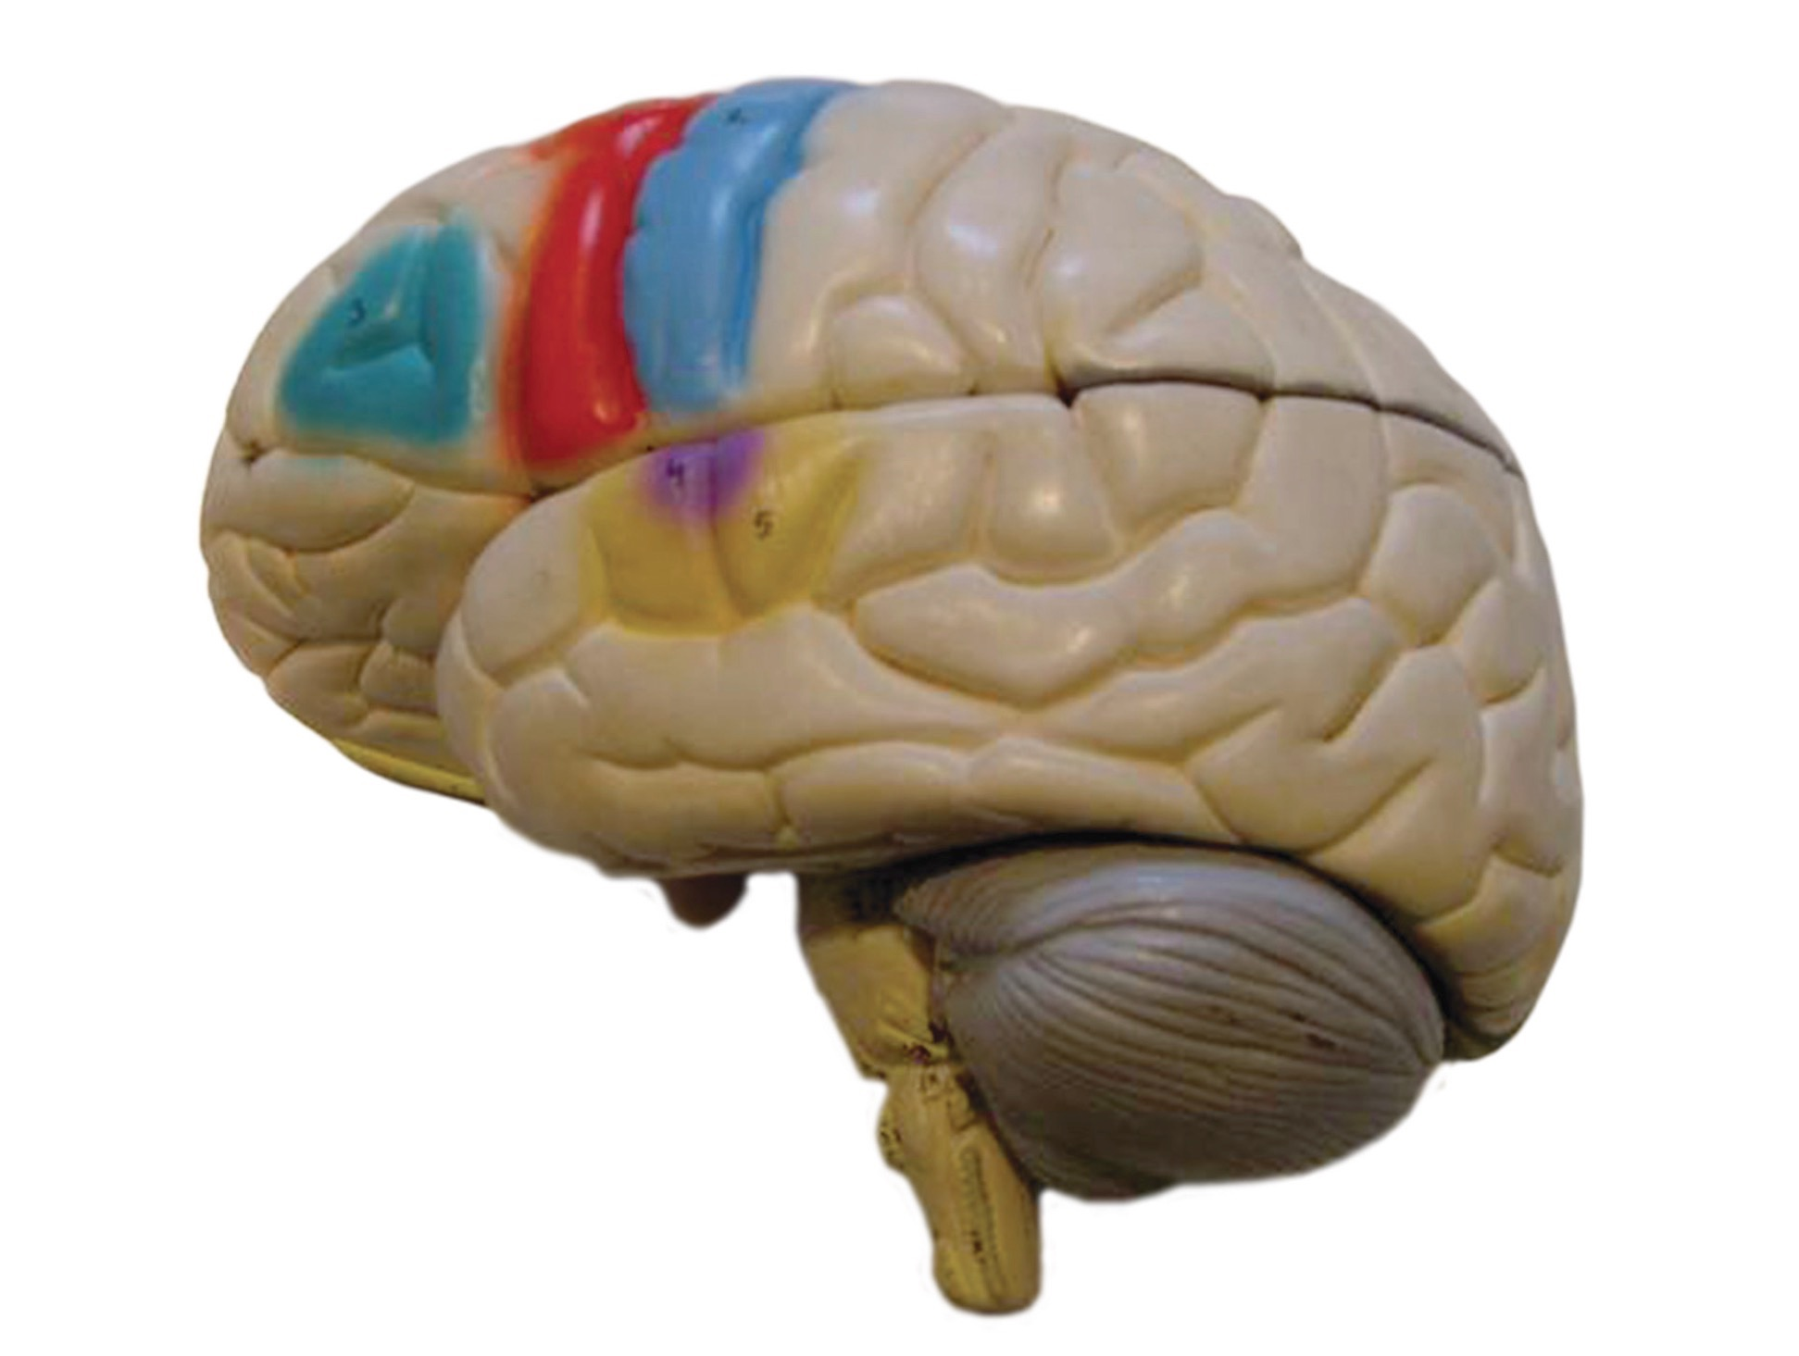
The motor cortex
Slide 32

Slide 33
The Gyan mudra
Slide 33

Slide 34
Exercise 6.1: Shoulders
Slide 34
Get yourself sitting in a comfortable position, close your eyes, and place one hand in the palm of the other.
Next, let your breath regulate and then focus on your shoulders.
Pull your shoulders up to your ears and then drop them on the exhale. After inhaling again, let them drop further on the next exhale.
Do this for a few minutes and you should isolate and feel the movement of your shoulders up towards the ears and down again.
Often during the course of the day, as we get tense, we raise our shoulders up closer to our ears. As a bit of homework, from time to time during a day, focus on where your shoulders are. If you feel them creeping up, just take a few minutes to sit with a straight back and go through this exercise.
This exercise is child friendly.

Slide 35
Exercise 6.2: Hook ups
Slide 35
Get yourself sitting comfortably and then cross one ankle over the other.
Extend your arms in front of you and cross your wrists, making sure that you follow the same side as the ankles. For example, if your left ankle is crossed on top of the right, make sure your left wrist is crossed over the right.
Turn your palms to face each other.
Next, interlace your fingers and bring your interlaced hands in towards your chin and rest them comfortably above your heart.
Close their eyes and breathe deeply for a few minutes.
This posture is from Brain Gym and it is intended to help relaxation. By crossing over left and right, you encourage your brain to integrate sensory input from both hemispheres. Sometimes the brain can be fooled and it can’t quite figure out where the sensory input is coming from.
This exercise is child friendly

Slide 36
Exercises 6.3 and 6.4: Fool your brain
Slide 36
Part 1
Divide into pairs.
One participant from each pair should extend their arms, interlace their fingers and bring their hands back to their chins, as we did in exercise 8.2: Hookups.
Next, the other member of each pair should point to (but not touch) one of their partner’s fingers. That partner must then try to wiggle the selected finger. Can they do it first time?
The same partner should choose a few more fingers, and then switch places so the other partner is picking fingers.
This exercise is child friendly.
Part 2
Hold your left ear lobe with your right hand and touch the tip of your nose with your left hand.
Next, swap over so that your left hand grips your right ear lobe and your right hand touches the tip of your nose.
Keep swapping and try to speed up. Are you bumping into yourself and getting mixed up?
This exercise is child friendly.

Slide 37
Exercise 6.5: Super brain yoga squats
Slide 37
Take your left hand and lightly but firmly hold your right ear lobe.
Cross your right hand and similarly hold your left earlobe. Your hands should be crossed in front of your bodies and your thumbs should be at the front of each ear lobe. The left arm should be closest to the chest with the right arm on top.
Next, inhale through your nose and squat down to the floor slowly. Squat as low as you comfortably can.
Once there, you should pause and hold your breath for two seconds and then exhale as you make your way back up to a standing position without letting go of your ears.
Keep your tongues behind their front teeth throughout.
Repeat this sequence for up to three minutes, or 14 repetitions.
This exercise is child friendly.

Slide 38
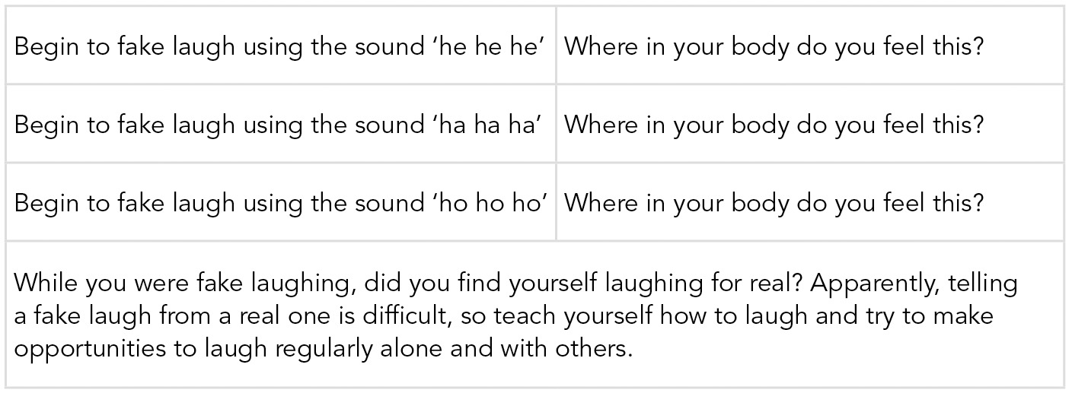
Exercise 6.6: The difference laughter makes
Slide 38
This exercise is child friendly.

Slide 39
Sleep problems
Slide 39
In NREM sleep people can sometimes experience physical jerks, night terrors and sleep walking. They may be aware of the physical jerks, which often wake them up, but sleep walking and night terrors are not something people are often aware of. Others, however, may be more aware of these sleep disturbances.
Night terrors and sleep apnoea are among the more serious sleep disorders, but treatments are available. During a night terror, a sufferer seems awake and is often frightened or panicked and they may call out or engage in protective/defensive gestures. This behaviour is often seen in people suffering from post-traumatic stress disorder (PTSD).
Sleep apnoea is a condition in which the sufferer stops breathing for a few seconds, even for minutes, and then wakes up to get air. This can occur several times throughout the night, resulting in an unsatisfactory night’s sleep. If you think you have either of these (or have been observed to have them), talk to your GP about them.

Slide 40
Exercise 6.7: Sleep diary
Slide 40
As a homework exercise, for the next week:
Note what time you go to sleep and what time you wake up.
Keep a notebook and pen beside your bed and, when you wake, record any dream fragments that you remember.
If you awake during the night, note the time and, if you were dreaming, write down anything you remember.
At the end of the week review your diary. Do you notice any patterns? Is there a pattern in the times you go to sleep and wake up, or that you awake during the night? Are there any recurring themes from your dreams?

Slide 41
Exercise 6.8: Progressive muscular relaxation
Slide 41
This exercise can be used as a guided meditation. Get comfortable and then work through the following progressive muscular relaxation sequence slowly and clearly. Don’t rush, and hold the tension in your muscles for five seconds before releasing. Take a moment before moving on to the next muscle group.
Find a comfortable position lying down or sitting.
Starting with your toes, tense them for about five seconds by curling them downwards, and then release them.
Move to your feet, again tensing them for five seconds by spreading your toes and curling them upwards, then release them.
Move to the calf and thigh muscles – tense them for about five seconds by lifting the legs and pulling them together, then release.
Move to the hips and buttocks – tense them for about five seconds and then release.
Move to the stomach – tense your stomach muscles for about five seconds and then release.
Move to the chest – tense the chest muscles, hold for about five seconds and then release.
Move to the back – tense the back muscles, hold for about five seconds and then release.
Tense the shoulders by bringing them up to your ears, hold for five seconds and then release.
Tense the upper and lower arms by making fists and pushing them straight out. Hold for five seconds and then release.
Tense the fingers, hold for five seconds and then release.
Finally, move on to the face – tense the facial muscles by wrinkling the forehead, grimace by pulling the corners of the mouth back and down, and squeezing the eyes shut. Hold for about five seconds and then release.

Slide 42
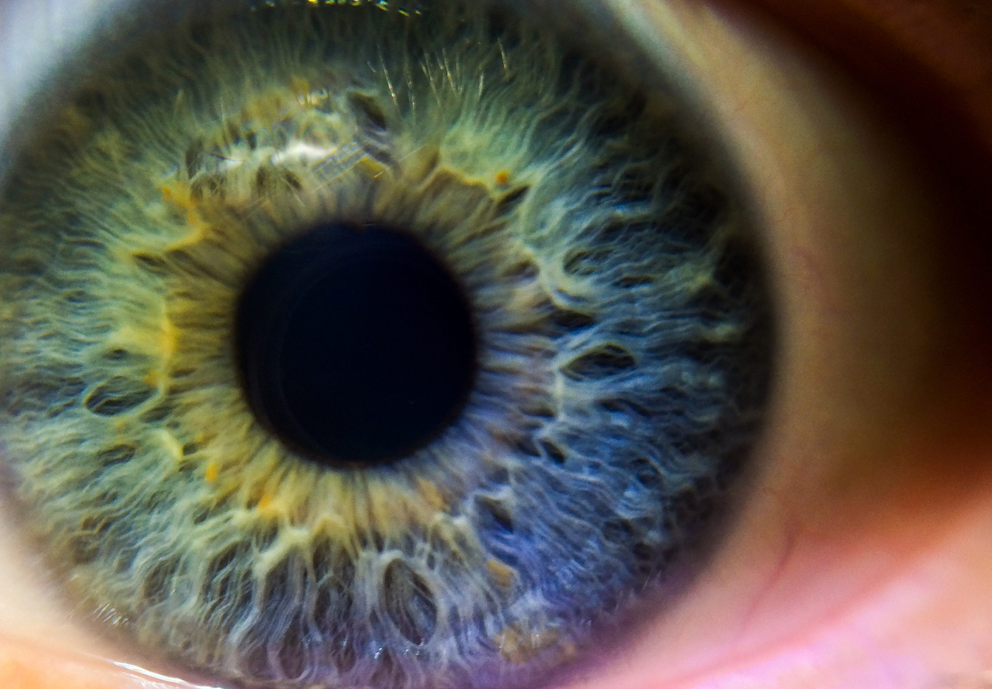
Module 3: Seeing and sight

Slide 43
Exercise 7.1:
Balance
Slide 43
Stand with your feet shoulder-width apart and your eyes open. In this position, balance on one leg.
Next, close your eyes and do the same thing again. What happens? Discuss as a group how you found this experiment, and which was harder.
Some people find it much harder to balance with their eyes closed. This suggests that using visual cues helps us to stabilise our position in space. We use our eyes to keep us balanced.
This exercise is child friendly.

Slide 44
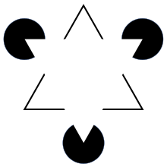
Optical illusions
Slide 44
The Hermann Grid
The Kanizsa Triangle

Slide 45
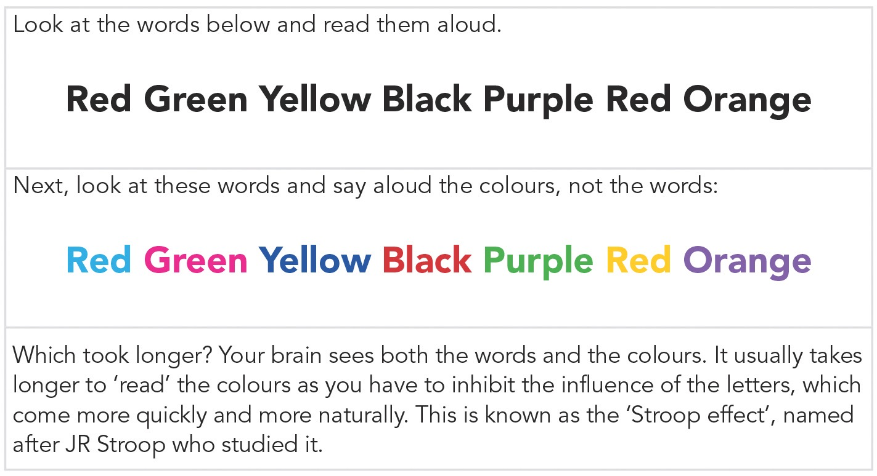
Exercise 7.2:
Colours
Slide 45
This exercise is child friendly.

Slide 46
Exercise 7.3: Safe space
Slide 46
Bring an image to mind that is connected to feeling safe, calm, relaxed and comfortable. This might be a real place, perhaps somewhere you have been before. It might be a person who you associate with feeling calm, safe and relaxed. It might be somewhere imaginary that you have created. It might be abstract, like a colour. Select a visual image so you picture this in your mind’s eye. You can do this in a chair or lying on the floor, anywhere you can be quiet, uninterrupted and comfortable.
Focus on this visual image and bring your attention to your breathing. Start to take long and deep breaths. Inhale through your nose and exhale through your nose. Close your eyes and focus, if you can, on the picture in your mind’s eye.
Consider the image you have created: what colours do you see? Is it light or dark? Is it still or moving?
Consider where you are in this picture.
Consider what you are doing.
If you find your mind drifting away, come back to your visual image and focus on your breath.
To end your guided visualisation, focus on your breathing and count backwards from five to zero.
Wiggle your fingers and toes. Take a deep breath and stretch your arms up. Open your eyes.

Slide 47
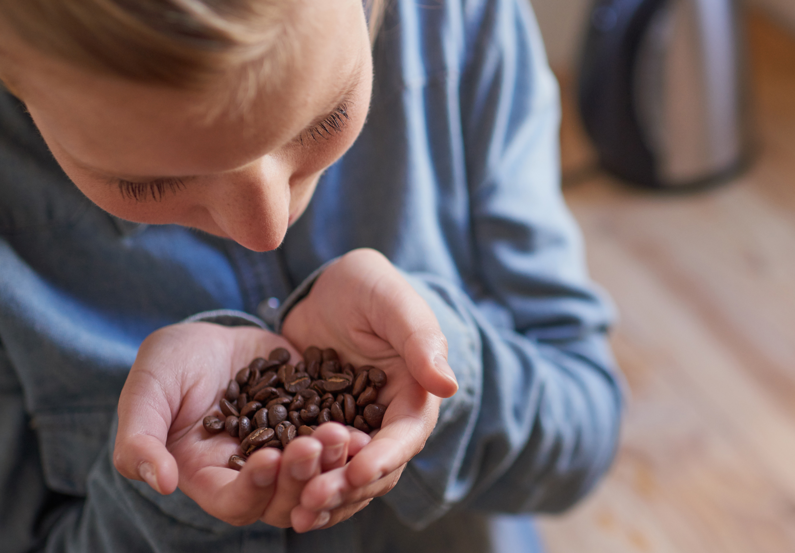
Module 4: Smell

Slide 48
Exercise 8.1: Taste and smell
Slide 48
Close your eyes and hold your noses. You are about to be given a jar of jelly beans. Take one and pass it on.
Next, taste your jelly bean. You will probably be able to experience its texture and sweetness, but you will struggle to identify its flavour.
Finally, open your eyes and release your noses. When you try another one the flavour will often become immediately obvious.
This exercise is child friendly.

Slide 49
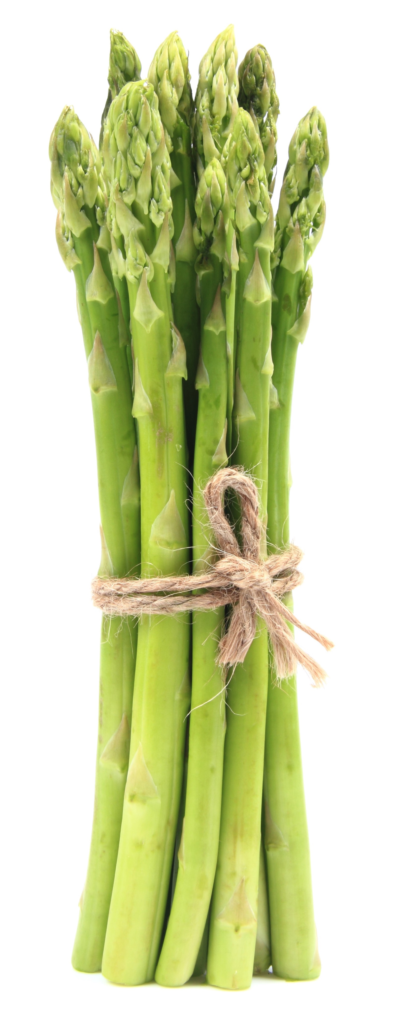
Asparagus anosmia blessing
Slide 49
Being unable to smell a certain scent is called anosmia. Most people will produce a distinct smell in their urine soon after eating asparagus. But only between 10–22 % of the population can smell it! What about you?

Slide 50
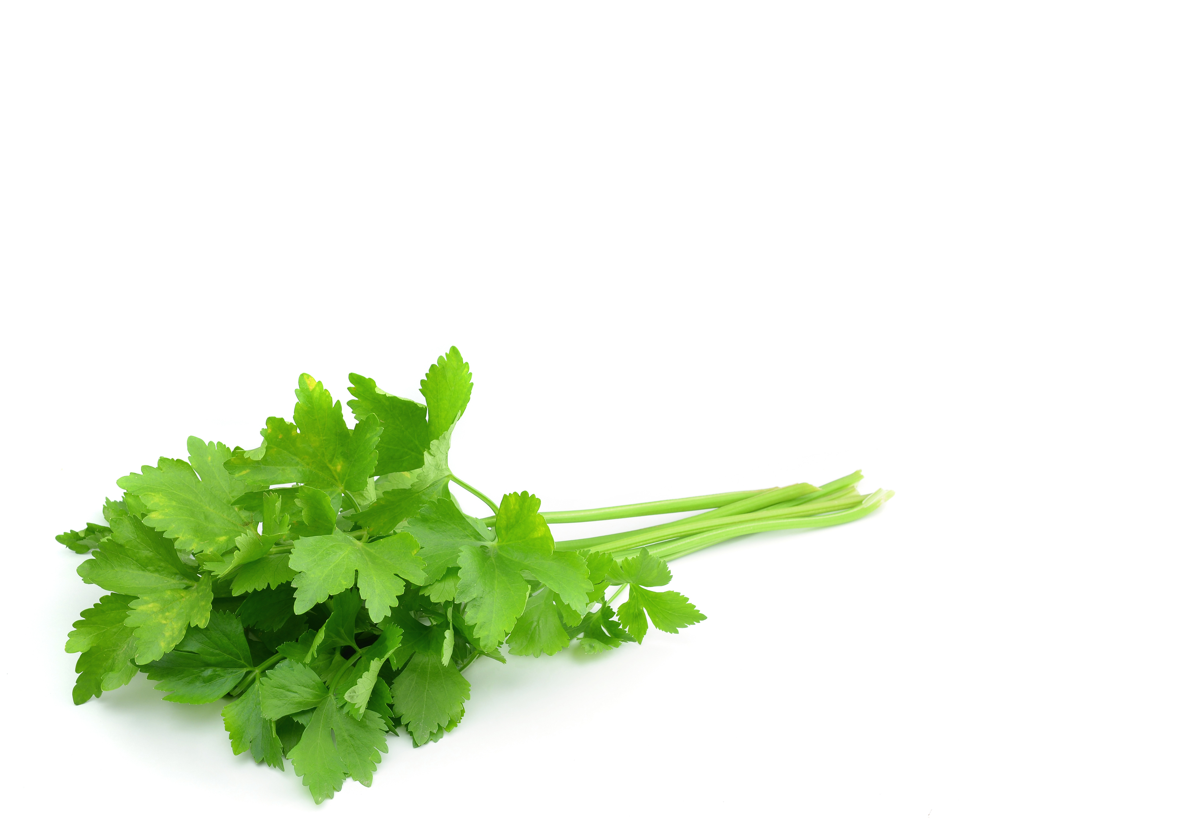
Coriander
Slide 50
O soapy flavour/Why pollutest thou my food? / Thou me makest retch,’ reads one of the hundreds of haikus posted to the website IHateCilantro.com. Dislike of herb coriander can be traced to genes encoding odour and taste receptors.
Apparently it’s in our genes
There are marked differences in taste for coriander, with 21% of east Asians, 17% of people of European ancestry and 14% of people of African descent loathing it. By contrast, 3–7% of south Asians, Latin Americans and Middle Eastern subjects disapproved of the herb, which is more common in their native cuisines.

Slide 51
Did you know?
Slide 51
The Guinness Book of World Records lists what it considers the two smelliest substances as:
a concentrated faeces smell (the US Government Standard ‘Bathroom Malodor’)
a substance called ‘Who me?’, which smells like rotting food and carcasses that was used briefly by the French resistance during the Second World War.
Both of these produce strong reactions in the vast majority of people, often forcing them to leave an area. This ‘flight response’ is a survival tactic, as things that smell disgusting are likely to be toxic.

Slide 52
Exercise 8.2: Remembering a smell
Slide 52
Either on your own or in a pairs, take a few minutes to think of a pleasant smell and the memories you associate with it.
You can write these memories down if working alone. If working in pairs, ask participants to share their memories with their partner.
Next, repeat this procedure with an unpleasant smell.
Then, as a larger group, share some of your smell memories. Write down all the smells people recalled on two pieces of paper – pleasant and unpleasant.
Does anyone share a similar pleasant or unpleasant smell? As people share the smells they remembered, ask yourself whether they evoke any memories for you as well?

Slide 53
Exercise 8.3: Scent trail
Slide 53
Around the room you will see a series of jars on various tables or spaces and a jar of coffee beans in the middle.
Go around the room and sniff the various scents. You should start with one scent. Have a sniff by taking the lid off and holding the jar quite a way from your nose and then inhaling. You may need to sniff a few times. After smelling this one scent, return to your seat and write down what you think the scent is and note any associations you have with it. This should take a few minutes at least.
You can then go to the coffee beans and smell them before moving on the next scent. Do this as an individual experience rather than discussing it together. The room should be pretty silent as you move from station to station.
Take your time and return to their seats for a few minutes between each new scent. If you rush from scent to scent, it can become much harder to identify the different scents.
In this way, work your way through each scent. Perhaps you could choose the one you most liked and use it in the relaxation at the end of the session or at home?

Slide 54
Exercise 8.4: Pick your relaxation scent
Slide 54
When you practice the relaxation techniques in this manual, start to surround yourself with a specific smell. If you choose to use an oil, for example, you could carry a tissue that has a few drops on it. If you begin to feel stressed or anxious, smelling the tissue should trigger a relaxation response.
If you have trouble sleeping, you could use a specific smell only at bedtime as part of your sleep hygiene routine. If you use it in the bath or as you lie down in your bed and then begin any relaxation technique, you will begin to associate the smell with sleeping.

Slide 55
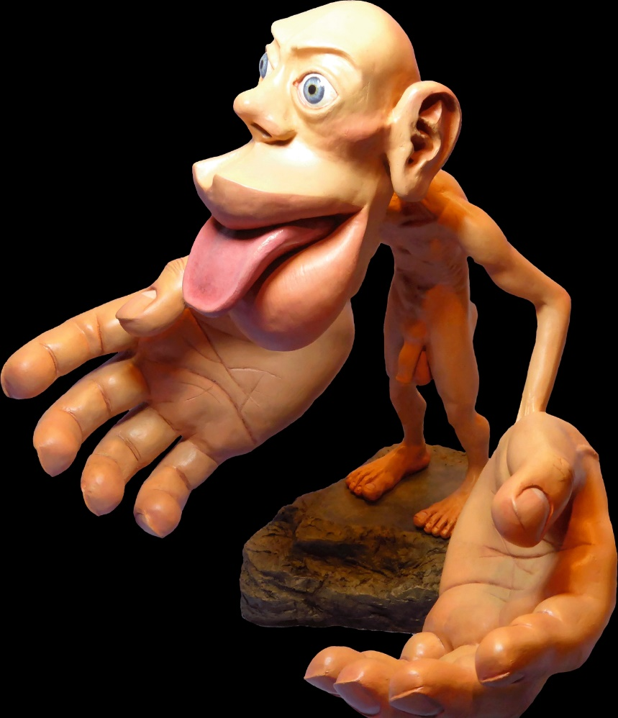
The cortical homunculus
Slide 55
A significant portion of our brains and nervous systems are dedicated to the sensation of touch, and you can see from the cortical homunculus, which is a representation of the human body correlated to the neural resource allocated to each area of the body for the somatosensory cortex. Notice how large the eyes, lips and tongue are, reflecting the amount of brain space given over to processing information from them.
Areas given more space are more sensitive and you will see these aspects of experience – sight, sound, smell, taste and touch – have been the foci of the self-soothing programme in this manual.
Credit: Mpj29, www.commons.wikimedia.org/

Slide 56
Exercise 9.1: Loving hands (1)
Slide 56
Choose someone to do the exercise with. Remember that holding hands alone can reduce anxiety, but holding the hand of someone within your significant other network is even better.
Choose a hand cream or you could use almond oil instead. Whichever you chose, only a small amount is needed - a few drops of oil or a 5p-size blob of hand cream. Put the hand cream or oil in your palms to warm it up.
Sit facing each other, knees touching. If you find this close encounter too much, try sitting side-by-side, facing one another.
Take one of the other person’s hands into both of yours.
Start by massaging the front and the back of their hand. Then turn their hand over so the palm is facing up.
Use both your hands to support their hand – you can do this by placing your ring finger and little finger (both together) from one hand in between their thumb on one side of the hand and your ring finger and little finger (both together) of the other hand, in between their little finger and ring finger on the other side of their hand. Then if you turn your palms up this should open out the palm of their hand for you, supporting their hand at the same time.
Using your thumbs, start in the middle of the palm, which feels a bit like a well, and move both thumbs up to the bottom of the palm near the wrist. Move each thumb out and then around the outside of the hand and back together in a point at the bottom of the middle finger. This makes the shape of a heart.
Slide the thumbs up together, back to the centre and continue with this pattern a number of times.

Slide 57
Exercise 9.1: Loving hands (2)
Slide 57
While you are doing this, you can talk together or you may remain quiet, whatever feels best.
When you have finished, turn the hand over, holding it in your hand and look for moons at the bottom of each finger nail. Using your thumb gently massage each finger nail, especially the nail bed.
Then, still holding the hand, gently but firmly twist the skin of each finger, starting at the base and moving to the tip as if squeezing a tube, and at the end twist away from the finger. (Originally this was as if throwing away anything that wasn’t needed). So enjoy this and make up your ‘good riddance’ list.
When you have completed twisting all five fingers and thumb, using your thumb gently slide it from the nail to the base replenishing ‘welcome wishes’ – things the other person would like to come into their life. You might suggest that as these ‘welcome wishes’ are smoothed through each finger, that they imagine them traveling all the way up their arm to their heart.
During this part of the exercise you will need to talk with each other as you negotiate ‘good riddance’ and ‘welcome wishes’. The exercise should be done with good intentions and should be heart felt.
This completes the sequence for one hand. Depending on time, move onto the other hand. It is important that both people get a chance to give and receive these massages. Don’t do both hands of one person, if it means the second person only receives and doesn’t have a chance to give.
Doing both hands of each person is likely to take about 20 minutes.

Slide 58
Exercise 10.1: White noise
Slide 58
Get yourself sitting comfortably and then close your eyes and listen to pure white noise for five minutes. If you don’t have a recording of white noise, the internet will provide a number of different examples. They are often advertised to help babies and adults sleep.
After five minutes of white noise, turn the sound off and enjoy a few minutes of long, deep breathing and silence, then open their eyes.
Did you find it relaxing? Not everyone does.

Slide 59
Exercise 10.3: Natural sounds
Slide 59
Get yourself sitting comfortably and begin long, deep breathing.
When you are nice and relaxed, listen to the sounds that will be played for two minutes each. Keep your eyes closed, breathing deeply.
Afterwards, sit for a few minutes in silence and then open your eyes and see if you can identify the three sounds that were played.

Slide 60
Exercise 10.4: Wave pattern relaxation
Slide 60
Get yourself sitting comfortably and play a recording of a pure beta wave sound for two minutes. If you don’t have a recording of beta waves, the internet will provide a number of different examples (YouTube is a good place to look). Often, beta wave sound is used to help with studying as it keeps you focused and alert. Beta waves are in the range between 12–40 Hz (cycles per second).
After two minutes of beta waves, turn the sound off and enjoy a few minutes of long, deep breathing and silence, then open your eyes. How did you find hearing this sound vibration? This frequency is not meant to be relaxing.
Next play an alpha wave recording for about two minutes. Alpha waves are in the range 7–12Hz.
As you move to theta waves, turn the volume down so it doesn’t jar you awake. Begin theta wave recording this time for two minutes. Theta waves are in the range 4–7Hz.
Turn the volume down (not off) and begin delta waves. Delta waves are in the range 0-4hz. They can be quite hard to hear. Leave this to play for 4 minutes.
Then reverse the wave patterns by turning the volume down and starting theta waves for two minutes and then finally alpha waves for the last two minutes.

