Slide 1
Keyboard literacy measure
Refers to Chapter 4: Creative live online teaching on page 47.
PowerPoint slide deck overview
This PowerPoint slide deck contains 15 slides to use as a keyboard literacy measure. When you open the slide deck, you will see that there are three slides of each response (e.g. oranges, apples and potatoes), which slowly build up in terms of complexity. It will probably take the first two for the learners to start getting the hang of things.
On the third slide, I recommend you begin actually measuring. You do this by starting a timer or stopwatch and recording how many seconds the first response takes to come in, how long it takes for just over half the group to type a response and how long it takes for all but a couple of your learners to respond – say, 90%.
If your learners can cope with this, move on to the next set of three slides (water, juice and milk – I have not included every slide here), which involve them typing the full words ‘Yes’ or ‘No’. Again, it may take them one or two slides to get the idea that they are now typing a word, not a letter, so it is probably best to do your timed response on the second or third slide.
The next set of slides requires the answers ‘Yes, I do’, ‘No, I don’t’ or ‘I don’t know’; in other words, it requires responses that are short sentences. This will show you how your learners will cope with short sentences or phrases.
The penultimate set requires longer sentences with lexical items in them: ‘Yes, I like ________.’ and ‘No, I don’t like ________.’ (so learners have to type in specific vocabulary items). The items are broccoli, tomatoes and onions.
The idea here is to work through the sets until you find a response type and time that is comfortable for you and your learners. In just one lesson phase, it will tell you about your group and more or less what you can expect them to do when you ask them to produce longer or shorter textual responses.

Slide 2
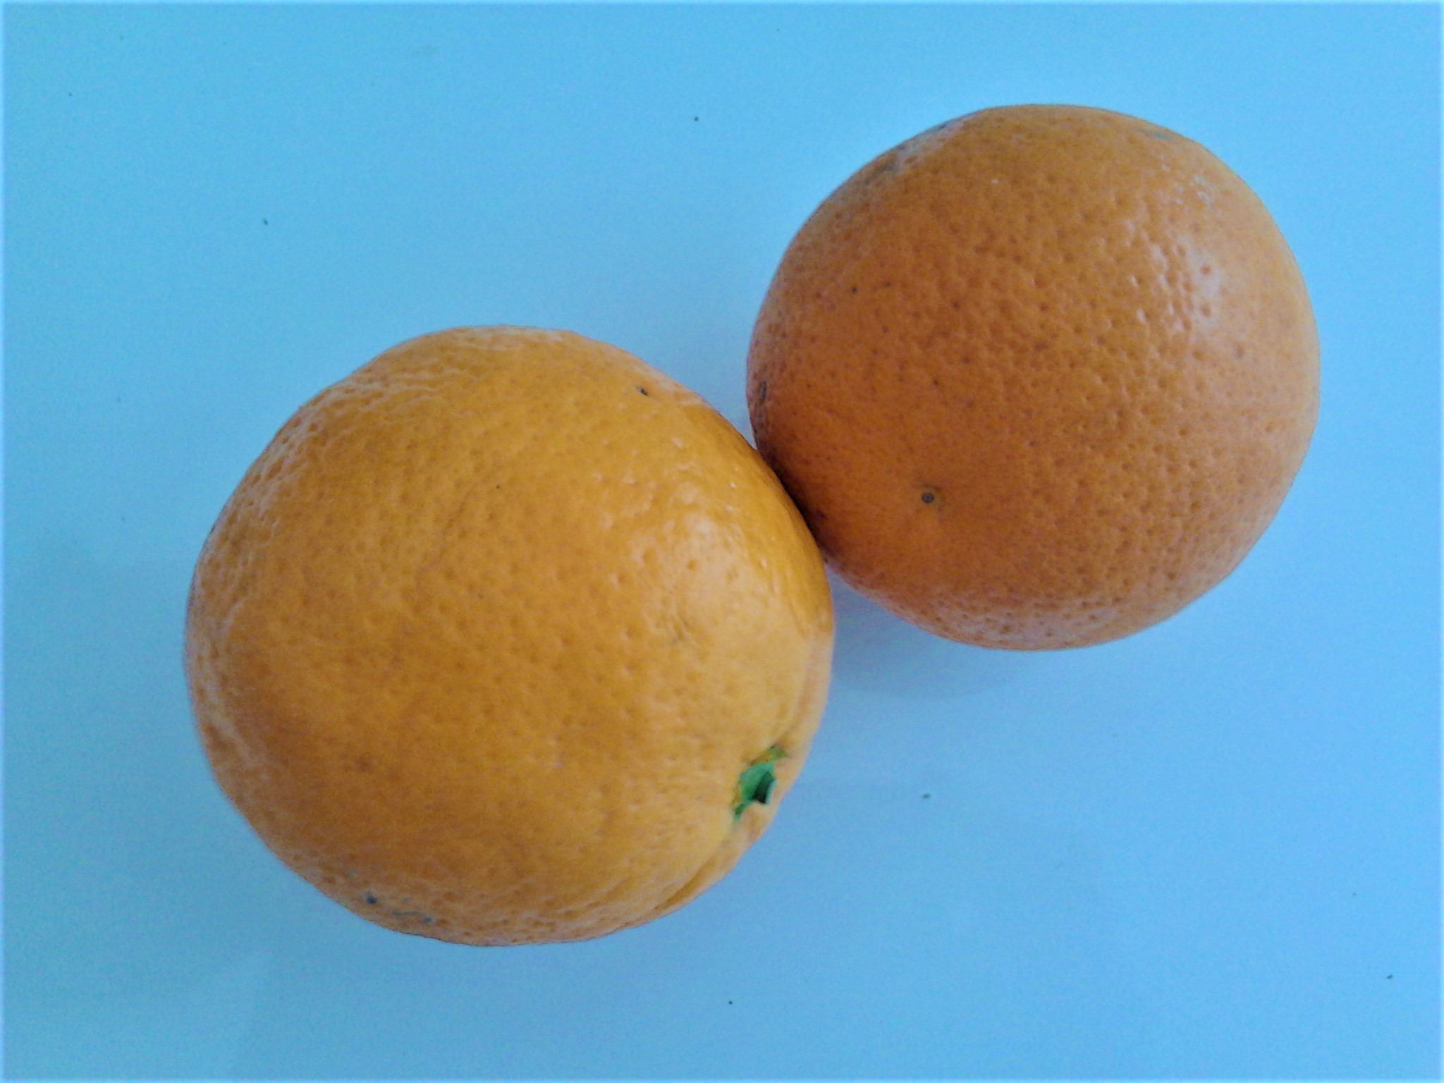
Do you like oranges?
Y
?
N
Y N

Slide 3
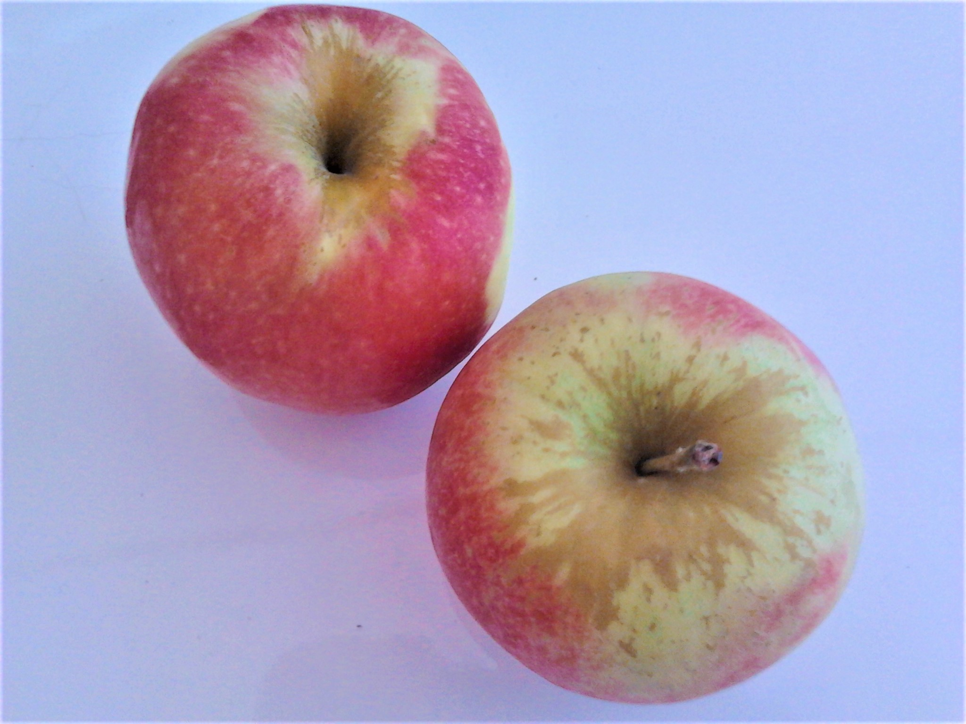
Do you like apples?
Y
?
N
Y N

Slide 4
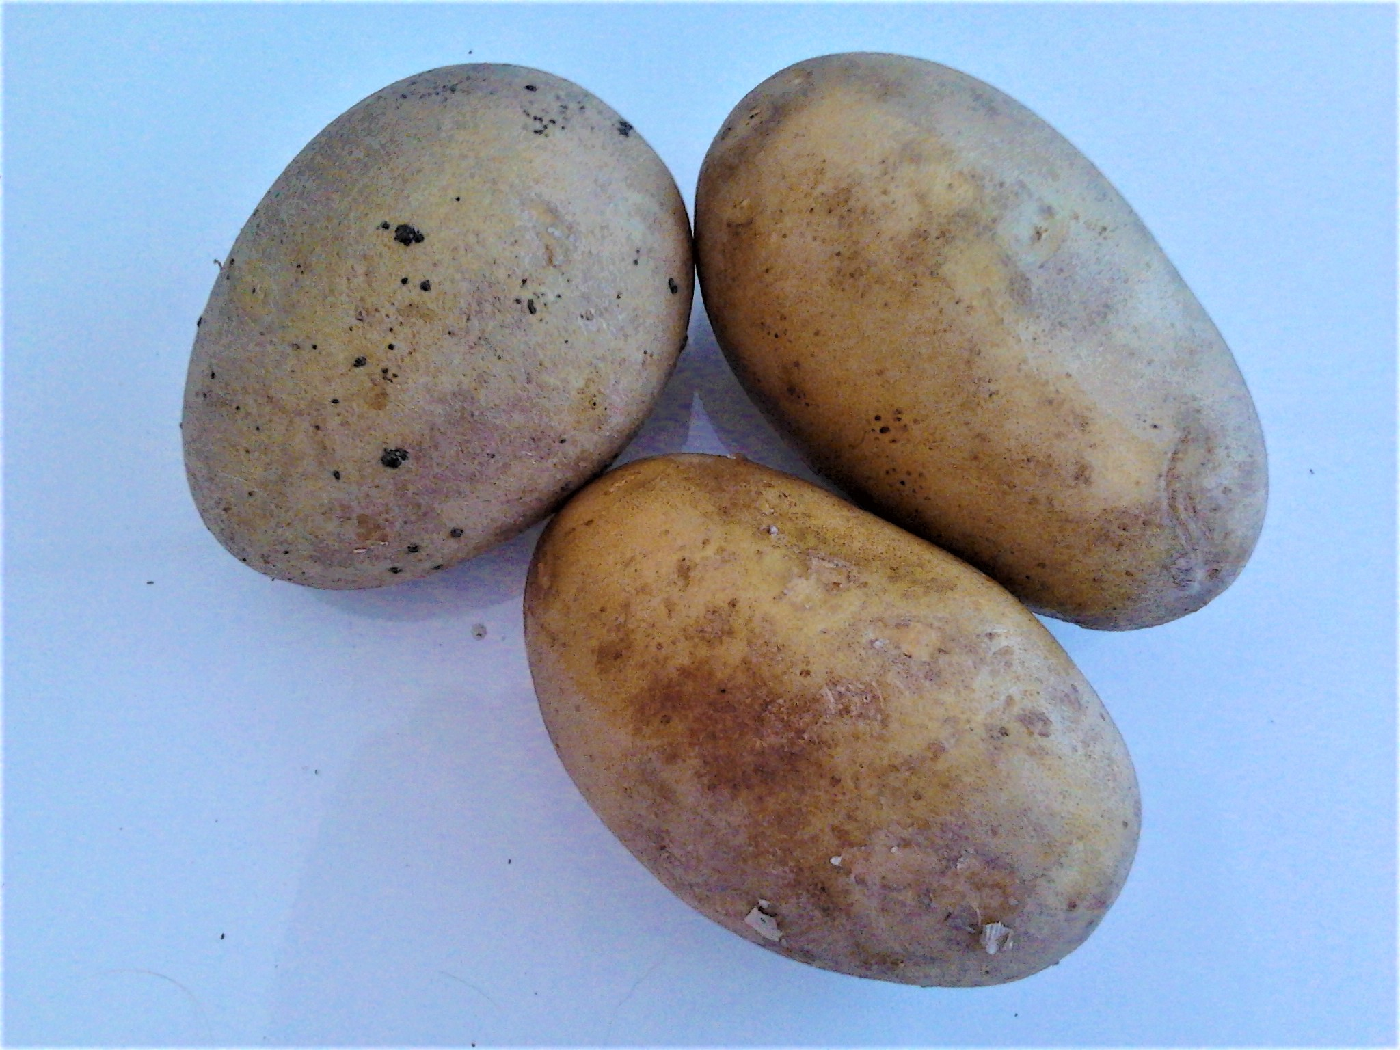
Do you like potatoes?
Y
?
N
Y N

Slide 5
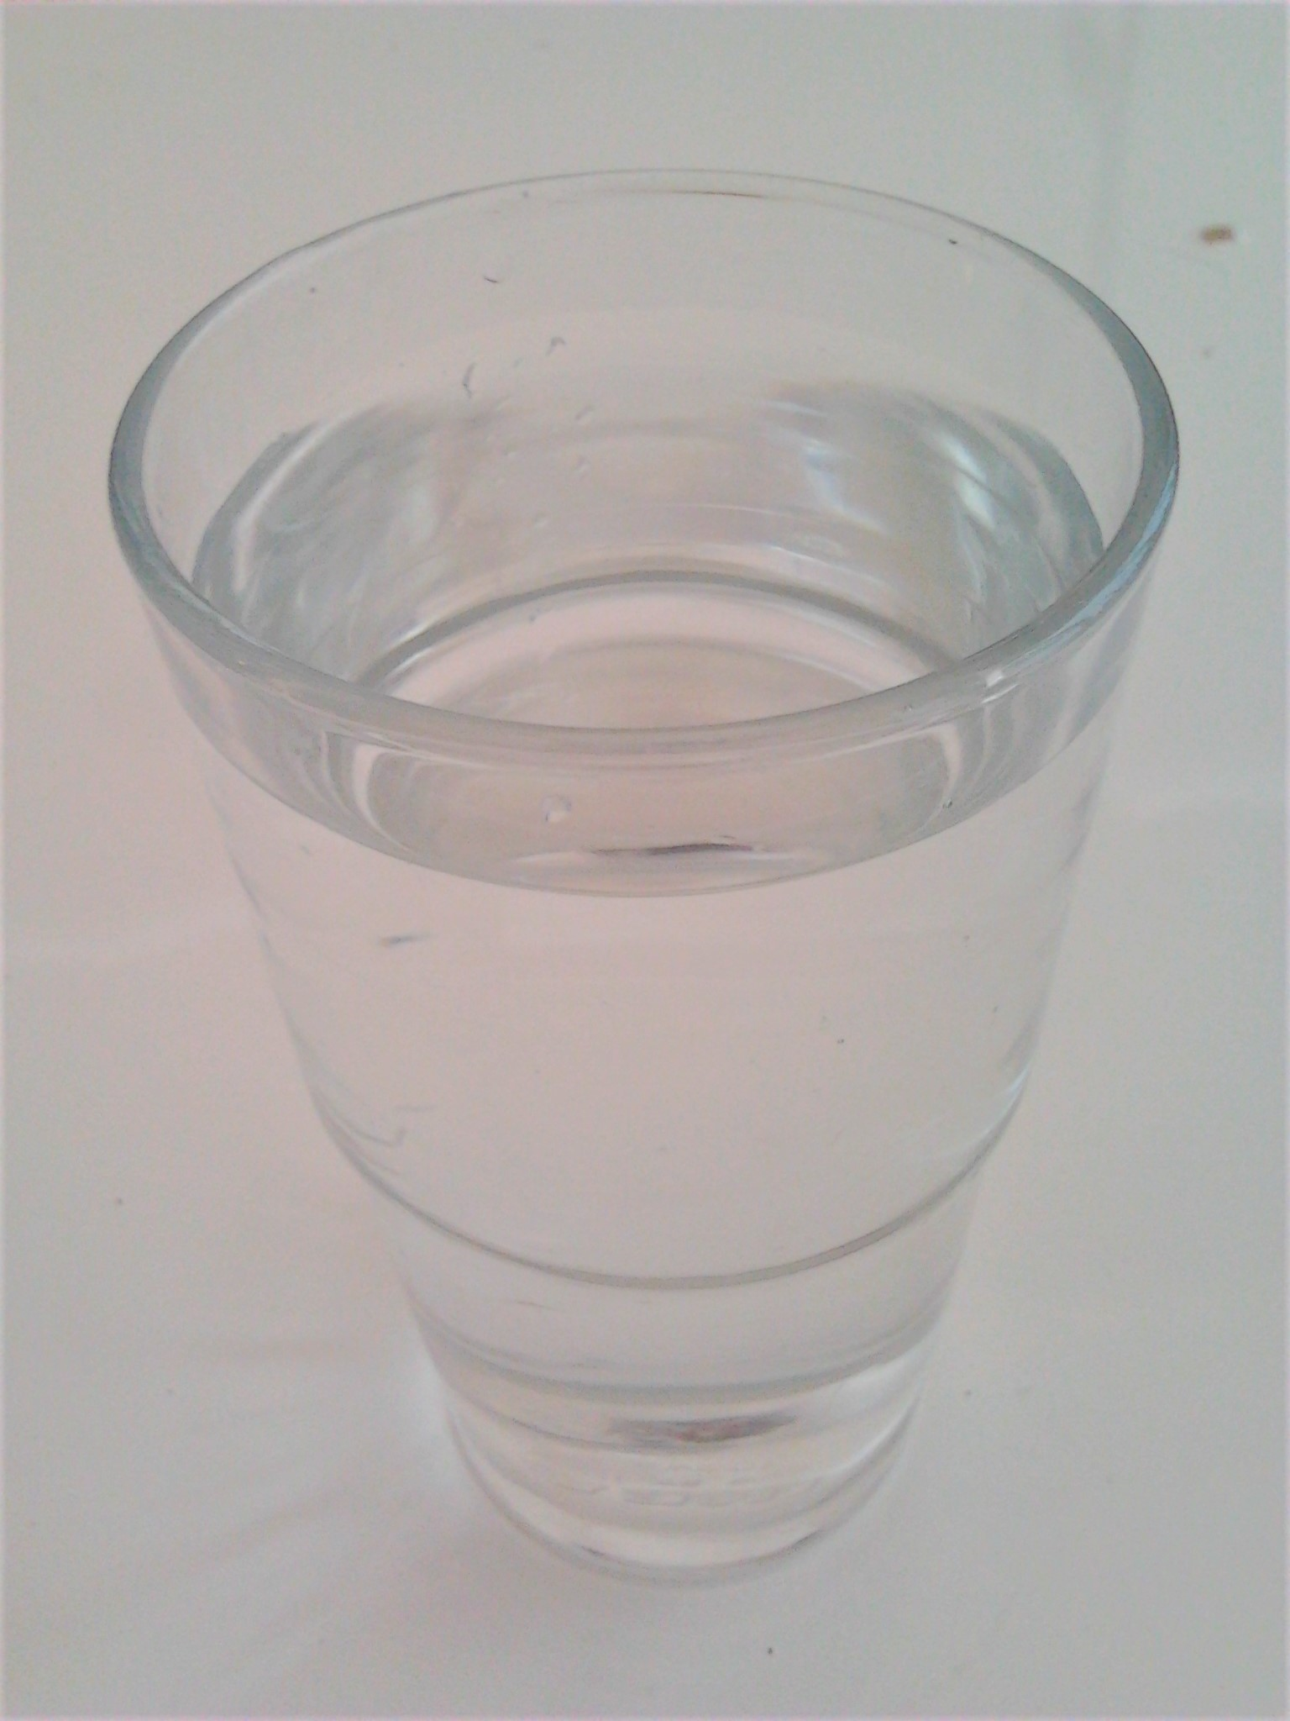
Do you like water?
Yes
?
No
Yes No

Slide 6
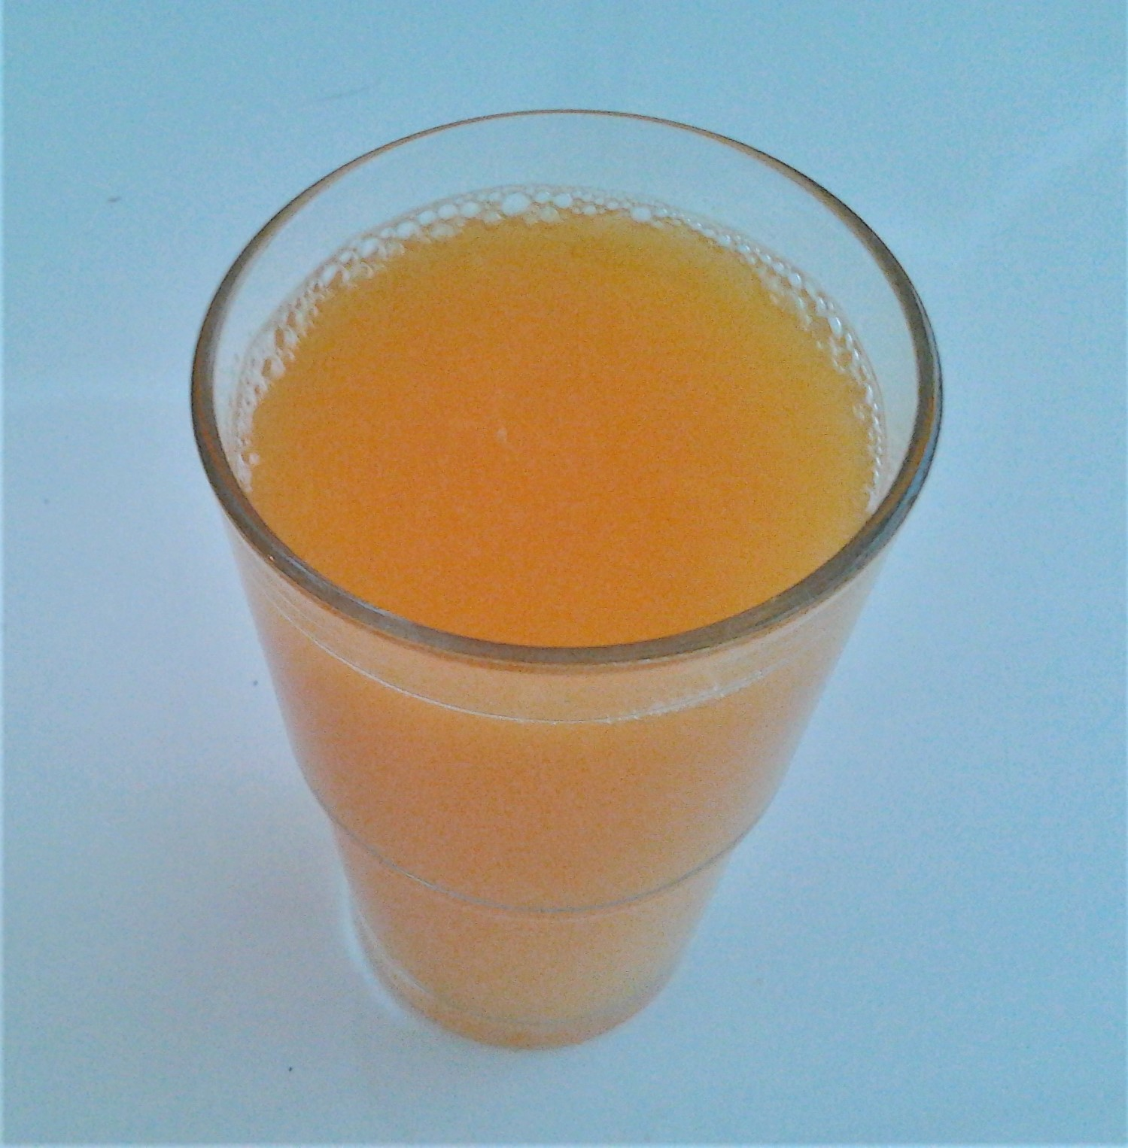
Do you like juice?
Yes
?
No
Yes No

Slide 7
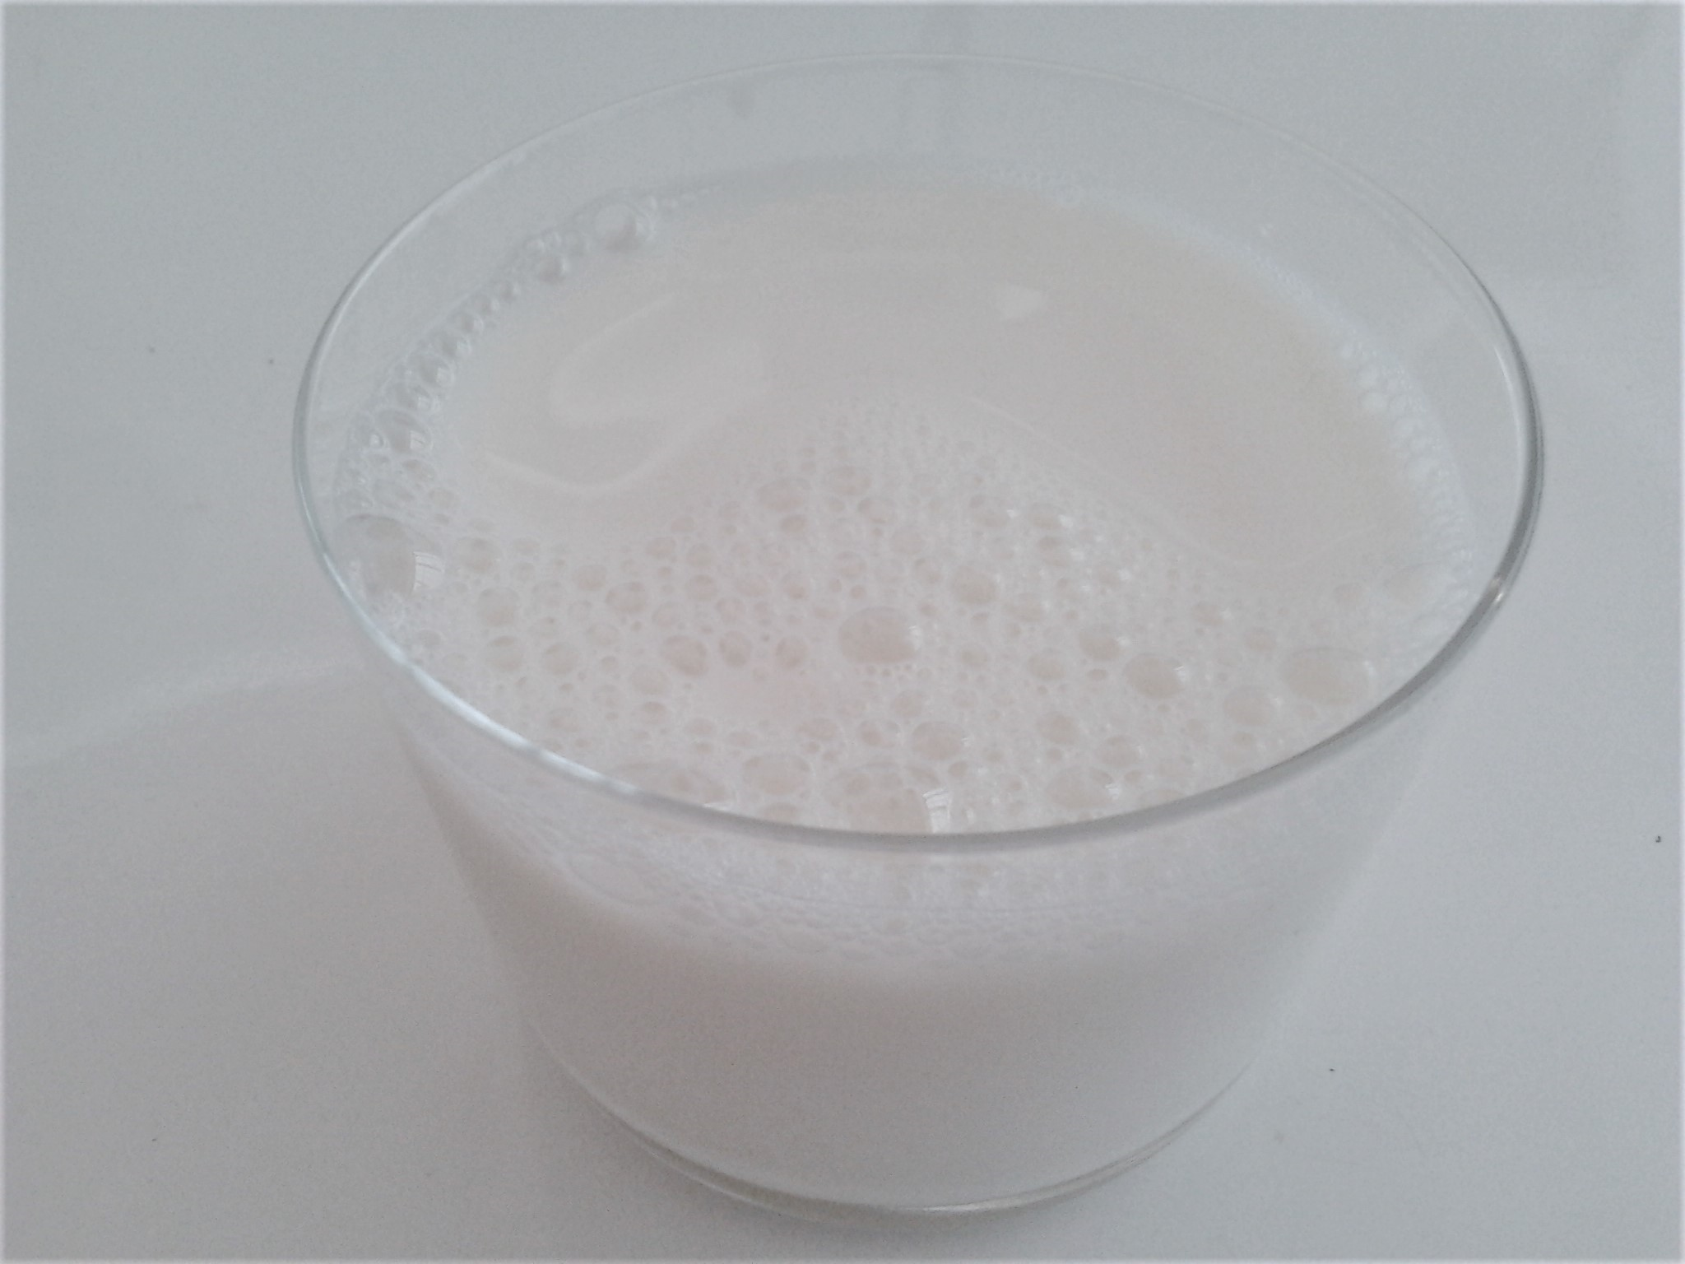
Do you like milk?
Yes
?
No
Yes No

Slide 8
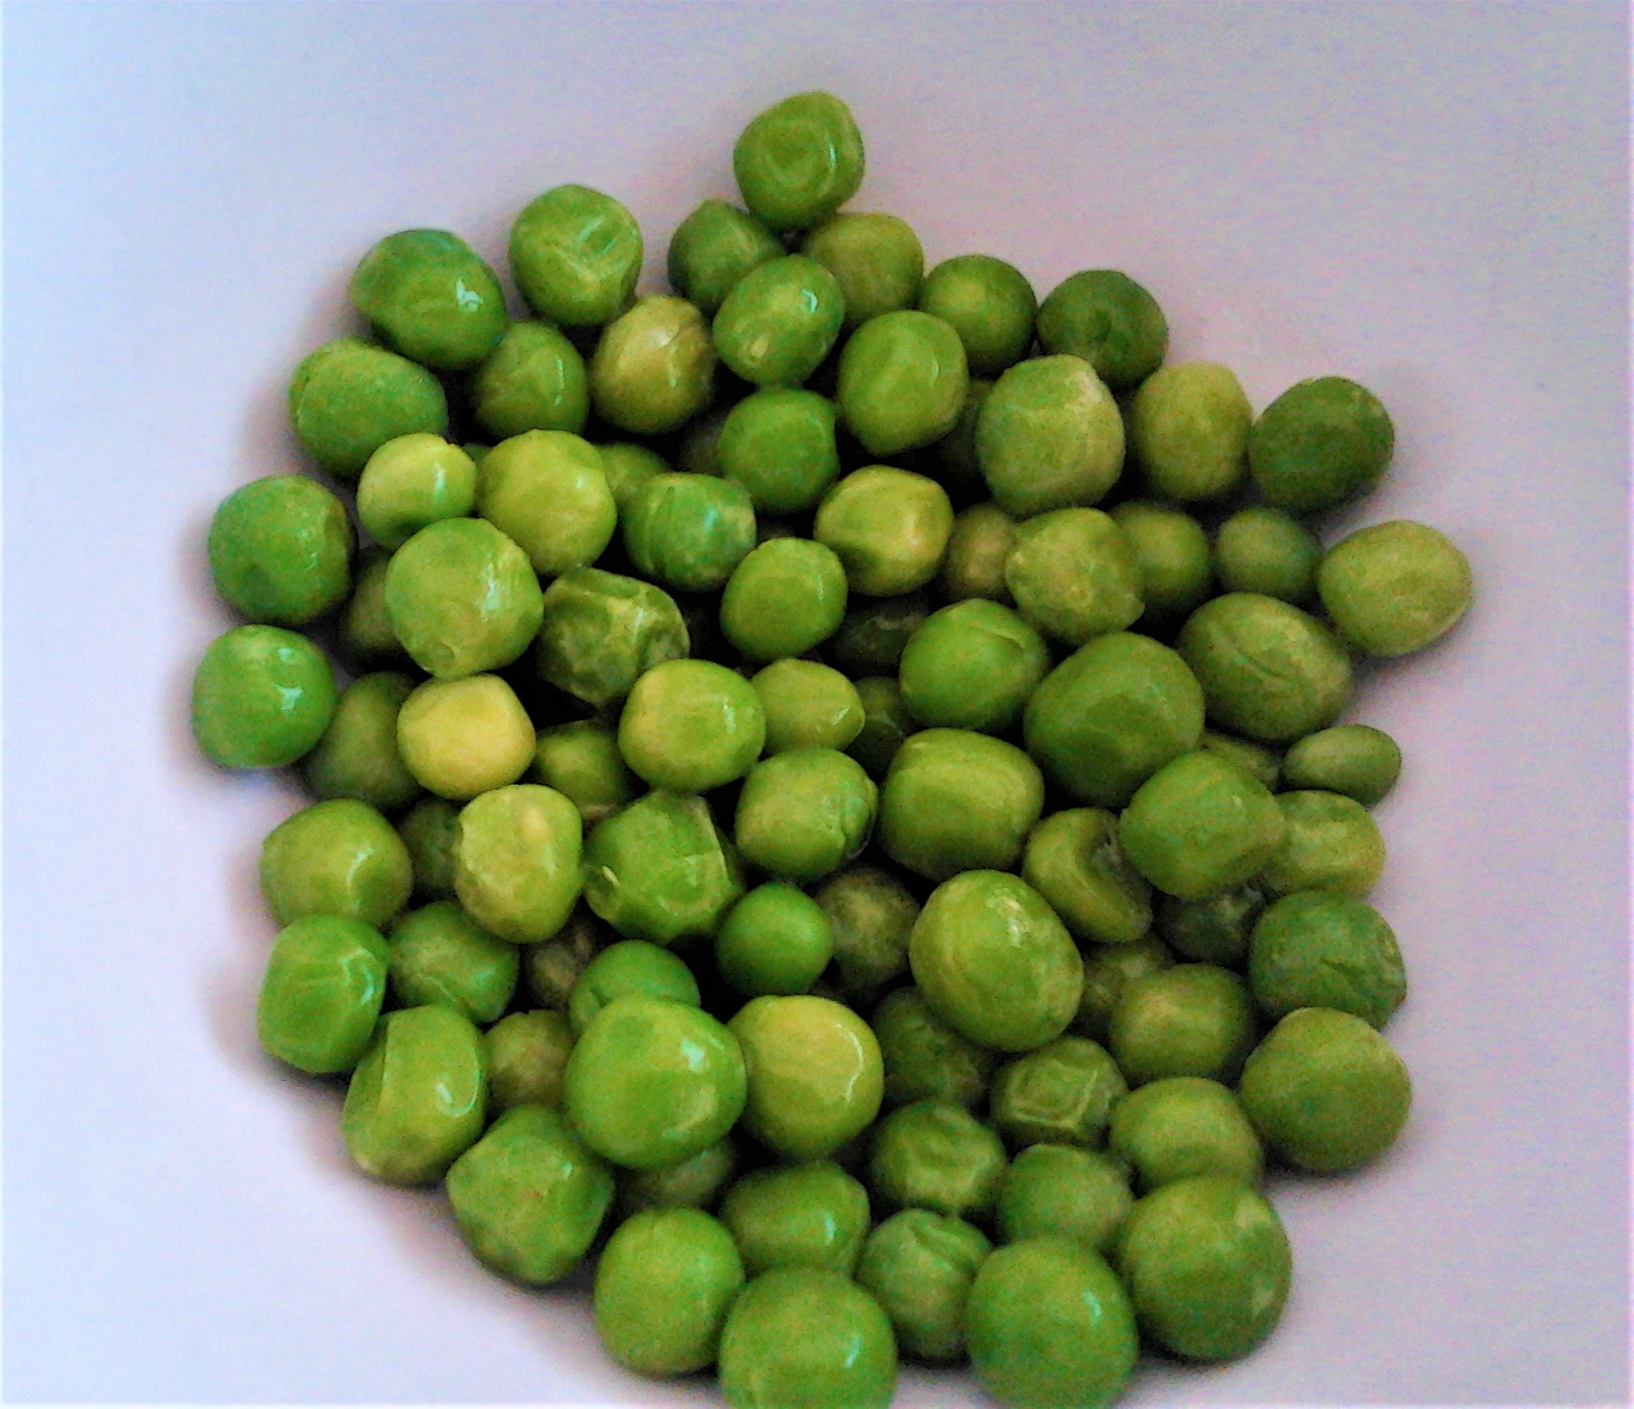
Do you like peas?
Yes, I do.
No, I don’t.
?
I don’t know.

Slide 9
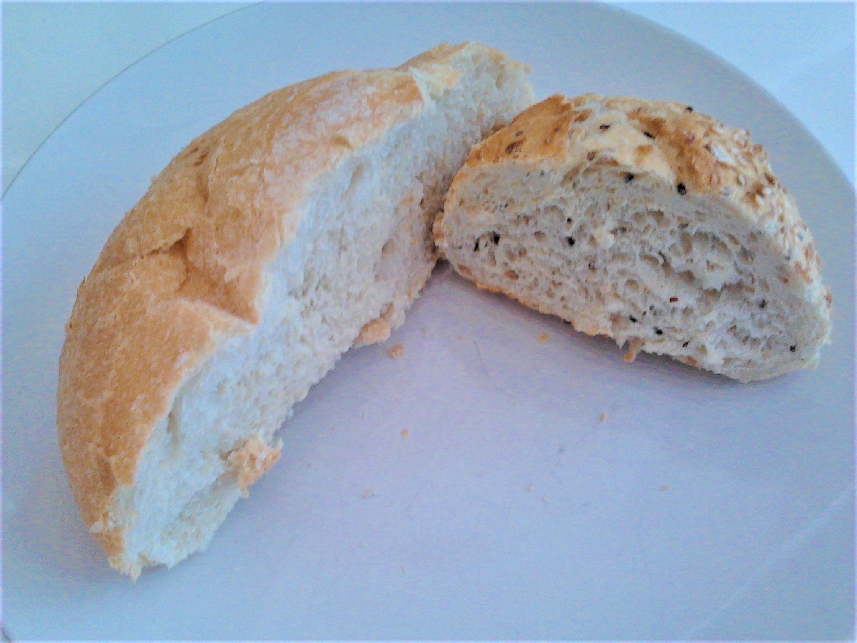
Do you like bread?
Yes, I do.
No, I don’t.
?
I don’t know.

Slide 10
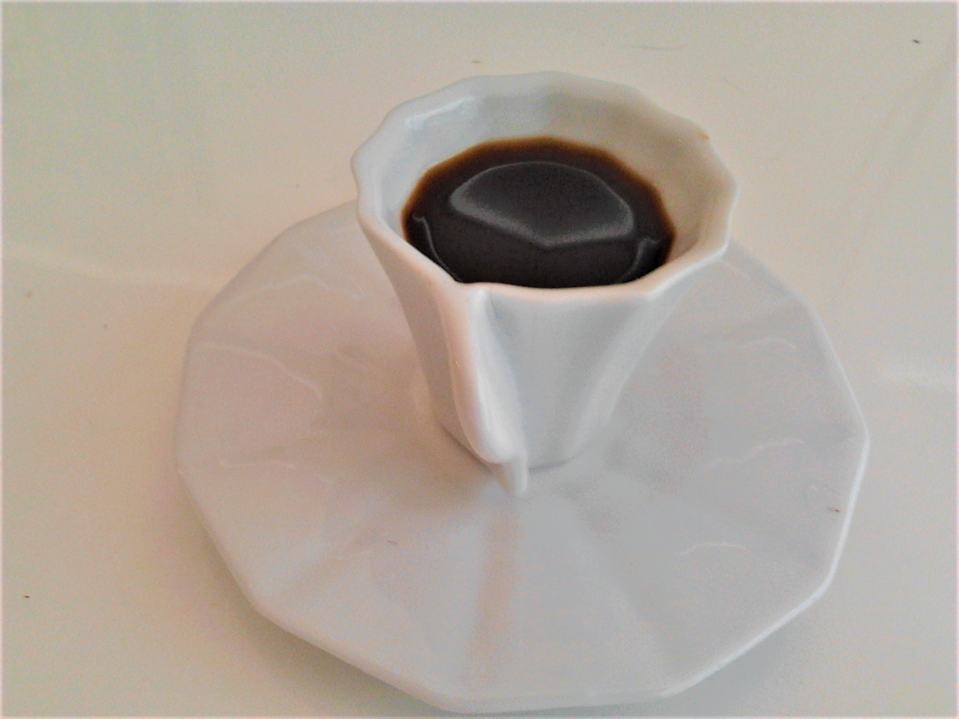
Do you like coffee?
Yes, I do.
No, I don’t.
?
I don’t know.

Slide 11
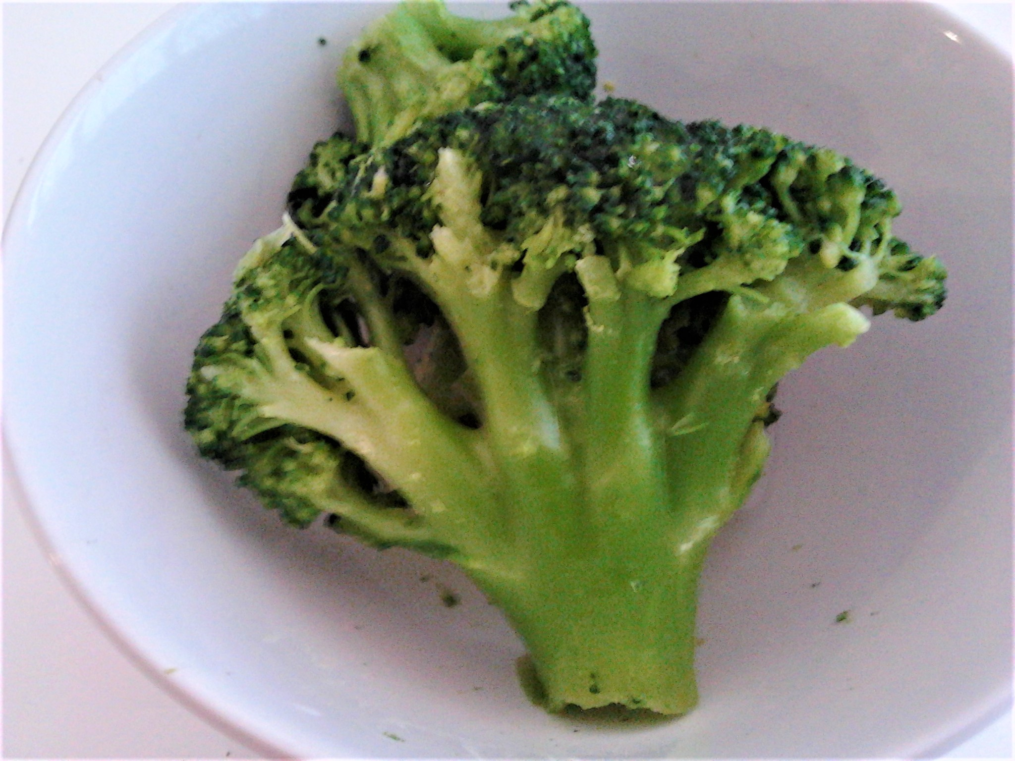
Do you like broccoli?
Yes, I like broccoli.
No, I don’t like broccoli.
?
I don’t know if I like broccoli.

Slide 12
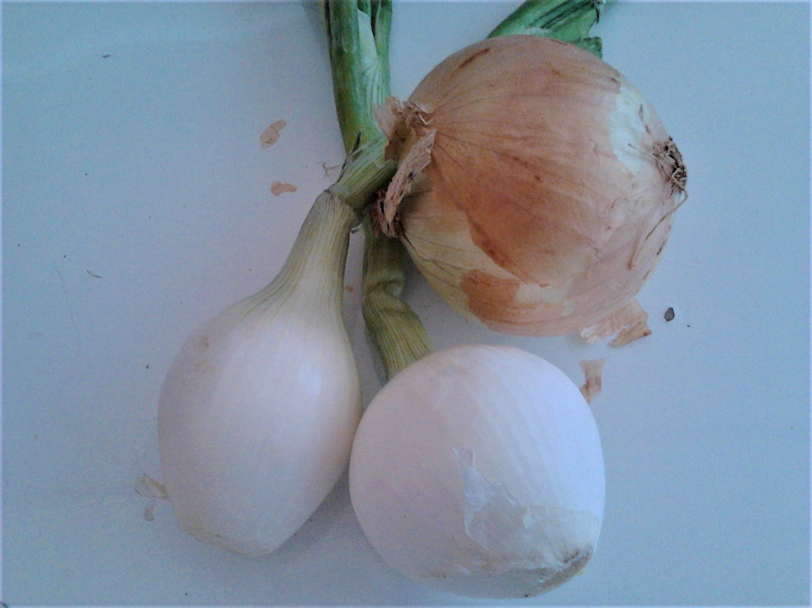
Do you like onions?
Yes, I like onions.
No, I don’t like onions.
?
I don’t know if I like onions.

Slide 13
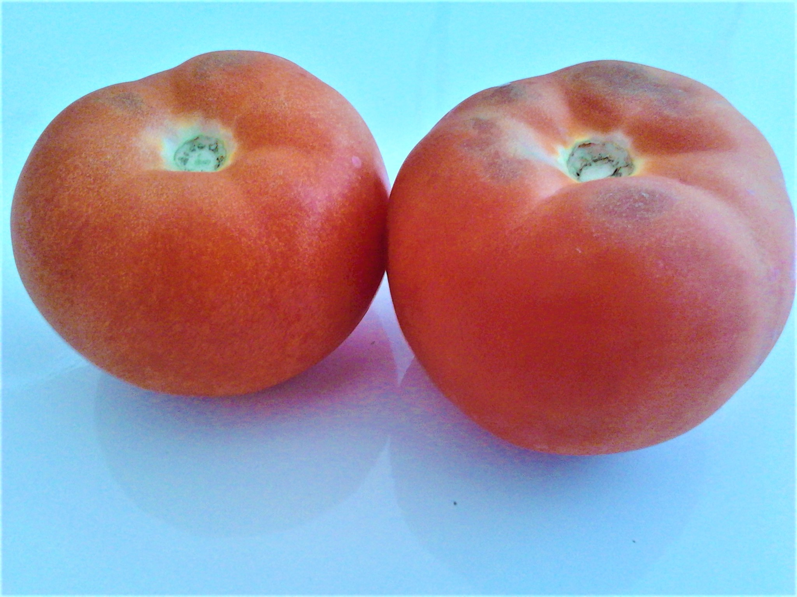
Do you like tomatoes?
Yes, I like tomatoes.
No, I don’t like tomatoes.
?
I don’t know if I like tomatoes.

Slide 14
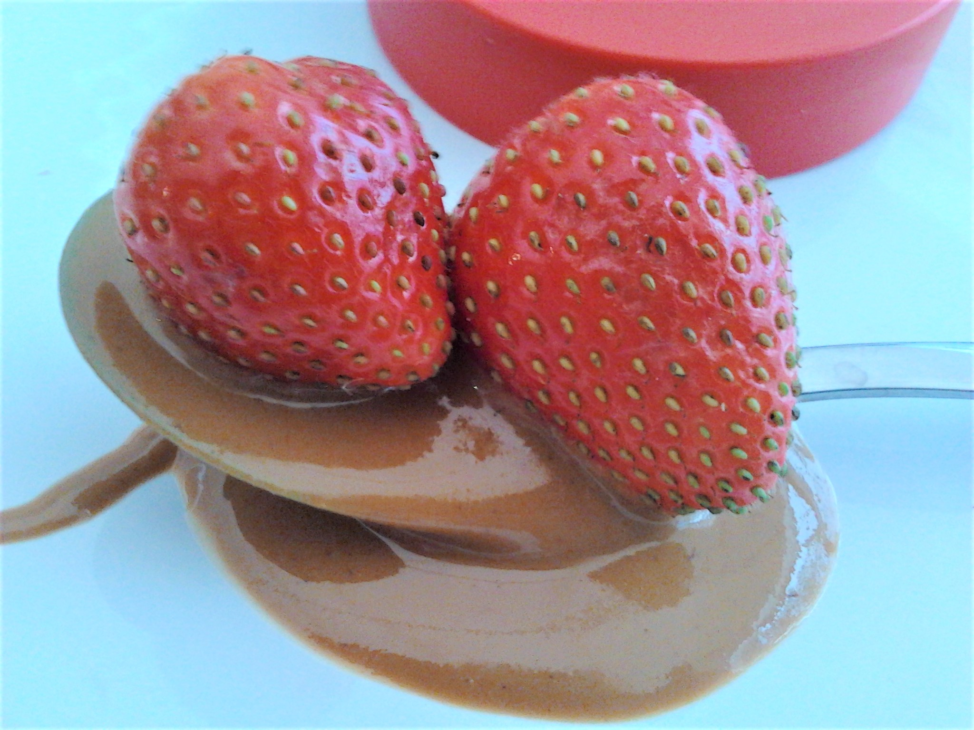
Do you like strawberries with peanut butter?
Yes, I like strawberries
with peanut butter.
No, I don’t like strawberries
with peanut butter.
?
I have never tried strawberries with peanut butter.

Slide 15
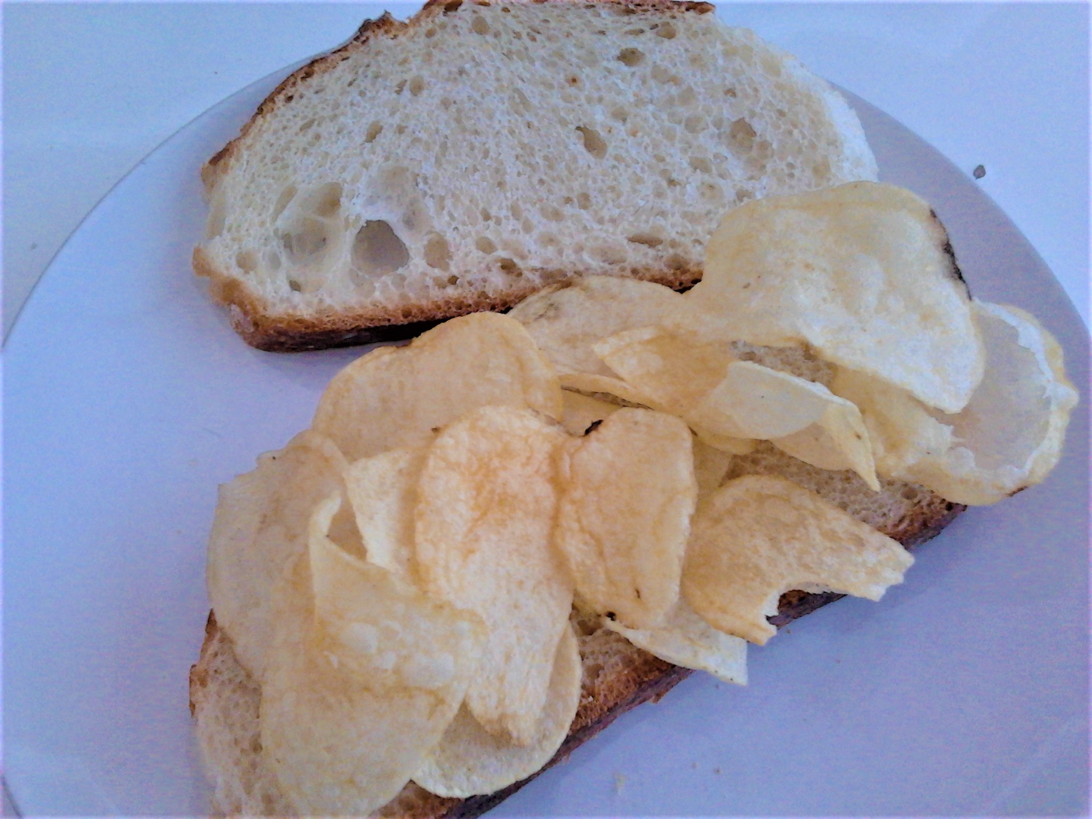
Do you like crisp sandwiches?
Yes, I like crisp
sandwiches.
No, I don’t like crisp
sandwiches.
?
I have never tried crisp sandwiches.

Slide 16
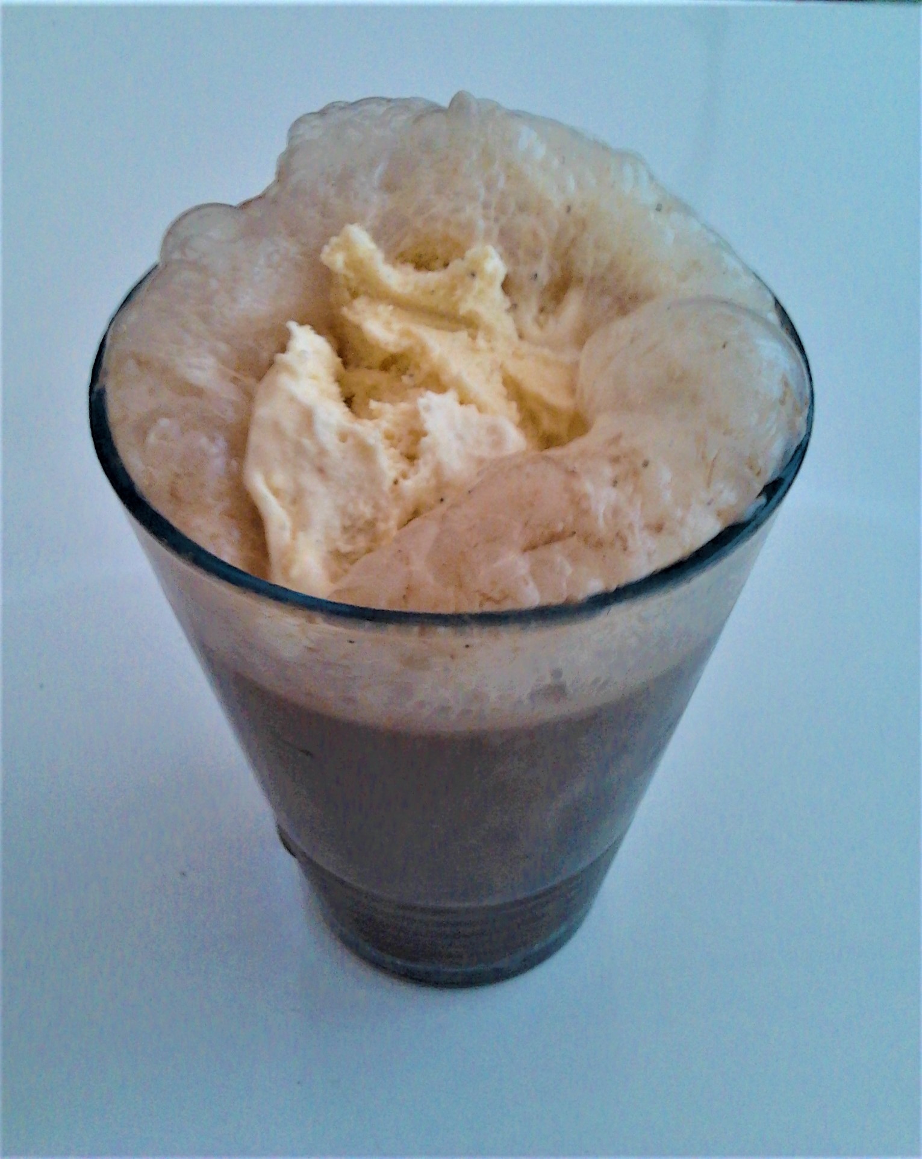
Do you like cola and ice-cream?
Yes, I like
cola and ice-cream.
No, I don’t like
cola and ice-cream.
?
I have never tried cola and ice-cream.

