Slide 1
Counting coins
Refers to Chapter 4: Creative live online teaching on pages 58–61.
PowerPoint slide deck overview
This PowerPoint slide deck contains 45 slides to use in the activity, Counting coins. The coin featured is an Edward VII bronze penny taken from the author’s personal coin collection. The first slide shows one penny, the second two, and so on.
With your learners’ microphones all activated, count together using the slides up to 20. When you get to 20, then count backwards. In terms of support, you can see that the number word appears next to each coin in the sequence, though these could be replaced by numerals for more difficult conversion tasks.
There is also a version without the number words and a couple of slides with up to 40 coins on them, all in open format so you can modify them to suit your own classes.
In the variation with a pale coin image, learners have to locate and type the ‘missing’ coin number into the chat box.
This is not a conversion activity proper – more of a transfer or copying task – but you can accommodate all learners by saying: If you need to look, that’s fine; if you don’t need to look, that’s magic! This ‘only look [at the support] if you have to’ message is a perfectly fine motto for your learners.

Slide 2
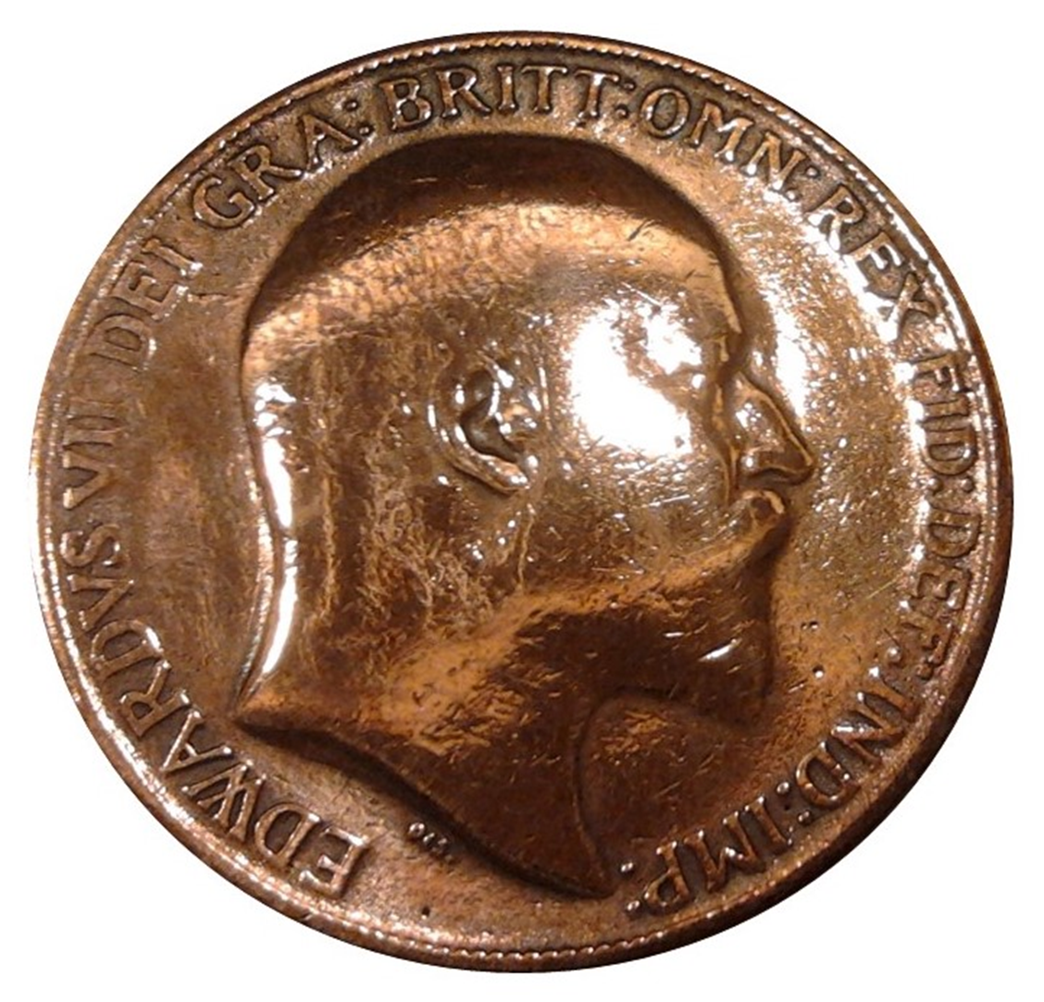
one

Slide 3
two
one

Slide 4
three
two
one

Slide 5
four
three
two
one

Slide 6
five
four
three
two
one

Slide 7
five
four
three
two
one
six

Slide 8
five
four
three
two
seven
one
six

Slide 9
five
four
three
eight
two
seven
one
six

Slide 10
five
four
nine
three
eight
two
seven
one
six

Slide 11
five
ten
four
nine
three
eight
two
seven
one
six

Slide 12
five
ten
four
nine
three
eight
two
seven
one
six
eleven

Slide 13
five
ten
four
nine
three
eight
twelve
two
seven
one
six
eleven

Slide 14
five
ten
four
nine
eight
thirteen
three
twelve
two
seven
one
six
eleven

Slide 15
five
ten
four
nine
fourteen
eight
thirteen
three
twelve
two
seven
one
six
eleven

Slide 16
five
ten
fifteen
four
nine
fourteen
eight
thirteen
three
twelve
two
seven
one
six
eleven

Slide 17
five
ten
fifteen
four
nine
fourteen
eight
thirteen
three
twelve
two
seven
one
six
eleven
sixteen

Slide 18
five
ten
fifteen
four
nine
fourteen
eight
thirteen
three
twelve
seventeen
two
seven
one
six
eleven
sixteen

Slide 19
five
ten
fifteen
four
nine
fourteen
eight
thirteen
eighteen
three
twelve
seventeen
two
seven
one
six
eleven
sixteen

Slide 20
five
ten
fifteen
four
nine
fourteen
nineteen
eight
thirteen
eighteen
three
twelve
seventeen
two
seven
one
six
eleven
sixteen

Slide 21
five
ten
fifteen
twenty
four
nine
fourteen
nineteen
eight
thirteen
eighteen
three
twelve
seventeen
two
seven
one
six
eleven
sixteen

Slide 22
Random numbers
‘Missing’

Slide 23
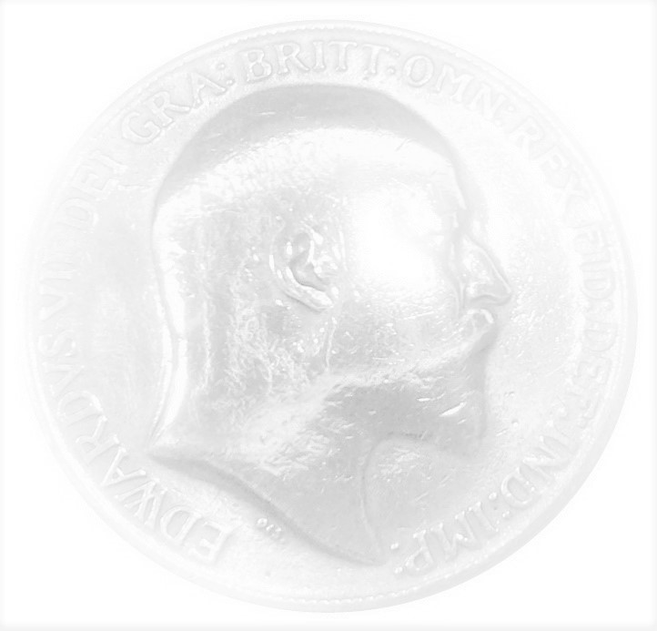
five
ten
fifteen
twenty
four
nine
fourteen
nineteen
eight
thirteen
eighteen
three
twelve
seventeen
two
seven
one
six
eleven
sixteen

Slide 24
five
ten
fifteen
twenty
four
nine
fourteen
nineteen
eight
thirteen
eighteen
three
twelve
seventeen
two
seven
one
six
eleven
sixteen

Slide 25
five
ten
fifteen
twenty
four
nine
fourteen
nineteen
eight
thirteen
eighteen
three
twelve
seventeen
two
seven
one
six
eleven
sixteen

Slide 26
five
ten
fifteen
twenty
four
nine
fourteen
nineteen
eight
thirteen
eighteen
three
two
seven
twelve
seventeen
one
six
eleven
sixteen

Slide 27
five
ten
fifteen
twenty
four
nine
fourteen
nineteen
eight
thirteen
eighteen
three
two
twelve
seventeen
seven
one
six
eleven
sixteen

Slide 28
five
ten
fifteen
twenty
four
nine
fourteen
nineteen
eight
thirteen
eighteen
three
two
seven
twelve
seventeen
one
six
eleven
sixteen

Slide 29
five
ten
fifteen
twenty
four
nine
fourteen
nineteen
eight
thirteen
eighteen
three
two
seven
twelve
seventeen
one
six
eleven
sixteen

Slide 30
five
ten
fifteen
twenty
four
nine
fourteen
nineteen
eight
thirteen
eighteen
three
two
seven
twelve
seventeen
one
six
eleven
sixteen

Slide 31
five
ten
fifteen
twenty
four
nine
fourteen
nineteen
eight
thirteen
eighteen
three
two
seven
twelve
seventeen
one
six
eleven
sixteen

Slide 32
five
ten
fifteen
twenty
four
nine
fourteen
nineteen
eight
thirteen
eighteen
three
two
seven
twelve
seventeen
one
six
eleven
sixteen

Slide 33
five
ten
fifteen
twenty
four
nine
fourteen
nineteen
eight
thirteen
eighteen
three
two
twelve
seventeen
seven
one
six
eleven
sixteen

Slide 34
five
ten
fifteen
twenty
four
nine
fourteen
nineteen
eight
thirteen
eighteen
three
two
seven
twelve
seventeen
one
six
eleven
sixteen

Slide 35
five
ten
fifteen
twenty
four
nine
fourteen
nineteen
eight
thirteen
eighteen
three
two
seven
twelve
seventeen
one
six
eleven
sixteen

Slide 36
five
ten
fifteen
twenty
four
nine
fourteen
nineteen
eight
thirteen
eighteen
three
two
seven
twelve
seventeen
one
six
eleven
sixteen

Slide 37
five
ten
fifteen
twenty
four
nine
fourteen
nineteen
eight
thirteen
eighteen
three
two
seven
twelve
seventeen
one
six
eleven
sixteen

Slide 38
five
ten
fifteen
twenty
four
nine
fourteen
nineteen
eight
thirteen
eighteen
three
two
seven
twelve
seventeen
one
six
eleven
sixteen

Slide 39
five
ten
fifteen
twenty
four
nine
fourteen
nineteen
eight
thirteen
eighteen
three
two
seven
twelve
seventeen
one
six
eleven
sixteen

Slide 40
five
ten
fifteen
twenty
four
nine
fourteen
nineteen
eight
thirteen
eighteen
three
two
seven
twelve
seventeen
one
six
eleven
sixteen

Slide 41
five
ten
fifteen
twenty
four
nine
fourteen
nineteen
three
eight
thirteen
eighteen
twelve
seventeen
two
seven
one
six
eleven
sixteen

Slide 42
five
ten
fifteen
twenty
four
nine
fourteen
nineteen
three
eight
thirteen
eighteen
two
seven
twelve
seventeen
one
six
eleven
sixteen

Slide 43
five
ten
fifteen
twenty
four
nine
fourteen
nineteen
three
eight
thirteen
eighteen
two
seven
twelve
seventeen
one
six
eleven
sixteen

Slide 44
Additional images

