Slide 1
First Impressions Learning through reflection

Slide 2
First Impressions
Learning Objectives
Participants will recognise that first impressions can impact on how we perceive other people.
Participants will be able to consider how first impressions may impact on the care and treatment people receive
Participants will be able to consider the first impression they want to give to others and reflect on whether they present in this way?

Slide 3
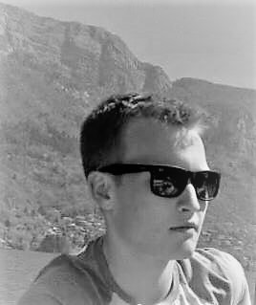
Who is this? Note five things you think about this person?

Slide 4
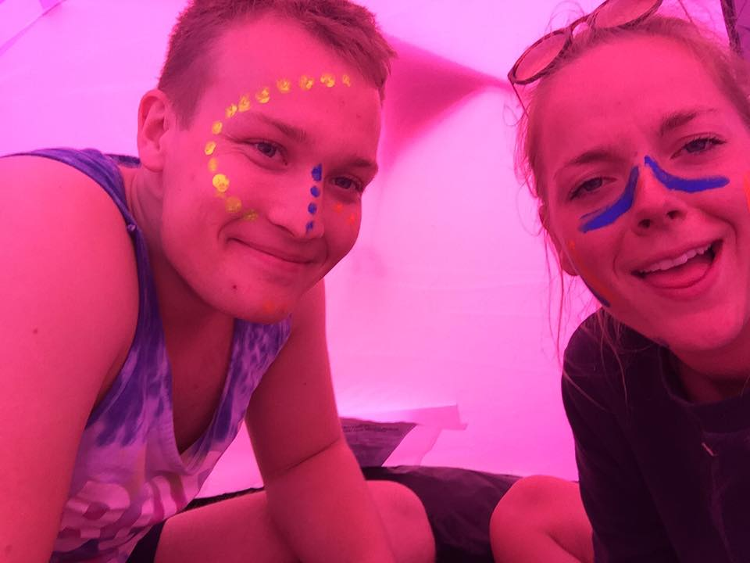
Does this change what you think about him? What about the girl?

Slide 5
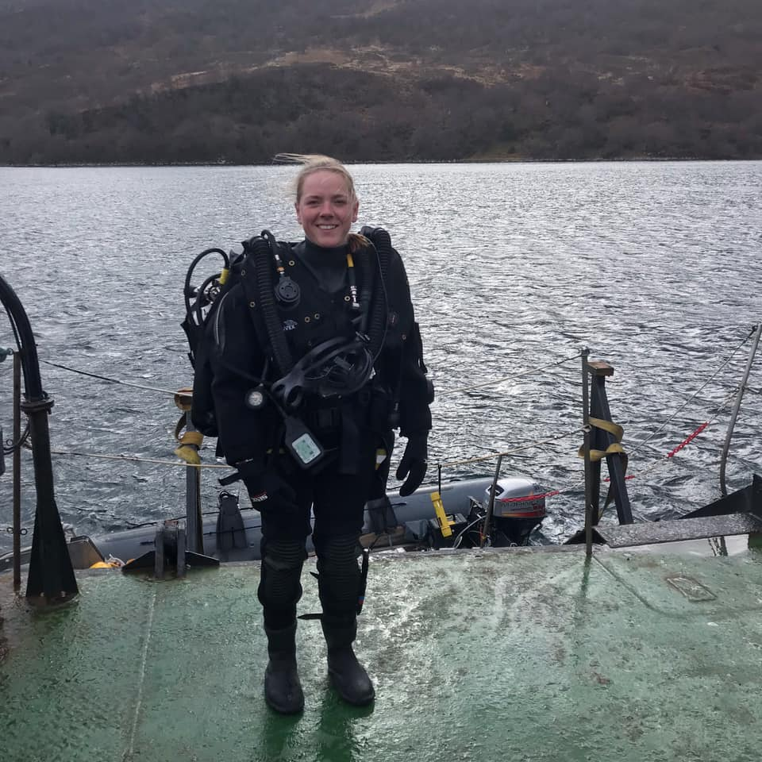
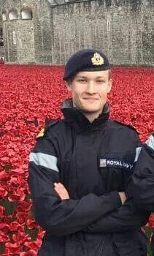
They are two Royal Navy lieutenants, who have both served several operational tours in the Gulf. Has that changed how you think about them?

Slide 6
They are two Royal Navy lieutenants, who have both served several operational tours in the Gulf. Has that changed how you think about them?

