Slide 1
Diversity and Inclusion Learning through reflection

Slide 2
Diversity and Inclusion
Learning Objectives
Participants will understand where their views on people with protected characteristics come from.
Participants will be able to understand that perception and reality may not be the same
Participants may begin to understand how they could improve the service they offer hard to reach groups

Slide 3
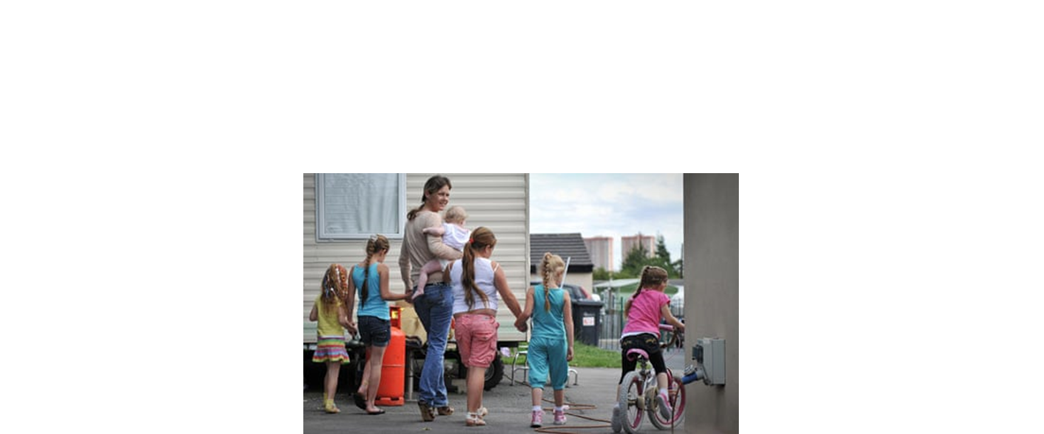

Slide 4
Consider the barriers Access to services Attitudes of others and public perception A discomfort with difference Media portrayal Way of life/cultural practices Financial

