Slide 1
Aims
Slide 1.1
To understand why desensitisation/familiarisation is an essential process in enabling people with a learning disability to access health screening.
2. To gain an awareness of the framework and practical tools that can be applied through the desensitisation process to enable successful health screening.

Slide 2
Objectives (1)
Slide 1.2
By the end of the training you will be able to:
State what health screening is and why it is important.
List what potential barriers to accessing health screening people with a learning disability have.
Apply reasonable adjustments to reduce the barriers.

Slide 3
Objectives (2)
Slide 1.3
Support an individual through the desensitisation process using the tools in this training session.
Apply the practical skills you learn to people with a learning disability that you currently support.
Enable the individuals you support to have positive health screening experiences.

Slide 4
Getting to know each other
Slide 1.4
Ask your partner:
Their name.
What is their experience of working with/ caring for people with learning disabilities.
What they understand desensitisation to be.

Slide 5
Professionals’ introduction
Slide 1.5
In groups of 3 or 4 look at your scenario. 1 person will be the service user. 1 person will be the nurse. 1 or 2 people to be observers.
Role play your scenario. The observer should look at what went well and what did not go well.

Slide 6
What is health screening?
Slide 1.6
Tests carried out by doctors, nurses and health professionals e.g. blood tests, physical examinations.
Identifies people who are at high risk of disease.
Identifies further treatment required.

Slide 7
Why is health screening important?
Slide 1.7
Identifies risk factors and risk markers.
Prevents progression into the condition.
Identifies diseases present.
Leads to detection, therefore increasing chances of survival.

Slide 8
Types of health screening available
Slide 1.8
Diabetic eye screening.
Abnormal aortic aneurysms.
Breast.
Cervical.
Bowel.

Slide 9
Health screening in pregnancy
Slide 1.9
Screening for infectious diseases.
Screening for Down's syndrome, Patau's syndrome and Edwards' syndrome.
Screening for sickle cell disease and thalassaemia.
Screening for physical abnormalities (mid-pregnancy scan).

Slide 10
Health screening in newborn babies
Slide 1.10
A physical examination, which includes the eyes, heart, hips and testes.
A hearing test.
A blood spot test to check if the baby has any of nine rare conditions.

Slide 11
Annual health checks
Slide 1.11
The Annual Health Check Scheme for people with learning disabilities.
NHS 40-74 Health Check.

Slide 12
Generalised issues
Slide 1.12
Communication.
Difficulty with comprehension.
Sensory impairments.

Slide 13
Evidence
Slide 1.13
Valuing People Now (Department of Health, 2009).
Death by Indifference (Mencap, 2012).
Six Lives report (Department of Health, 2010).
The Confidential Inquiry into Premature Deaths of People with Intellectual Disabilities in the UK: A population-based study (CIPOLD) (Heslop et al, 2013).
Our Health, Our Care, Our Say (Department of Health, 2006).

Slide 14
What is anxiety?
Slide 1.14
A combination of feelings of fear and unease, with physical symptoms.
Fight or flight response.
We feel anxiety at times that provoke nervous feelings such as sitting an exam, starting a new job etc.
(MIND, 2015a)

Slide 15
What is a phobia?
Slide 1.15
A phobia is when a person suffers an extreme form of fear that may be triggered by a situation, place or object, even when there are no signs of clear danger (MIND, 2015b).

Slide 16
Symptoms of anxiety (1)
Slide 1.16
Physical symptoms:
Nausea.
Tense muscles.
Pins and needles.
Fast breathing.
Feeling light headed and dizzy.
Sweating/hot flushes.
Raised blood pressure.
Needing the toilet more often.

Slide 17
Symptoms of anxiety (2)
Slide 1.17
Psychological symptoms:
Feeling tense/nervous.
Feeling of dread.
Dwelling on negative experiences.
Feeling restless.
Feeling numb.
(MIND, 2016)

Slide 18
Symptoms of a phobia
Slide 1.18
Feeling dizzy.
A feeling of choking.
Sweating.
Hot or cold flushes.
Vomiting.
Numbness or tingling sensations/trembling or shaking.
Fear of fainting.
Fear of death.

Slide 19
Treatments for anxiety and phobias
Slide 1.19
Relaxation techniques.
Systematic desensitisation.
Mindfulness.
Role playing.
Progressive muscle relaxation.
Focused breathing.
Sounds and music.
Medication.
Talking therapies/cognitive behaviour therapy (CBT).
Faith/spirituality.
Complimentary therapies.
Exercise.
Healthy eating.
Avoiding alcohol and caffeine/stimulants.
Support groups.

Slide 20
What is desensitisation?
Slide 1.20
Desensitisation is when anxiety is reduced by gradually getting used to the object or situation which causes fear (Neil et al, 2007).

Slide 21
Three steps to desensitisation
Slide 1.21
Step 1: Develop a fear hierarchy.
Step 2: Relaxation techniques.
Step 3: Exposure to the phobic situation.

Slide 22
Fear of clowns (graded approximation)
Slide 1.22
Activity | Fear level (0-100)
Going to the circus. | 90
Watching a DVD of a real clown. | 80
Watching a cartoon of a clown. | 50
Looking at a picture of a clown. | 40
Talking about clowns. | 30

Slide 23
The screening process
Slide 2.1
The screening tool identifies:
Clinical priority.
One-to-one input, desensitisation clinic and/or carer education.
Onward referral or signposting e.g. speech and language therapy.

Slide 24
Barriers to health screening (1)
Slide 2.2
Environment: buildings, medical staff, equipment.
Past experiences: pain, restraint, sedation, fear, anxiety, emergencies.
Waiting times: anxiety.

Slide 25
Barriers to health screening (2)
Slide 2.3
Communication.
Support.
Sensory issues: autism spectrum disorder, sight, sound, touch, personal space, behaviour.

Slide 26
Reasonable adjustments (1)
Slide 2.4
The Confidential Inquiry into Premature Deaths of People with Learning Disabilities (CIPOLD) (Heslop et al, 2013) identifies the lack of reasonable adjustments to facilitate healthcare for people with learning disabilities.

Slide 27
Reasonable adjustments (2)
Slide 2.5
Removing physical barriers.
Ensuring equality by making alterations to policies, procedures, staff training and service delivery.
Must be considered in advance.
(Hatton et al, 2011)

Slide 28
Examples of reasonable adjustments (1)
Slide 2.6
Double length appointments.
First appointment to reduce waiting time.
Pre-appointment visits to familiarise with environment.
Easy Read information.

Slide 29
Examples of reasonable adjustments (2)
Slide 2.7
Support from LD practitioner.
Access to health checks.
Access to health action plans.
Home visits.

Slide 30
The Mental Capacity Act (2005)
Slide 2.8
The Mental Capacity Act (2005) says that we must help people to make their own decisions where possible.
When a person cannot make their own decisions, other people have to decide what is in their best interest.

Slide 31
The principles
Slide 2.9
Always assume capacity.
All feasible steps to help the individual make a decision must be in place.
Individuals are allowed to make unwise decisions.
Least restrictive option.

Slide 32
Valid consent
Slide 2.10
Competent.
Acting voluntarily.
Provided with enough information.
(Department of Health, 2003)

Slide 33
Capacity
Slide 2.11
Comprehend and retain information.
Understand the consequences.
Use and weigh this information in the decision-making process.

Slide 34
When would you assess capacity? (1)
Slide 2.12
When:
Level of learning disability indicates they do not have full understanding of the decision to be made.
Understanding fluctuates e.g. dementia/mental health issues.

Slide 35
When would you assess capacity? (2)
Slide 2.13
You believe the person is being coerced.
The person is suggestible and/or usually acquiesces.
The person has made several unwise
decisions.

Slide 36
What are the potential ethical issues faced?
Slide 2.14
Individual does not have capacity to consent.
Individual appears to be acquiescing or is being coerced.
Individual with capacity chooses not to have screening.
PRN (‘as needed’) medication/sedation.
Physical intervention/support.

Slide 37
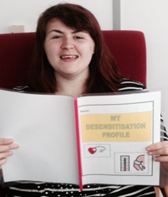
Person-centred programmes (1)
Slide 2.15
Move at the individual’s pace not the clinician’s.
Allow plenty of time.
Use flexible approaches.
Are resourceful and imaginative.

Slide 38
Person-centred programmes (2)
Slide 2.16
Communication needs are met.
Individuals are supported by carers they trust.
Carers ‘sign up’ to supporting individuals with ‘health screening homework’ in between appointments.

Slide 39
Person-centred programmes (3)
Slide 2.17
Ensuring that individuals:
Feel in control.
Feel less anxious.
Build trust.
Have a positive health screening experience.

Slide 40
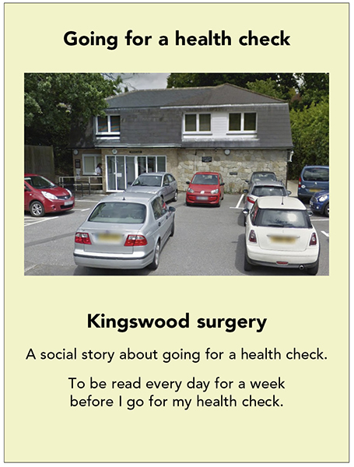
What is a health screening story? (1)
Slide 2.18
They:
Are simple tailor made stories.
Set out the systematic steps required.
Are user friendly.
Use/provide visual resources.

Slide 41
What is a health screening story? (2)
Slide 2.19
Reinforce the sequence of events.
Detail what happens before, during and after the screening.
Identify support required for that journey.
They are concrete and meaningful for that person.

Slide 42
Benefits of health screening stories
Slide 2.20
They give a concrete visual sequence of events.
Are specific to the individual’s appointment.
Can be incorporated into a weekly programme.

Slide 43
Desensitisation profile exercise
Slide 2.21
Complete a desensitisation profile for the individual in your case study with the knowledge you have of:
What screening they require/priority.
What the potential barriers are.
Reasonable adjustments required.
Person-centred approaches.

Slide 44
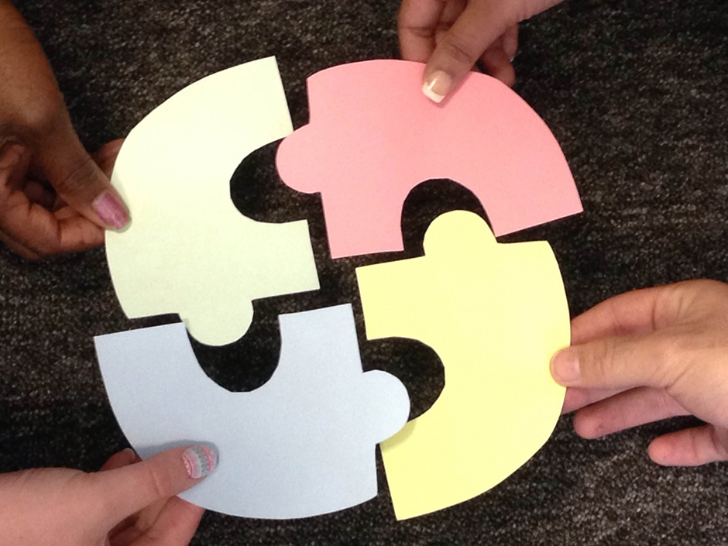
The commitment tool (1)
Slide 2.22
Ensures:
Carers are ‘signed up’ and committed.
Understanding of the individual’s health needs.
Awareness of barriers and how to overcome them.

Slide 45
The commitment tool (2)
Slide 2.23
Ensures:
The importance of their role.
Commitment to ‘health screening homework’.
Working in partnership.

Slide 46
What can go wrong?
Slide 2.24
Inappropriate behaviour/communication body language, tone of voice and words.
Rushing an individual.
Clinicians/carers give up under the guise of the person ‘does not want to engage’, or ‘it is too time consuming’, or ‘the service supporting the individual are not doing their part’.

Slide 47
Preparing the environment (1)
Slide 2.25
How would you prepare the environment for the individual?
What practical steps can you make within the environment to ensure it enables them to relax during the health screening desensitisation?

Slide 48
Slide 2.26
Preparing the environment (2)

Slide 49
Slide 2.27
Preparing the environment (3)
Be:
as calm, relaxed and quiet as possible
welcoming.
Offer:
positive interaction
minimal clutter.

Slide 50
Preparing the environment (4)
Slide 2.28
Avoid sensory overload.
Ensure freedom from interruptions.
Set up with the individual’s specific needs in mind.
Key objects/visual cues.

Slide 51
The clinician’s role (1)
Slide 3.1
Collaborative working.
LDES (Learning Disability Enhanced Services).
Working in partnership.

Slide 52
The clinician’s role (2)
Slide 3.2
Complimenting the family’s vast indepth knowledge of the individual, with clinical expertise and practical support.
Ensuring reasonable adjustments are made to enable and support carers to be involved effectively.
Provision of up-to-date clinical knowledge.
Provision of user friendly information/Easy Read resources.

Slide 53
The clinician’s role (3)
Slide 3.3
Practical support to overcome barriers faced.
Practical support with implementing familiarisation and desensitisation approaches in the home setting.
Service co-ordination.
Ensuring the individual is at the centre of the health screening process and families are a key part of this.

Slide 54
The clinician’s role (4)
Slide 3.4
Being realistic for families.
Signposting/referring to other agencies.
Ensuring reasonable adjustments are made to enable access and support carers to be involved effectively.
Educating and supporting services.

Slide 55
Educating services (1)
Slide 3.5
Before the process:
Increases positive and proactive interventions.
Encourages services to purchase their own equipment.
Encourages services to incorporate in daily care plans for individuals.

Slide 56
Educating services (2)
Slide 3.6
Midway during the process:
Problem solving.
Celebration of achievements.
Changes and ‘tweaks’ to ensure person-centred approach.
Educate new staff if there has been staff turnover during interventions.

Slide 57
Educating services (3)
Slide 3.7
End of the process:
Recognise achievements and challenges faced.
Plan further interventions if required.
Hand over to services and clinician to phase out.
Services to take responsibility for continuing desensitisation work.

Slide 58
Supporting children with learning disabilities (1)
Slide 3.8
The younger you implement the familiarisation process the more positive experiences regarding health screening and medical treatment the child will have.
Significant impact on their responses to health screening as an adult.

Slide 59
Slide 3.9
Supporting children with learning disabilities (2)
So many adults with a learning disability now have difficulty accessing health screening partly due to their experiences as a child.
What has gone wrong??

Slide 60
Supporting children with learning disabilities (3)
Slide 3.10
Essential process for children with a learning disability.
Early introduction/weekly routine within the family home.
The tools and visual resources within this pack can be used with/adapted for children.

Slide 61
Practical application (1)
Slide 3.11
Using the tools within this pack will ensure …
Reduced negative experiences.
Increased access to health screening for the future population of adults.
Increased longevity for the future population of people with a learning disability.

Slide 62
Practical application (2)
Slide 3.12
Using the tools within this pack will ensure…..
Children and families are provided with education and practical support regarding accessing health screening.
Smoother transition for more complex and invasive health screening that may be required during adolescence and adulthood.

Slide 63
What services and health professionals can do to be proactive (1)
Slide 3.13
Act early.
Identify barriers.
Educate.
Facilitate workshops.

Slide 64
Slide 3.14
What services and health professionals can do to be proactive (2)
Incorporate as part of the LDES training.
Commitment tool.
Visual resources.

Slide 65
Slide 3.15
Aims
To understand why desensitisation/ familiarisation is an essential process in enabling people with a learning disability to access health screening.
To gain an awareness of the framework and practical tools that can be applied through the desensitisation process to enable successful health screening.

Slide 66
Slide 3.16
Objectives (1)
By the end of the training today you will be able to:
State what health screening is and why it is important.
List what potential barriers to accessing health screening people with a learning disability have.
Apply reasonable adjustments to reduce the barriers.

Slide 67
Slide 3.17
Objectives (2)
Support an individual through the desensitisation process using the tools in this training session.
Apply the practical skills learnt to people with a learning disability that you currently support.
Enable the individuals you support to have positive health screening experiences.

Slide 68
Slide 3.18
THE TIME IS FOR:
NOW GO AND DO IT

