Slide 1
Slide 1

Slide 2
Slide 2

Slide 3
Module 1: The Lived Experience of Dementia
Slide 3

Slide 4
Learning Outcomes
Slide 4
By completing this Module, the learner will be able to:
Understand what dementia is
Recognise best practice in the identification, assessment and diagnosis of dementia
Understand how to prevent dementia and reduce the risk factors associated with dementia
Support people affected by dementia to live well

Slide 5
Session 1: Definitions, prevalence and risk factors
Slide 5

Slide 6
Defining Dementia
Slide 6

Slide 7
Slide 7
The history of dementia
Hippocrates, the ‘Father of Western Medicine’
The symptoms of dementia were recognized by this Ancient Greek physician (460-370 BC)

Slide 8
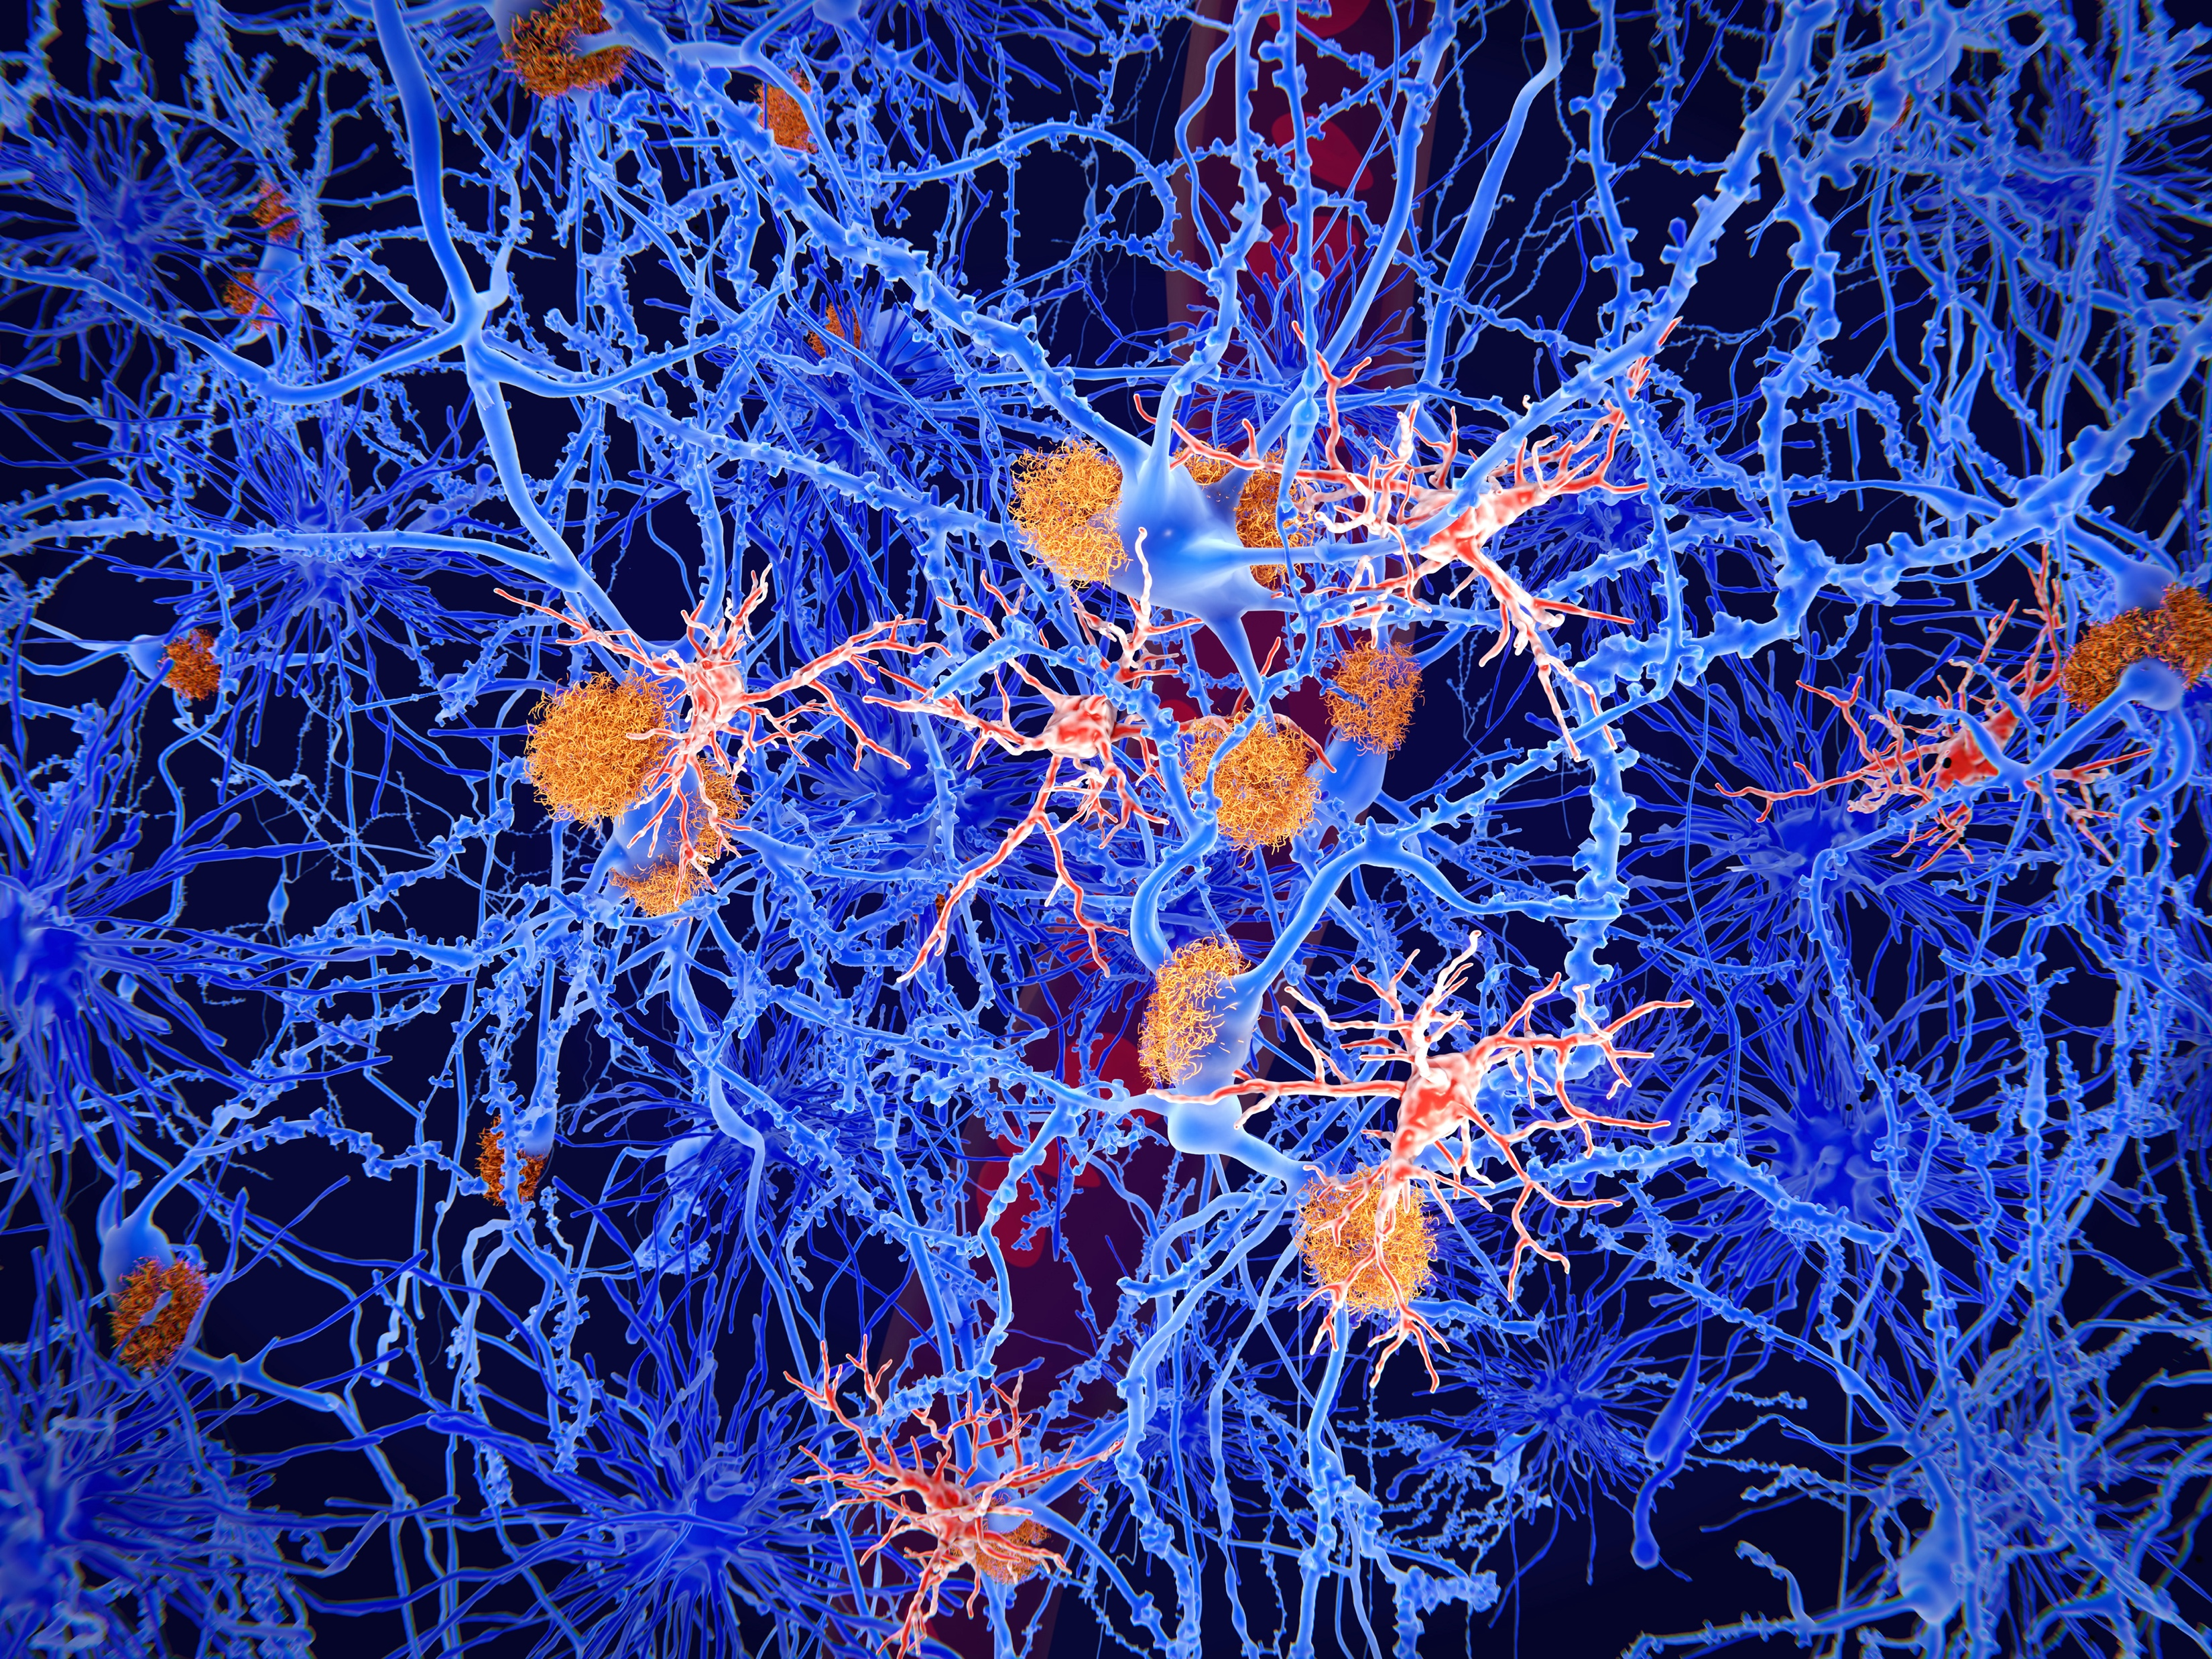
Slide 8
The discovery

Slide 9
Risk factors for dementia
Slide 9
Age: The risk of developing dementia varies from person to person. Everyone has some risk because age is the strongest risk factor and we're all growing older.
Genes: Apart from some rare cases, most instances of dementia are not inherited. But we can inherit certain genes from our parents that make us more vulnerable to developing dementia.
Lifestyle: smoking, drinking too much alcohol, lack of exercise, fatty diet.
Other health conditions: Your chance of developing dementia can be greater if you have other health conditions like type 2 diabetes, obesity or high blood pressure in middle age, high cholesterol, an existing neurological disorder, head injury, heart disease, stroke.
Gender: More women develop Alzheimer’s disease than men; more men develop Vascular disease than women.
Down’s Syndrome: people with Down’s Syndrome are at risk of developing dementia about 30–40 years earlier than the rest of the population.

Slide 10
The Dementia Research Institute
Slide 10
The UK Dementia Research Institute (UK DRI) is a joint £290 million investment from the Medical Research Council (MRC), Alzheimer’s Society and Alzheimer’s Research UK.
The institute will carry out research relevant to all dementias, including Alzheimer’s disease, Parkinson’s disease, Fronto-temporal disease, Vascular disease, Huntington’s disease and beyond.
The six universities that make up the UK DRI are: University of Cambridge, Cardiff University, University of Edinburgh, Imperial College London, King’s College London and University College London (UCL). The hub of the Institute activity and the national operational headquarters of the UK DRI is based at UCL.

Slide 11
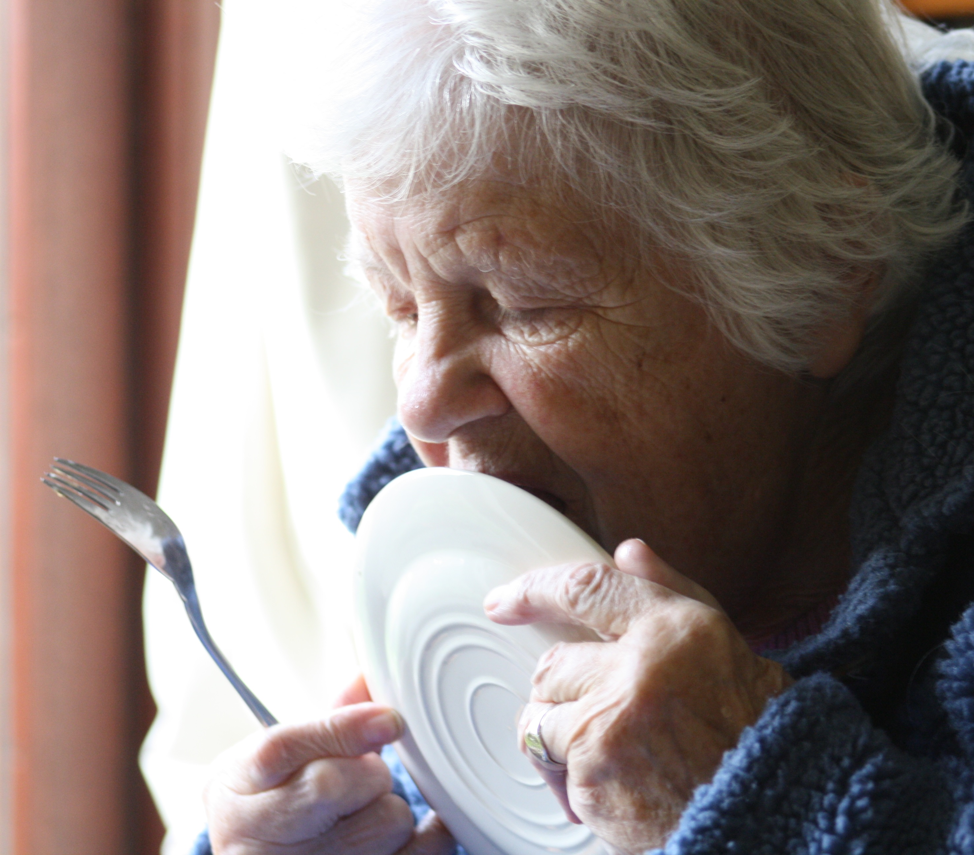
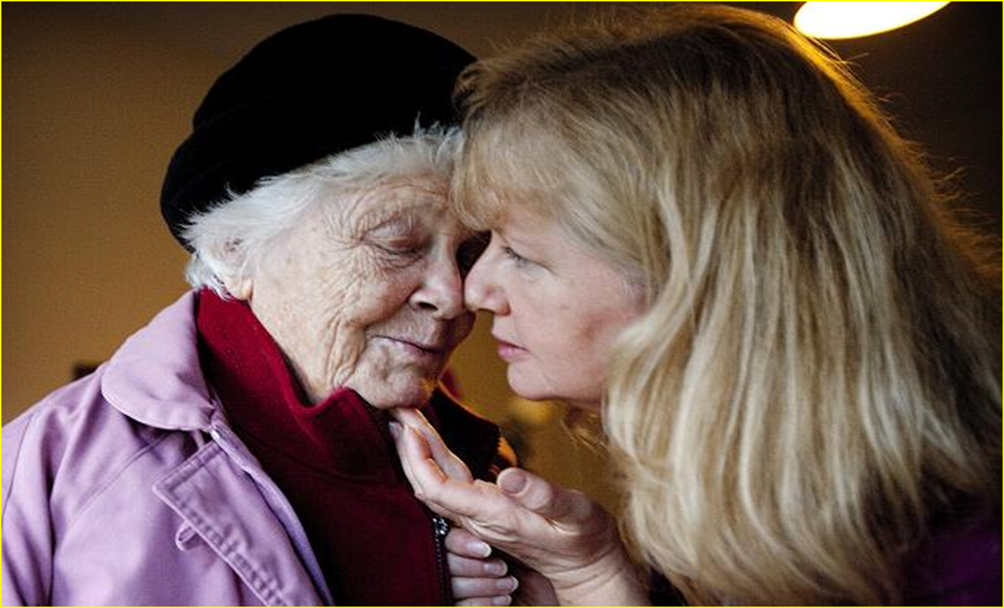
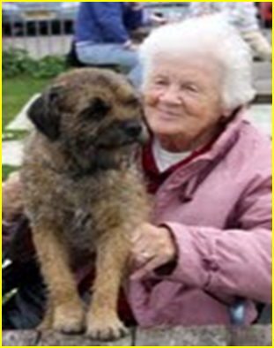
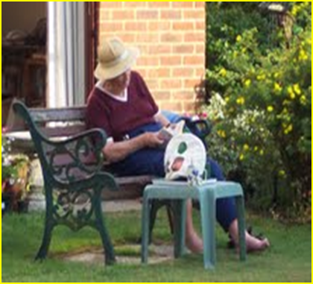
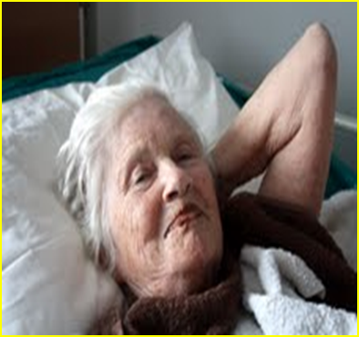
This is Ella…
Slide 11

Slide 12
What dementia is
Slide 12
“Dementia is a syndrome – usually of a chronic or progressive nature – in which there is deterioration in cognitive function (i.e. the ability to process thought) beyond what might be expected from normal ageing. It affects memory, thinking, orientation, comprehension, calculation, learning capacity, language, and judgement. Consciousness is not affected. The impairment in cognitive function is commonly accompanied, and occasionally preceded, by deterioration in emotional control, social behaviour, or motivation.”
(WHO 2019)

Slide 13
What dementia isn’t
Slide 13
Delirium
Depression
Mild Cognitive Impairment

Slide 14
Slide 14
End of Session 1
Thank you!

