Slide 1
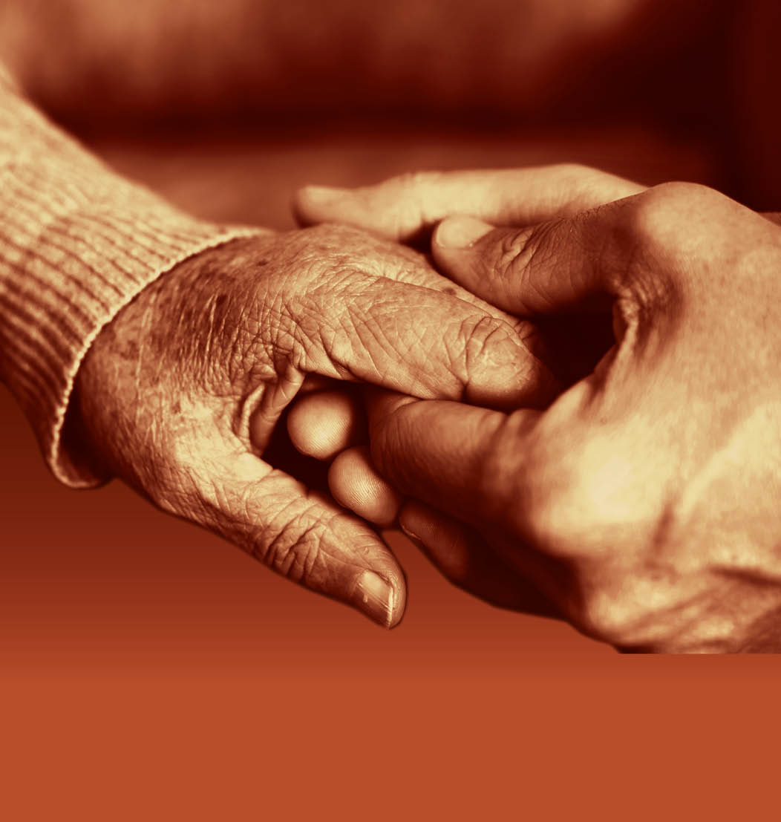
Slide 23
Session 3: Signs, symptoms and identification of dementia

Slide 2
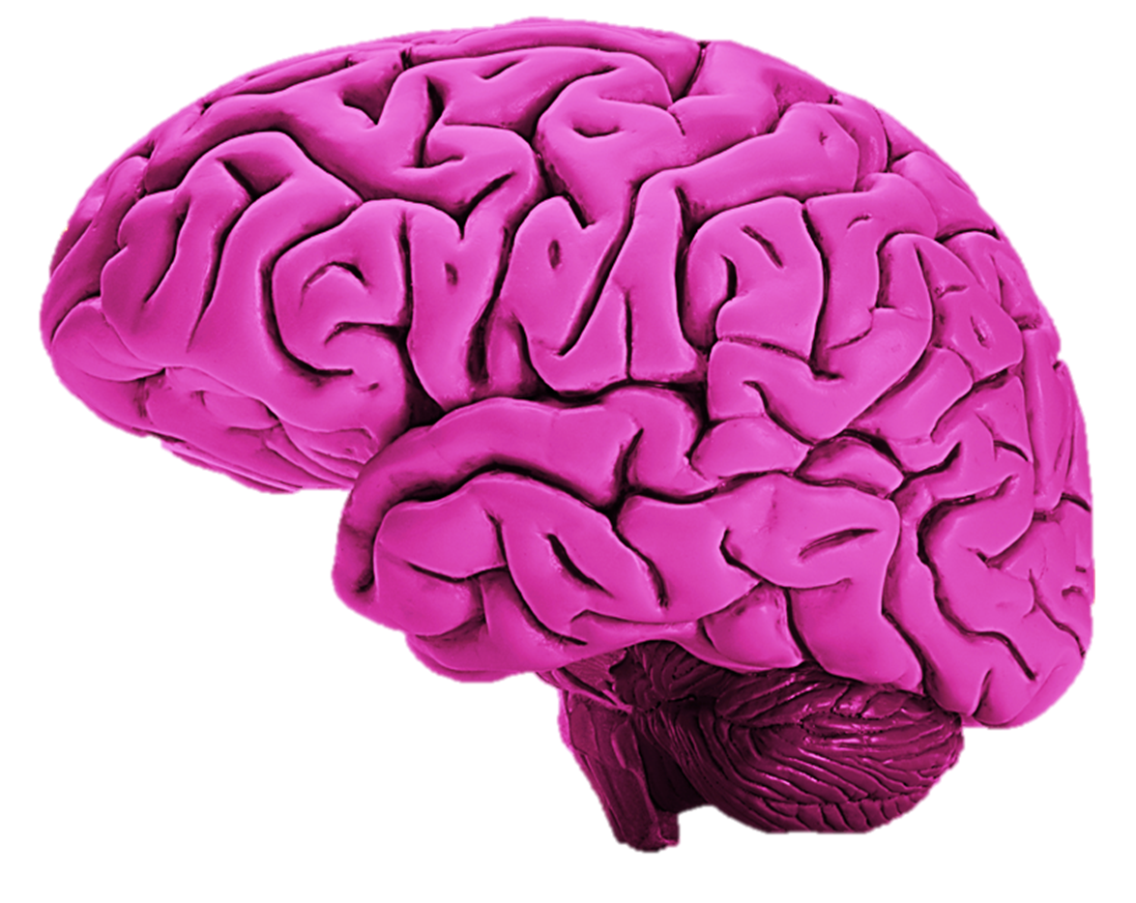
How the brain works
Slide 24
Parietal Lobes
Perception, making sense of the world, arithmetic, spelling
Frontal Lobes
Executive functions, thinking, planning, organising and problem solving, emotions and behavioural control, personality
Temporal Lobes
Memory, understanding, language
Occipital Lobes
Vision, sight memory
Brain Stem
breathing, heart rate,
swallowing
Cerebellum
Balance, co-ordination

Slide 3
Slide 25
Dementia as a disability
Neurological damage caused by the type of dementia an individual has results in impairments of thinking, judgment, reasoning, memory, initiating and understanding or COGNITIVE IMPAIRMENTS.
The interplay between the individual, their cognitive impairment and the environment they are in will have an immense impact on their experience of dementia.
If the individual is in an UNDERMINING social or physical environment they may become disabled in their ability to communicate, wash and dress, dine, shop, bathe, undertake domestic or leisure activities or find their way.
An individual with cognitive impairment needs a social and physical environment that does not disable him or her. When dementia is viewed as a disability there is an opportunity to recognise what others bring to the situation, and to facilitate an environment in which the individual is enabled.

Slide 4
The different types of dementia and their causes
Slide 26
Lewy
Body
disease
Alzheimer’s disease
Vascular disease
Tay-Sachs disease...
Herpes encephalitis…
AIDS related dementia complex…
Semantic dementia…
Creutzfeldt-Jakob disease...
Niemann-Pick disease type C…
Multiple Sclerosis...
Progressive supranuclear palsy…
Parkinson’s disease...
Normal pressure hydrocephalus...
Friedreich’s ataxia…
CADASIL…
Huntington's disease…
Fronto-temporal disease…
Binswanger’s disease…
Post cortical atrophy…
Korsakoff’s disease…
and many more

Slide 5
Slide 27
End of Session 3
Thank you!

