Slide 1
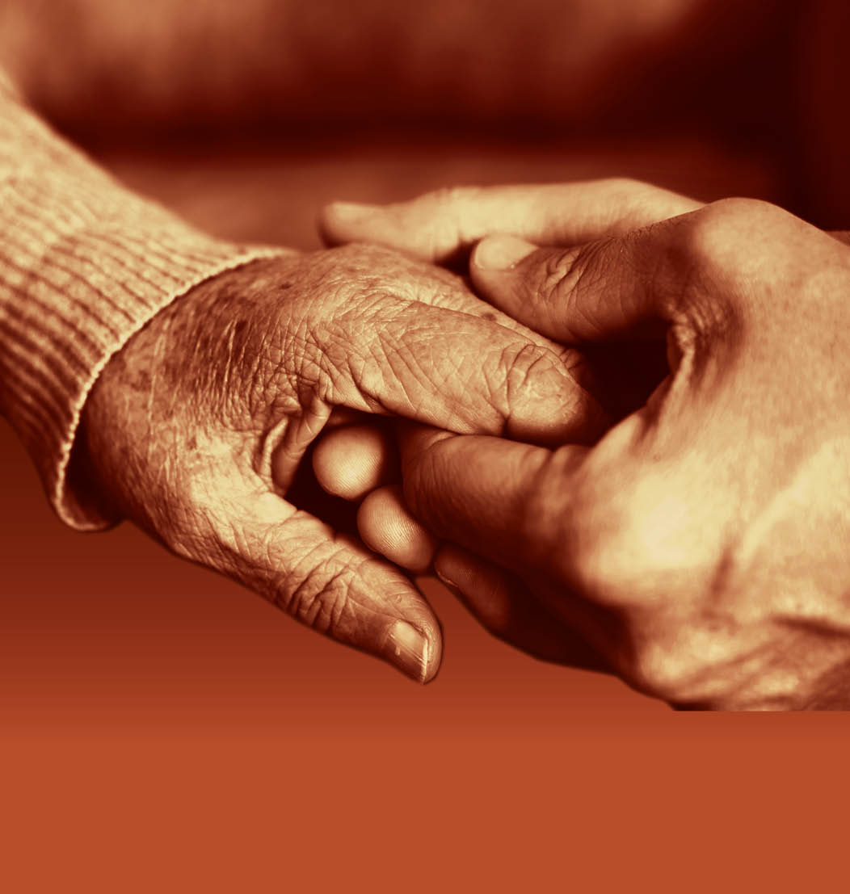
Slide 28
Session 4: The assessment and diagnosis of dementia

Slide 2
Contemplating dementia
Slide 29
Imagine for a moment that you are experiencing possible signs of dementia.
Please share, as a group, why you might seek a diagnosis and why you might not.

Slide 3
Assessment for dementia
Slide 30
There is no single test for dementia. A diagnosis is based on a combination of assessments and tests. These may be done by a GP or a specialist at a memory clinic or hospital and should include:
Taking a full history – from the person and from someone who knows them well
Cognitive ability tests - short- and long-term memory, concentration and attention span, language and communication skills, awareness of time and place (orientation)
Physical health check
Mental health check
Brain scan

Slide 4
Slide 31
Sharing a diagnosis
“The neurologist told me I had Alzheimer’s disease.
I asked him where he thought I would be in five years time.
He told me I’d be dead in five years.”
James
“The GP asked George some questions.
He then ummmd and aahhd and told
us he was going to refer us to a
specialist. He started talking into a
dictaphone. He said “I would like to
refer this gentleman to you as I believe he
is in the early stages of dementia”.
That’s how we were told… how we found
out George had dementia.”
Sally and George
“The doctor could not have been more lovely.
He was so kind and sensitive when he told us
that mum had Lewy Body dementia.
He gave us lots of time… we felt important to him.”
Ann and Jenny

Slide 5
Slide 32
Post-diagnosis support
NICE quality standard for supporting people to live well with dementia

Slide 6
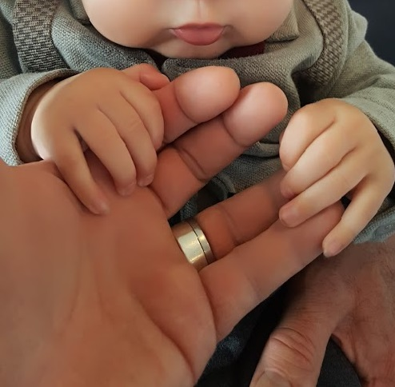
Slide 33
Understanding the impact of dementia on a young person and their family

Slide 7
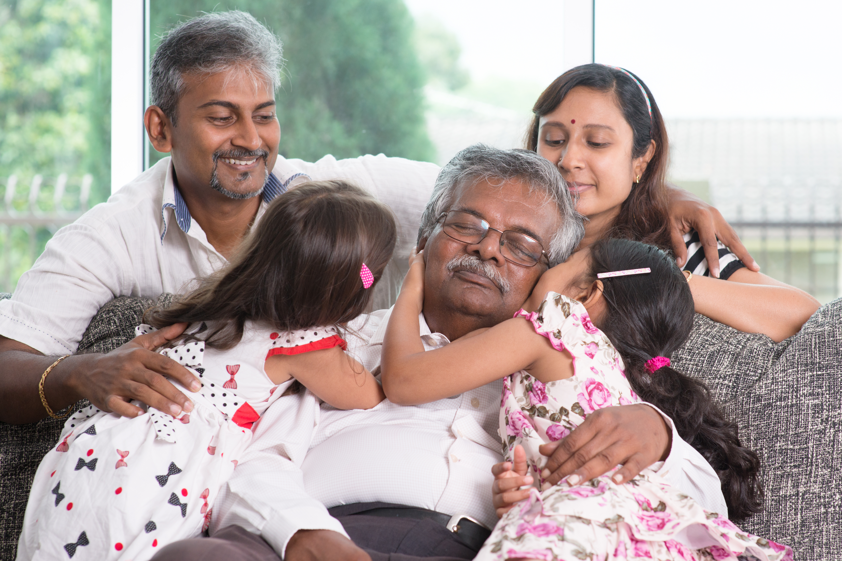
The needs of people with dementia from diverse communities
Slide 34

Slide 8
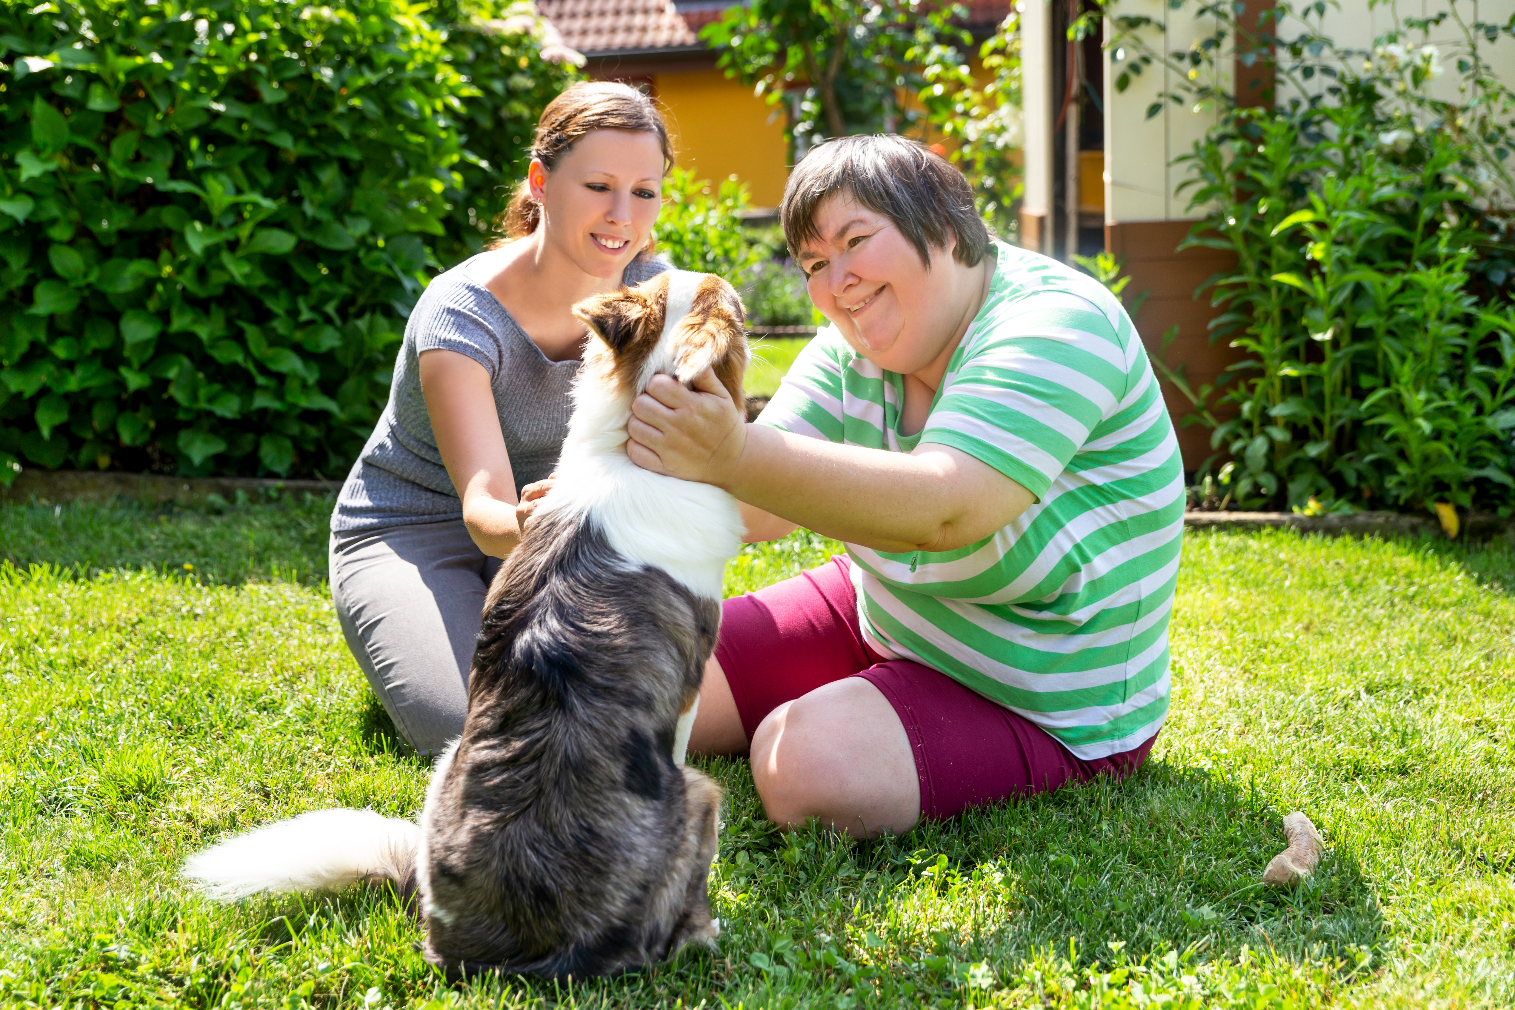
Slide 35
Working in a person centred way with an individual with a learning disability and dementia

Slide 9
Slide 36
End of Session 4
Thank you!

