Slide 1
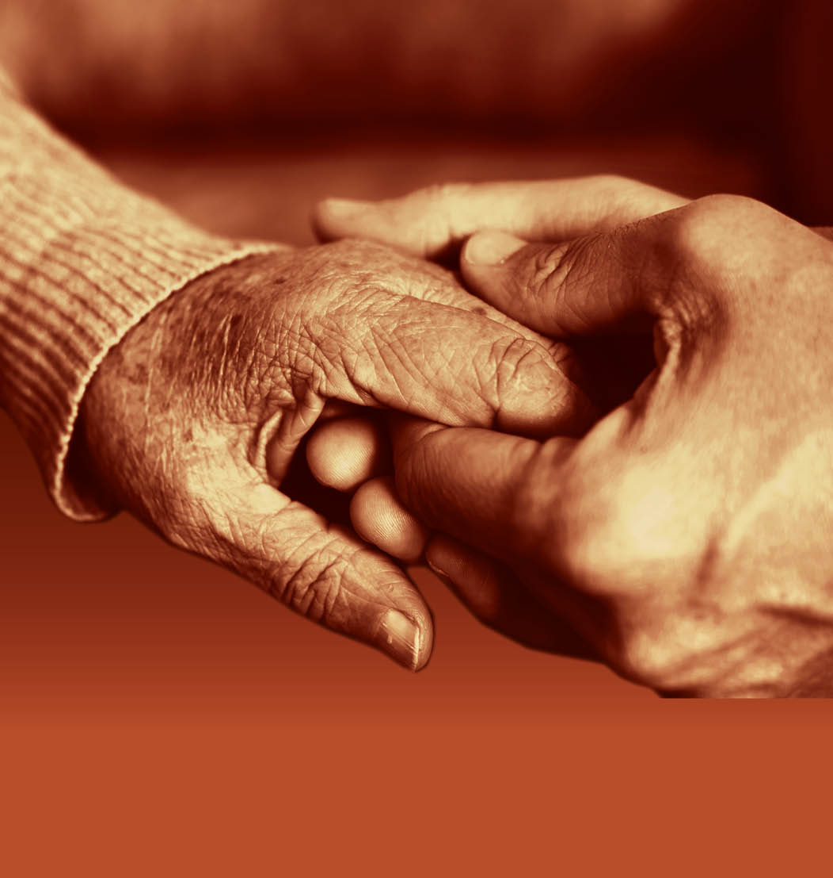
Slide 37
Session 5: Dementia risk reduction and prevention

Slide 2
Slide 38
Risk factors
associated with dementia

Slide 3
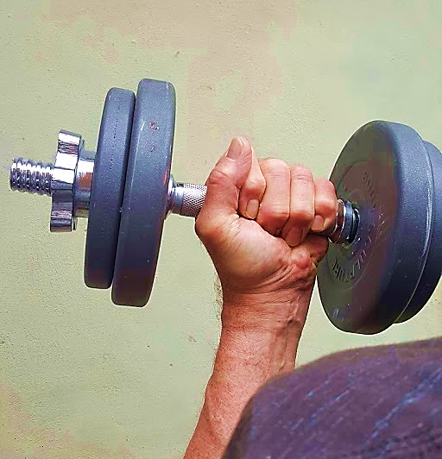
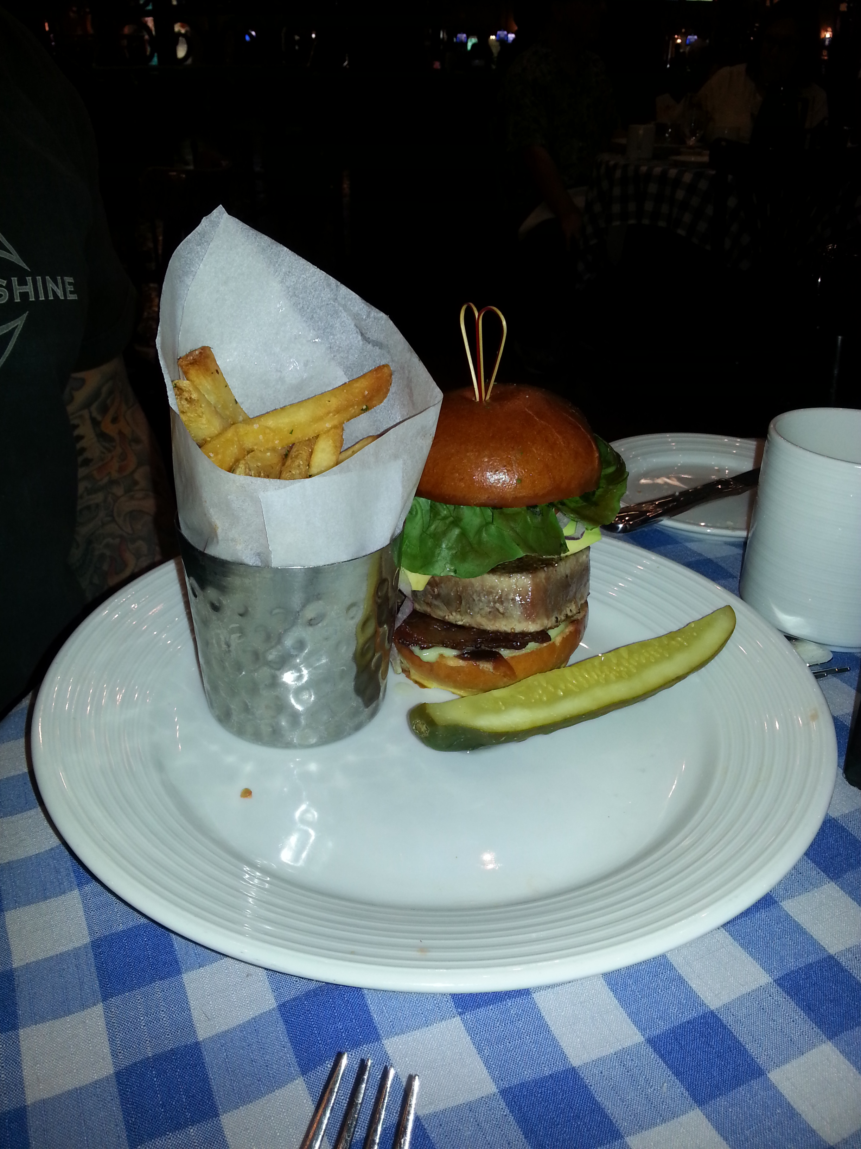
Slide 39
Communicating messages about healthy living

Slide 4
Supporting people to live well with dementia
Slide 40

Slide 5
Slide 41
Challenging myths and stereotypes about dementia

Slide 6
Slide 42
“People with dementia don’t just want to be kept alive… they want to live.”
Ella Fuller (1929–2013)

Slide 7
Slide 43
End of Session 5
Thank you!

Slide 8
Slide 44
End of
Module 1

