Slide 1
Slide 1

Slide 2
Slide 2

Slide 3
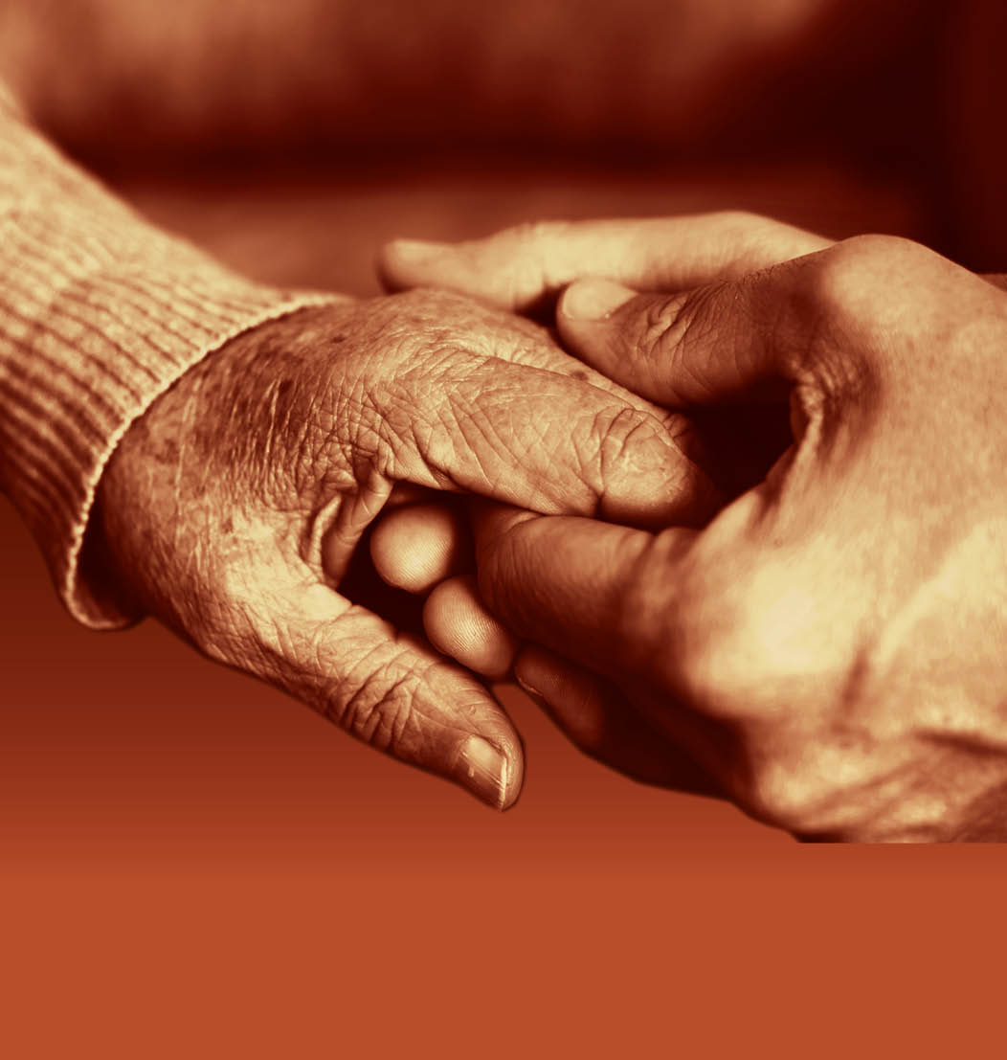
Module 2: Communication and Behaviours Viewed as Challenging
Slide 3

Slide 4
Learning Outcomes
Slide 4
By completing this training, the learner will be able to:
Understand how we communicate
Explore techniques to help communication and interactions with people with dementia
Discuss our role in supporting people with dementia
Understand behaviour viewed as challenging
Describe the impact the behaviours of others may have on a person with dementia
Develop our approach in supporting people with dementia who display behaviours that could be viewed as challenging

Slide 5
Slide 5
Session 1: Communicating with people with dementia

Slide 6
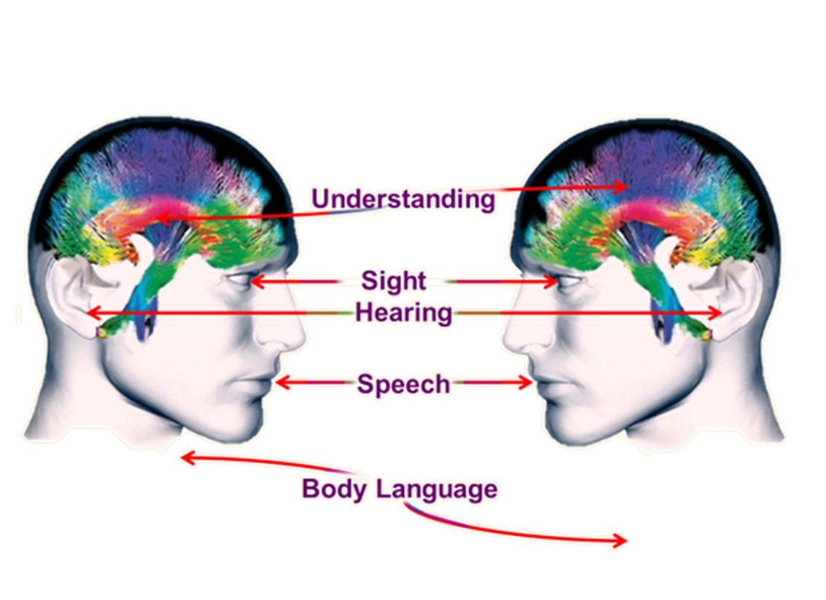
Understanding the factors that can influence communication and interaction with people who have dementia
Slide 6

Slide 7
How do we communicate?
Slide 7
38% Non-
verbal speech
55% Body language
7% Verbal speech

Slide 8
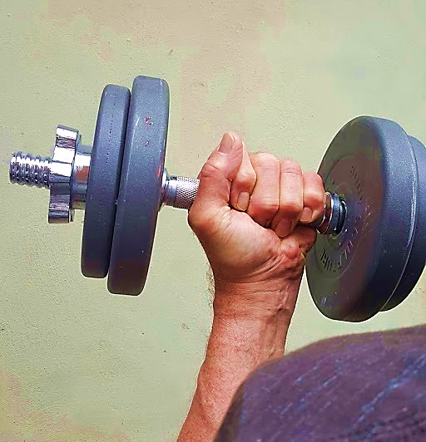
Slide 8
Experiential exercises

Slide 9
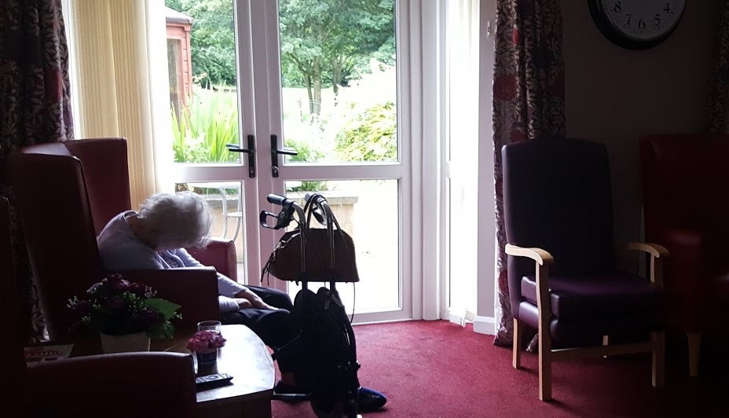
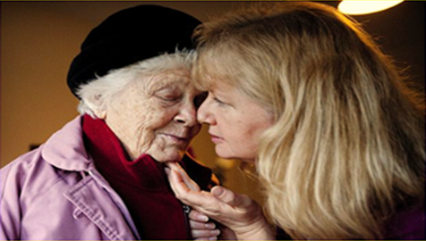
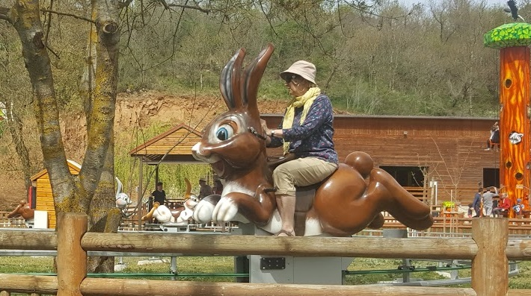
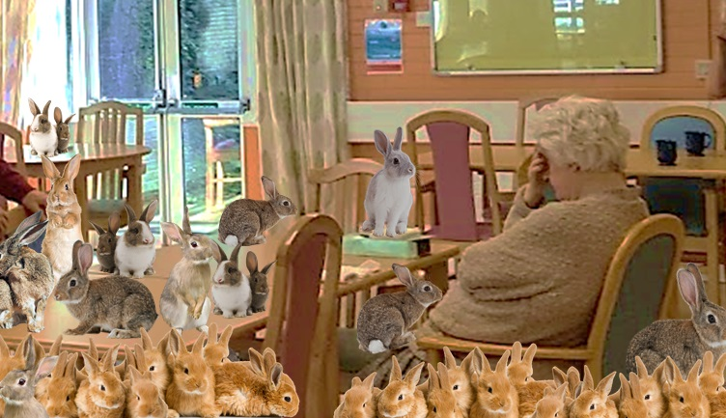
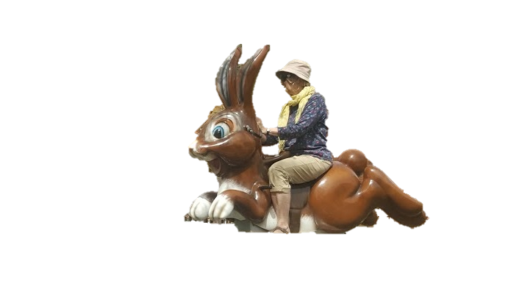
Slide 9
How dementia can affect a person’s ability to communicate
Alzheimer’s disease
Vascular disease
Lewy Body disease
Fronto-temporal disease

Slide 10
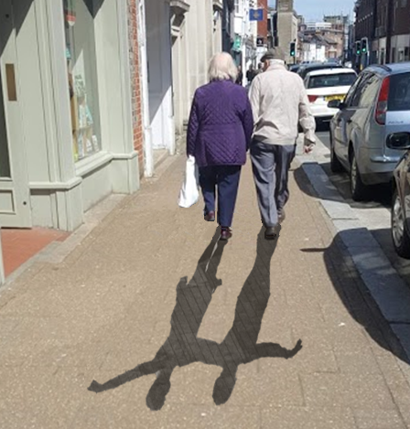
The role of memory in communication
Slide 10

Slide 11
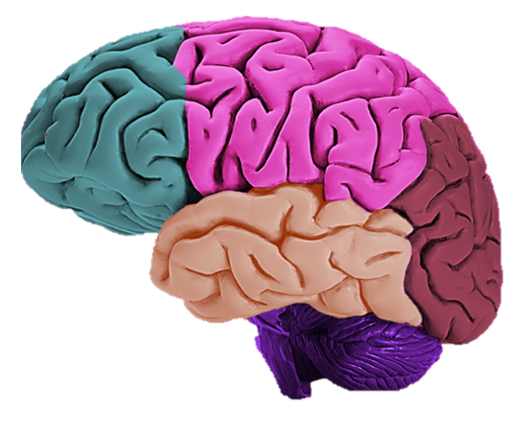
Imagery systems of the brain
Slide 11
Touch
Smell
Taste
Pictures
Objects
Places Actions
Words

Slide 12
Social theory of communication disability in dementia
Slide 12
Language Impairment
+
Unsupportive and Undermining Social and Physical Environment
= Communication Disability

Slide 13
The VERA framework for communicating with people who have dementia
Slide 13
Based on four key concepts:
V alidate
E ngage with emotion
R eassure
A ctivity

Slide 14
The VERA framework for communicating with people who have dementia
Slide 14
V for Validate
“To make something (or someone) officially acceptable or approved, especially after examining.”
Cambridge Dictionary

Slide 15
The Validation method
Slide 15

Slide 16
The VERA framework for communicating with people who have dementia
Slide 16
E for Engage with emotion
“To take part in or do something connected with… a strong feeling such as love or anger, or strong feelings in general.”
Cambridge Dictionary

Slide 17
What are our emotional needs?
Slide 17
Comfort
Cultural
Sexuality
Identity
Love
Attachment
Spiritual
Inclusion
Occupation
Adapted from: Kitwood, T. Dementia Reconsidered. pp 80-84
Open University Press (1997)
Notes:
These needs are experienced by us all. Seeking to meet them, or not having them met can help to explain the behaviour of a person with dementia.
Attachment needs:
Inclusion needs:
Occupation needs:
Identity needs:
Comfort needs:
Sexual needs:
Cultural needs:
Spiritual needs:

Slide 18
The VERA framework for communicating with people who have dementia
Slide 18
R for Reassure
“To comfort someone and stop them from worrying.”
Cambridge Dictionary

Slide 19
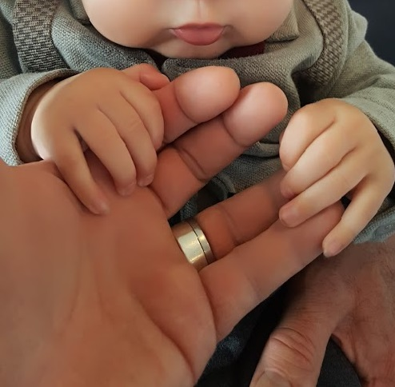
Who can give us reassurance?
Slide 19
Notes:
These needs are experienced by us all. Seeking to meet them, or not having them met can help to explain the behaviour of a person with dementia.
Attachment needs:
Inclusion needs:
Occupation needs:
Identity needs:
Comfort needs:
Sexual needs:
Cultural needs:
Spiritual needs:

Slide 20
The VERA framework for communicating with people who have dementia
Slide 20
A for Activity
“The state of being active. An action or pastime.”
Cambridge Dictionary

Slide 21
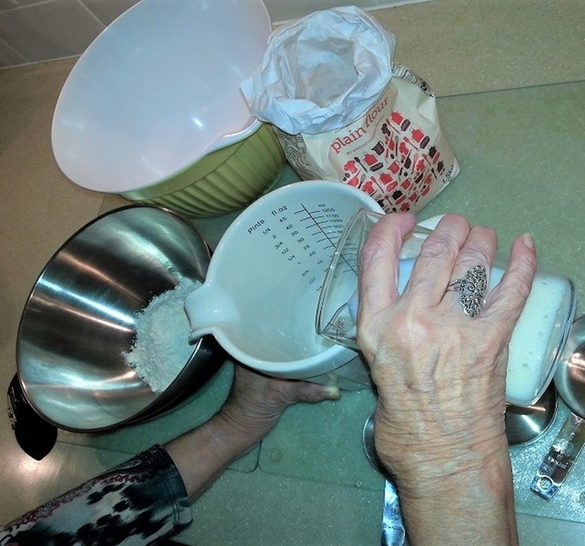
An activity-based model of care
Slide 21
Notes:
These needs are experienced by us all. Seeking to meet them, or not having them met can help to explain the behaviour of a person with dementia.
Attachment needs:
Inclusion needs:
Occupation needs:
Identity needs:
Comfort needs:
Sexual needs:
Cultural needs:
Spiritual needs:

Slide 22
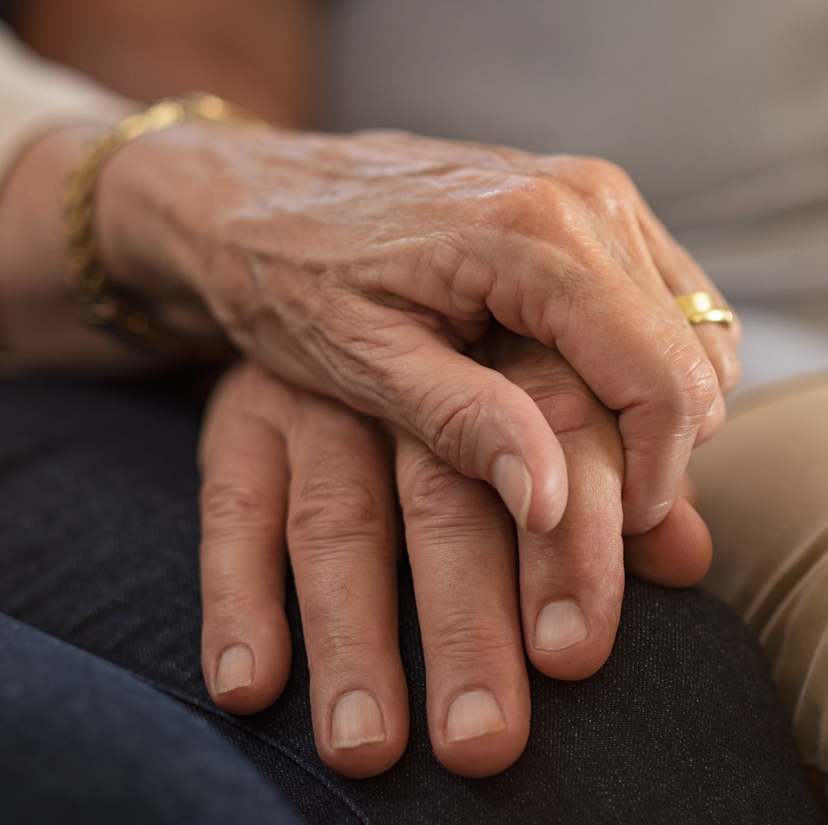
Identifying the communication strengths and abilities of an individual with dementia
Slide 22
Care that values people regardless of age or cognitive ability
Individualised recognition that each one of us is unique
Includes the perspective of the person with dementia as central to all care planning
Values the person as being able to live a life that has meaning
Provides a supportive social environment to enable people to experience relationships

Slide 23
Slide 23
Identifying the communication strengths and abilities of an individual with dementia
P (personality)
+
B (biography/life history)
+
H (health)
+
NI (neurological impairment/capacity for doing)
+
SP (social psychology/life at the moment)

Slide 24
Slide 24
End of Session 1
Thank you!

