Slide 1
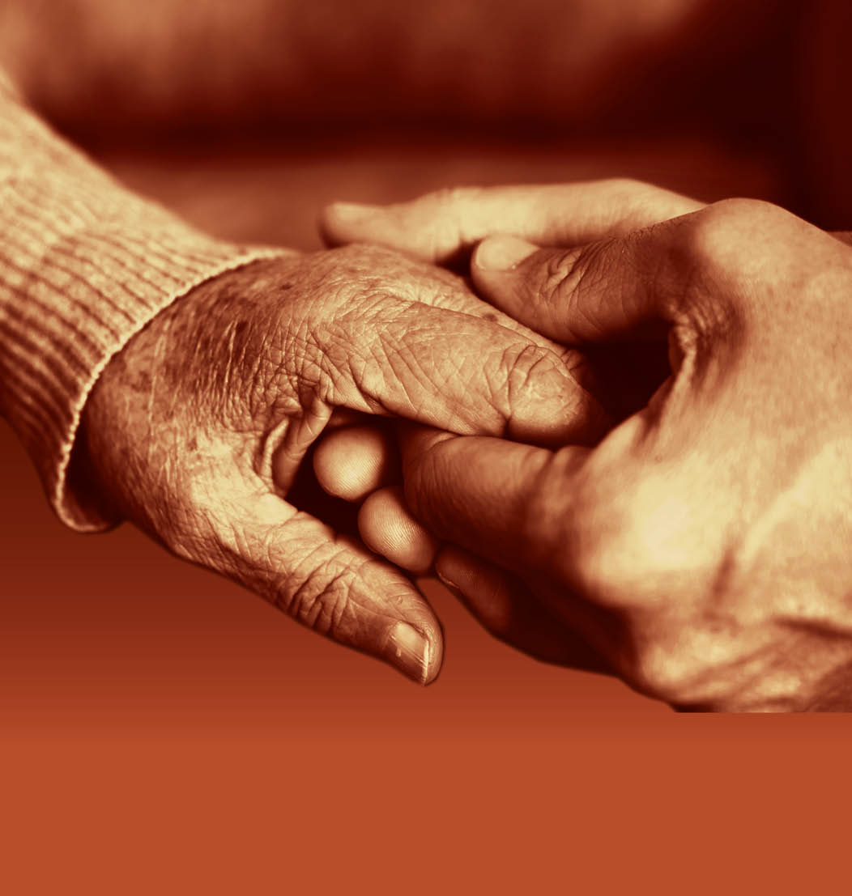
Slide 42
Session 3: Supporting people to live well with dementia

Slide 2
Who should be supporting people living with dementia?
Slide 43
‘‘Every individual living with dementia should have the support of people who are confident in adapting their interaction to reduce the stress and anxiety that dementia may bring.
It is essential that support is tailored to the individual, their personal interests and specific needs, encouraging independence and choice in the decisions they make.”

Slide 3
The new culture of dementia care
Slide 44
We don’t DO person centred care… …we need to BE person centred.’
David Sheard
In a culture that typically views aging as a period of decline, our philosophy asserts that no matter how old we are or what challenges we live with, life is about continuing to grow. Building on this new paradigm, it affirms that care is not a one-way street, but rather a collaborative partnership. All caregivers and care receivers are described as “care partners,” each an active participant in the balance of giving and receiving.’
Eden Alternative
‘…personhood (as) transcendent, sacred, and unique; and that it accords people who have dementia with an ethical status that offers them absolute value resulting in an obligation “to treat each other with deep respect.”
Tom Kitwood

Slide 4
Positive and proactive care – reducing the need for restrictive interventions
Slide 45
‘This guidance forms a key part of the Government’s commitment to end the use of restrictive interventions across all health and adult social care. ‘Positive and Safe’ is a therapeutic new initiative to drive this forward. ‘Positive and Safe’ recognises that environments are most effective for promoting both physical and emotional wellness and that restrictive interventions should only be used in modern compassionate health and social care services where there is a real possibility of harm to the person or to staff, the public or others.’
What is a restrictive intervention in dementia care?

Slide 5
Positive and proactive care – key messages
Slide 46
Staff must not deliberately restrain people in a way that impacts on their airway, breathing or circulation, such as face down restraint on any surface, not just on the floor.
If restrictive intervention is used it must not include the deliberate application of pain.
If a restrictive intervention has to be used, it must always represent the least restrictive option to meet the immediate need.
Staff must not use seclusion other than for people detained under the Mental Health Act 1983.
People who use services, families and carers must be involved in planning, reviewing and evaluating all aspects of care and support.
Individualised support plans, incorporating behaviour support plans, must be implemented for all people who use services who are known to be at risk of being exposed to restrictive interventions.

Slide 6
Slide 47
Positive and proactive care – six key principles
Compliance with the relevant rights in the European Convention on Human Rights at all times.
Understanding people’s behaviour allows their unique needs, aspirations, experiences and strengths to be recognised and their quality of life to be enhanced.
Involvement and participation of people with care and support needs, their families, carers and advocates is essential, wherever practicable and subject to the person’s wishes and confidentiality obligations.
People must be treated with compassion, dignity and kindness.
Health and social care services must support people to balance safety from harm and freedom of choice.
Positive relationships between the people who deliver services and the people they support must be protected and preserved.

Slide 7
What makes individuals who support people with dementia ‘dynamic’ ?
Slide 48
We must be positive and proactive in our support of people with dementia…
not reactive

Slide 8
What do we do well and what do we do less well?
Slide 49

Slide 9
Understanding behaviour viewed as challenging
Slide 50
Behaviour is a form of communication.
Behaviour is often an emotional response to an experience.
There will always be a reason for our behaviour.
These three points apply to people living with dementia.
‘Behaviour’ can be defined as observable acts which can be recorded and measured – this is known as a topographical definition of behaviour covering what a person does and says.
Whether behaviour is viewed as ‘challenging’ or not will depend on the observer, the context, the time, the place, the emotion expressed and more.
Only when we seek to understand WHY the person is behaving in a particular way will we begin to understand how to respond to it.
In dementia care, there are approaches, care practices, tools, guidance and legislation which enable us to formulate positive, person centred responses.

Slide 10
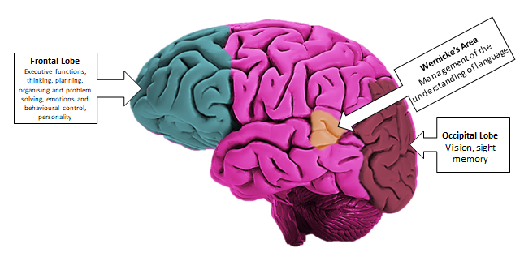
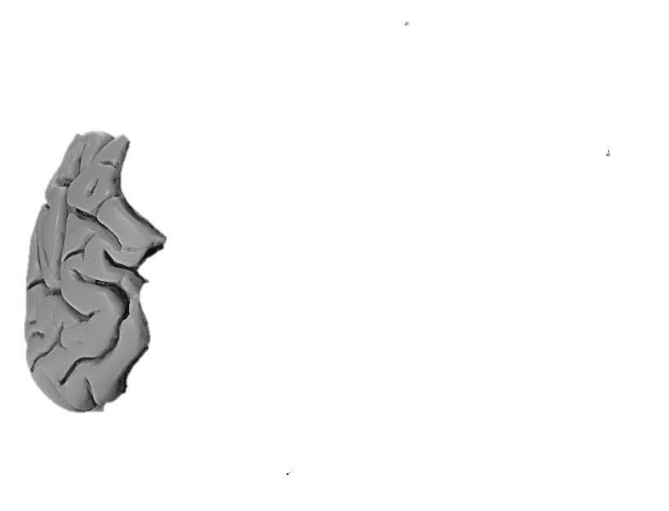
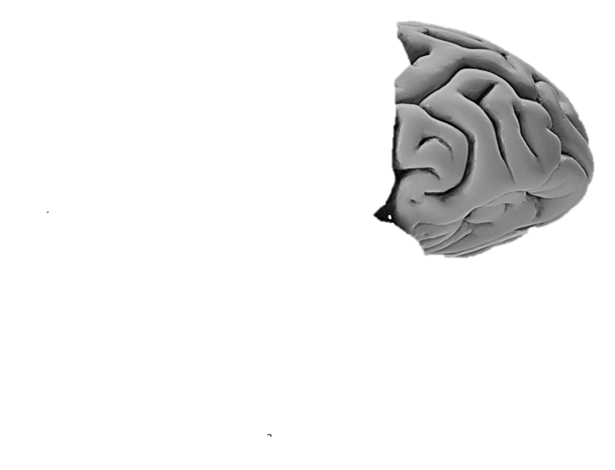
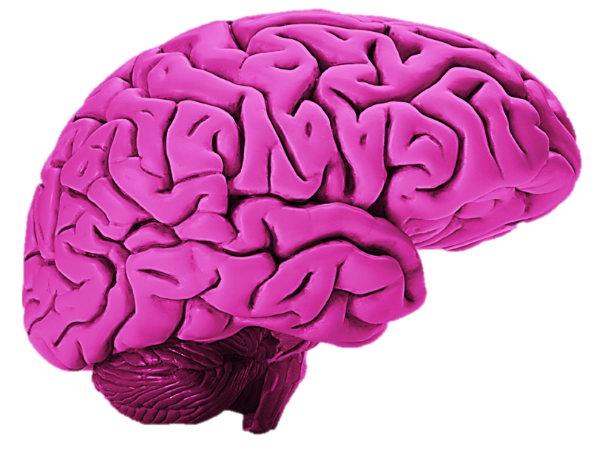
The Biomedical Model
Slide 51
Frontal Lobe
Executive functions, thinking, planning, organising and problem solving, emotions and behavioural control, personality
Wernicke’s Area
Management of the understanding of language
Wernicke’s Area
Management of the understanding of language
Frontal Lobe
Executive functions, thinking, planning, organising and problem solving, emotions and behavioural control, personality
Occipital Lobe
Vision, sight memory
Occipital Lobe
Vision, sight memory
Hippocampus
formation, organisation, and storage of new ‘short-term’ memories

Slide 11
The Biological Model
Slide 52
Constipation
Infection
Adverse reaction to drugs
Dehydration
Multi-pharmacology

Slide 12
The Psychiatric Model
Slide 53
Delusions:
False beliefs that conflict with reality, often reinforced by misinterpretation of events. Many delusions also involve a level of paranoia. Some people may experience delusions that could happen in real life (being poisoned, followed, lied to, conspired against, or loved from a distance). 37% of people with Vascular disease and Alzheimer’s disease are thought to experience delusions
Hallucinations:
Experiences are where someone sees, hears, smells, tastes or feels things that do not exist outside of their mind. 80% of people with Lewy Body disease are likely to experience visual hallucinations
Anxiety:
A feeling of unease that can be mild or severe. A person can feel worried, on edge, afraid, panicky, overwhelmed, full of dread or out of control. Some people may have insomnia, low appetite, tiredness and irritability. They may believe they are having a heart attack, feel faint, have stomach cramps, sweat more than usual and and/or need to go to the toilet more than usual.
Depression:
A low mood that can last for weeks or months, causing feelings of unhappiness, hopelessness, low self-esteem, and lack of pleasure in things that would usually be enjoyable. In its mildest form, depression can be low spirits. At its most severe, it can be life-threatening.

Slide 13
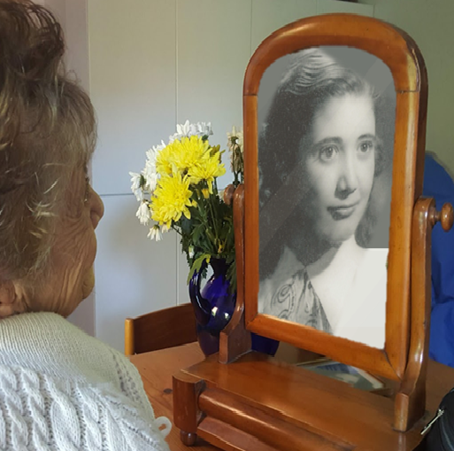
The Psychological Model
Slide 54
Inflexibility
Confabulation
Isolation
Denial
Adaptive Paranoia

Slide 14
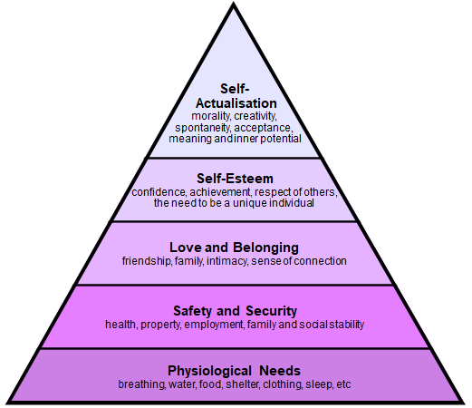
Maslow’s Hierarchy of Human Needs
Slide 55
SOURCE:
Maslow A H (1943)
A Theory of Human Motivation
Psychological Review 50(4) 370-96

Slide 15
The person-centred approach in dementia care
Slide 56
D = P + B + H + NI + SP
Kitwood T (1993) “Discover the person, not the disease”. Journal of Dementia Care. Vol 1 No 1 pp16-17.

Slide 16
Slide 57
End of Session 3
Thank you!

