Slide 1
Slide 58
Session 4: Rethinking behaviours viewed as challenging

Slide 2
Common Core Principles for Supporting People with Dementia – Principle 5
Slide 59
‘Recognise the signs of distress resulting from confusion and respond by diffusing a person’s anxiety and supporting their understanding of the events they experience’

Slide 3
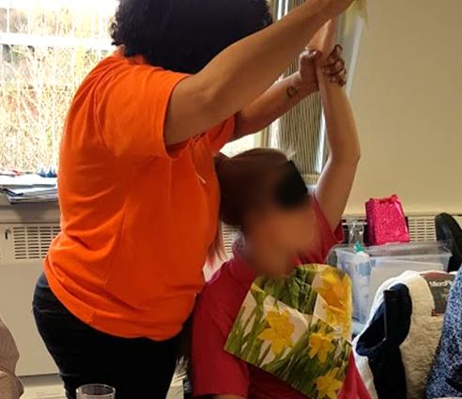
Personal detractors revisited
Slide 60
Personal detractors come from any interactions that have a negative, undermining or de-skilling effect on the person with dementia and their well-being.

Slide 4
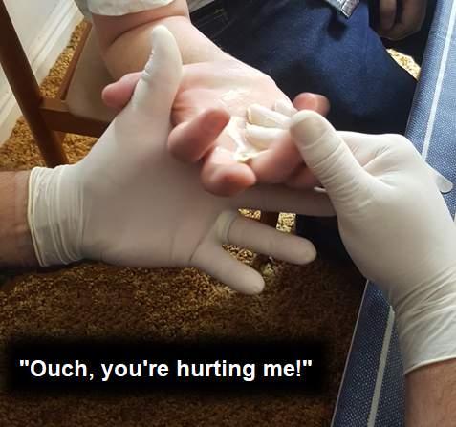
The impact of carers and others
Slide 61

Slide 5
Observation skills
Slide 62
Cambridge Dictionary definition:
“The act of watching something or someone carefully.”
Cambridge Dictionary

Slide 6
Observation skills – theory and practice
Slide 63
When we talk about observation skills, they can be divided into Objective and Subjective observation. Both are valid, but they need to be distinguished.
Objective observation is based on fact – things that we can see and measure. These may include weight, body temperature, blood pressure, fluid intake, bowel movements, monitoring allergies and bruises and taking note of anything that is abnormal.
Subjective observation is open to greater interpretation, as it may be based on personal feeling, emotion, aesthetics and so on. This cannot be measured as easily as objective observation, but involves noting conditions such as headache, nausea, stomach upset, emotional distress, uninhibited behaviour and agitation.

Slide 7
Excellent observation skills are crucial when supporting people with dementia because…
Slide 64
People are not always able to explain clearly what they think or feel, want or need, hope or fear.
They may be too engrossed in what is happening for them to see things clearly.
They may have difficulty in using verbal communication.
They could be trying to hide things because they fear the consequences.
Observing people in their environment, rather than just listening to what is said, is an important way of gathering information in such circumstances. It can shed light on how people are living and the dynamics between them.

Slide 8
Kim’s Game
Slide 65

Slide 9
Defining ‘behaviour viewed as challenging’
Slide 66
‘Behaviour’ can be defined as observable acts which can be recorded and measured. This is known as a topographical definition of behaviour – covering what a person actually says and does, rather than interpretations of these actions.

Slide 10
‘Challenging behaviour’ or a misunderstood situation?
Slide 67

Slide 11
Recording, reporting and practice that supports an individual who is behaving in a manner viewed as challenging
Slide 68
When supporting an individual with dementia who is behaving in a manner viewed as challenging, a robust, structured and measurable approach to understanding their behaviour and formulating a positive and proactive response is required.

Slide 12
The ABC approach to understanding and measuring behaviour viewed as challenging
Slide 69
Antecedent – What was happening immediately prior to the behaviour? Who was there? Where were they?
Behaviour – What was the behaviour you actually observed? Be clear, specific and descriptive.
Consequence – What happened after the behaviour? Who was involved?

Slide 13
Behaviour Monitoring Chart (blank)
Slide 70
Instructions Establish a colour code with highlighter for each target behaviour Use the assigned colour to indicate each occurrence of target behaviour. Do not exceed behaviours. | Target Behaviour Colour Code (highlight in colour) Usual _________________________ _________________________ __________________________
Purpose Statement |  |  |  |  |  |  |  |  | Patient Name: _____________________________________________________
Hourly | 1 | 2 | 3 | 4 | 5 | 6 | 7 | 8 | 9 | 10 | 11 | 12 | 13 | 14 | 15 | 16 | 17 | 18 | 19 | 20 | 21 | 22 | 23 | 24 | 25 | 26 | 27 | 28 | 29 | 30 | 31
07:00
08:00
09:00
10:00
11:00
12:00
13:00
14:00
15:00
16:00
17:00
18:00
19:00
20:00
21:00
22:00
23:00
24:00
01:00
02:00
03:00
04:00
05:00
06:00

Slide 14
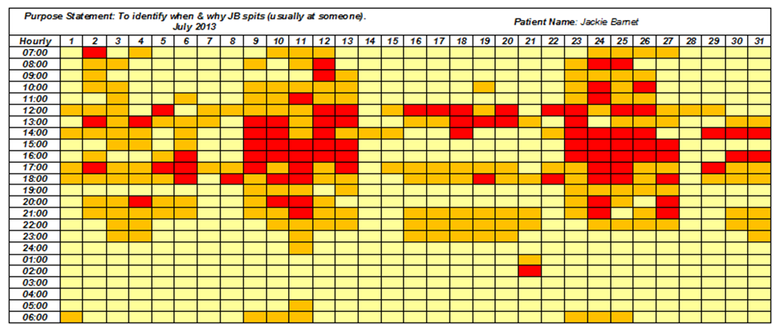
Behaviour Monitoring Chart (completed)
Slide 71
Purpose Statement |  |  |  |  |  |  |  |  | Patient Name: _____________________________________________________
Hourly | 1 | 2 | 3 | 4 | 5 | 6 | 7 | 8 | 9 | 10 | 11 | 12 | 13 | 14 | 15 | 16 | 17 | 18 | 19 | 20 | 21 | 22 | 23 | 24 | 25 | 26 | 27 | 28 | 29 | 30 | 31
07:00
08:00
09:00
10:00
11:00
12:00
13:00
14:00
15:00
16:00
17:00
18:00
19:00
20:00
21:00
22:00
23:00
24:00
01:00
02:00
03:00
04:00
05:00
06:00

Slide 15
Behaviour support planning
Slide 72
Gather Information
Review the Personalised Plan
Look at the Information
Share the Personalised Plan
Create a Personalised Plan

Slide 16
Slide 73
Person-centred techniques for de-escalating behaviour viewed as challenging
Validate the person’s feelings
Keep an open posture
Use non-threatening body language
Avoid using words that challenge
Respect personal space
Keep calm
Ask for help
Policy and procedure

Slide 17
Slide 74
Keep exploring, understanding and applying positive and proactive ways of supporting people living with dementia who display behaviours viewed as ‘challenging’
“As their dementia progresses, people may be less able to enter our world – we may need to enter theirs and enjoy it with them.”
Barbara Pointon MBE
(Former carer; Ambassador for Alzheimer’s Society and Dementia UK )

Slide 18
Slide 75
End of Session 4
Thank you!

Slide 19
Slide 76
End of
Module 2

