Slide 1
Slide 1

Slide 2
Slide 2

Slide 3
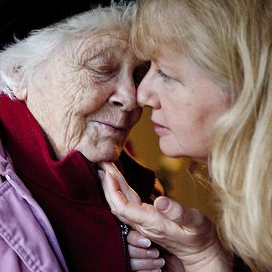
Slide 3
Module 4: Working with Families

Slide 4
Slide 4
Learning outcomes
By completing this Module, the learner will be able to:
Explore the impact of caring for a person with dementia, and the diverse and complex needs of families and carers.
Understand the importance of developing partnerships with family members and carers.
Understand the importance of recognising and assessing a carer’s own needs.
Support the families and carers of people with dementia to live well.

Slide 5
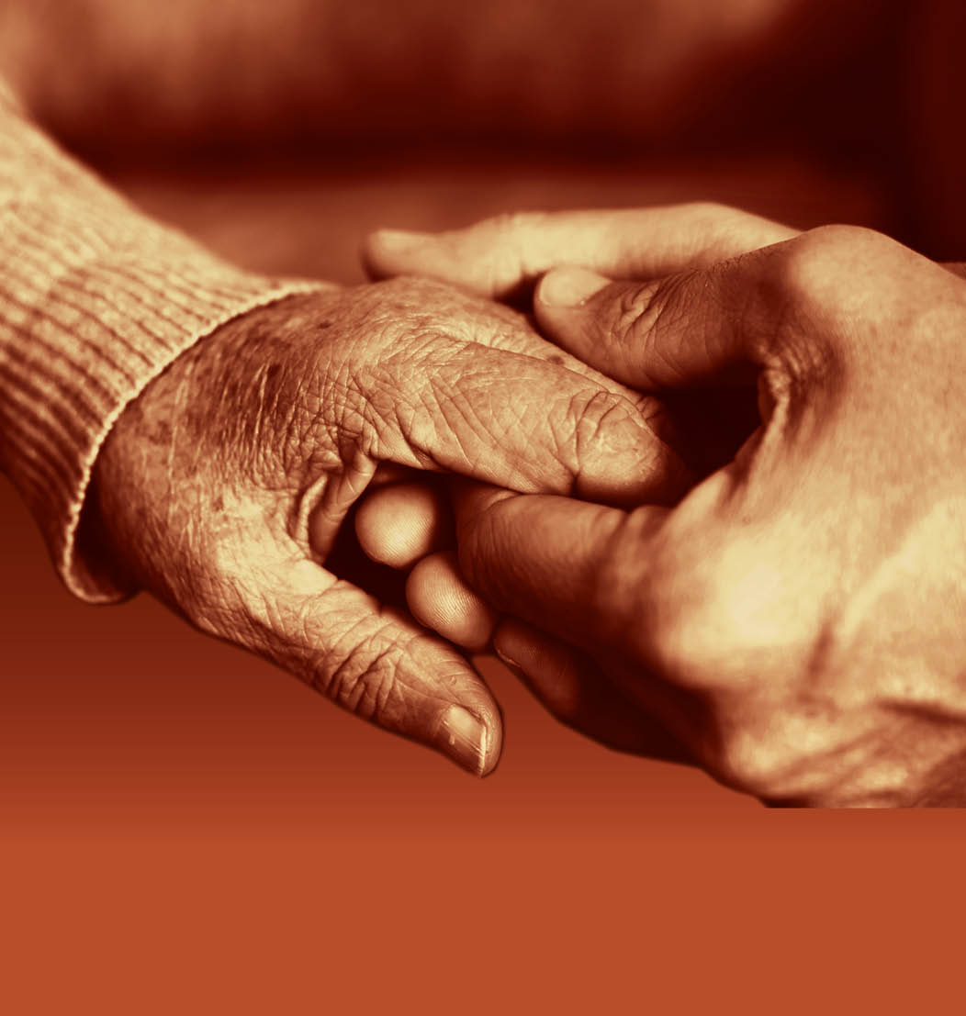
Slide 5
Session 1: The impact of caring for a family member with dementia

Slide 6
As a verb: If you care about something, you feel that it is important If you care for someone, you feel a lot of affection for them As a noun: You might specialise in the care of people with dementia We take great care in walking across the road
Slide 6
Defining the word ‘care’

Slide 7
Slide 7
Definitions of a ‘carer’ (1)
“A carer is anyone, including children and adults, who looks after a family member, partner or friend who needs help because of their illness, frailty, disability, a mental health problem or an addiction and cannot cope without their support. The care they give is unpaid.” (NHS England)
“You’re probably a carer if all of the following apply:
You do things like helping someone to wash, dress and eat; taking them to regular appointments, doing their shopping or keeping them company.
You aren’t paid to look after the person you’re caring for.
You spend a lot of time caring for the person - there’s no legal definition of this, but it could mean anything from a few hours a day, to 24 hours a day, 7 days a week.
You may or may not live with the person you’re caring for.” (Citizen’s Advice)

Slide 8
Slide 8
Definitions of a ‘carer’ (2)
“Put simply, a carer is anyone who looks after a family member, friend or partner who needs extra help. This could be because they’re ill, or have a disability or mental health problem. Carers are usually unpaid and can provide all sorts of emotional and practical support. Unpaid carers are different to paid care workers who earn money for looking after someone.” (Marie Curie)
“In every country around the world, individuals with disabilities, chronic health issues or frailty rely on unpaid care from family and friends. Known as unpaid carers, their role can range from helping with daily activities to more complex medical care. Although there are invaluable emotional benefits to providing care, being an unpaid carer can be time-consuming and take a heavy toll on the carer’s health and well-being.” (Embracing Carers)

Slide 9
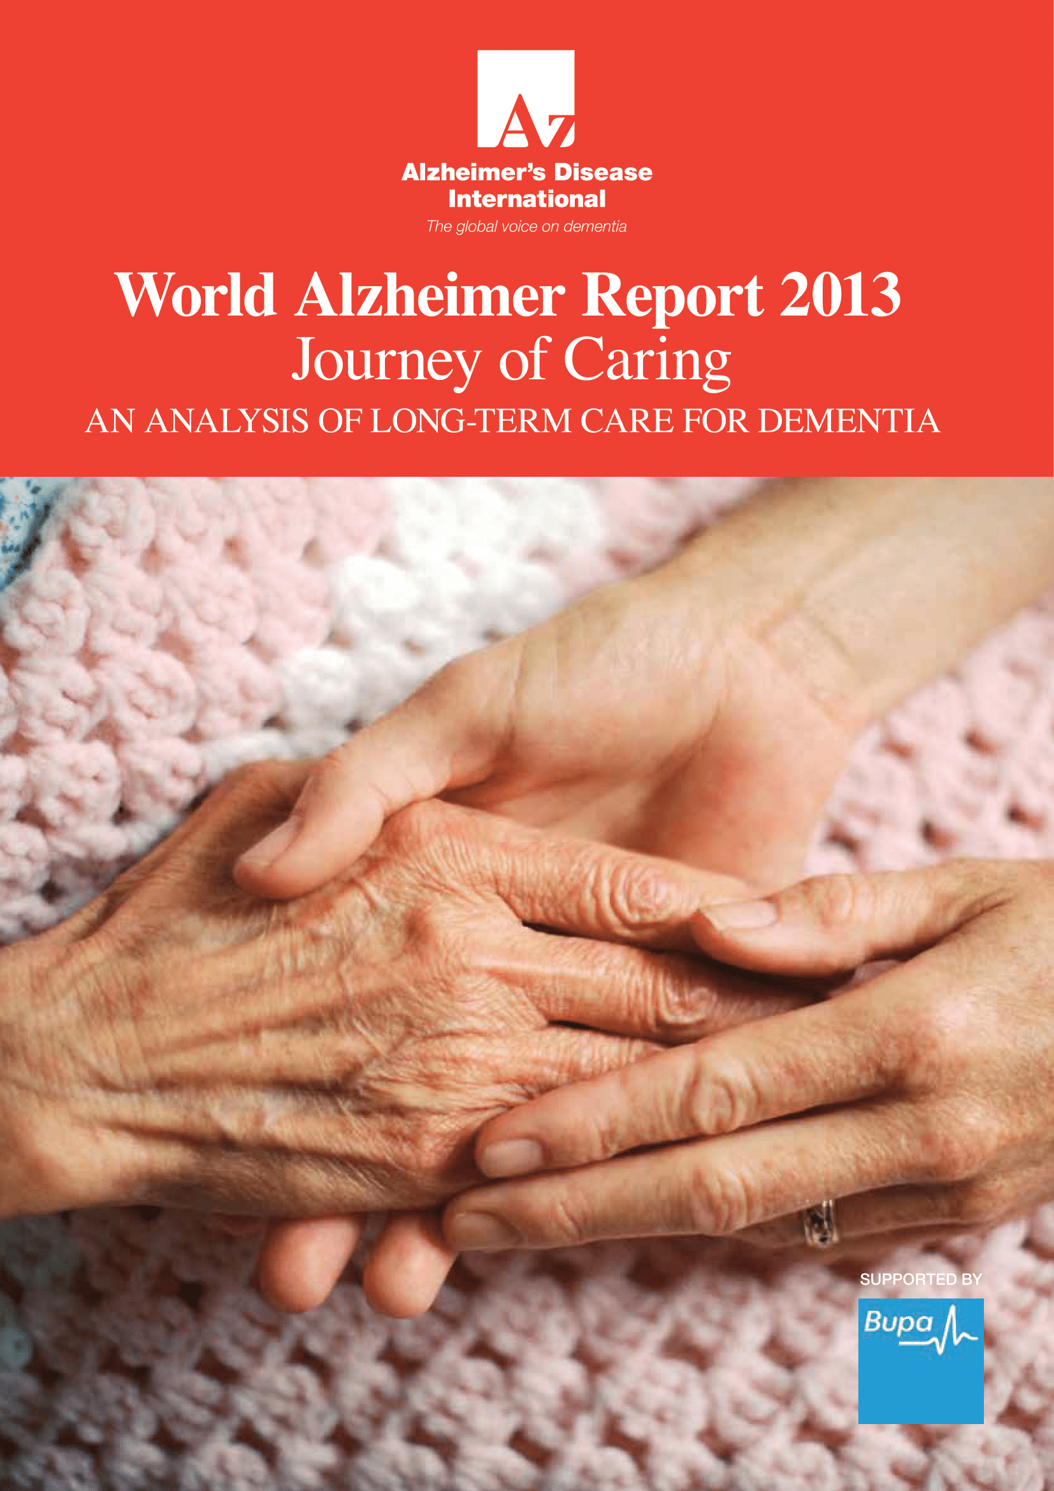
Slide 9
Alzheimer’s Disease International's definition of a carer
World Alzheimer Report 2013 ‘Journey of Caring: An analysis of long-term care for dementia’ “It is common to distinguish between care provided unpaid by family, friends and community, and care provided by paid care workers. Unpaid care provided by family is generally referred to as ‘informal’ care and paid care as ‘formal’ care.”

Slide 10
Being a carer for a person with dementia
Slide 10
Love
Fulfilment
Life changing
Loss
Sacrifice
Exhaustion
Pride
Fear
Duty
Giving back
Journey together… but apart

Slide 11
Dementia in the family: the impact on carers
Slide 11

Slide 12
Slide 12
Carers’ awareness of the pathology of dementia
Across the four carers there was a limited awareness of the pathological deterioration involved in dementia, which was closely linked to understanding of the biological processes behind the diseases that cause it. Some carers regarded dementia as simply a decline in memory, whereas others believed that all aspects of cognitive functioning were affected. Their understanding of this aspect of the condition was directly related to the symptoms that they had seen their loved one exhibit. Recent research supports this finding, and suggests that many carers do not attribute some symptoms to the condition because of a lack of understanding.
Existing evidence suggests that by increasing their knowledge of the condition, both from a biological and caring perspective, carers can improve the quality of care they provide and increase their own ability to manage the situation. However, there was little appetite amongst family carers to deepen their knowledge of the disease. News articles were the most accessible source of information, but most had little time, energy or appetite to absorb new information, and some appeared not to want to find out more. The prospect of learning more about the condition was linked to an unhappy vision for the future that would only exacerbate worry and unhappiness.

Slide 13
Slide 13
Changing relationships
Caring for their loved one also affected the carers’ relationships with other family members, because of the resentment and guilt caused by one family member taking on the vast majority of the caring responsibility.
Existing research shows that family carers often treat their loved one in a different, more infantile way because of the impact of the condition on their behaviour and personality. The carers we spoke to all demonstrated this to an extent, and they particularly struggled to cope with behaviours such as anger and frustration, which sometimes in turn led to physical violence by the person with dementia. The emotional impact of all these factors led carers to become frustrated and depressed.
Carers’ relationships with siblings typically became strained as the amount of care required increased. This led to some siblings falling out with each other and to feelings of resentment. Carers UK suggest that 57% of carers lose touch with family or friends as a result of their caring responsibilities, leading to increased isolation and emotional distress. Carers also felt that other family members did not understand the physical and emotional strain that caring places on them, which led to further resentment.
Despite the challenges and frequent negative impact, caring is often a very rewarding experience that can strengthen the bonds in a relationship. There were elements of caring that the carers we spoke to viewed in a far more positive light. This included seeing behaviours which reminded them of the family member before the onset of the condition, and the bond created through the close and intimate relationship they now shared.

Slide 14
Slide 14
Social isolation
This is not unusual; according to Carers UK, 83% of carers have felt lonely or socially isolated as a result of their caring responsibilities. Despite this isolation, the carers strongly emphasised the positive aspects of being able to provide support at such a crucial time in their loved one’s life.
The absence of a social life was a sacrifice recognised by carers, but they considered it their duty and responsibility to look after their loved one. Care for their family member was prioritised over their own well-being, and this finding corresponds to the findings from other studies. It was clear that all four carers sacrificed their social lives to provide round the clock care for their loved one, but this was justified through a strong sense of duty and responsibility. They prioritised their caring responsibilities over personal time, holidays and romantic relationships.

Slide 15
Slide 15
Physical and psychological health
Existing research suggests that stress is a common problem for carers of people with dementia. The responsibility of providing round the clock care had a negative impact on the carers’ psychological well-being, and this was exacerbated by the sadness of feeling that they were gradually losing their loved one.
Changes in the behaviour and personality of the person with dementia also caused stress and frustration. Carers have to constantly adapt their emotional and physical relationship to the shifting needs of the person with dementia.
The physical health of carers is often poor. They may be exhausted as a result of sleep deprivation, carrying out household chores, extra cleaning and laundry as well as moving or lifting their loved one.
The high level of responsibility carers feel towards their caring duties, in combination with selflessness, leaves some carers feeling ambivalent towards the maintenance of their own health. This lack of self-care is alarming, as evidence shows that a carer’s ability to provide high quality care decreases in line with their own health. Despite wishing to prioritise the health of their loved one, if their own health deteriorates then this will ultimately have a detrimental impact on their ability to care for them.

Slide 16
Slide 16
The financial cost
Carers may need to turn down job opportunities, promotions and so on if the potential new role is not flexible enough to meet the needs of their caring role.
In addition to reduced work opportunities and income, there are direct financial costs to providing care. These include:
• higher energy bills
• specialist food
• higher phone bills
• higher transport costs
• care products
• equipment and adaptations
Among the biggest increased costs experienced by the carers was increased use of utilities because the family were at home most of the day, as well as increased levels of washing due to incontinence.
Carers report using up their savings to meet the additional costs.

Slide 17
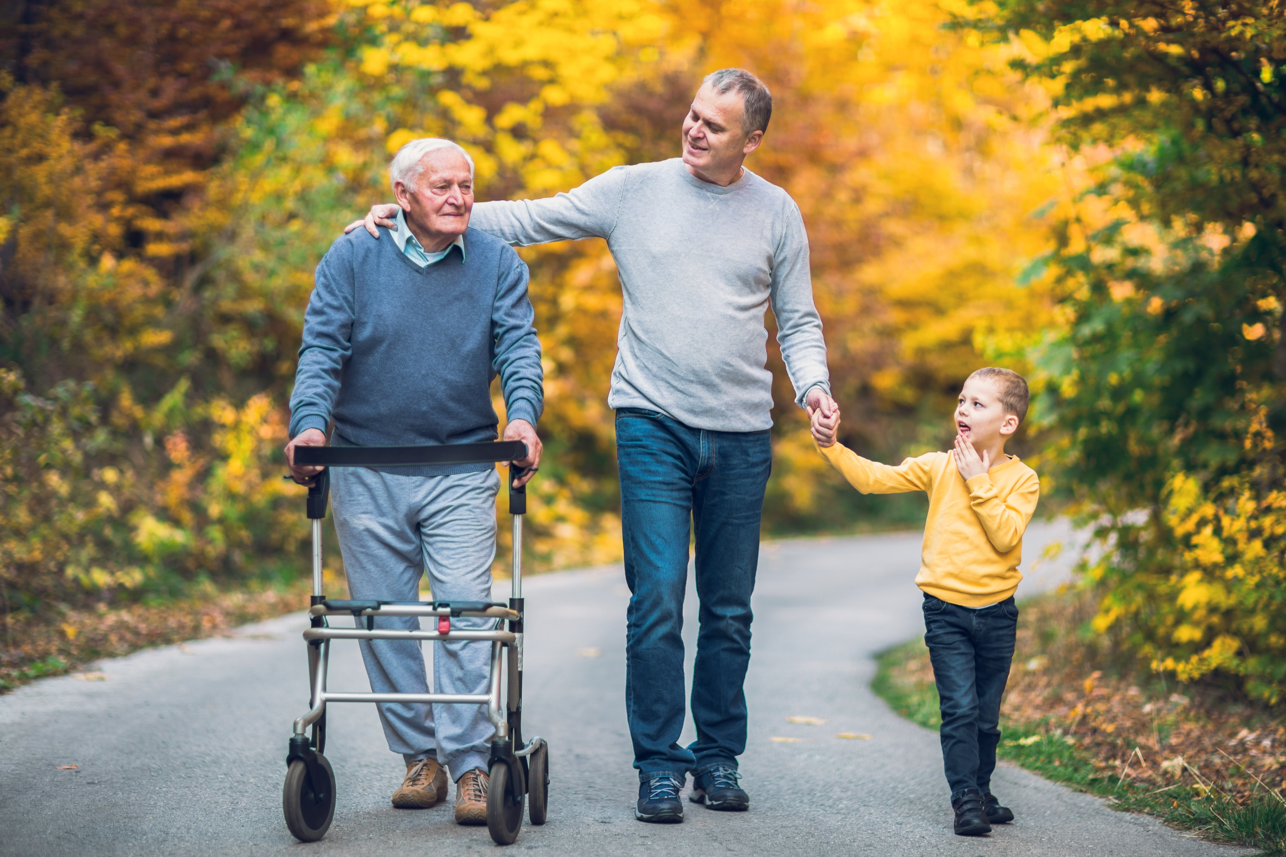
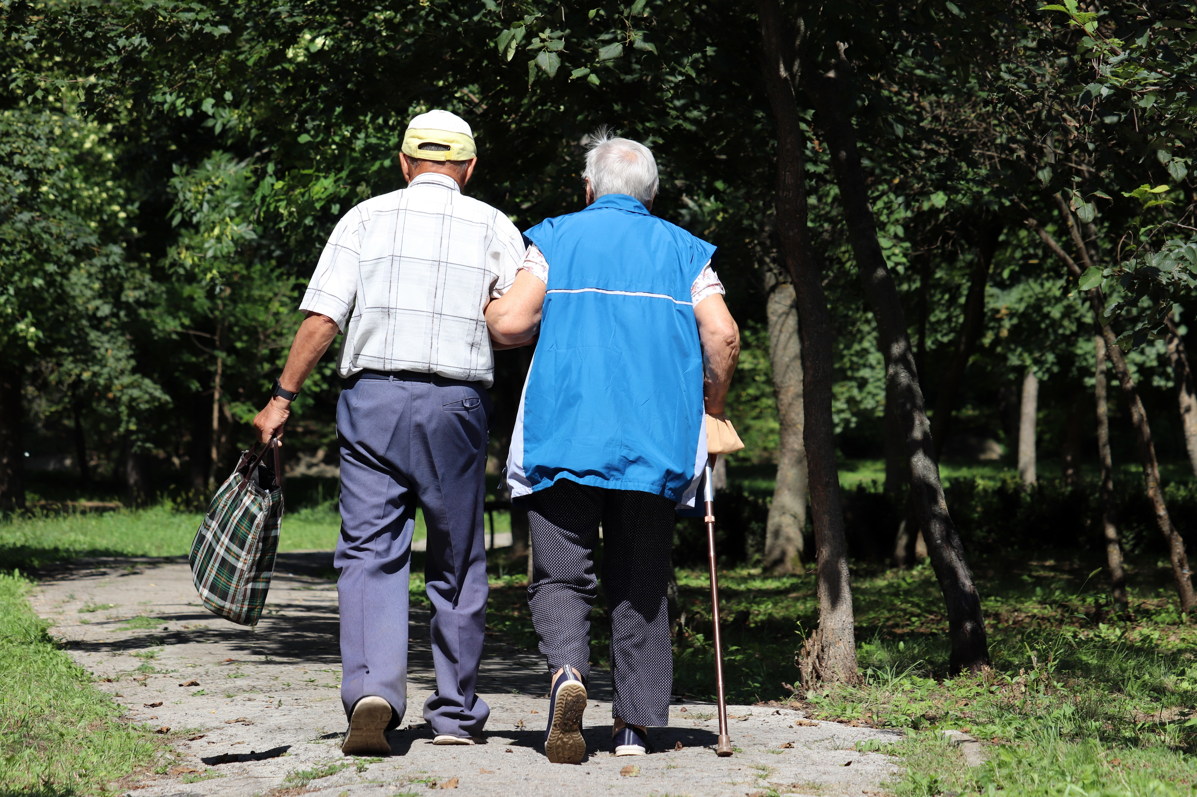
Slide 17
Sharing the journey but taking different paths

Slide 18
Slide 18
Recognised, valued and supported –
next steps for the Carer’s Strategy
Vision:
Carers will be universally recognised and valued as being fundamental to strong families and stable communities. Support will be tailored to meet individuals’ needs, enabling carers to maintain a balance between their caring responsibilities and a life outside caring, while enabling the person they support to be a full and equal citizen.
Outcomes:
Carers will be respected as expert care partners and will have access to the integrated and personalised services they need to support them in their caring role.
Carers will be able to have a life of their own alongside their caring role.
Carers will be supported so that they are not forced into financial hardship by their caring role.
Carers will be supported to stay mentally and physically well and treated with dignity.
Children and young people will be protected from inappropriate caring and have the support they need to learn, develop and thrive and to enjoy positive childhoods.

Slide 19
Slide 19
End of Session 1
Thank you!

