Slide 1

Slide 1

Slide 2
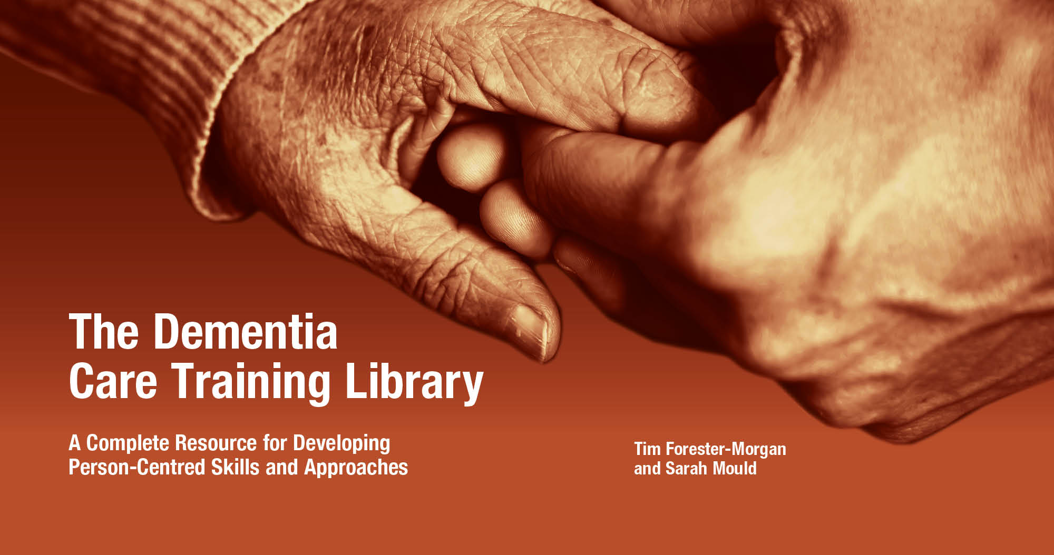
Slide 2

Slide 3
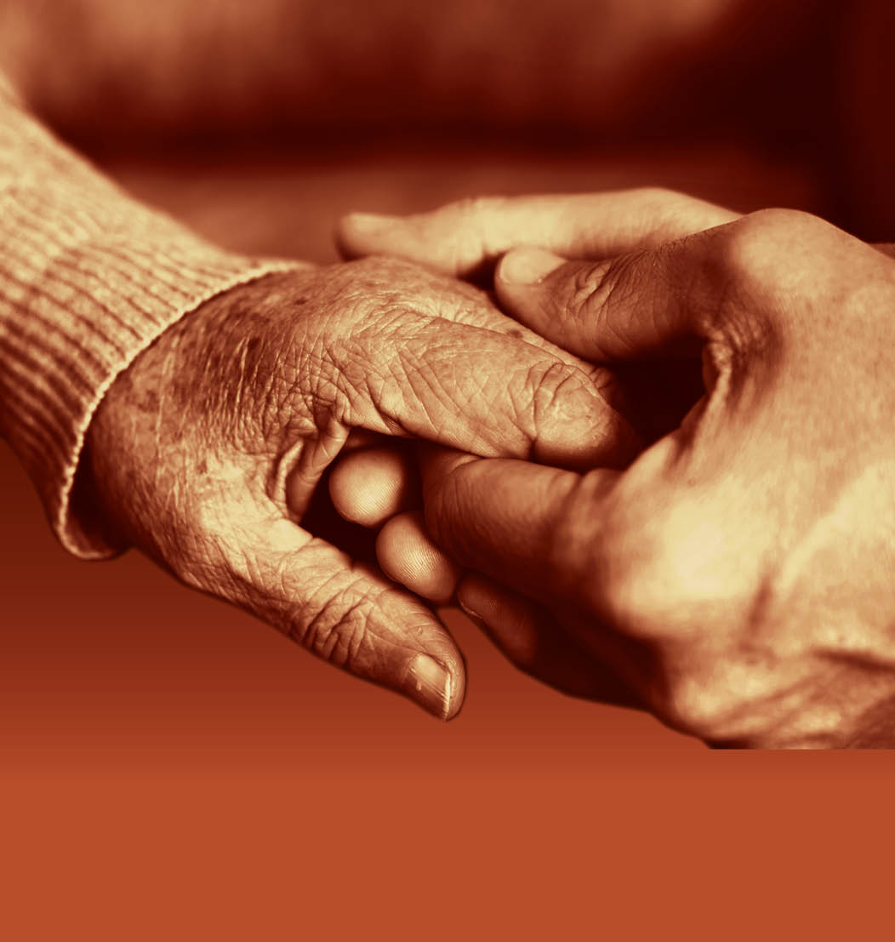
Module 3: Person-centred Practice
Slide 3

Slide 4

Slide 4
Learning outcomes
By completing this Module, the learner will be able to:
Understand the experience of well-being.
Understand approaches that enable individuals with dementia to experience well-being.
Understand the roles of carers in the care and support of individuals with dementia.
Understand the roles of others in the care and support of individuals with dementia.

Slide 5
Slide 5
Session 1:
What is
well-being?

Slide 6
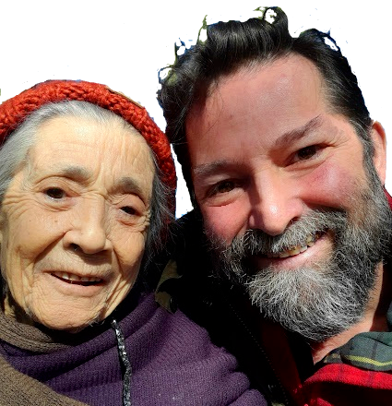
Exploring the experience of well-being
Slide 6

Slide 7
Take a moment to think about who you are…
Slide 7
If you had to write your own care plan, what key messages would you want highlighted?
If you ever needed to receive care, what would you want people to know?

Slide 8
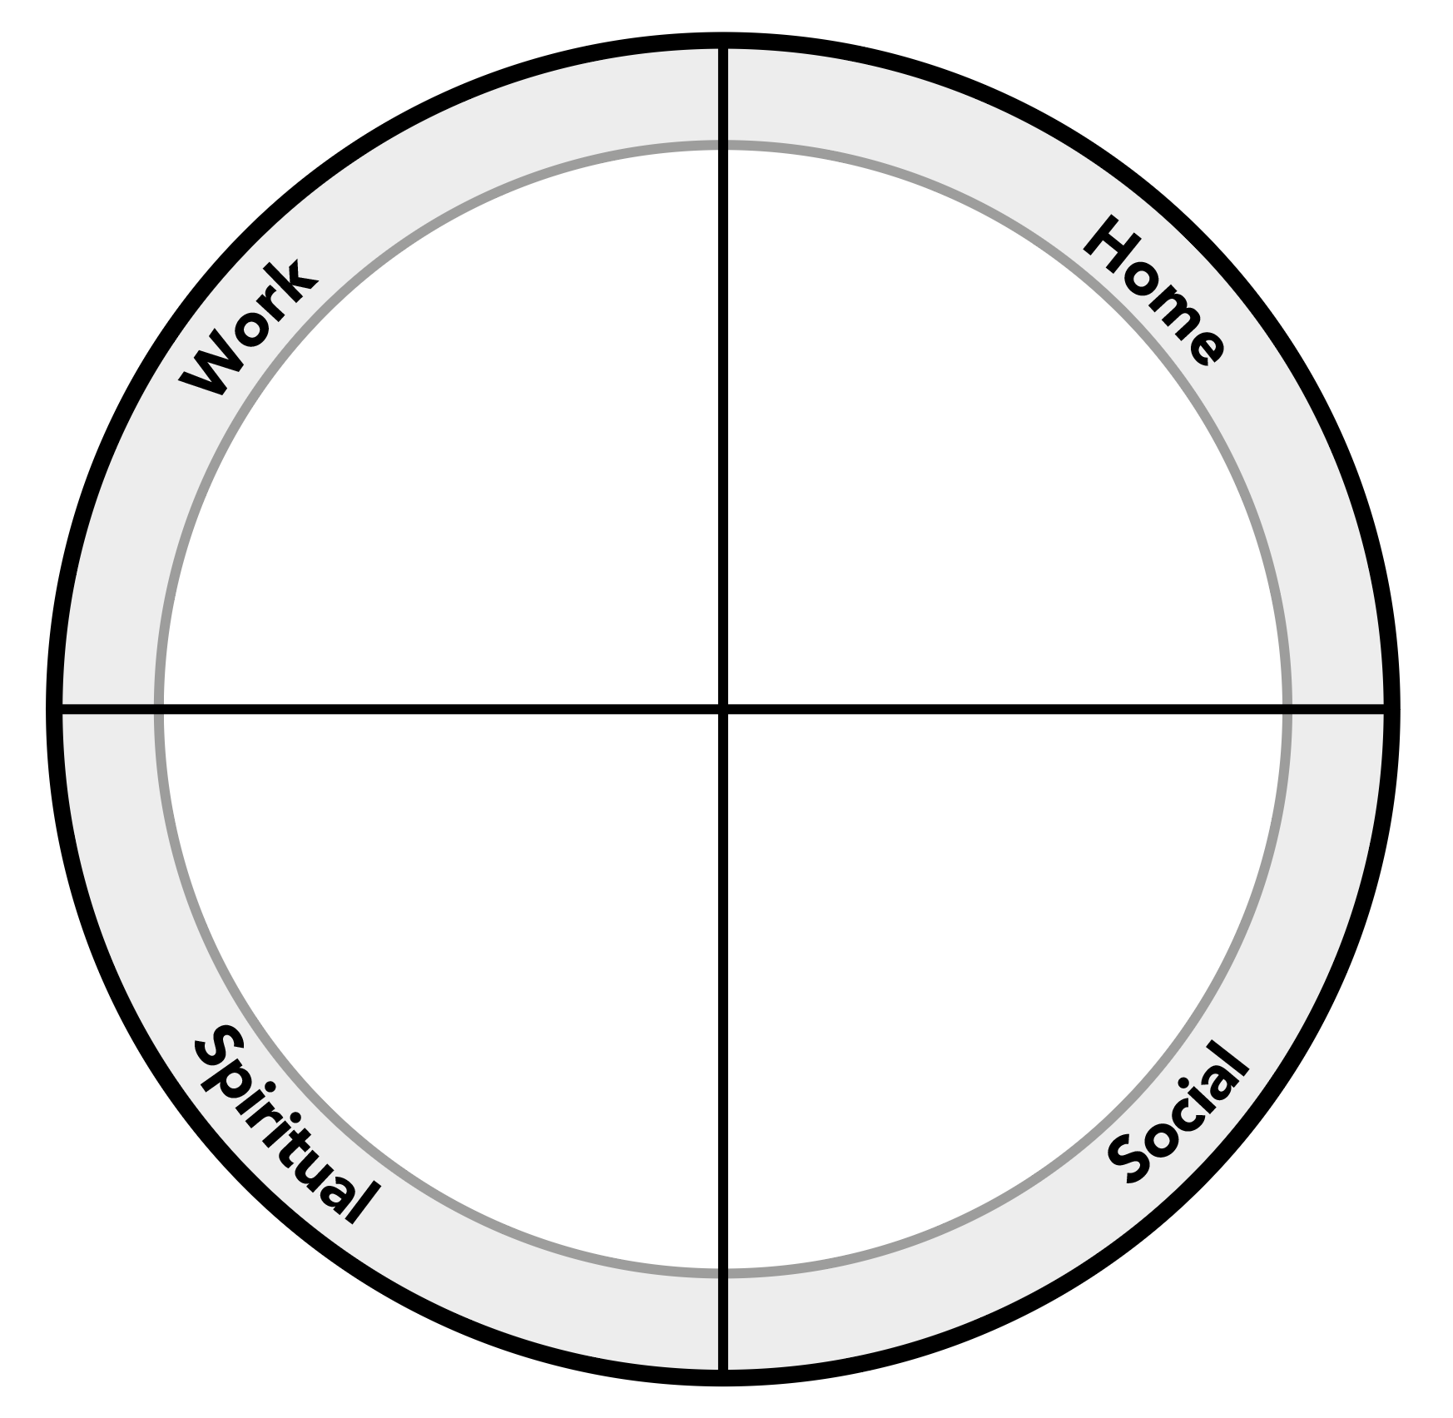
Slide 8
The Wellness Wheel

Slide 9
Slide 9
The PERMA Model
Seligman, M. (2011) Flourish: A New Understanding of Happiness and Well-Being - and How To Achieve Them. Nicholas Brealey Publishing

Slide 10
The Human Becoming Theory
Slide 10
Parse, R.R. (1996) ‘Quality of life for persons living with Alzheimer's disease: the human becoming perspective’. Nursing Science Quarterly.
This theory states that people have a combination of biological, psychological, sociological and spiritual factors that need to work together to enable the person with dementia to experience a higher level of well-being and better quality of life.
It is essential that the whole environment (including access to appropriate outdoor spaces, familiar and recognisable built environments, professional approaches, effective communication opportunities, access to appropriate activities of daily living, etc.) is appropriate and supportive of the person with dementia.

Slide 11
The Dementia Quality of Life Instrument (DQoL)
Slide 11
Brod, M., Stewart, A.L., Sands, L. & Walton, P. (1999) ‘Conceptualization and Measurement of Quality of Life in Dementia:
The Dementia Quality of Life Instrument (DQoL)’. The Gerontologist, Vol. 39, No. 1, 25-35.
It was identified following the research-based development of this instrument that “dementia affects all traditional domains of quality of life (QoL), confirming our belief that the impact is multidimensional”.
Furthermore, it was identified that there are five specific Quality of Life concepts (which were taken directly from people with dementia and/or their advocates). These are:
Self-esteem (Feeling accomplished, confident, able to make own decisions)
Positive Affect/Humour (Feeling content, happy and hopeful, joking and laughing with others)
Absence of Negative Affect (Feeling lonely, worrying, frustration, depression, anxiety, sadness, fear, irritability, embarrassment and anger)
Feelings of Belonging (Feeling loveable, feeling that people like me and feeling useful).
Sense of Aesthetics (Feeling pleasure from sensory awareness, looking at colourful things,
enjoying beauty, nature, music and watching animals and/or birds, seeing the sky)

Slide 12
Slide 12
The Four Global States of Well-being Model
Kitwood T. & Bredin, K. (1992) ‘Towards a Theory of Dementia Care: Personhood and Well-being’.
Ageing & Society, Volume 12, Issue 3, 269–287.
Hope: a sense that there are opportunities for positive experiences, and that others will be kind and helpful
Agency: a sense of autonomy, of being able to make things happen and have an impact on the world
Hope
Agency
Self-esteem: having confidence in your own abilities, feelings of self-respect and a sense of being a worthwhile person
Social Confidence: receiving positive messages from others, feeling confident to explore things and do what you enjoy
Self-esteem
Social Confidence

Slide 13
The Bradford Well-being Profile
Slide 13
`The Bradford Well-being Profile’ (2008). University of Bradford, School of Health Studies.
The Bradford Well-being profile can be used to:
Observe and monitor how people with dementia are engaging over an period of time.
Provide a framework for everyone to discuss the social and emotional needs of people with dementia.
Support assessments of social and emotional needs through observation and discussion.
Help care plan development by addressing social and emotional aspects of care.

Slide 14
Slide 14
End of
Session 1
Thank you!

