Slide 1
Session 2: An activity-based approach to eating and drinking well

Slide 2
An activity-based approach
An activity-based approach is based on the fundamental belief that everything a person does has the potential to be experienced as an activity, if it is presented in a way that the person can, and wishes, to engage in. This means that not only leisure but also personal care is viewed as an activity that can provide fulfilment and enjoyment for individuals receiving support.
A therapeutic relationship creates a helpful social environment within which the person with dementia is facilitated to reach his or her potential to carry out activities and connect with others.
If all staff understand that everything they do with an individual with dementia is an activity, then the quality of experience for both the person with dementia and staff member will be heightened, especially if time is limited.
Engaging in ‘activity’ is not about being ‘entertained’. It is about participating in a meaningful and fulfilling experience. Being active is a fundamental aspect of what it means to be human. Unless it is stymied in some way, the impetus to be active drives us all to try new things, enjoy old things, be with others, express our identity, be emotional and reinforce who we are… and why we are.

Slide 3
SP = Social Psychology

Slide 4
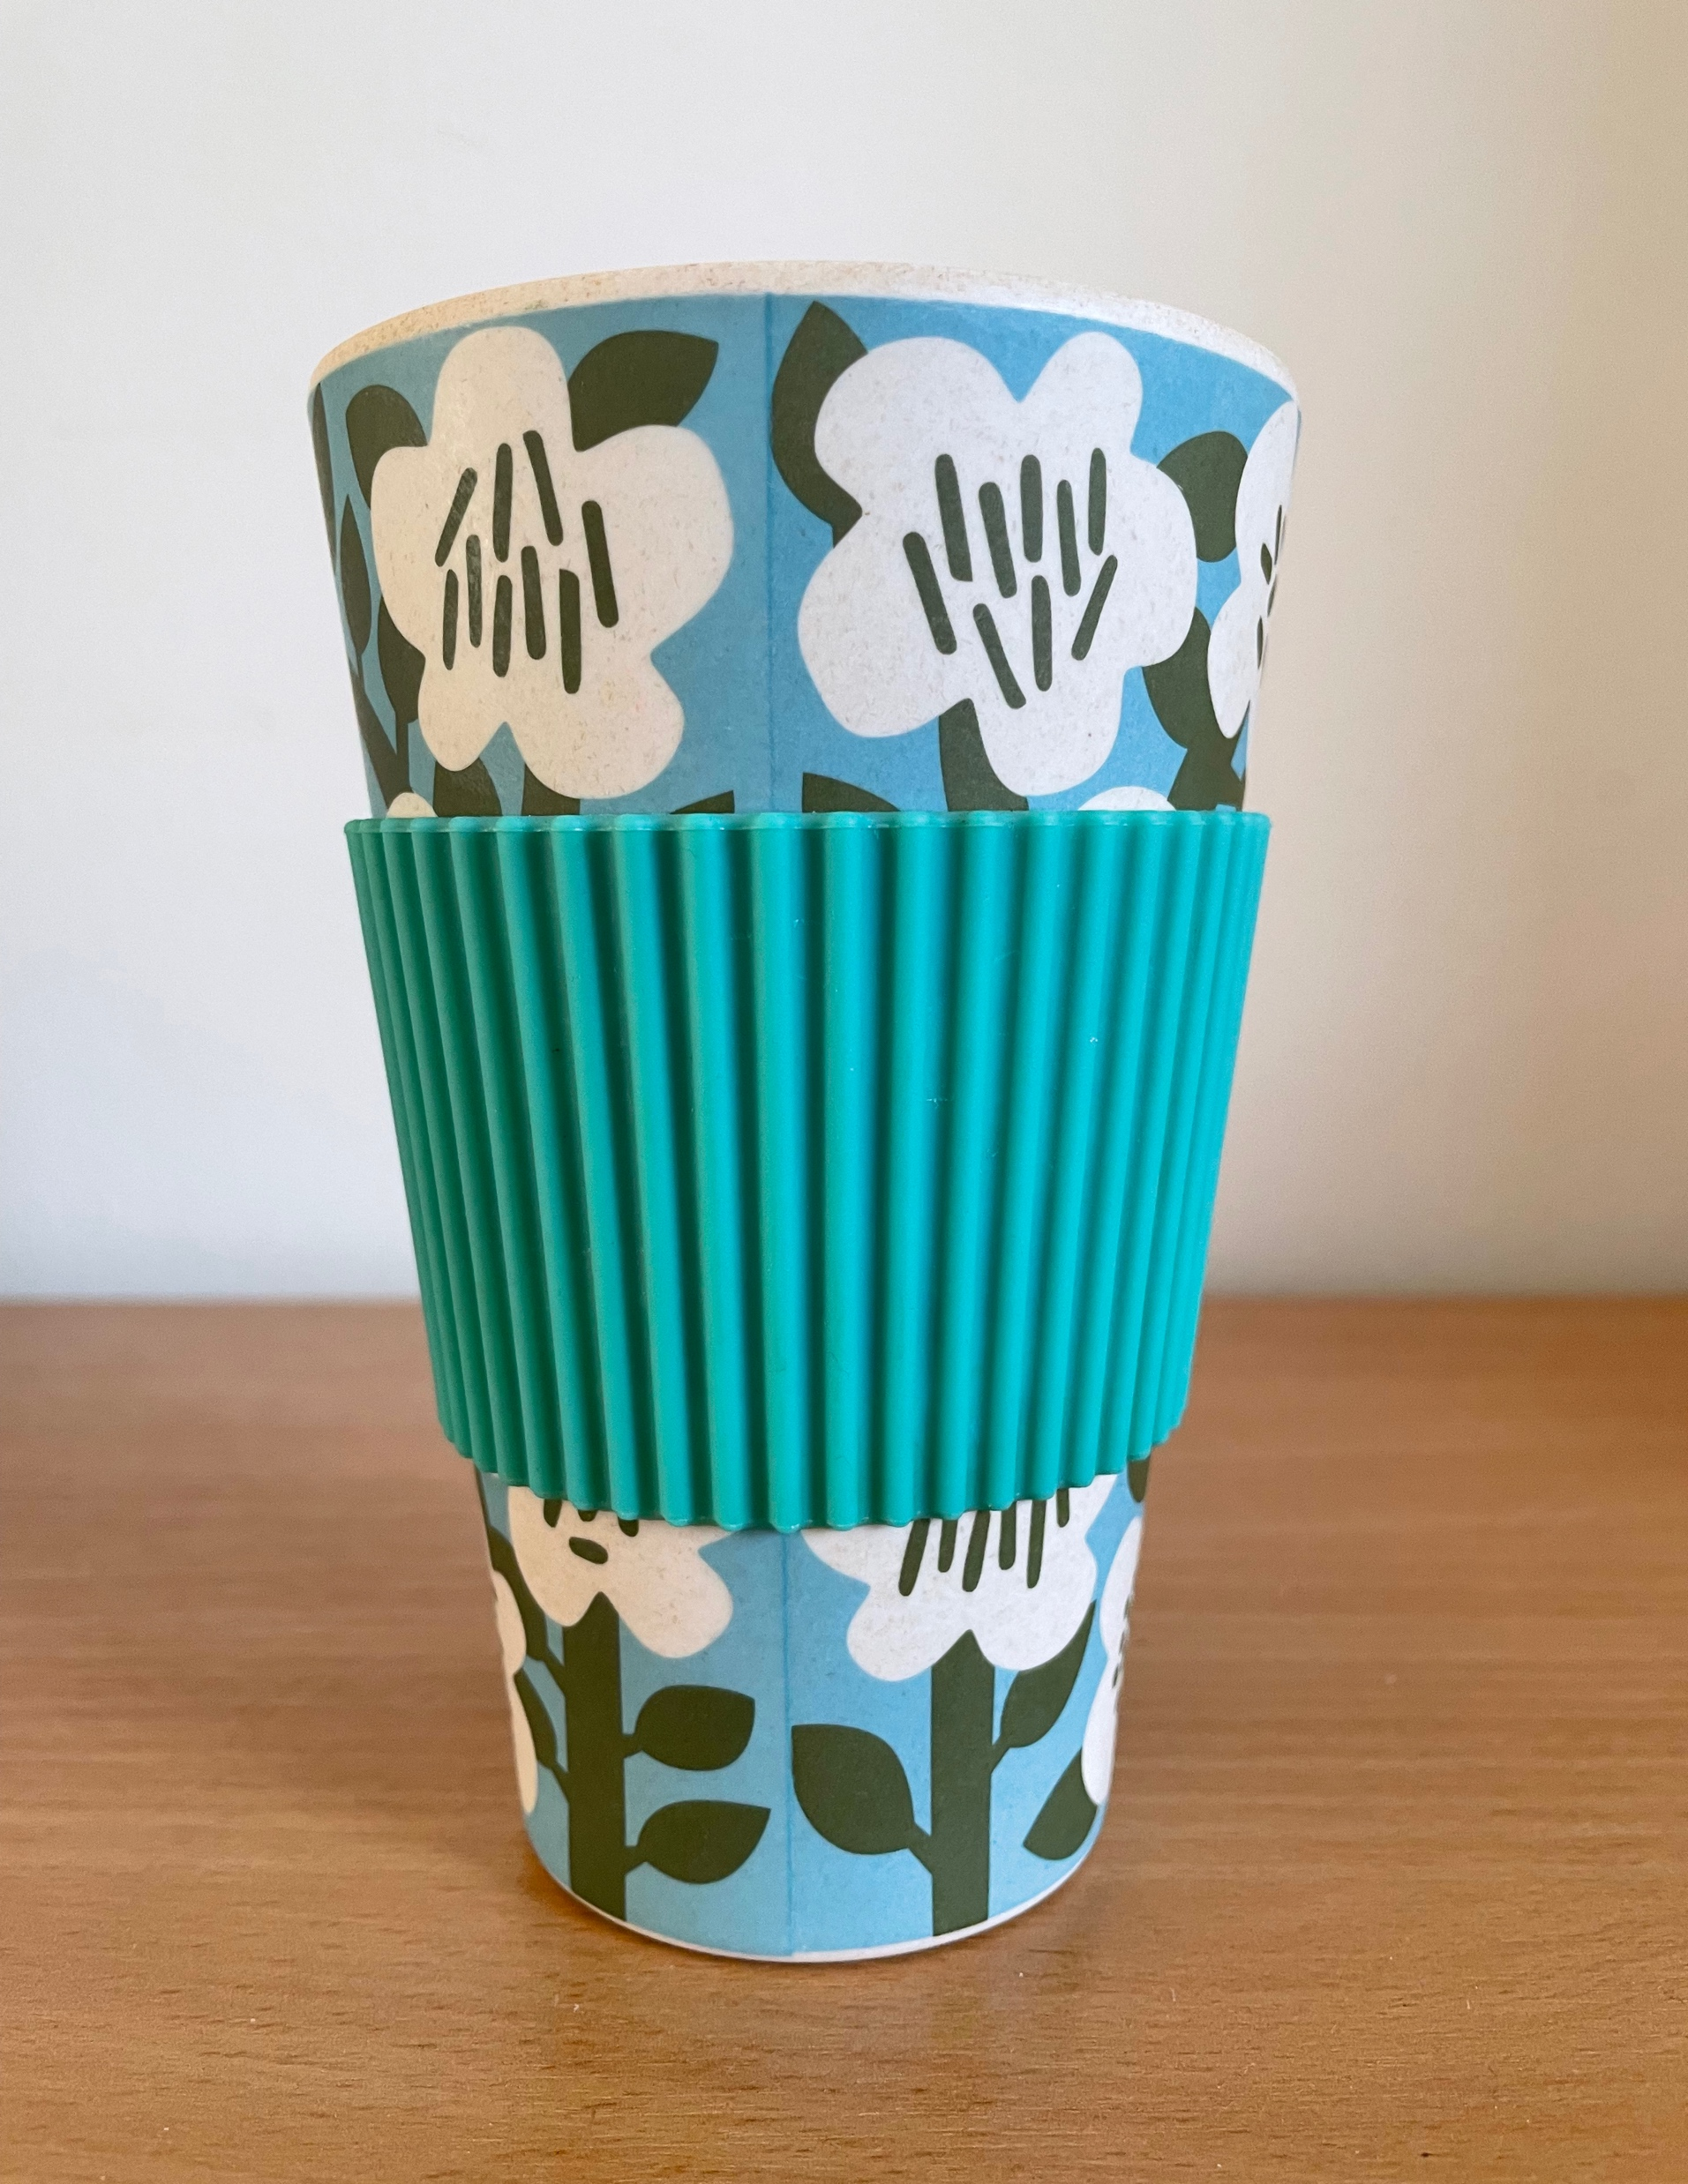
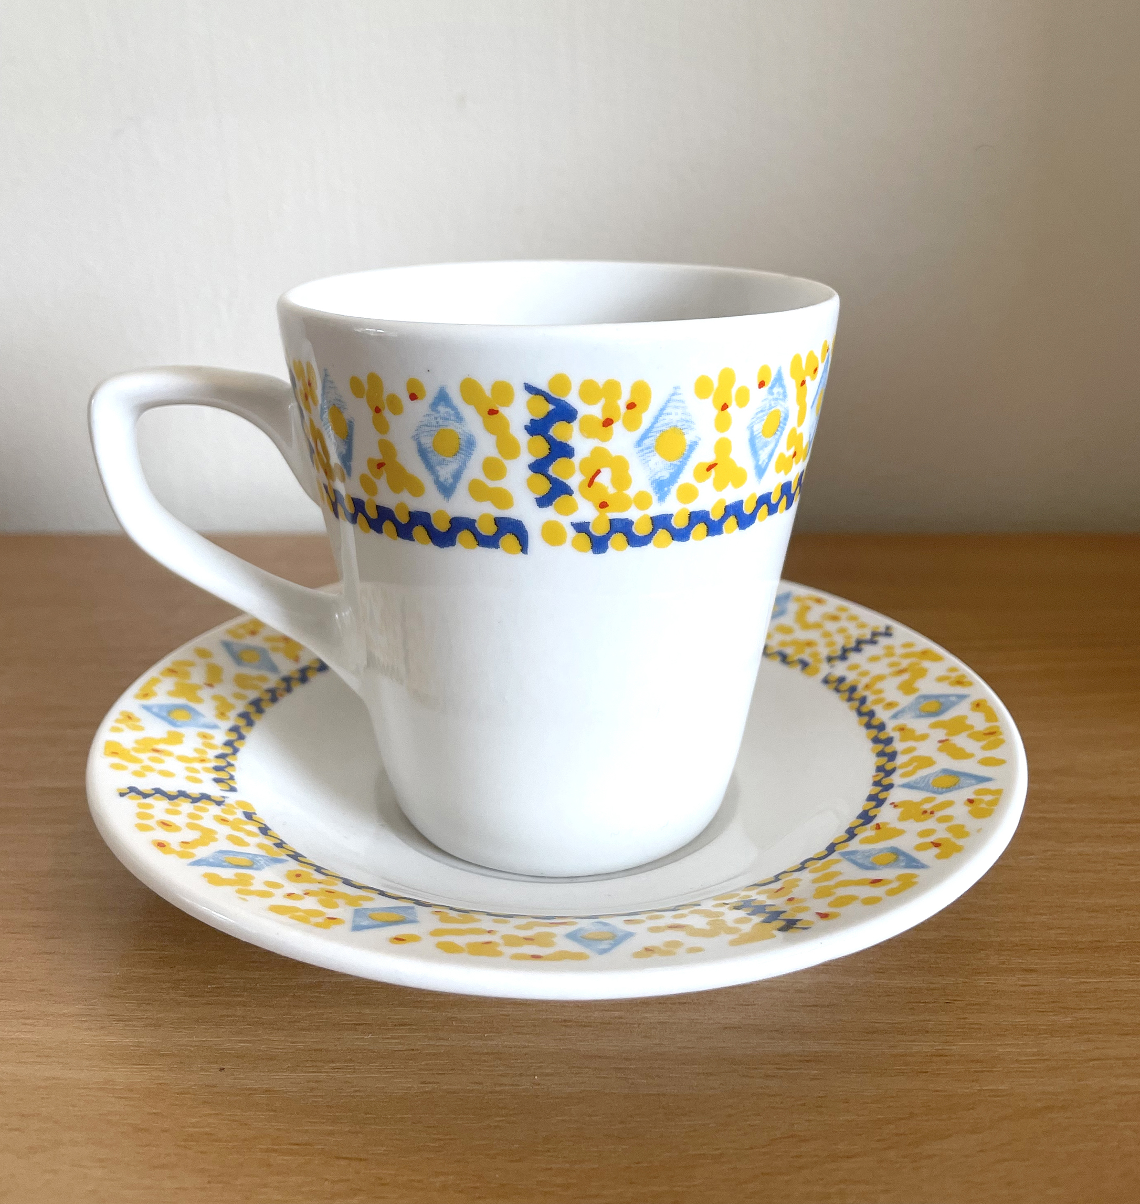
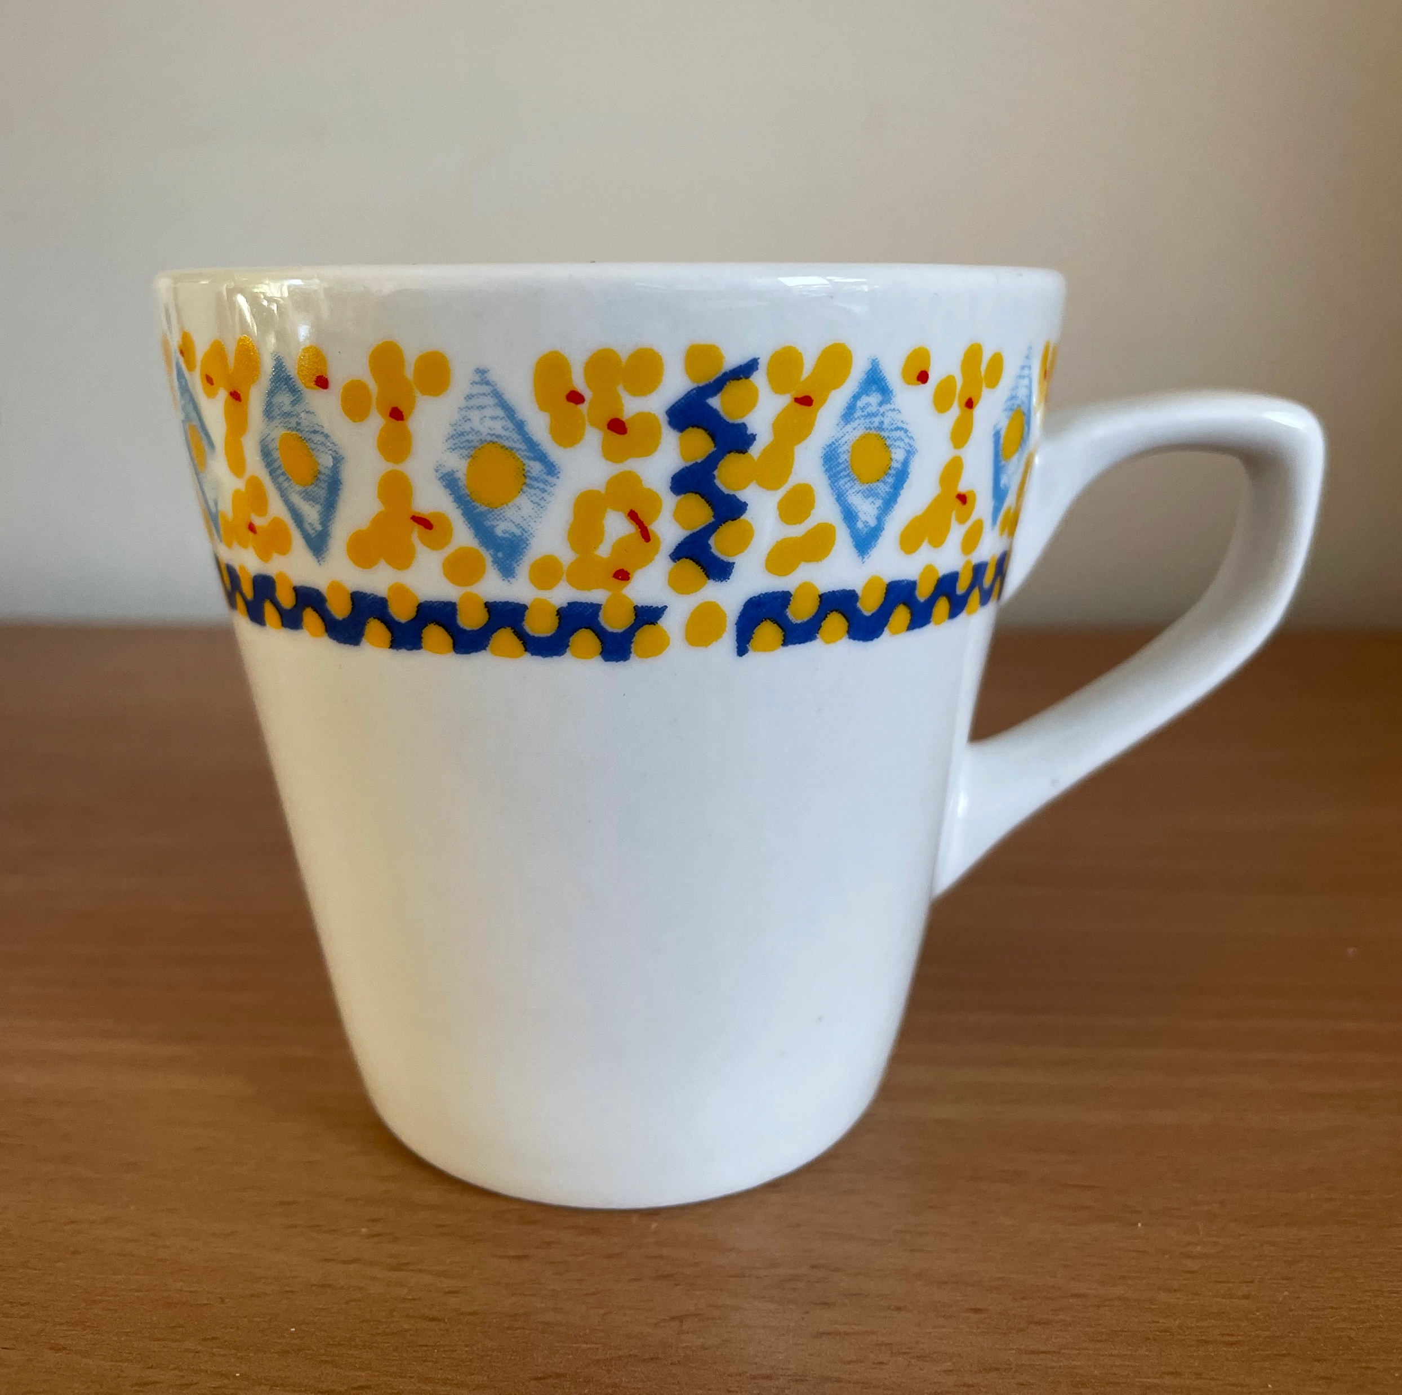
Mugs and cups

Slide 5
End of Session 2
Thank you!

