Slide 1
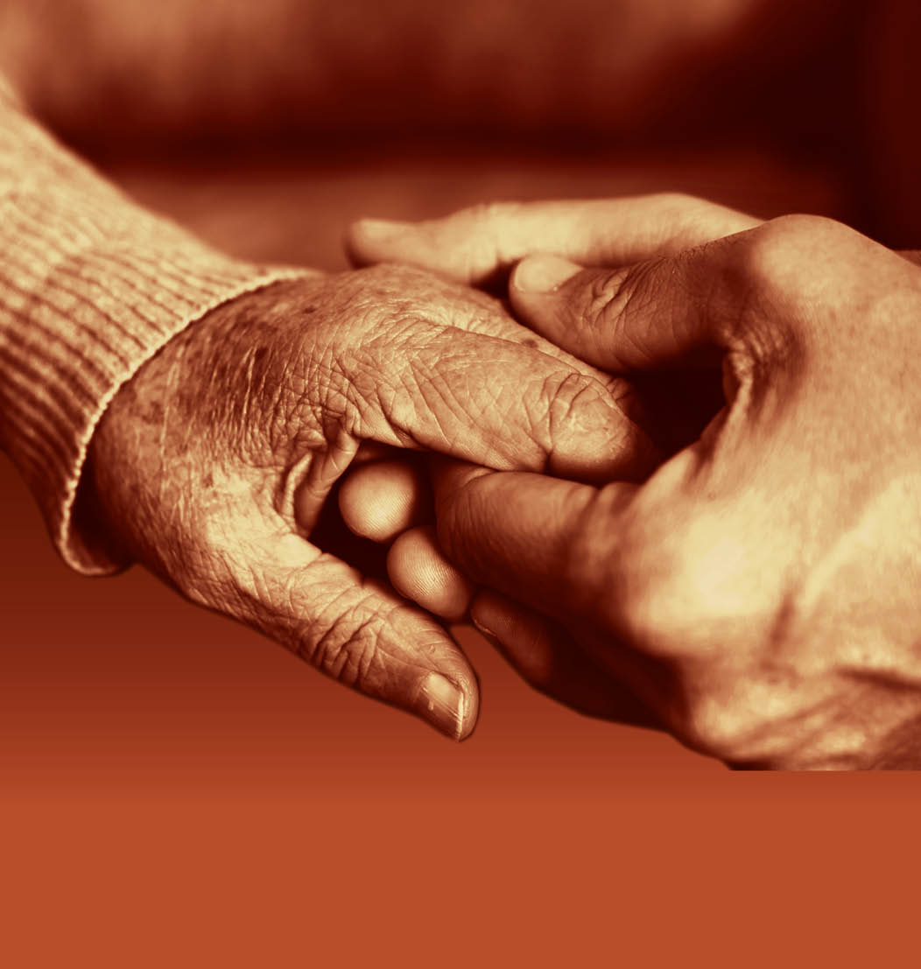
Slide 20
Session 2: The diverse experiences of family carers of people with dementia

Slide 2
Slide 21
Applying the person-centred approach to carers of people with dementia
D = P + B + H + NI + SP
D = Dementia
P = Personality
B = Biography (life history)
H = Health
NI = Neurological Impairment
SP = Social Psychology

Slide 3
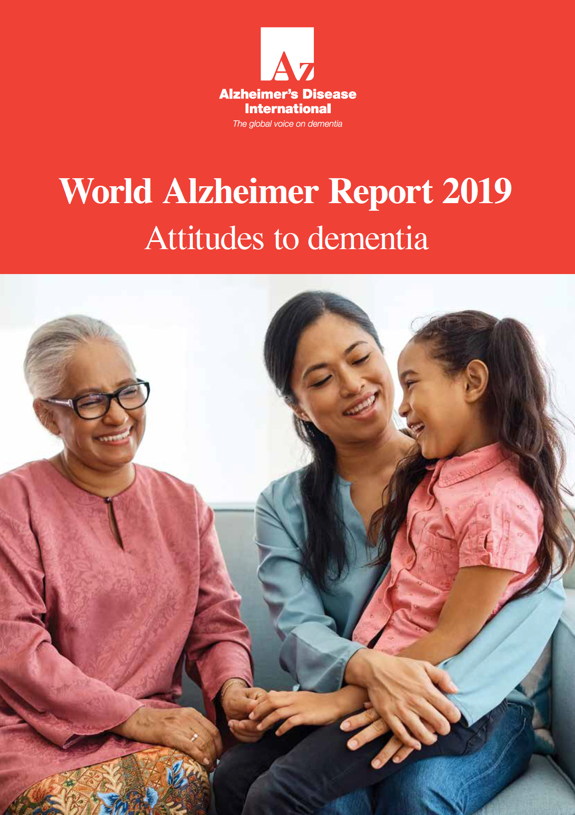
Slide 22
ADI World Alzheimer Report ‘Attitudes to dementia’ 2019
The research found that globally:
The majority of carers expressed positive sentiments about their caring role
52% of carers said their health had suffered
49% of carers said their work had suffered
62% of carers said their social life had suffered
Over 35% of carers globally have hidden the diagnosis of a person with dementia

Slide 4
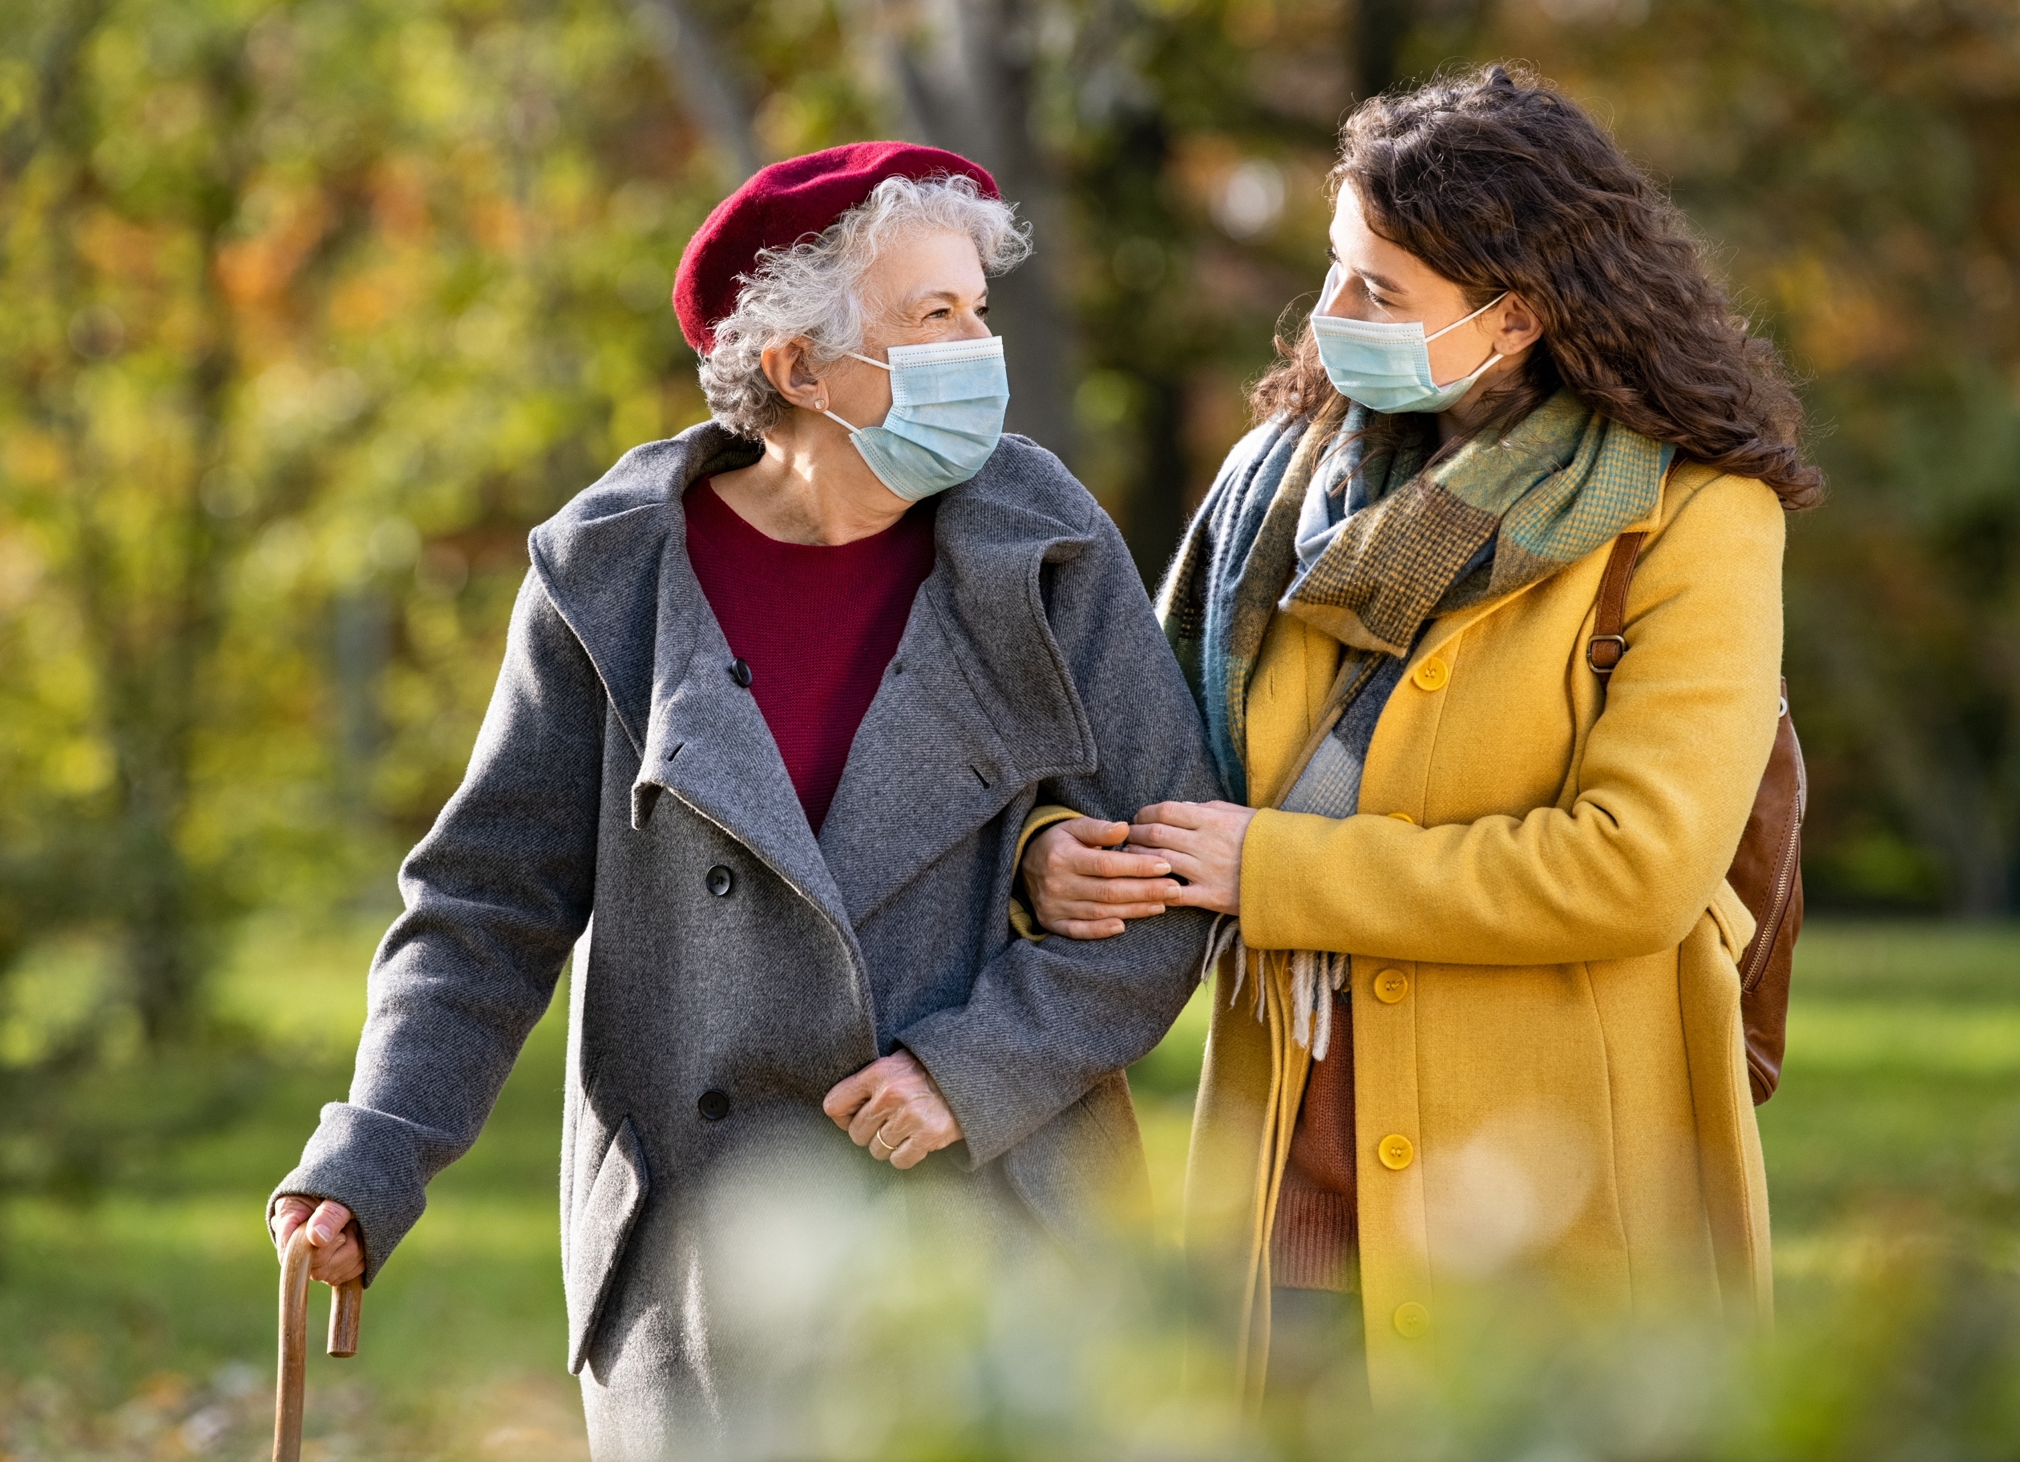
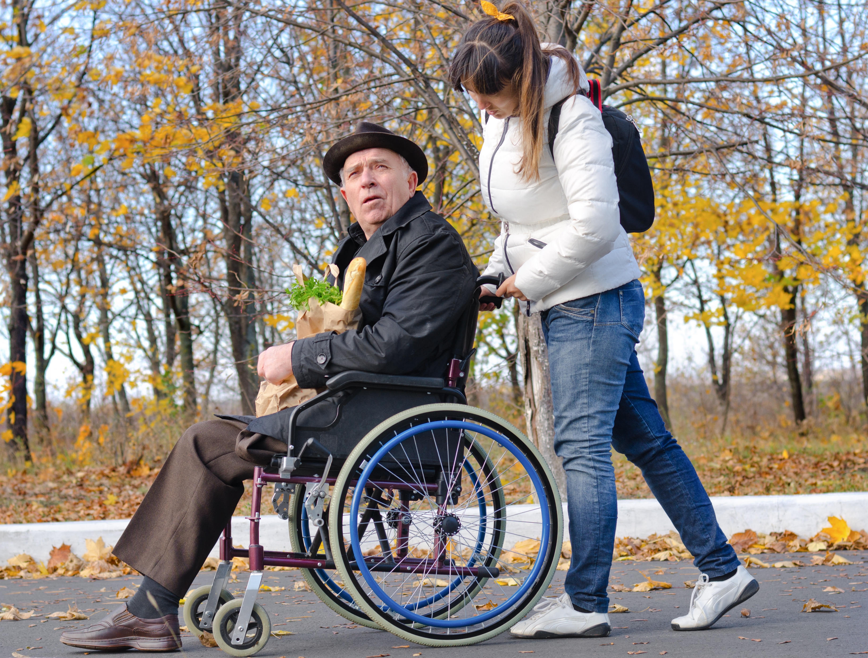
Slide 23
The gendered experience
“Between 60% and 70% of all family carers of people with dementia are women. Female spouses, daughters and daughters-in-law are more likely to take on the caring role compared to their male counterparts.”

Slide 5
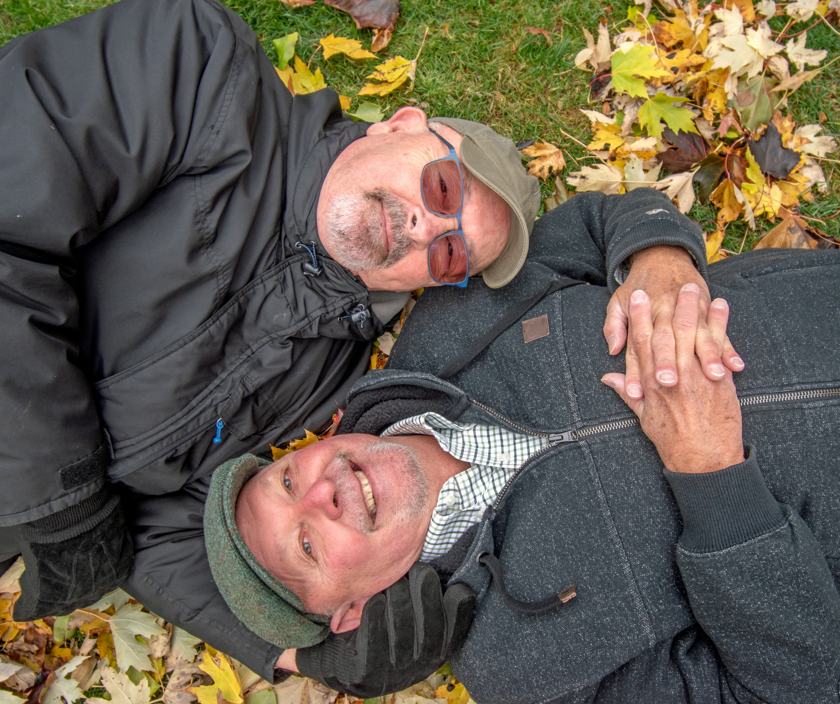
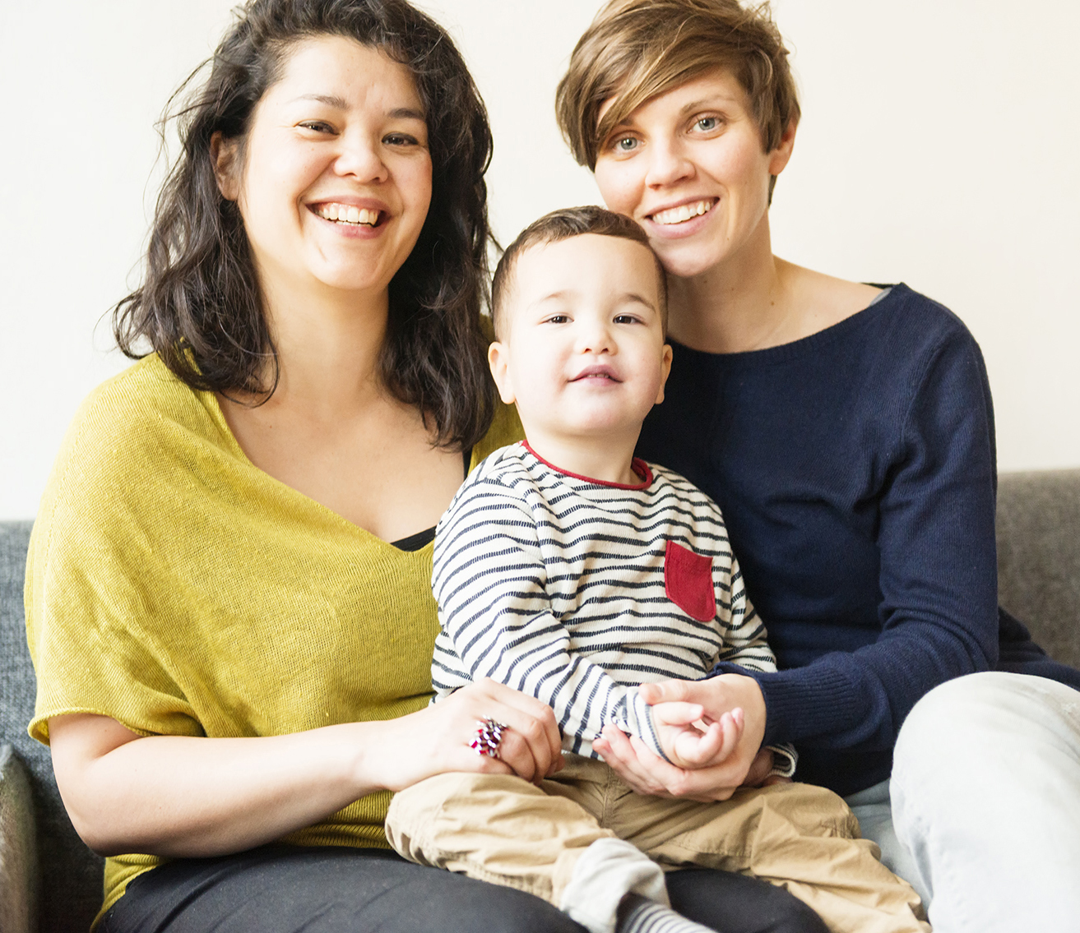
Slide 24
Dementia in the lived experience of lesbian, gay, bisexual, trans and gender diverse (LGBT) people
All aspects of life are impacted by the passage of time, and just as a person’s needs in relation to health, education, housing, employment and family relations alter as we age, so the particular concerns of lesbian, gay, bisexual, trans and other gender diverse persons also evolve and change.

Slide 6
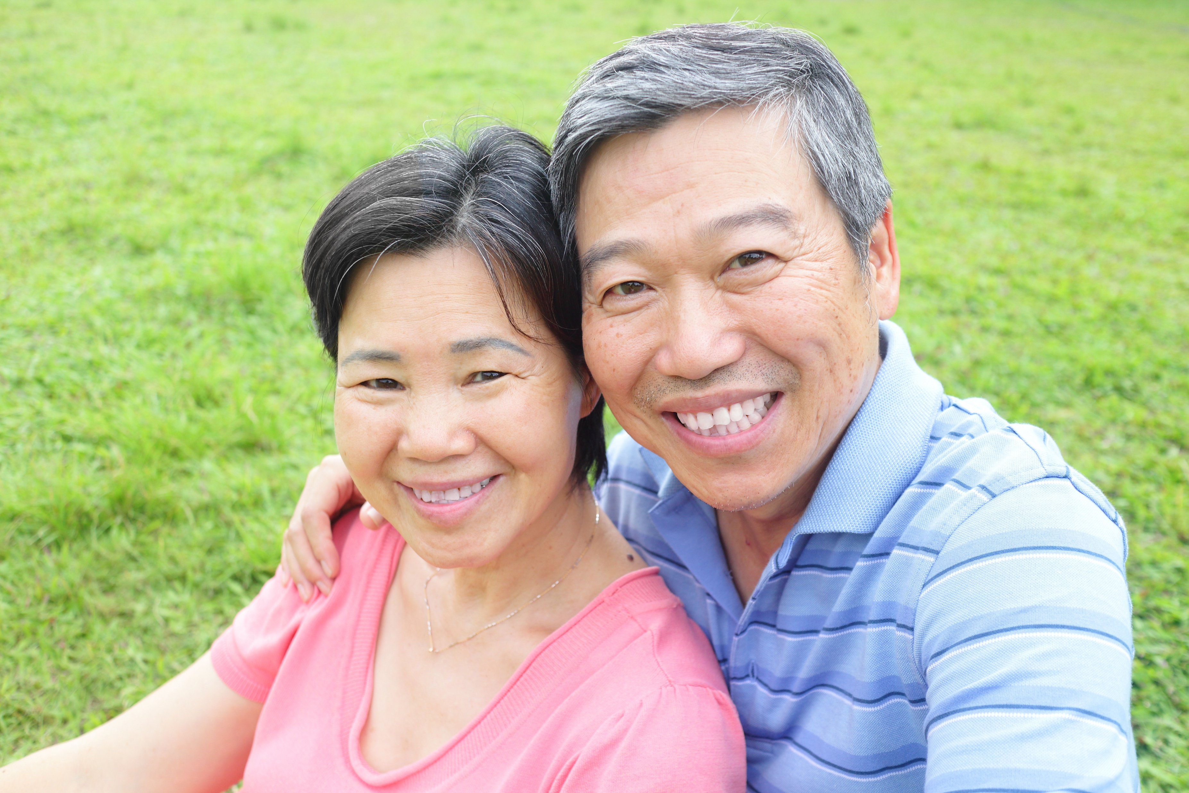
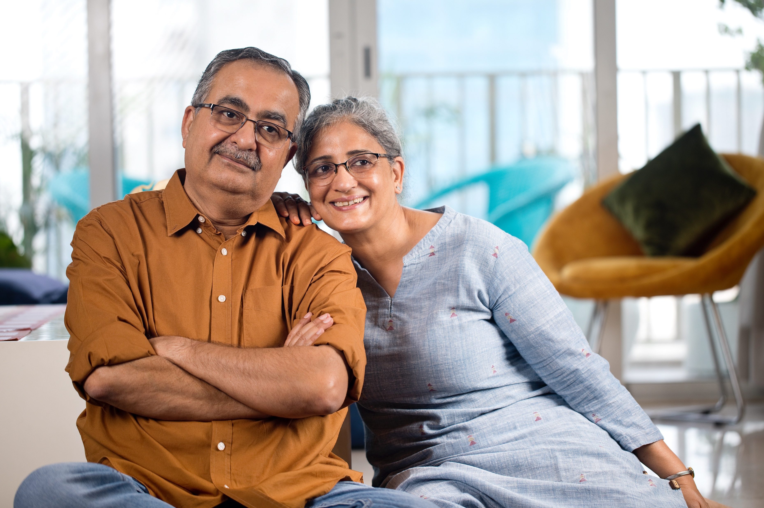
Slide 25
The experiences of carers of people with dementia from ethnic minority communities
There is evidence that African-Caribbean and South Asian UK communities are at higher levels of risk of dementia than the white population. However, despite substantial increases in the number of older people from these groups, policy guidance on older people from ethnic minority groups has yet to find its way into practice.
Understanding of dementia within ethnic minority communities also appears limited, with poor knowledge of services and stigma around dementia.

Slide 7
Slide 26
Young carers of people with dementia
Being a younger carer for someone with dementia can be challenging.
It can be hard to watch a loved one lose the ability to do things.
It may be difficult to juggle caring with education, paid work, hobbies, or seeing friends.

Slide 8
Slide 27
End of Session 2
Thank you!

