Slide 1
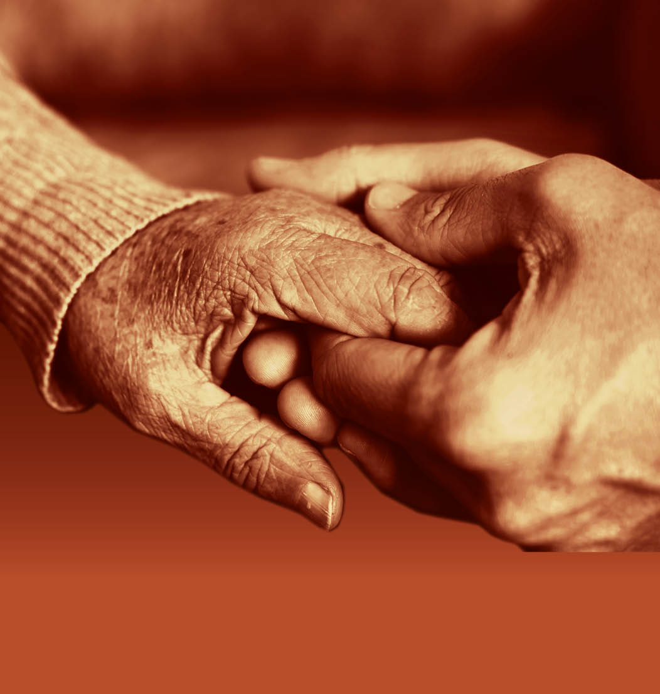
Slide 15
Session 2: The person-centred approach – working with carers

Slide 2
The person-centred approach
Slide 16
D = P + B + H + NI + SP
Kitwood, T. (1993) ‘Discover the person, not the disease’. Journal of Dementia Care. Vol 1, No 1, 16-17.

Slide 3
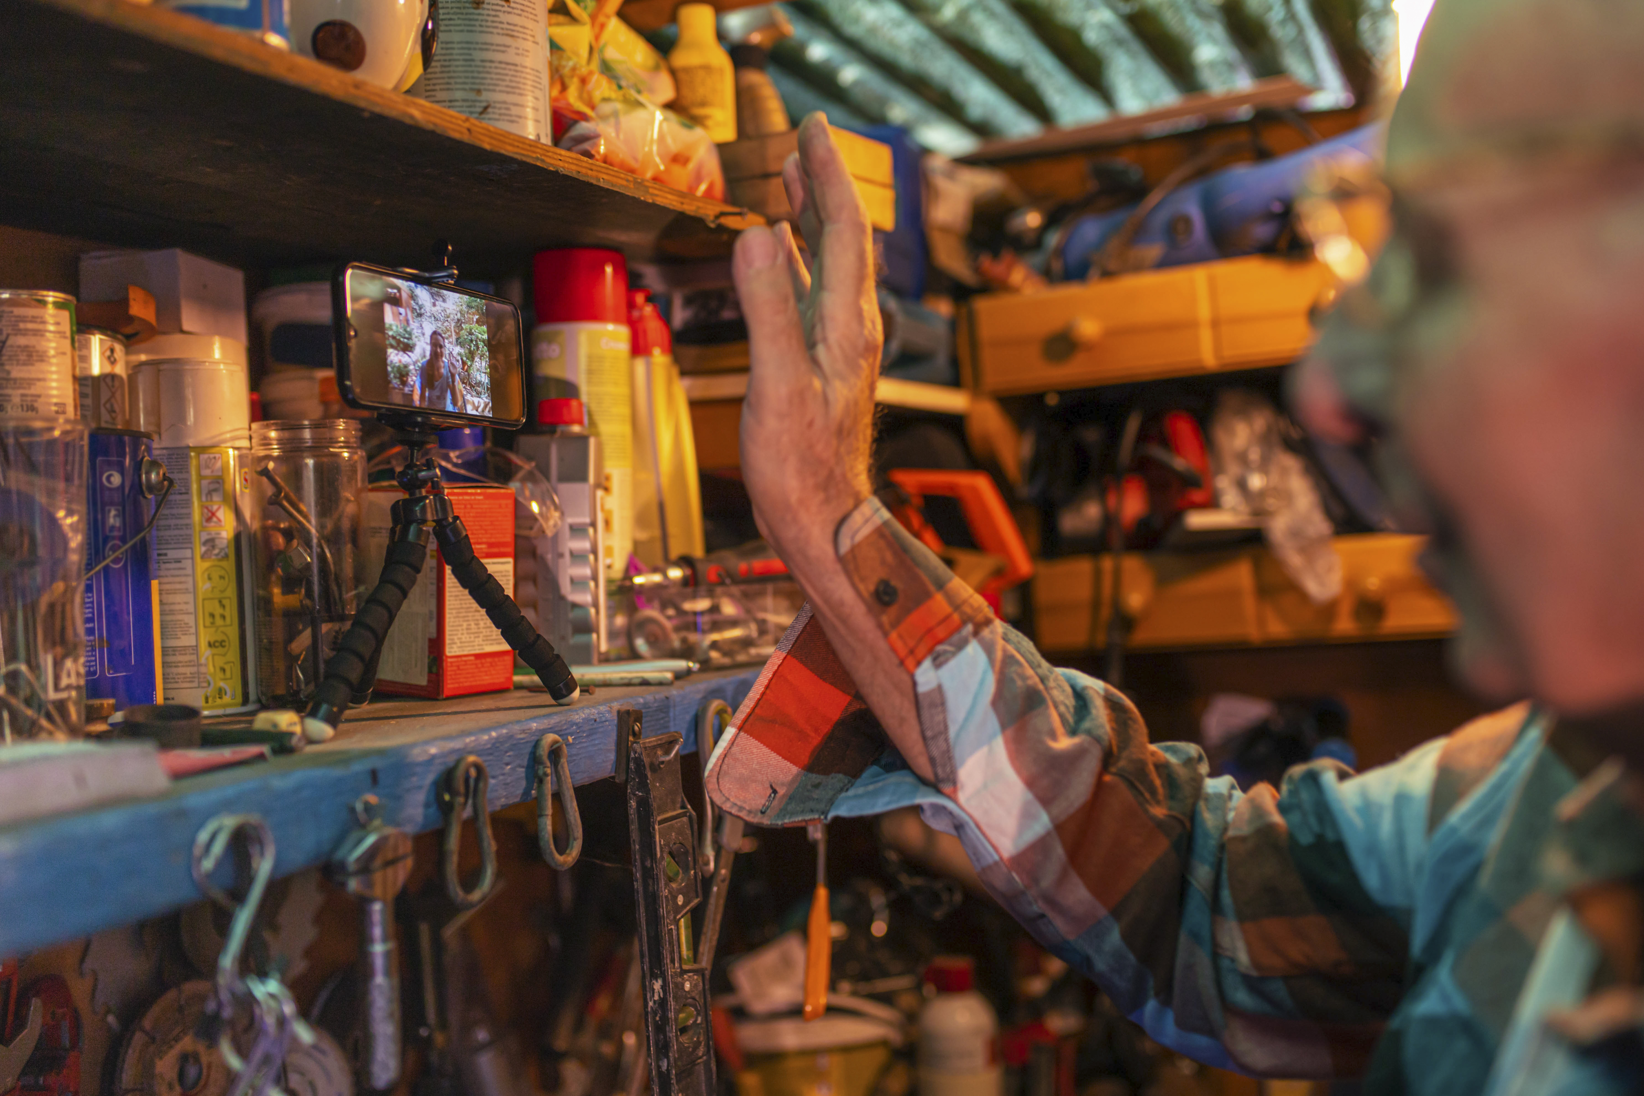
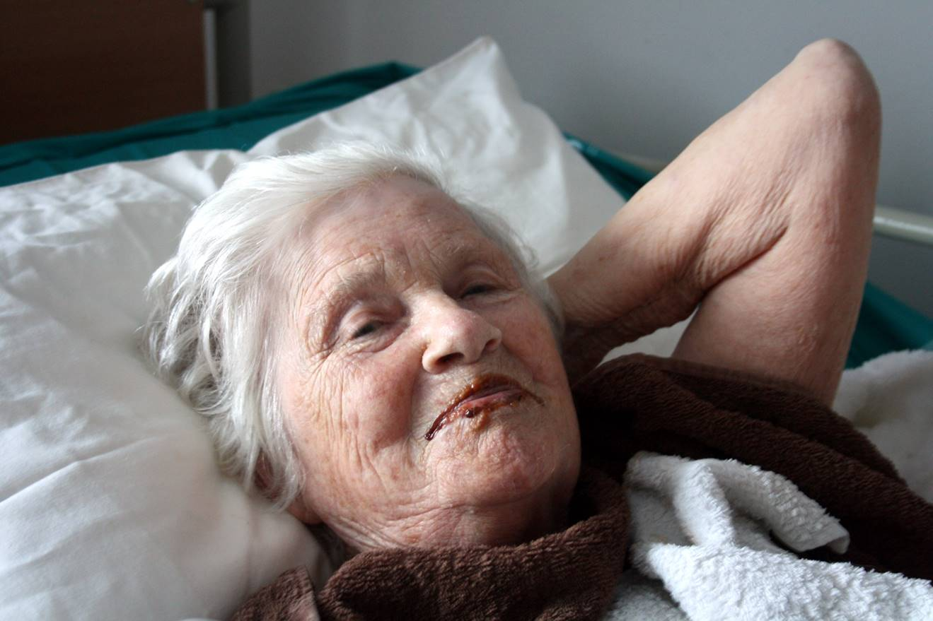
What are the benefits of working in a person-centred way?
Slide 17
Thank you to Jane Ward for permission to use this photo of her Mum, Ella.

Slide 4
Understanding the role of carers in the care and support of a person with dementia
Slide 18
What is your understanding of the word ‘carer’?
Who can be a ‘carer’?
What do ‘carers’ do?

Slide 5
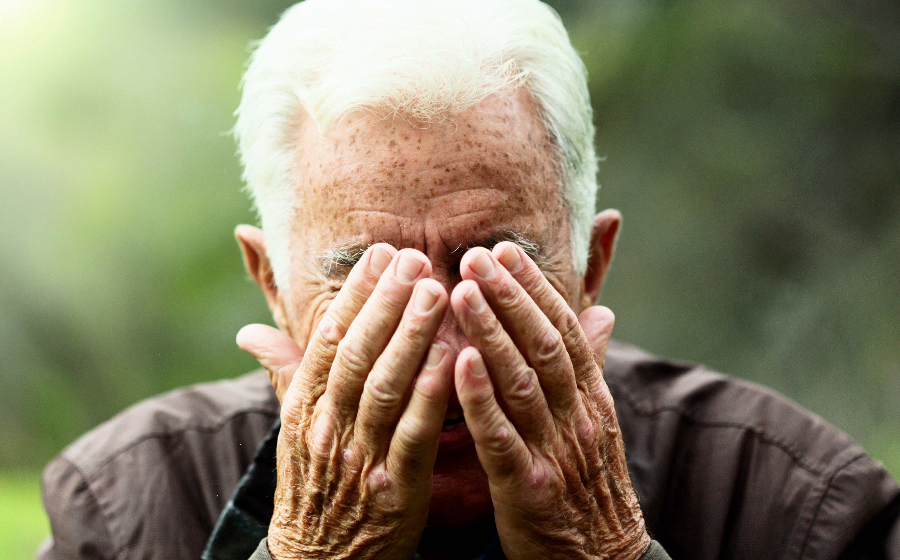
Why do carers care?
Slide 19
Paul
Mrs. Snow

Slide 6
What support is available to carers of people with dementia?
Slide 20
Many carers of people with dementia do not initially think of themselves as a carer, particularly if the person with dementia is a partner, parent or close friend.
Health and social care services increasingly recognise that both the person with dementia and their carer will need support to understand and accept the changes in symptoms, and to adapt to changes in presentation that will come.
All carers should be encouraged to register as a ‘carer’ with their GP practice and ask to see the ‘Carer’s Champion’.
There are a range of charities and organisations from which carers should be encouraged to access guidance and advice.
It is very important that carers are encouraged to carry out a Carer’s Assessment.

Slide 7
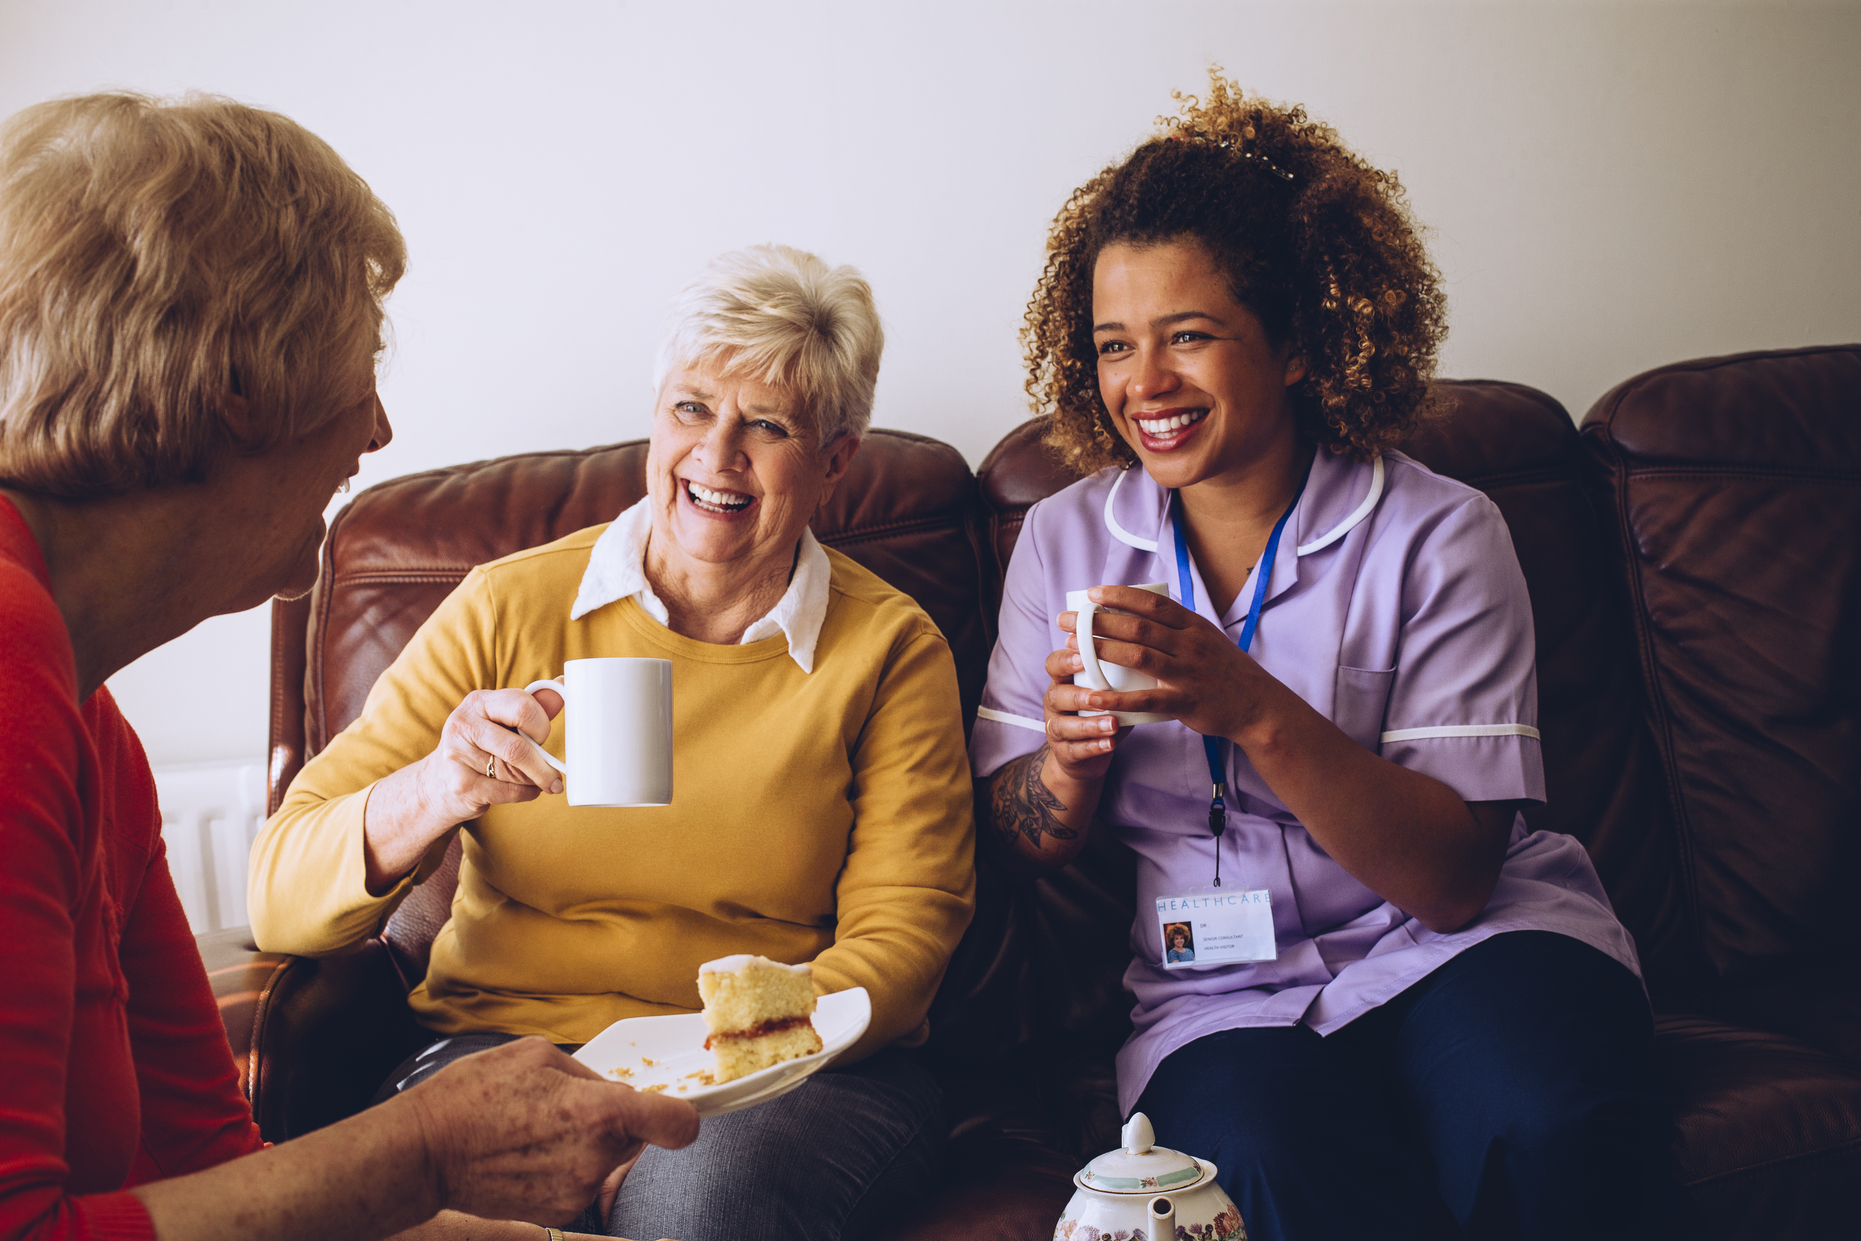
Carers and professionals working in partnership
Slide 21

Slide 8
Slide 22
End of Session 2
Thank you!

