Slide 1
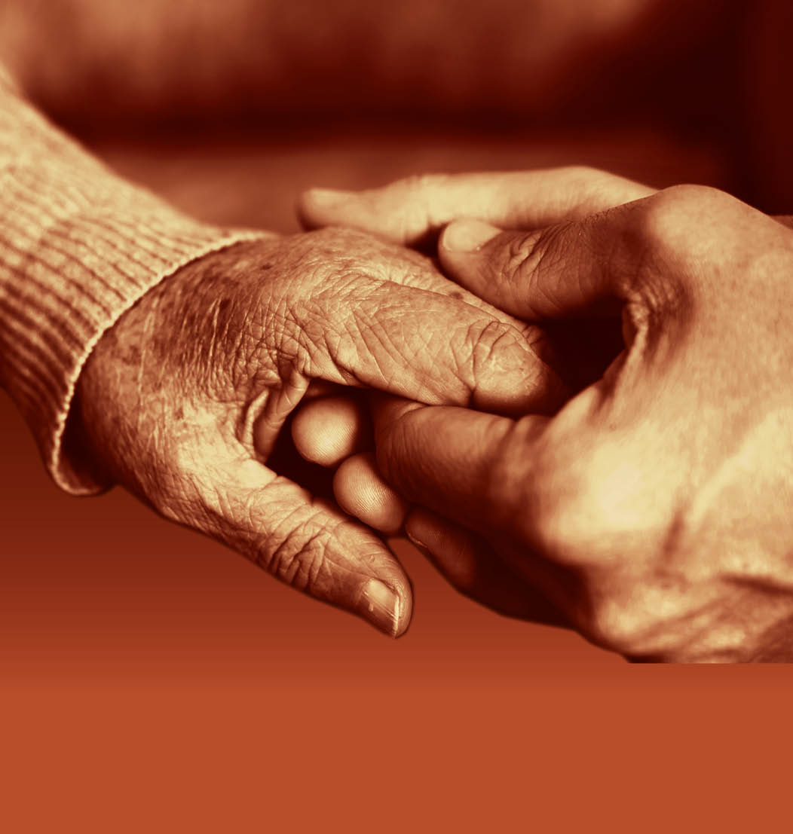
Session 3: Enabling people with dementia to eat and drink well

Slide 2
Anticipating the health needs of a person with dementia related to eating and drinking
As the eating and drinking needs and abilities of people with dementia change over time, it is crucial that those providing for their care and support are vigilant as to the impact of this in relation to their health. This includes reducing the risk of:
malnutrition
dehydration
infections
vitamin and mineral deficiencies
weight loss or gain
reduced mobility
delirium

Slide 3
Delirium
Delirium is sudden, severe confusion and rapid change in brain function that occurs with physical or mental illness. It is temporary and reversible. Many issues can cause delirium, including conditions that deprive the brain of oxygen or other substances:
Pain
Infection
Nutrition
Constipation
Hydration
Medication
Environment

Slide 4
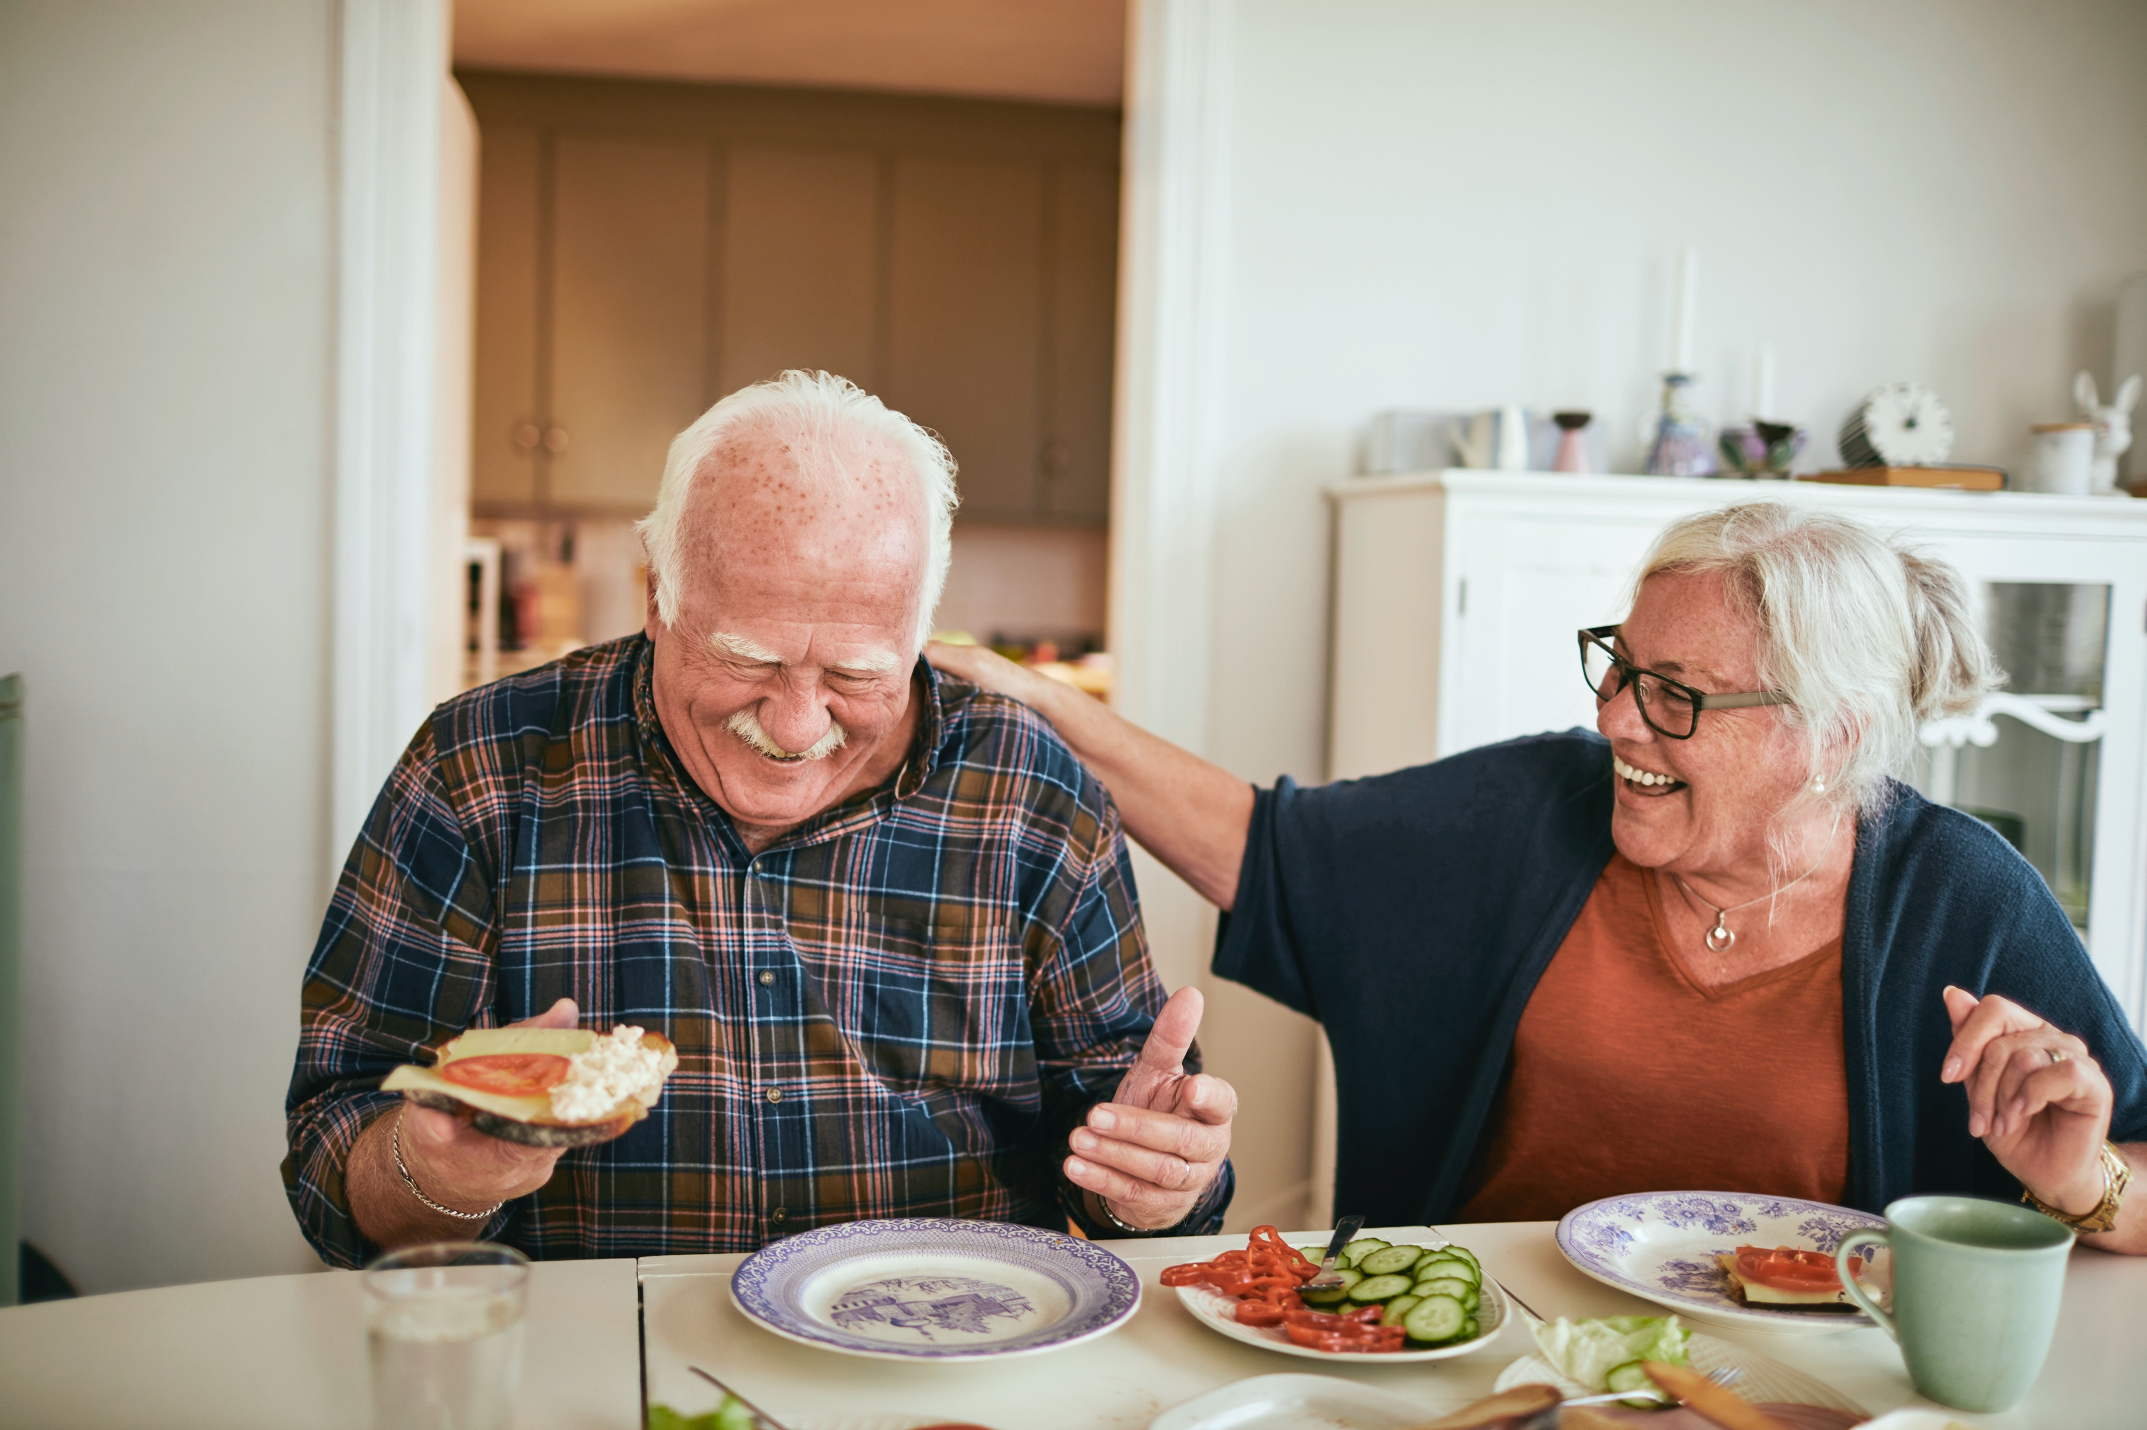
Creating positive mealtime experiences

Slide 5
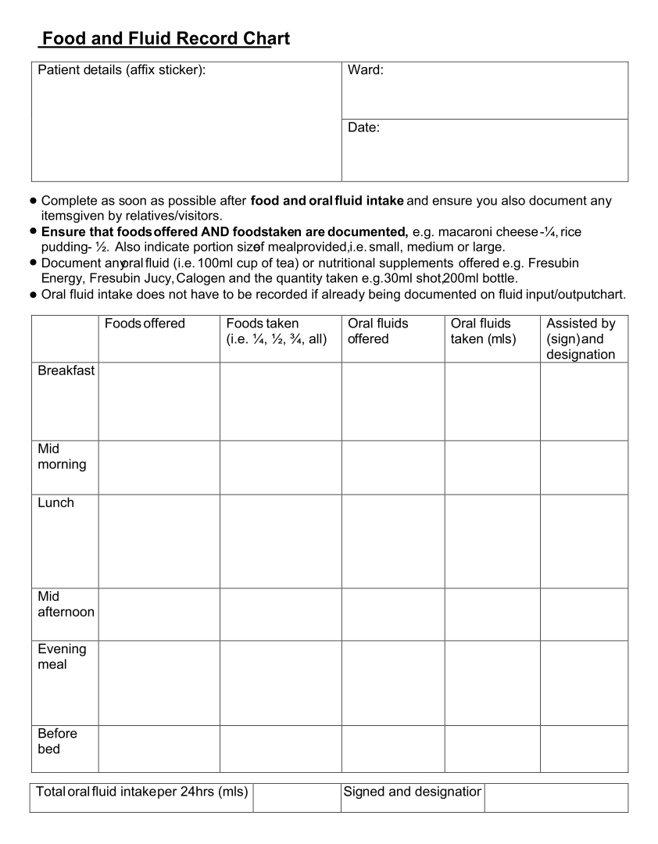
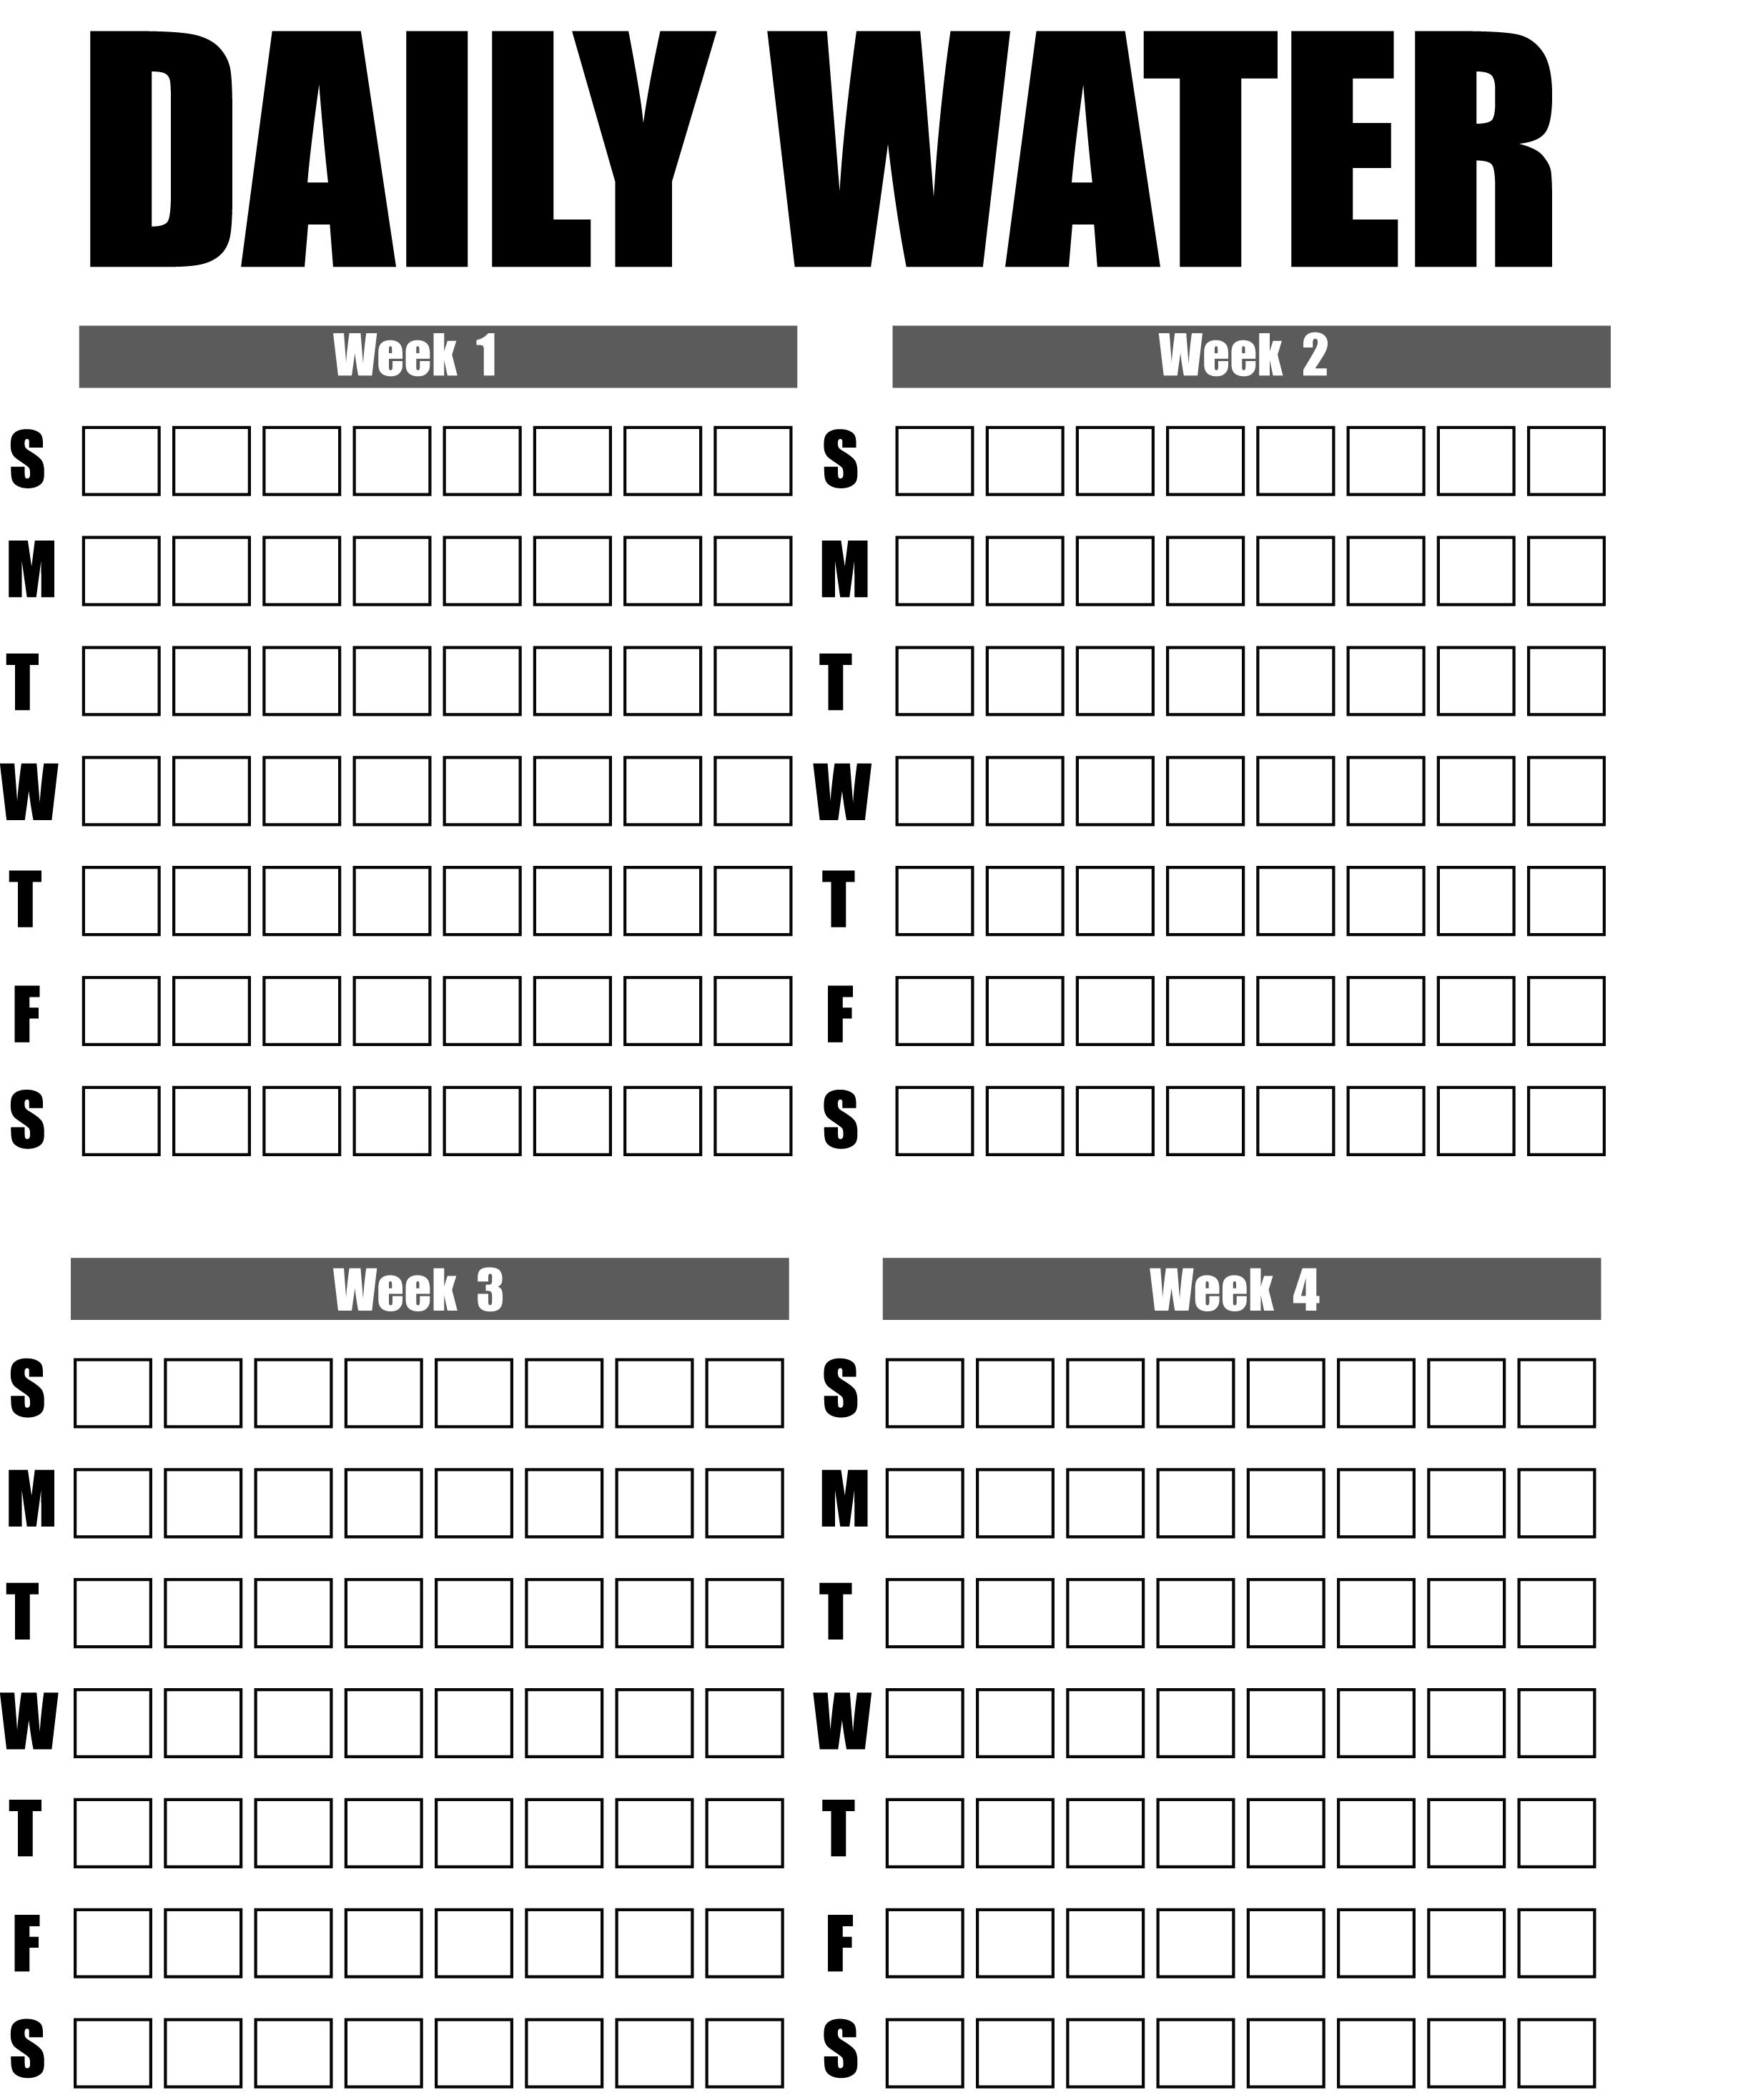
Food and fluid monitoring
(these and other charts available at www.printablee.com/post_printable-fluid-intake-charts_382021/)

Slide 6
End of Session 3
Thank you!

