Slide 1
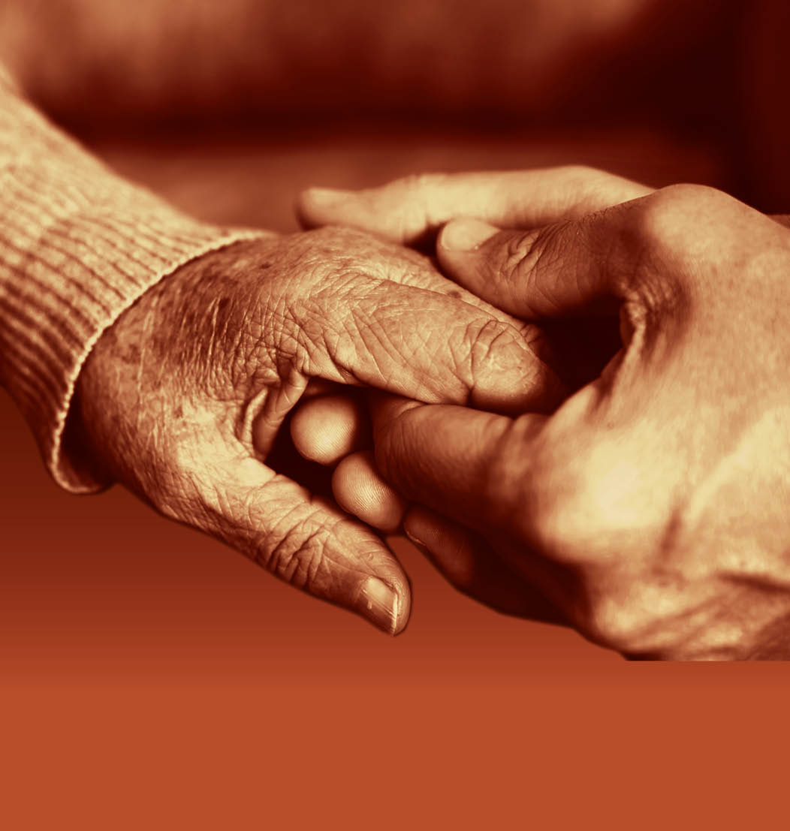
Slide 23
Session 3: The person-centred approach – working with others

Slide 2
Understanding the role of others in the care and support of a person with dementia
Slide 24
List as many professionals, services and organisations as you can that provide care and support for people with dementia.

Slide 3
The importance of a good working partnership between carers and professionals
Slide 25
Case study - Diane and George
What positive experiences did Diane have with members of the professional care teams?
What negative experiences did Diane have with members of the professional care teams?
Why do you think this situation in the ‘River Suite’ happened?
What impact does the attitude of the care professionals towards Diane have on her?
What could the whole care team have done differently?

Slide 4
The importance of professional practice (1)
Slide 26
List five aspects of your role which are in your job description.
Can you list any things you do in your workplace that are not in your job description?
Why do you do these things?
Why are they not in your job description?
Do you think that some of these things should be there? If so, who might you need to discuss this with, once you return to your workplace?

Slide 5
The importance of professional practice (2)
Slide 27
List five things that your job role does not permit you to do when you are supporting a person with dementia.
Why must you not do these things?
What would happen if you did?
What would happen if you witnessed a colleague doing something that was not permitted when they were supporting a person with dementia?
When might it be necessary to refer to others when supporting people with dementia?

Slide 6
How to access additional support from others when supporting people with dementia
Slide 28
Which local services do you currently have access to?
Do you know their contact details? If yes, what are they?

Slide 7
The essence of person-centred practice
Slide 29
“I have found it of enormous value when I can permit myself to understand another person.”
Carl Rogers
Rogers, C. (1961) On Becoming a Person. A Therapist's View of Psychotherapy. Houghton Mifflin.

Slide 8
Slide 30
End of Session 3
Thank you!

Slide 9
Slide 31
End of
Module 3

