Slide 1
Slide 28
Session 3: Working in partnership with family carers of people with dementia

Slide 2
Slide 29
What does ‘working in partnership with family carers’ mean?

Slide 3
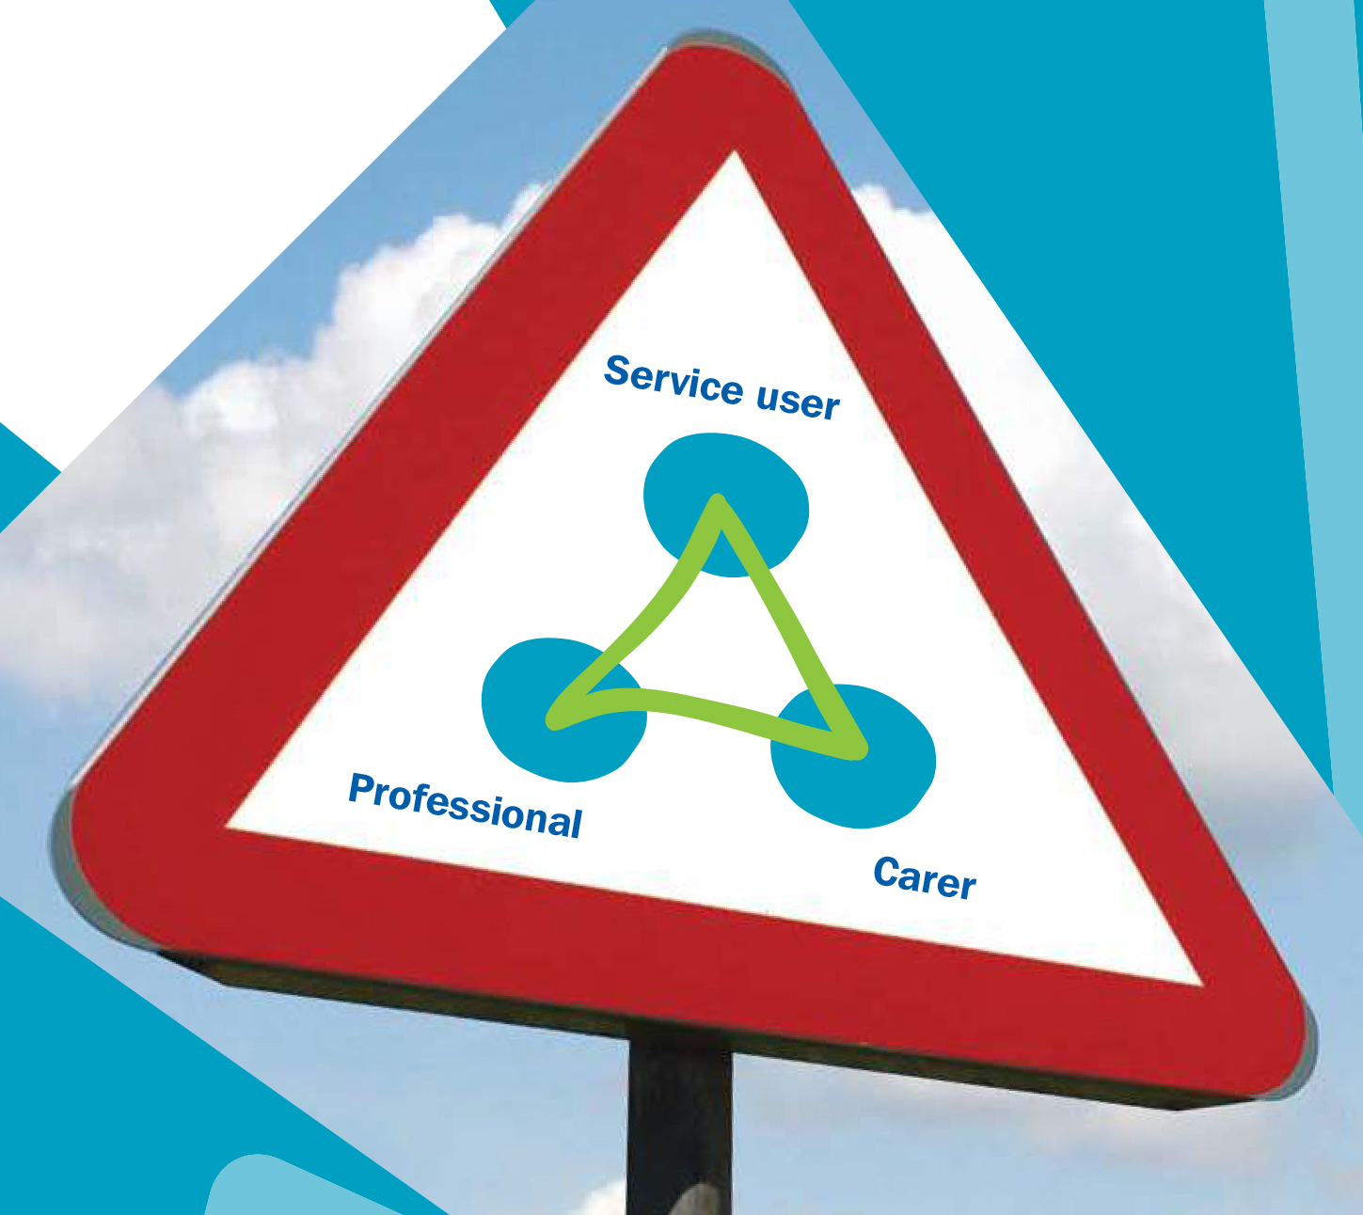
Slide 30
The Triangle of Care
The Triangle of Care describes a therapeutic relationship between the person with dementia (patient), staff member and carer that promotes safety, supports communication and sustains well-being. There are six key standards required to achieve better collaboration and partnership with carers:
Carers and the essential role they play are identified at first contact or as soon as possible thereafter.
Staff are ‘carer aware’ and trained in carer engagement strategies.
Policy and practice protocols regarding confidentiality and sharing information are in place.
Defined post(s) responsible for carers are in place.
A carer introduction to the service and staff is available, with a relevant range of information across the care pathway.
A range of carer support services is available.
Taken from the document ‘The Triangle of Care, Carers Included: A Guide to Best Practice for Dementia Care’ (2016), a collaborative effort between the Royal College of Nursing and Carers Trust. It has been co-designed with carers, people with dementia and practitioners, with the support of Uniting Carers and Dementia UK.

Slide 4
Slide 31
The benefits of working in partnership with family carers of people with dementia
Including carers in care and treatment will:
Enable better outcomes for the person with dementia.
Allow staff and services to ensure they have a fuller picture of the person’s needs and how their dementia affects their behaviour and general well-being.
Provide peace of mind for carers that the person they care for is receiving the best and most appropriate treatment possible.
The Triangle of Care for Dementia builds on the concept of relationship-centred care which, as highlighted within guidelines for dementia, emphasises “the importance of relationships and interactions with others to the person with dementia, and their potential for promoting well-being in the delivery of person-centred care.” (NICE/SCIE, 2006).
A disconnected model of involvement can lead to carers being excluded at important points. This leads to gaps in practice which can result in the carer being left on the outside and a failure to share information that may be vital to assessment, care planning, and acting in the best interests of both the person with dementia and the carer.
The concept of a triangle has been proposed by many carers who wish to be thought of as active partners within the care team. This requires collaboration between the professional, the person with dementia and the carer.
An effective Triangle of Care will only be complete if both the professional and the carer are willing to engage.

Slide 5
Slide 32
Compassionate communication
“I know that there are no cures… I know that things are going to get worse… all I’m asking for is just a little compassion.”

Slide 6
Slide 33
Madeline and Robbie

Slide 7
Slide 34
The Mental Capacity Act – the 5 Statutory Principles
The presumption of capacity: “A person must be assumed to have capacity unless it is established that he/she lacks capacity.” The Act sets out clearly that individuals have the right to make choices and decisions for themselves (the right to autonomy) unless it is shown that they lack capacity to make these choices and decisions themselves.
Maximising decision-making capacity: “A person is not to be treated as unable to make a decision unless all practical steps to help them to do so have been taken without success.” Practical steps might include using different means of communication, providing information in an accessible form, or treating an underlying medical condition.
Unwise decisions: “A person is not to be treated as unable to make a decision merely because he/she makes an unwise decision”. This principle again underpins the right to autonomy, and reflects the fact that we each have our own individual values, beliefs, preferences and attitudes to risk, which may not be the same as those of other people.
Best interest: “An act done, or decision made, under this Act for or on behalf of a person who lacks capacity must be done, or made, in his/her best interest.” It is not possible for statute to give a single, universal definition of “best interest” because what is in one person’s best interests will depend on that particular individual and his or her personal circumstances.
Least restrictive alternative: “Before the act is done, or the decision is made, regard must be given as to whether the purpose for which it is needed can be as effectively achieved in a way that is less restrictive of the person’s rights and freedom of action.” Is it possible to decide or act in a way that would interfere less with the person’s rights and freedoms?

Slide 8
Slide 35
The Mental Capacity Act – the family carer as decision maker
A lasting power of attorney (LPA) is a legal document that lets you (the ‘donor’) appoint one or more people (known as ‘attorneys’) to help you make decisions or to make decisions on your behalf.
This gives you more control over what happens to you if you have an accident or an illness and cannot make your own decisions (you ‘lack mental capacity’).
You must be 18 or over and have mental capacity (the ability to make your own decisions) when you make your LPA. There are 2 types of LPA:
health and welfare
property and financial affairs
A health and welfare LPA does not come into force until the donor has lost the capacity to make decisions for themselves.

Slide 9
Slide 36
End of Session 3
Thank you!

