Slide 1
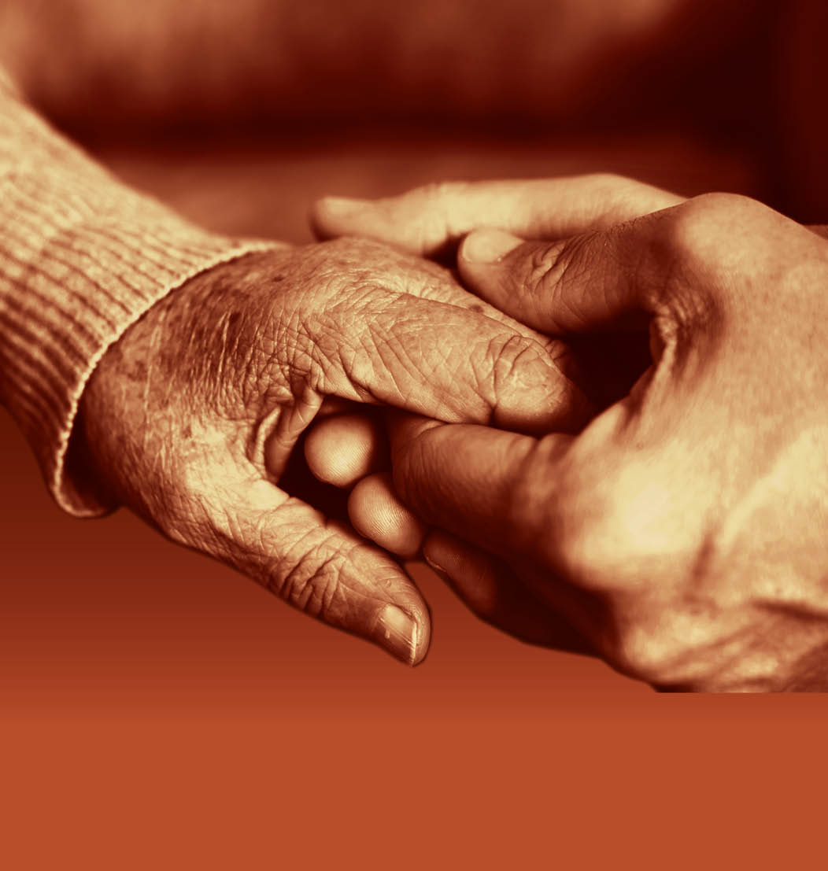
Session 4: Eating and drinking problems and forms of support

Slide 2
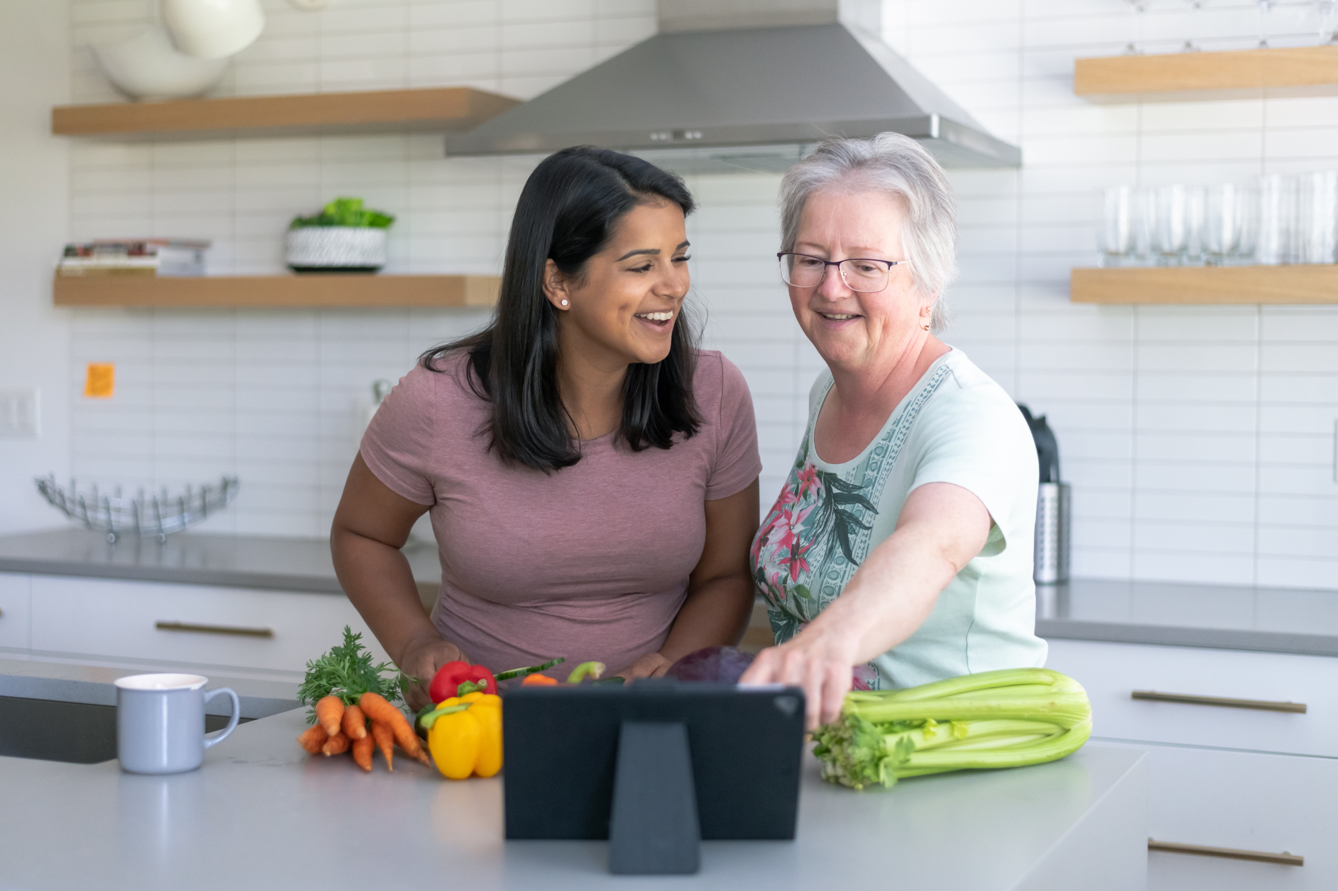
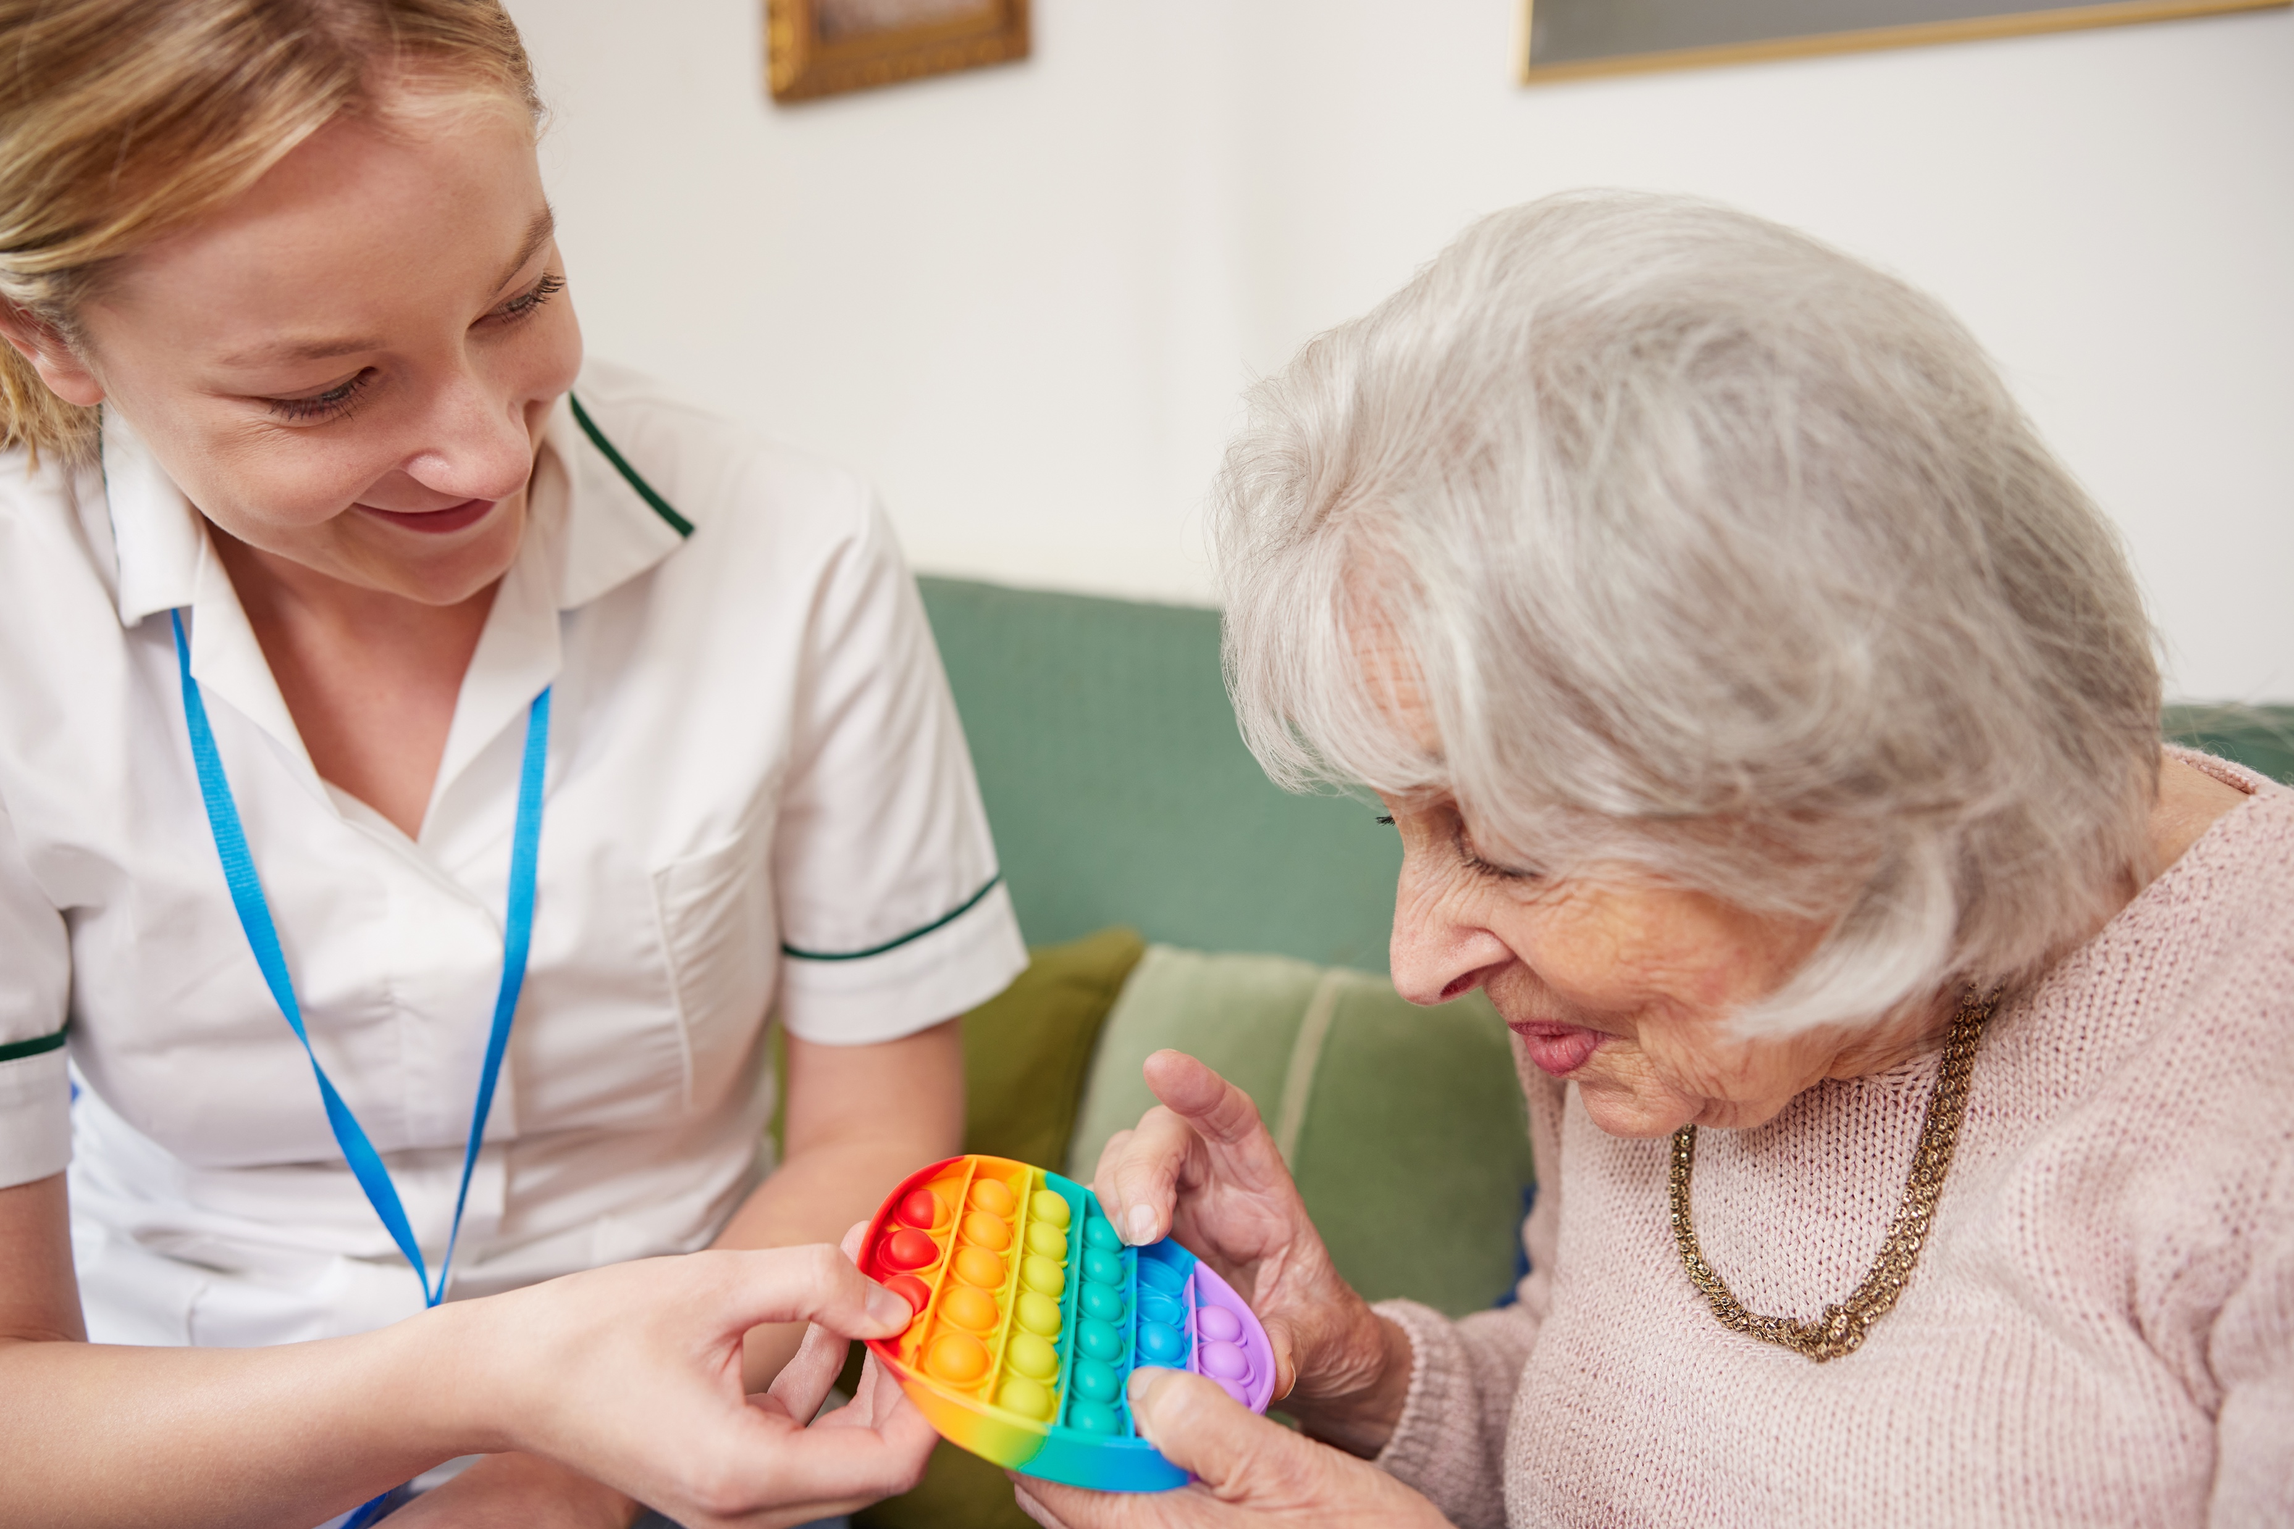
Specialists involved in supporting people with dementia to eat and drink safely
Speech and language therapist
Dietician
Occupational therapist

Slide 3
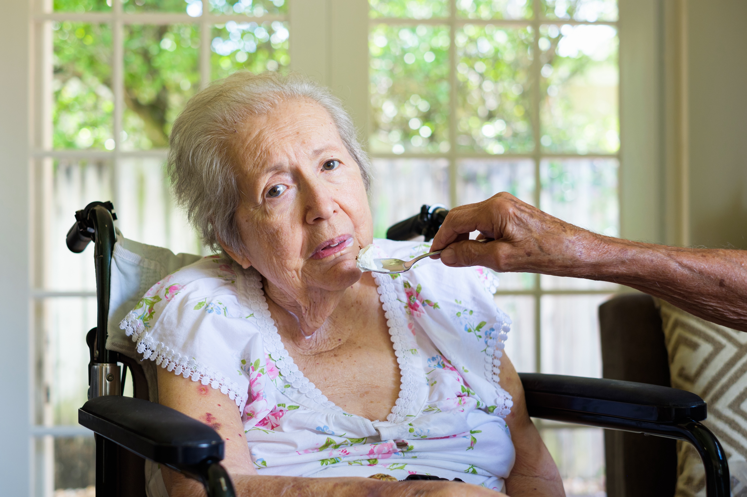
Mitzi’s story

Slide 4
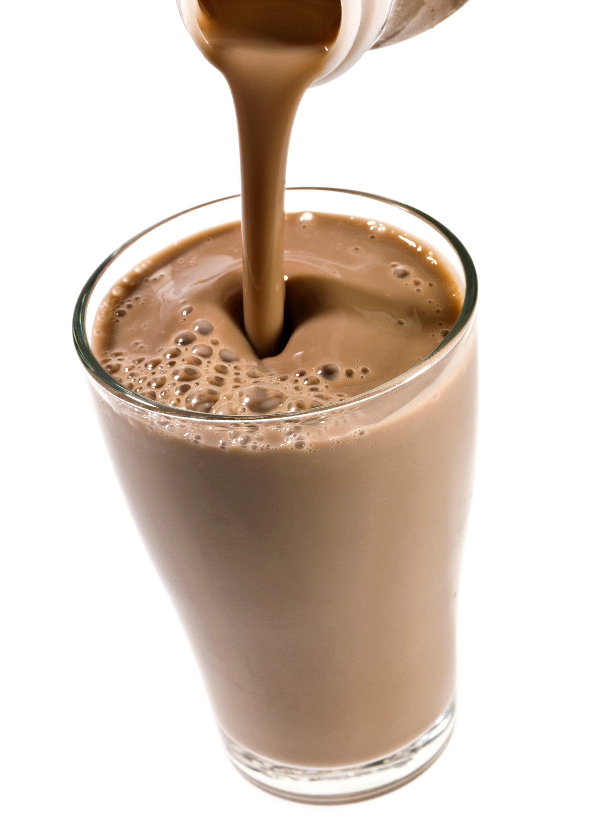
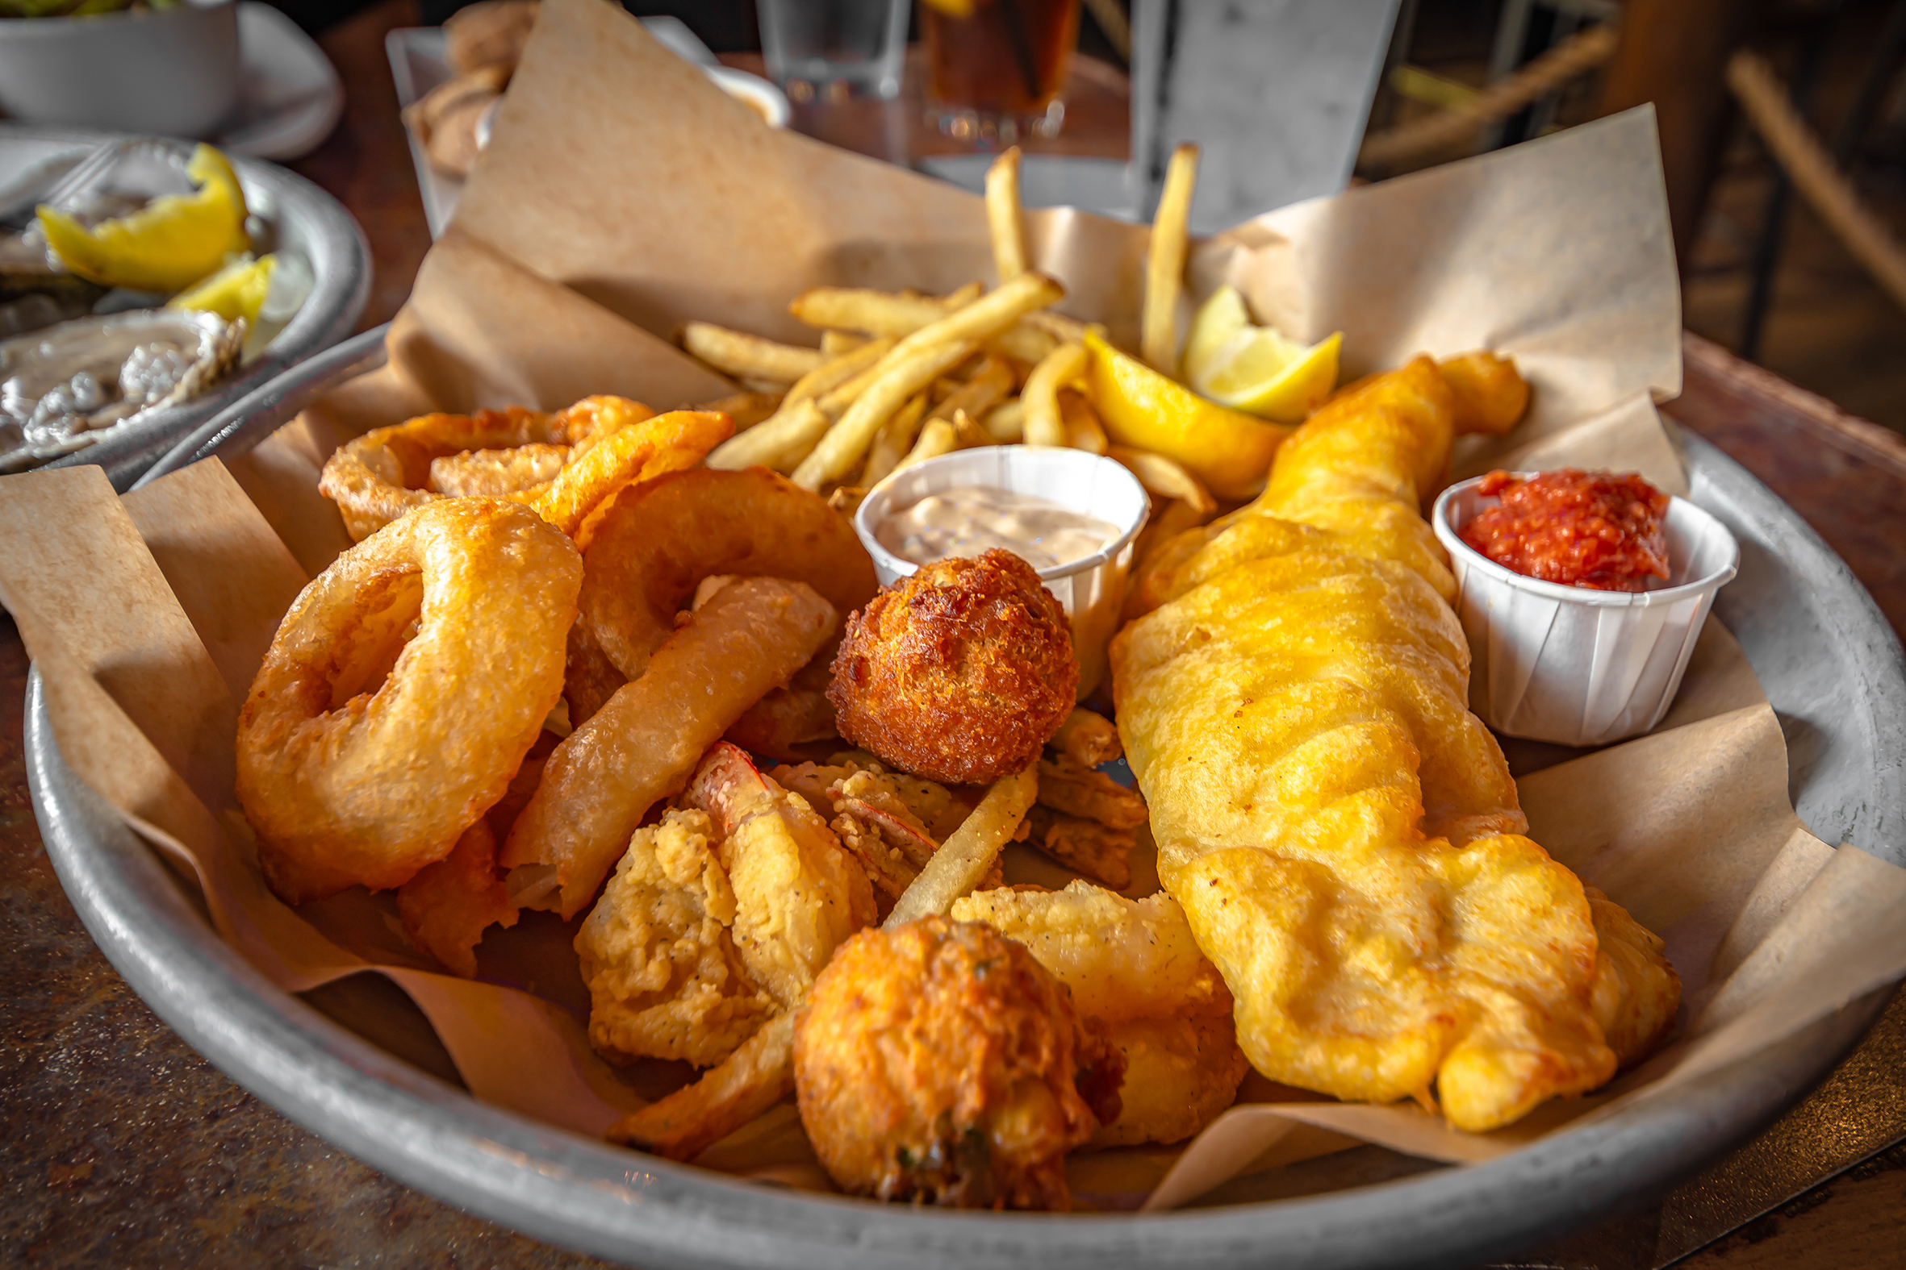
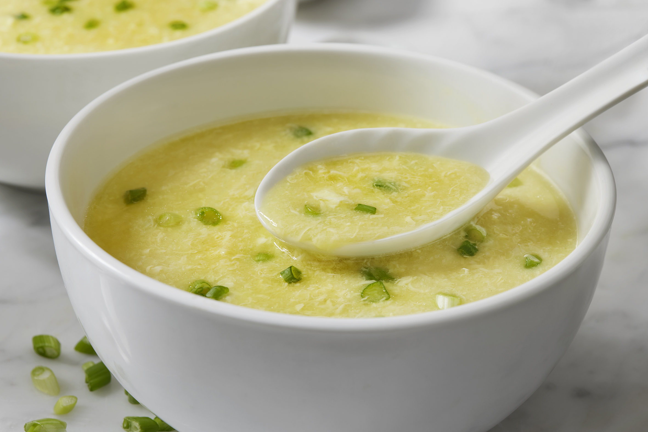
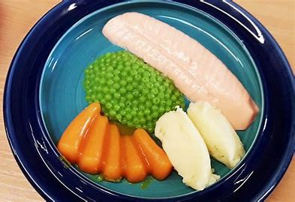
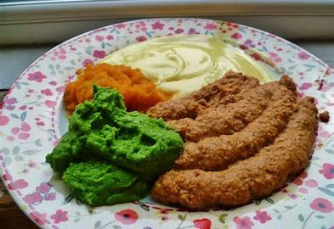
Supplements and special diets

Slide 5
Thickened foods and fluids
The International Dysphagia Diet Standardisation Initiative or IDDSI (www.iddsi.org) has been adopted around the world, and provides a common framework to describe food textures and drink thicknesses. The framework consists of a continuum of 8 levels, where drinks are measured from Levels 0-4 and foods are measured from Levels 3-7.
Drinks
0 = Thin
1 = Slightly Thick
2 = Mildly Thick
3 = Moderately Thick
4 = Extremely Thick
Foods
7 = Regular
6 = Soft and Bite Sized
5 = Minced and Moist
4 = Pureed
3 = Liquidised

Slide 6
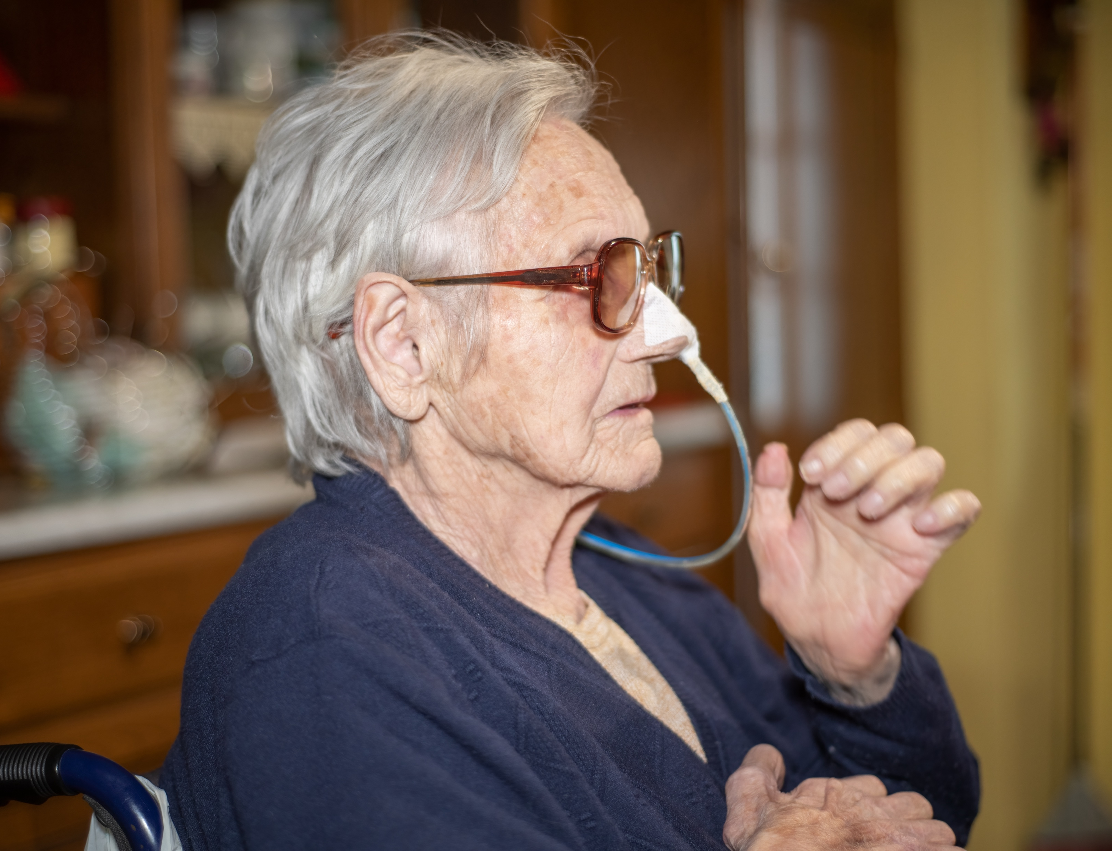
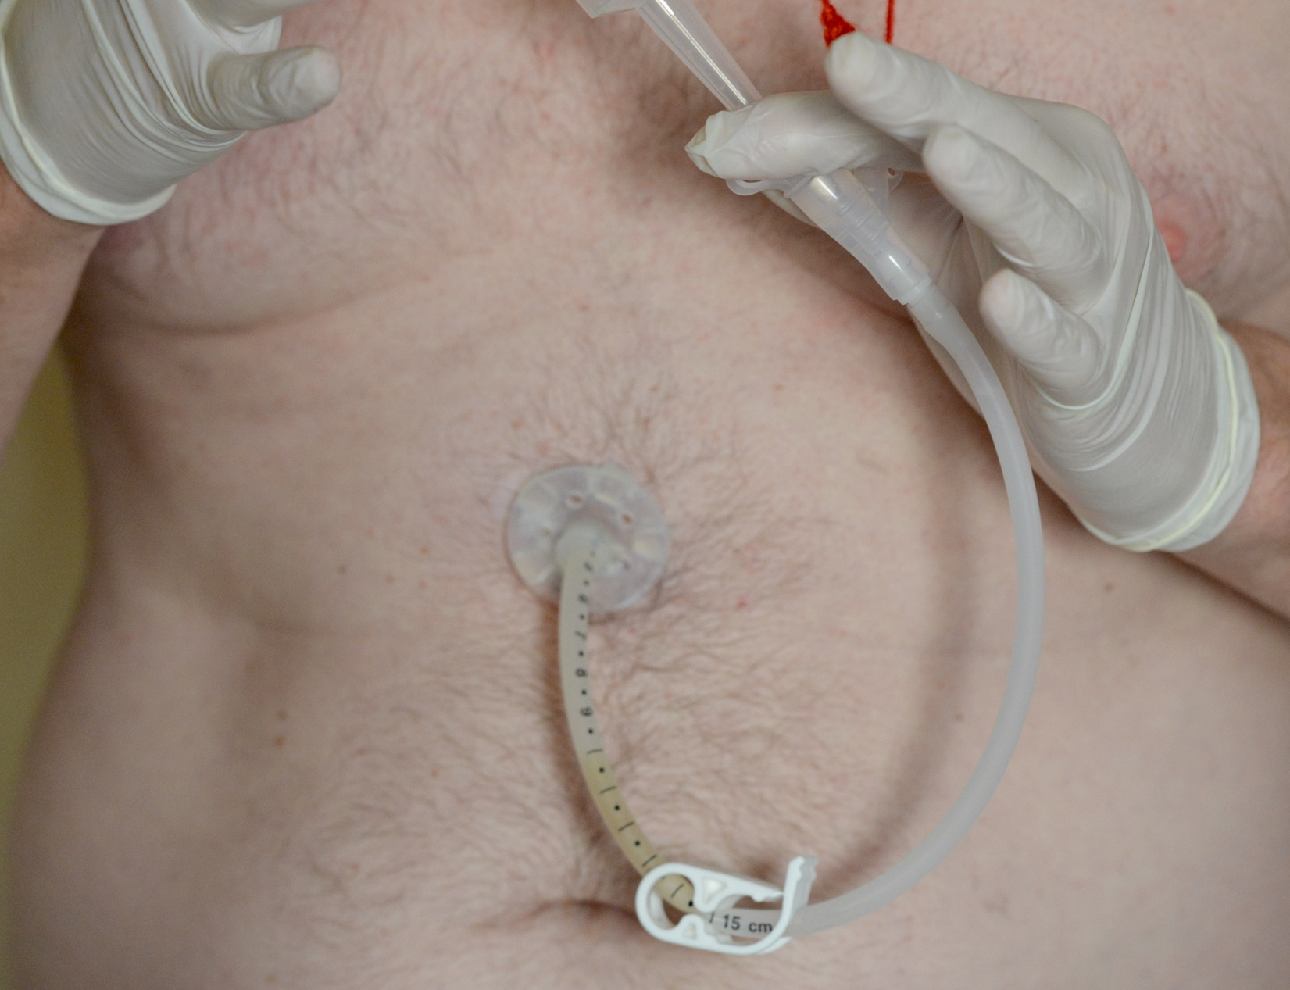
NG Tube and PEG
Nasogastric (NG) feeding is where a narrow feeding tube is placed through the nose down into the stomach. The tube can be used to give fluids, medications and liquid food complete with nutrients directly into the stomach.
A percutaneous endoscopic gastrostomy (PEG) feeding tube is a way to give food, fluids and medicines directly into the stomach by passing a thin tube through the skin and into the stomach. ‘Percutaneous’ means through the skin.

Slide 7
“Eating is not merely a material pleasure. Eating well gives a spectacular joy to life, and contributes immensely to goodwill and happy companionship. It is of great importance to the morale.”
Elsa Schiaparelli

Slide 8
End of Session 4
Thank you!

