Slide 1
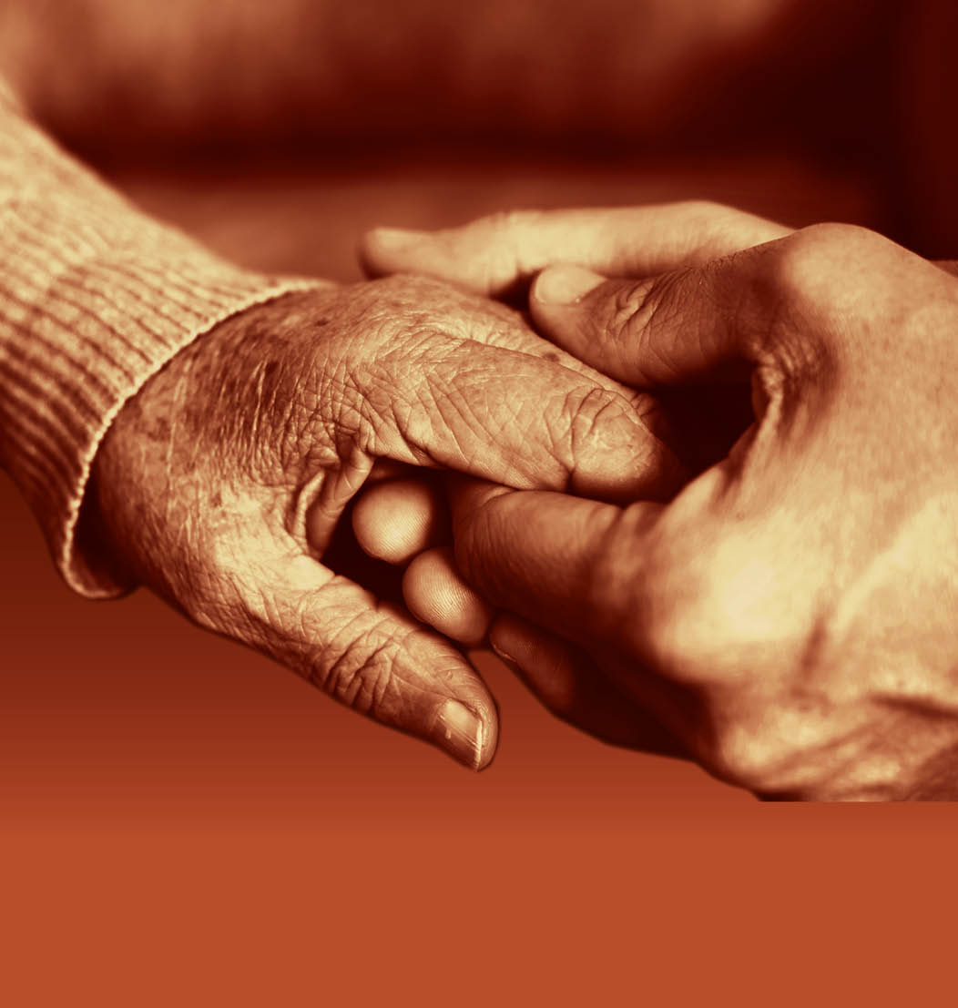
Slide 37
Session 4: Supporting family carers of people with dementia to live well

Slide 2
Slide 38
Recognition for carers
"To feel able to cope, and to have a life alongside caring."
"Services that can help support them in their role."
"I want my family and friends to have fond memories of me."
"Societies where people with dementia and their carers can meaningfully participate."
"Acknowledging the vital importance of involving carers of people with dementia."

Slide 3
Identifying and assessing carers’ own needs
Slide 39

Slide 4
Slide 40
The Carer’s Assessment
Where an individual provides or intends to provide care for another adult and it appears that the carer may have any level of needs for support, local authorities must carry out a Carer’s Assessment.
Carer’s Assessments must seek to establish not only the carer’s needs for support, but also the sustainability of the caring role itself, which includes both the practical and emotional support the carer provides to the adult. Therefore, where the local authority is carrying out a Carer’s Assessment, it must include in its assessment a consideration of the carer’s potential future needs for support.
Some carers may need support in recognising issues around sustainability, and in recognising their own needs. This will allow local authorities to make a realistic evaluation of the carer’s present and future needs for support and whether the caring relationship is sustainable.
The Carer’s Assessment must also consider the outcomes that the carer wants to achieve in their daily life, their activities beyond their caring responsibilities, and the impact of caring upon those activities. This includes considering the impact of caring responsibilities on a carer’s desire and ability to work and to partake in education, training or recreational activities, such as having time to themselves.

Slide 5
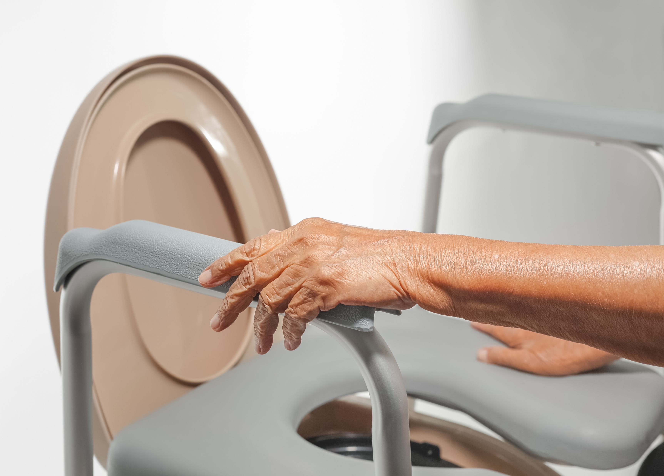
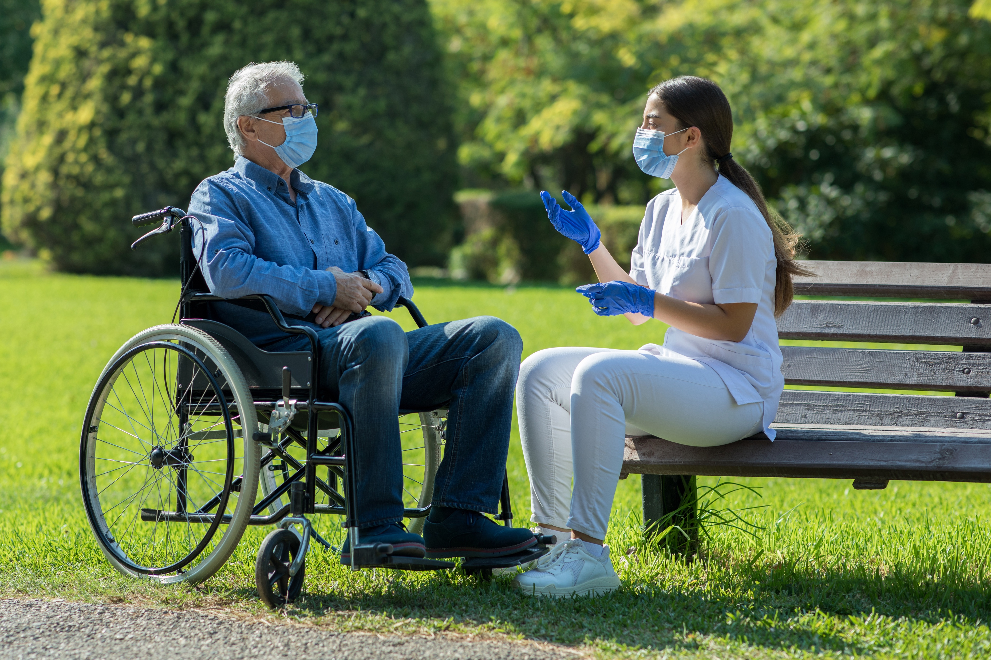
Slide 41
What might the needs of carers of people with dementia be?

Slide 6
Slide 42
To be a family carer of a person with dementia
“To love a person is to learn the song in their heart, and sing it to them when they have forgotten.”
Arne Garborg

Slide 7
Slide 43
End of Session 4
Thank you!

Slide 8
Slide 44
End of
Module 4

